Slide 1
Department Training on Metadata
Session 2: Metadata Standards

Slide 2
Overview of Session 1
Concept of metadata
Formatting metadata into containers
MARC as metadata
What can metadata do?

Slide 3
Session 2 Outcomes
What is a standard?
The Need for standards
Metadata Standards
How a Metadata Standard is Created
Overview of Metadata Standards Being Used in the Library/Archives/Museum Communities

Slide 4
What is a Standard?
Definition from Merriam-Webster:
something established by authority, custom, or general consent as a model or example
Consensus or commitment to a certain way of doing things, in this case, describing resources

Slide 5
What is a Standard?
Created by a community
Local, national, or international
Examples of Standards Committees
PCC Standing Committee on Standards
ALCTS/LITA Metadata Standards Committee
Joint Steering Committee for Development of RDA

Slide 6
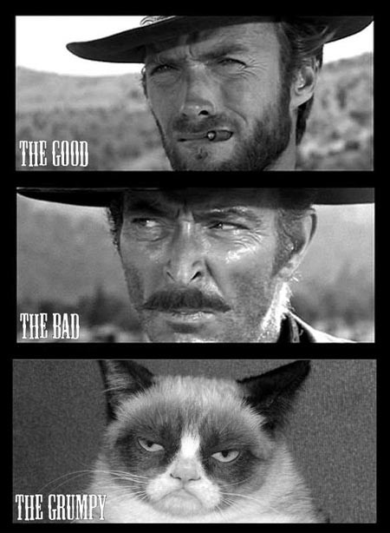
The Need for Standards

Slide 7
The Need for Standards
Without standards:
Inconsistent description
Many different types of metadata fields
Inconsistent meaning behind metadata fields
No interoperability
No easy way to share metadata, use others’ metadata, or contribute to a consortium

Slide 8
Three Types of Standards in Metadata
Metadata standards
Content standards
Data value standards

Slide 9
Metadata Standards
A set of agreed-upon metadata fields
Definition of each metadata field
Guidelines for each metadata field

Slide 10
How a Metadata Standard is Created
A community sees the need for a standard
Community creates a standard for describing certain types of resources
Describing a book
Describing a piece of sculpture
Describing an archival collection

Slide 11
How a Metadata Standard is Created
A metadata standard is created for a particular need and is influenced by the community that creates it
Example: library catalog vs archival description

Slide 12
Example: MARC
Project launched in 1966
Originally meant to describe textual print materials
Still the go-to standard for traditional cataloging
Maintained by MARC Advisory Committee
Link to standard

Slide 13
Example: Dublin Core
Built for general purpose resource description
Maintained by the Dublin Core Metadata Initiative
Only 15 metadata fields
Influenced by cataloging community
Link to standard

Slide 14
Example: VRA Core
VRA Core is a data standard for the description of works of visual culture as well as the images that document them. Works of visual culture can include objects or events such as paintings, drawings, sculpture, architecture, photographs, as well as book, decorative, and performance art.
An Introduction to VRA Core

Slide 15
Example: VRA Core
Maintained by Network Development and MARC Standards Office and Visual Resources Association
Has some metadata fields that are unique to cultural heritage material
Inscription
Material
Link to VRA Core outline

Slide 16
Exercise: Choosing a Standard
Which would you choose: Dublin or VRA Core?
eBook
Painting
Image of trashcan art
Journal
Image of meeting minutes from printed documents

Slide 17
Exercise: Choosing a Standard (Answers)
Which would you choose: Dublin or VRA Core?
eBook
Dublin Core
Painting
VRA Core
Image of trashcan art
Dublin Core or VRA Core. It depends on how you want to describe the image.
Journal
Dublin Core
Image of meeting minutes from printed documents
Dublin Core

Slide 18
Questions?

