Slide 1
Department Training on Metadata
Session 8: Metadata Mapping

Slide 2
Session 8 Outcomes
Review of Session 7
Metadata Schemas
What is Metadata Mapping?
Why?
Challenges of Metadata Mapping
Examples
Metadata Mapping at ISU

Slide 3
Review of Session 7
Overview of Dublin Core Terms
Comparison of Dublin Core Element Set and Dublin Core Terms
Detailed Look at Certain Dublin Core Term Fields
Dublin Core Terms in Action

Slide 4
Metadata Schemas
Machine-readable version of a metadata standard
Difference between a standard and a schema
A standard doesn’t have to be machine-readable
Notes:
A metadata standard is human-understandable; a formal agreement among a community. A metadata schema is machine-readable and often embodies a metadata standard.

Slide 5
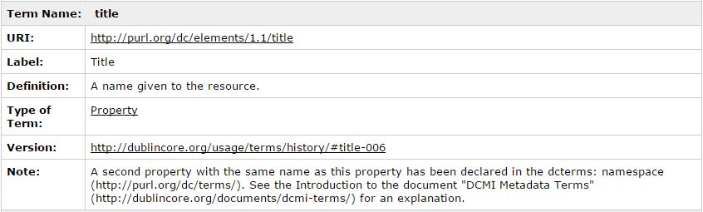
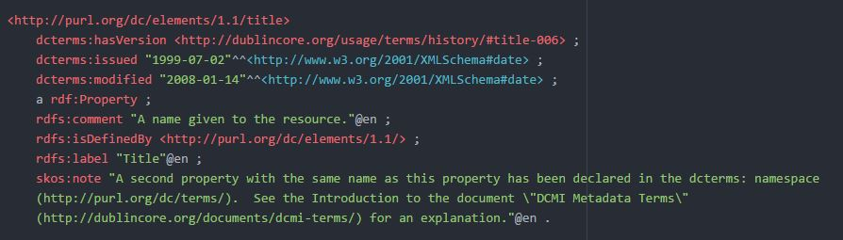
Metadata Schemas
DCES Standard: Title
DCES Schema: Title

Slide 6
What is Metadata Mapping?
Specifies a translation from one metadata schema to another
Often a table showing a metadata field from one schema and its equivalent in another schema
Synonyms: field mapping, crosswalk

Slide 7
Why?
Data sharing
Want to use another institution’s data, but they use a different metadata schema
Consortia
Mapping to the same schema
Open Archives Initiative – Protocol for Metadata Harvesting
Migrating to new system that uses a different metadata schema

Slide 8
Challenges
Moving from a complex schema to a simple schema
What goes where?
Loss of rich metadata
Notes:
Moving from one complex schema to another complex is also very difficult. Remember that different metadata standards serve different communities and purposes. Talk about EAD to MODS.

Slide 9
Examples
MARC to Dublin Core
MODS to Dublin Core Element Set
EAD mappings

Slide 10
Metadata Mapping at ISU
ISU Digital Collections
University Photographs
Atanasoff
custom schema
custom schema
Dublin Core
Cookbook Collection
Civil War
custom schema
custom schema
Notes:
Within ContentDM, the system we use for digital collections, you can have multiple collections, each with its own unique/custom schema. A user can go to each specific collection and search. A user can also search across all collections. However, in order to search across all collections we have to map each of the custom schemas to Dublin Core so that ContentDM has a uniform schema to search across.

Slide 11
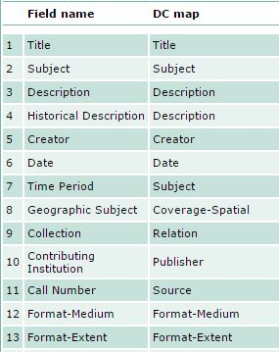
Metadata Mapping at ISU
Metadata Mapping for University Photographs

Slide 12
Questions?

