Slide 1
Schema.org: Part One

Slide 2
Schema.org

Slide 3
What is it?
Schema.org is a set of vocabularies for describing things in an interoperable and semantic way on the web.

Slide 4
Historical Context
Started in 2011 by Google, Yahoo, Bing (“Big Engines”)
“[To] create and support a common set of schemas for structured data markup on web pages.”
Maintained by members of the Big Engines
Community driven
Original scope was for businesses
Notes:
Embedded metadata in web pages predates the Schema.org vocabulary.

Slide 5
Purpose
Set of vocabularies for describing things in an interoperable and semantic way on the web
To make data on the web more meaningful to machines
Notes:
Humans have one big advantage over machines: we can infer like crazy. Machines can’t. They’re so literal that you have to specify everything, including inferences. A person can look at a web page and pick out data, and understand what the page means. A machine cannot do that without guidance. This is where structured data comes into play.

Slide 6
Exploring Schema
http://schema.org/
Notes:
Things to talk about: classes and properties, organizational breakdown, core vs extensions

Slide 7
Publishing Strategies
Three ways to embed structured data into web pages
Microdata
RDFa
JSON-LD
Back to Schema.org

Slide 8
Usage by Big Engines
Schema.org: Evolution of Structured Data on the Web

Slide 9
Examples
Event
Movie times
Book
Person

Slide 10
JSON-LD

Slide 11
JSON Basics
JavaScript Object Notation is a data format
Based on a subset of the JavaScript Programming Language
Text based and language independent

Slide 12
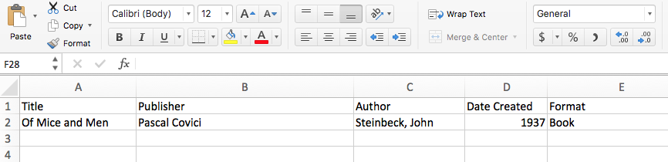
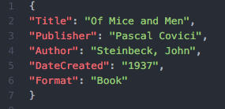
JSON Example

Slide 13
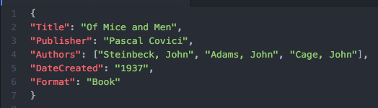
JSON Datatypes
See JSON - Datatypes
String - “Text in double quotes”
Number - 1937 (no quotes)
Object
Array

Slide 14
JSON-LD Extension
Lightweight linked data format
Extends JSON
Link to JSON-LD homepage

Slide 15
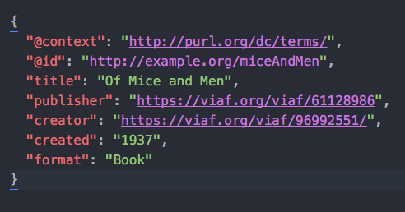
JSON-LD and Linked Data
Three important pieces: “@context”, “@id”, “@type”

Slide 16
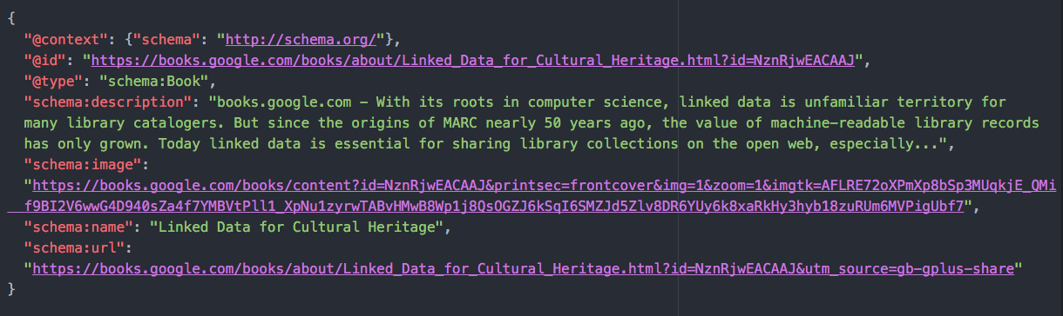
Schema.org + JSON-LD Example

Slide 17
Visualizing JSON-LD
We didn’t get to this slide, but I was just going to write some stuff on the whiteboard anyway.

