Slide 1
Introduction to Schema.org and JSON-LD

Slide 2
Schema.org

Slide 3
What is it?
Schema.org is a set of vocabularies for describing things in an interoperable and semantic way on the web.

Slide 4
Historical Context
Started in 2011 by Google, Yahoo, Bing
Maintained by members of Google, Yahoo, Bing, Yandex
Original scope was for businesses
Community driven
Notes:
Embedded metadata in web pages predates the Schema.org vocabulary.

Slide 5
Purpose
“[To] create and support a common set of schemas for structured data markup on web pages.”*
To make data on the web more meaningful to machines
* https://webmasters.googleblog.com/2011/06/introducing-schemaorg-search-engines.html
Notes:
Humans have one big advantage over machines: we can infer like crazy. Machines can’t. They’re so literal that you have to specify everything, including inferences. A person can look at a web page and pick out data, and understand what the page means. A machine cannot do that without guidance. This is where structured data comes into play.

Slide 6
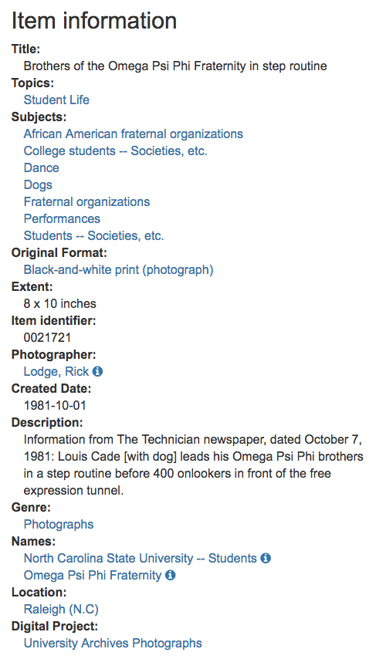
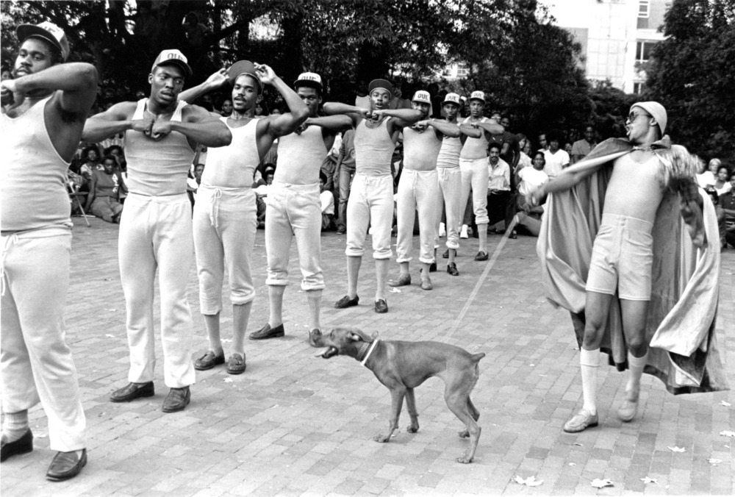
Photograph
Person
Place
Image

Slide 7
Schema.org
Notes:
Things to talk about: classes and properties, organizational breakdown, core vs extensions, nested entities

Slide 8
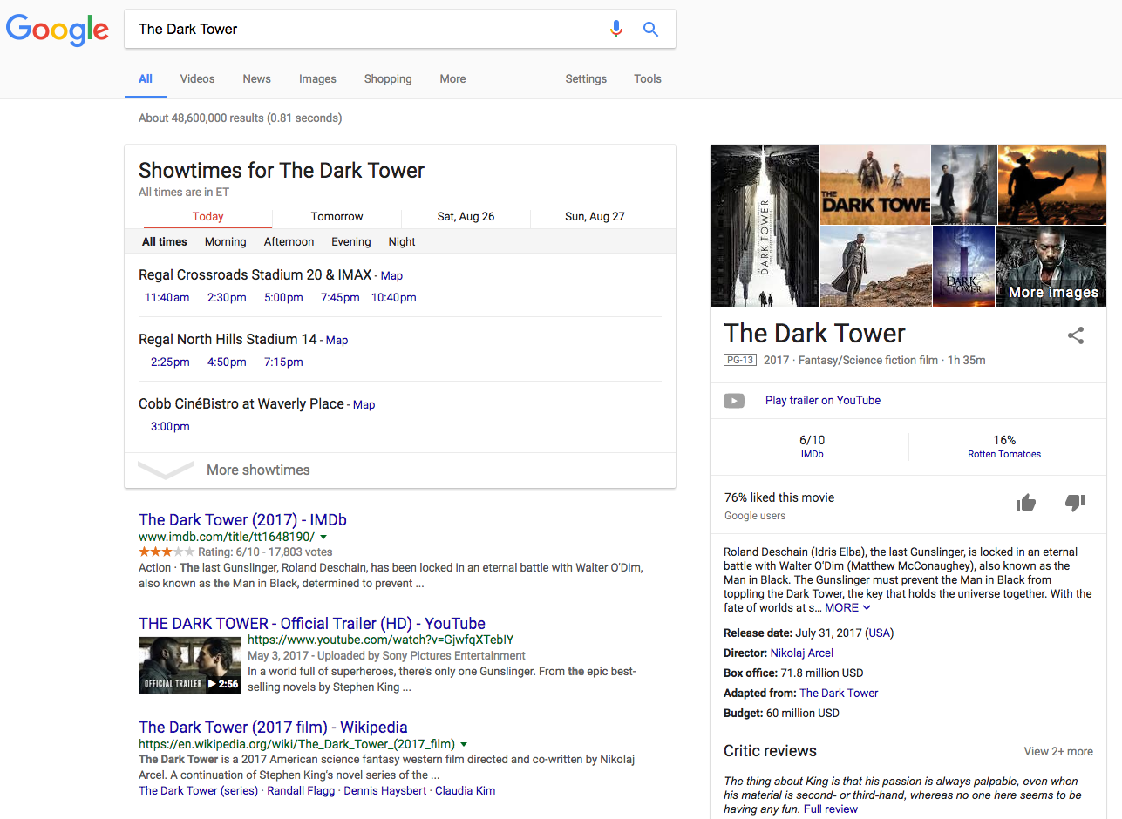
Movie Example
https://www.google.com/search?q=The+Dark+Tower
Notes:
Gives answers and not just search results. "Save the time of the user." --Raganathan

Slide 9
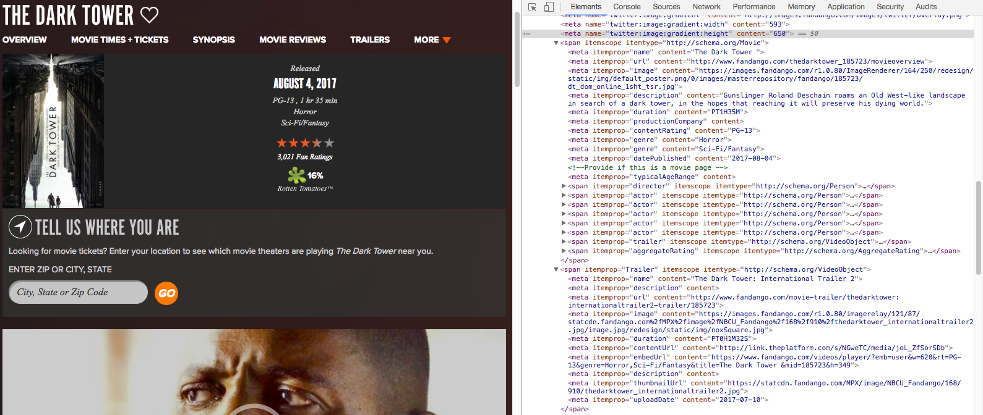
https://www.fandango.com/thedarktower_185723/movieoverview

Slide 10
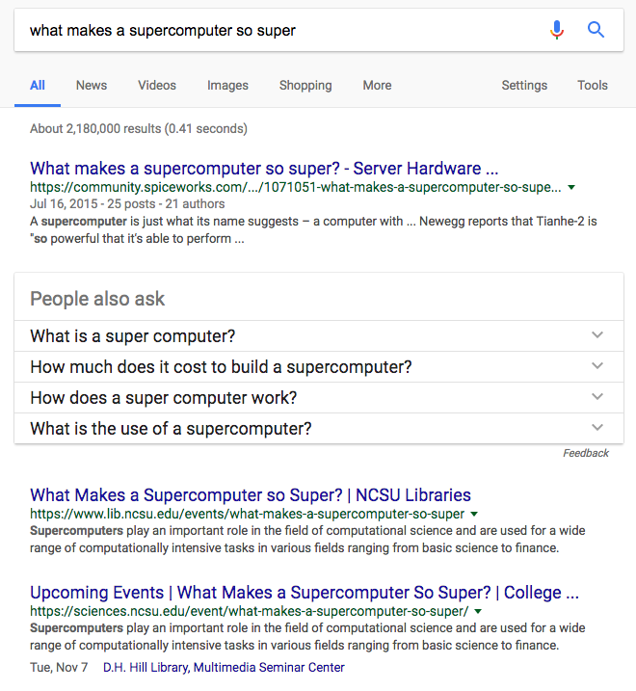
https://www.google.com/search?q=what+makes+a+supercomputer+so+super

Slide 11
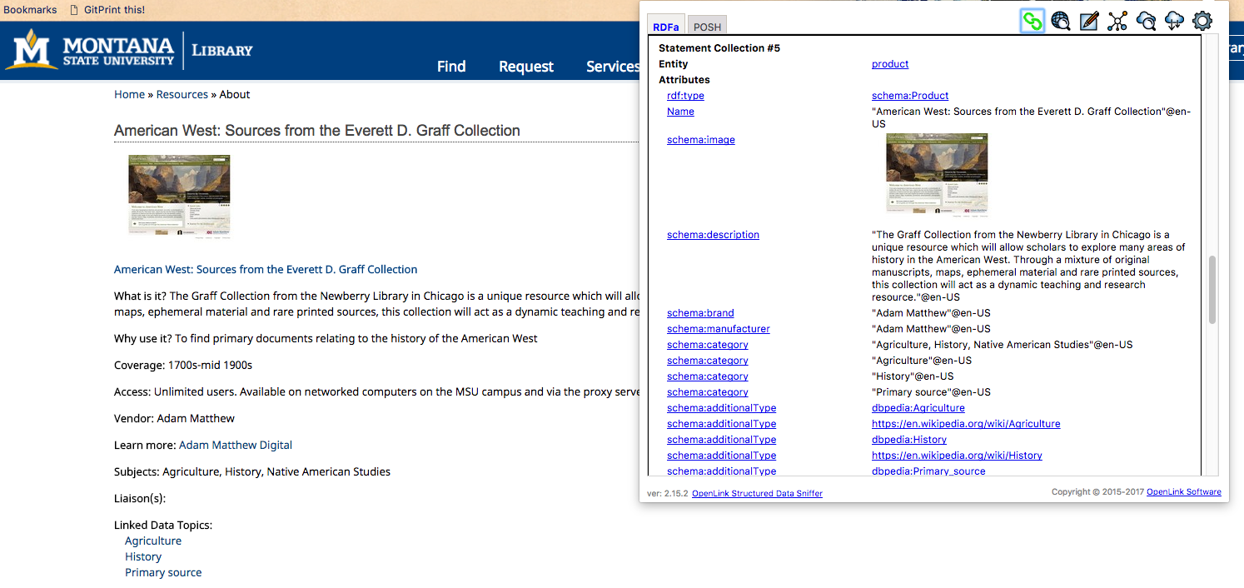
Montana State University Databases
http://www.lib.montana.edu/resources/about/482

Slide 12
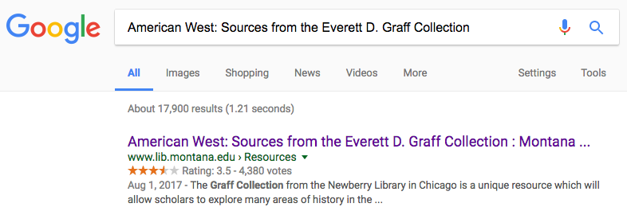

Slide 13
Usage by Big Engines
Schema.org: Evolution of Structured Data on the Web
Google - Introduction to Structured Data

Slide 14
Impact on Library SEO
The Open SESMO (Search Engine & Social Media Optimization) Project: Linked and Structured Data for Library Subscription Databases to Enable Web-scale Discovery in Search Engines
Linked Data is People: Building a Knowledge Graph to Reshape the Library Staff Directory

Slide 15
Semantic Markup
Notes:
AKA Structured Data Markup, Embedded Structured Data

Slide 16
Notes:
And so let’s say that we have a web page. On the backend the page is marked up with HTML. HTML is designed to bring structure to a web page. This helps a machine understand the structure of the document, but it doesn’t make the data within the document understandable to a machine. Semantic markup is inserted into the backend of the page to bring meaning to the data. There are a variety of semantic markup languages that can be used to do this.

Slide 17
Person Example: Without Markup
<p>George Bush, the 41st President of the United States is the father of George W. Bush, the 43rd President of the United States.</p>
http://schema.org/Person
Notes:
Here's an example straight from the schema.org page.
These are all the same example and the user would see things looking like this in every case

Slide 18
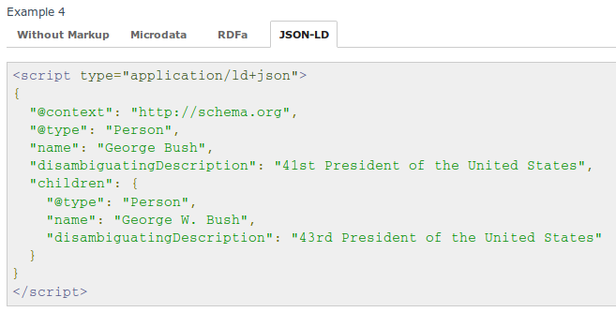
Person Example: JSON-LD Syntax
http://schema.org/Person
Notes:
Avoids issue with trying to include data within text. It decouples the markup from the
Easy for developers. Can be consumed by JavaScript clients.
JSON serialization of linked data.

Slide 19
JSON Basics
JavaScript Object Notation is a data format
Based on a subset of the JavaScript Programming Language
Text based and language independent

Slide 20
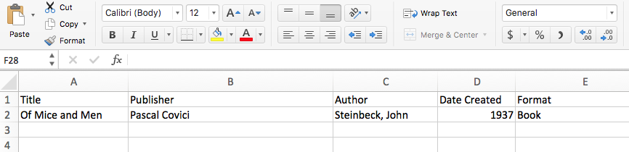
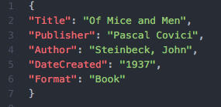
JSON Example

Slide 21
JSON-LD Extension
Lightweight linked data format
Extends JSON
JSON-LD homepage

Slide 22
Describing a Painting
with schema.org in JSON-LD
Notes:
Since we're going to do a hands-on exercise in just a few minutes I'm going to show you a bit what the syntax looks like so we can try to create our own schema.org in JSON-LD

Slide 23
JSON
{ }
Notes:
Like all JSON objects we'll start with curly braces

Slide 24
JSON-LD
{
"@context": "http://schema.org",
"@type": "Painting"
}
http://schema.org/docs/jsonldcontext.json
Notes:
Then we'll add some of the bits that make this more than just JSON and make this linked data. The @context give us the definition of what all the properties mean and allow for using properties that are defined in different places. You can think of the @context as some boilerplate you just need to add. One of the advantages of working with JSON-LD is that you can think of it at different levels. If you want to ignore that it is linked data that's fine--you still get the rigor of how the terms have been defined. Then we set the @type. This is the type of thing we're defining.

Slide 25
JSON-LD with Properties
{
"@context": "http://schema.org",
"@type": "Painting",
"name": "The Scream",
"url": "https://en.wikipedia.org/wiki/The_Scream",
"creator":
}
Notes:
The painting that we're describing is the Scream so we'll add a name for it and URL. But who painted The Scream?

Slide 26
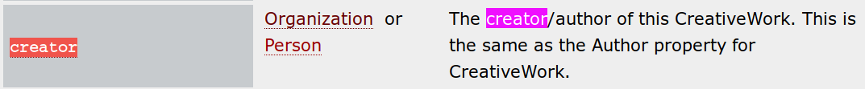
Nested Properties
Notes:
The "creator" did.
You'll sometimes see that the value of a property ought to be another thing rather than just Text.
In this case the value of "creator" ought to be an Organization or Person.

Slide 27
JSON-LD with Nesting
{
"@context": "http://schema.org",
"@type": "Painting",
"name": "The Scream",
"url": "https://en.wikipedia.org/wiki/The_Scream",
"creator": {
"@type": "Person",
"name": "Edvard Munch",
"sameAs": "https://en.wikipedia.org/wiki/Edvard_Munch"
}
}
Notes:
We we nest another object with curly braces underneath "creator". And besides his name we can also give more information like his telephone number.

Slide 28
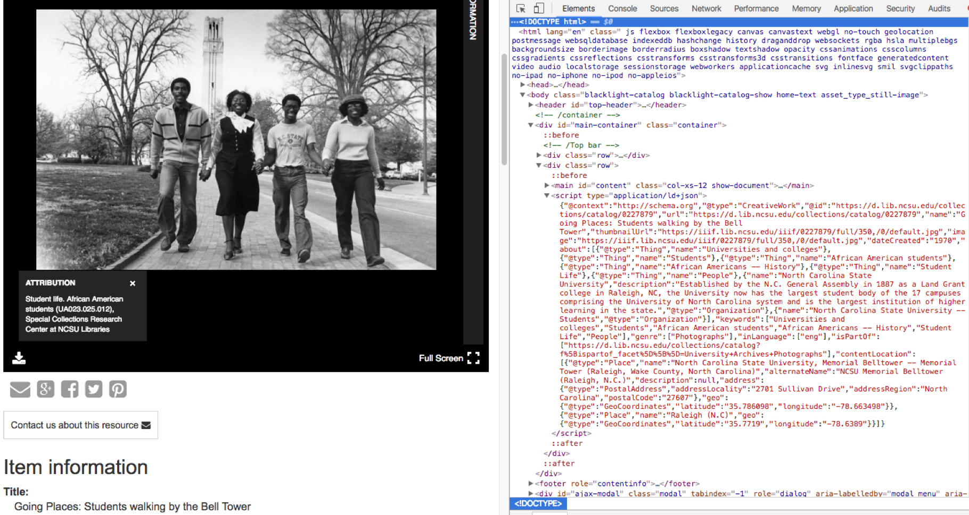
Image from https://d.lib.ncsu.edu/collections/catalog/0227879

Slide 29
Now to apply what we’ve learned

Slide 30
Activity Instructions
See https://github.com/eightBitter/erl2018-linked-data-workshop/blob/master/schemaOrg-jsonld/activity-instructions.md
Notes:
**half-way through** say: For an event make sure to have a nested location
Don’t forget to show some examples using the Google Structured Data Testing Tool

Slide 31
What Now?

Slide 32

Publishing Workflow
Extract
Data from source
Transform
Data into schema.org + semantic markup
Load
Transformed data into HTML documents
Notes:
You *could* manually create the data, but the most common workflow for generating schema.org data is the following:
There are two main components to a batch conversion: a map to translate the metadata; a technical infrastructure for transforming the data. Good collaborative project for metadata and IT people

