Slide 1
URIs in MARC records
Session 1

Slide 2
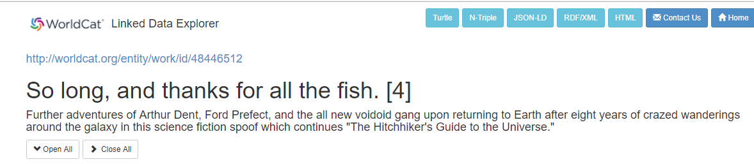
What are URIs?
Uniform Resource Identifiers
Strings of characters that uniquely identify a resource
URI

Slide 3
Why use URIs?
Convey information
Connect sources
Explore relationships

Slide 4
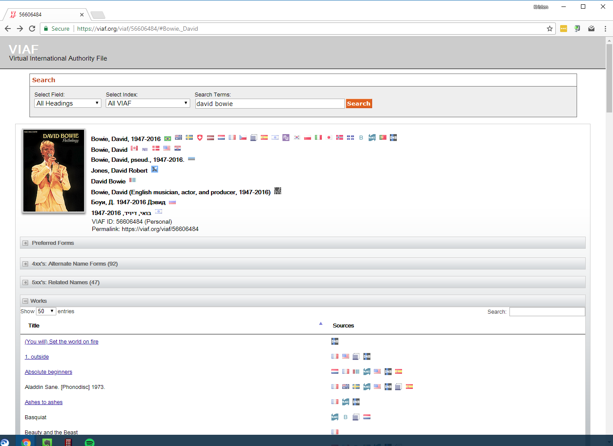

Slide 5
Why use URIs?
Convey information
Connect sources
Explore relationships

Slide 6
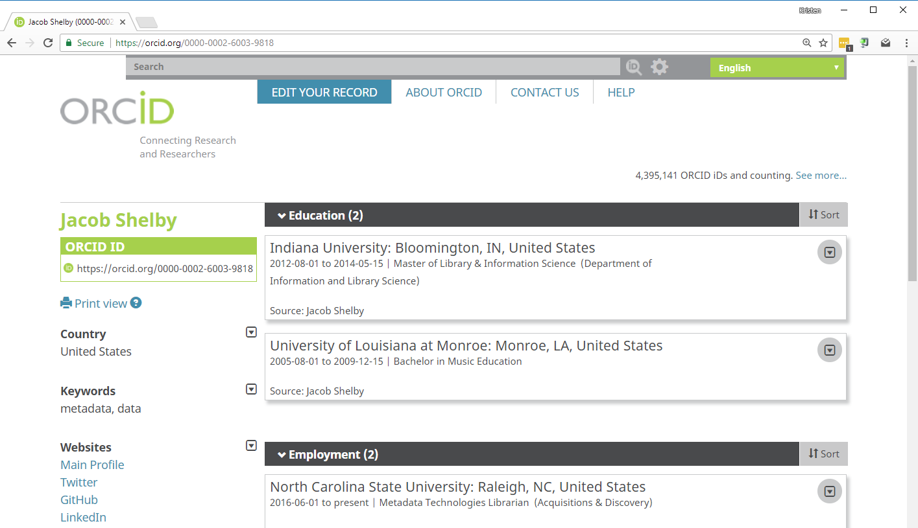

Slide 7
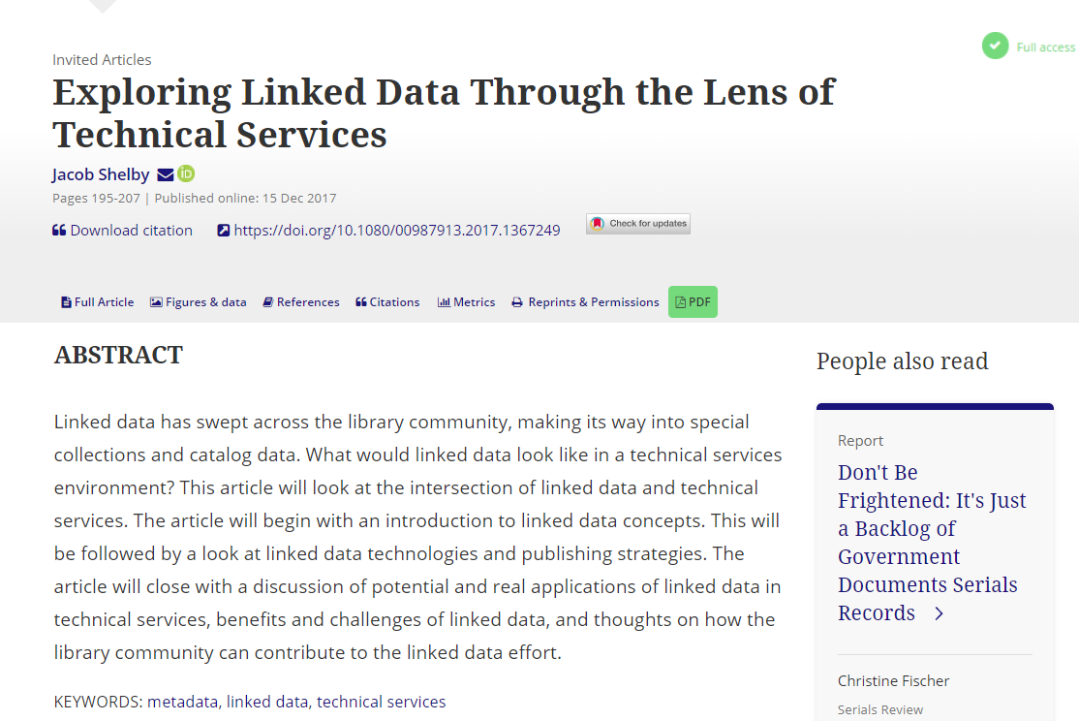
URI
URI

Slide 8
Why use URIs?
Convey information
Connect sources
Explore relationships

Slide 9
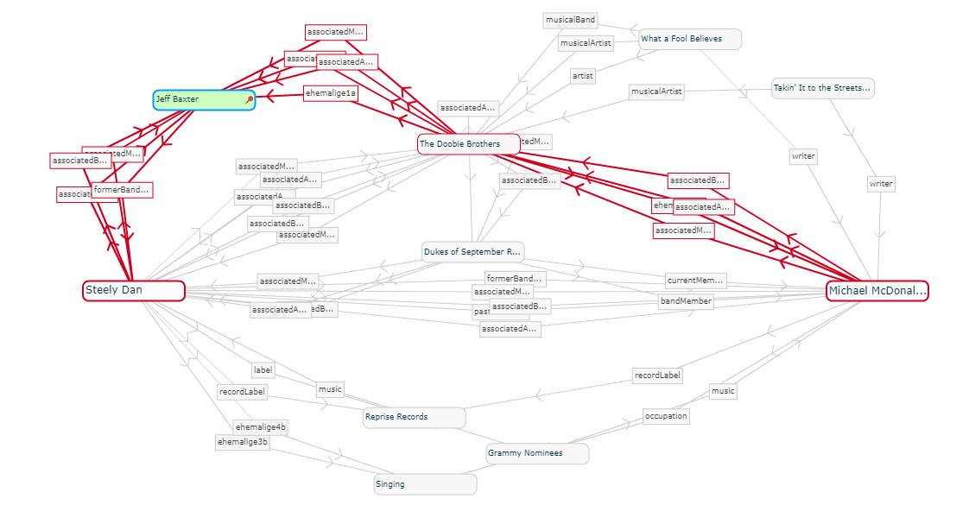
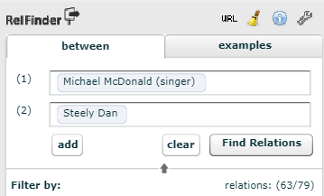

Slide 10

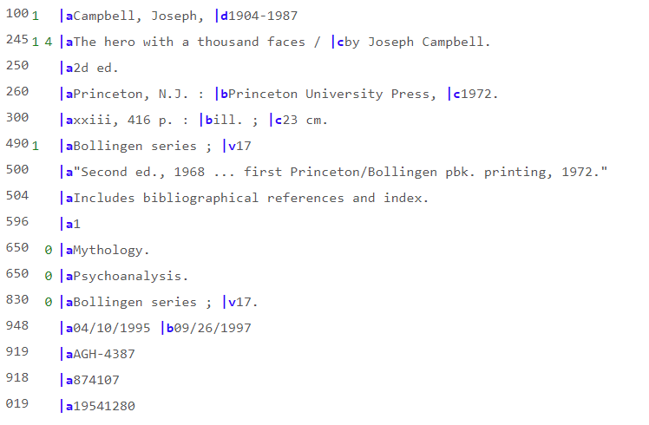
But what about MARC?
No URI
No URIs

Slide 11
But what about MARC!
$0 http://id.loc.gov/authorities/names/n50030939
$0 http://id.loc.gov/authorities/names/n50030939
$0 http://id.loc.gov/authorities/names/n50030939

Slide 12
Why add URIs to MARC records?
It’s extra work
They don’t do anything
Shouldn’t we just wait for BIBFRAME?

Slide 13

Why add URLs to MARC records?
It helps us learn more about URIs
It helps learn more about tools that can harvest them
There may be ways to experiment with the data
The process might reveal other ideas
Adding URIs to our data now helps us prepare for BIBFRAME

Slide 14
NCSU’s URIs in MARC records micro-project
What we did:
Investigated how to get URIs into records
Conducted department-wide training
Wrote a follow up report with more ideas

Slide 15
URIs in MARC records activity
Get MARC records from your ILS
Convert MARC records to .mrc
Harvest URIs
Look at the results
Import records back into your ILS
https://github.com/eightBitter/erl2018-linked-data-workshop/blob/master/uris-marc/activity-instructions.md

Slide 16
URIs in MARC records activity
Get MARC records from your ILS
Convert MARC records to .mrc
Harvest URIs
Look at the results
Import records back into your ILS
https://github.com/eightBitter/erl2018-linked-data-workshop/blob/master/uris-marc/activity-instructions.md

Slide 17
What now?
Evaluate MARC enhancement workflows
Local scripting
Vendor-provided records
Create a small pool of URI-enhanced records to use for future testing
Convert to RDF
Put into a triplestore

Slide 18
Special thanks to Sonoe Nakasone and Lisa Madden for original work on the slides and activity

