Slide 1
Do Something Real with Linked Data:
A Micro-projects Approach
Jacob Shelby and Kristen Wilson
North Carolina State University Libraries
ER&L - March 7, 2018

Slide 2
Workshop agenda
Introduction - 30 minutes
URIs in MARC records - 60 minutes
Break - 15 minutes
Entity reconciliation - 60 minutes
Schema.org and JSON-LD - 60 minutes

Slide 3
Introductions
Notes:
Speakers to introduce themselves
Ask participants
Name
Job role
Goals for this workshop

Slide 4
What is linked data?
A way of publishing data and the relationships between them so they can be queried and understood by computers.

Slide 5
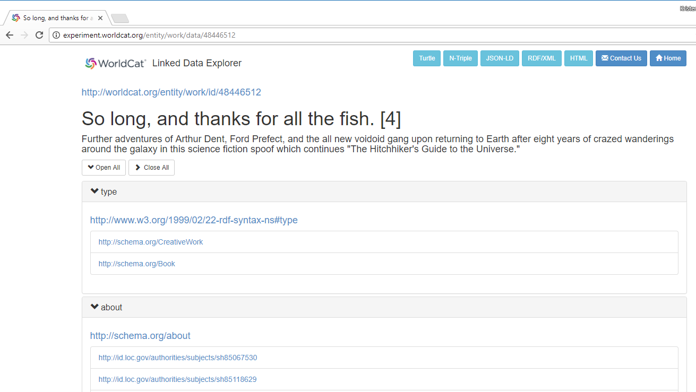

Slide 6
URI
Notes:
https://www.w3.org/DesignIssues/LinkedData.html

Slide 7
HTTP URI
URI
Notes:
https://www.w3.org/DesignIssues/LinkedData.html

Slide 8
HTTP URI
URI
Standards
Notes:
https://www.w3.org/DesignIssues/LinkedData.html

Slide 9
HTTP URI
URI
Standards
Links to other URIs
Notes:
https://www.w3.org/DesignIssues/LinkedData.html

Slide 10
Why linked data?
Big picture perspective:
Enhance collections and data
Create links between disparate data sets
On the web
Across disciplines
Within the library environment
Express data in an intelligent way

Slide 11
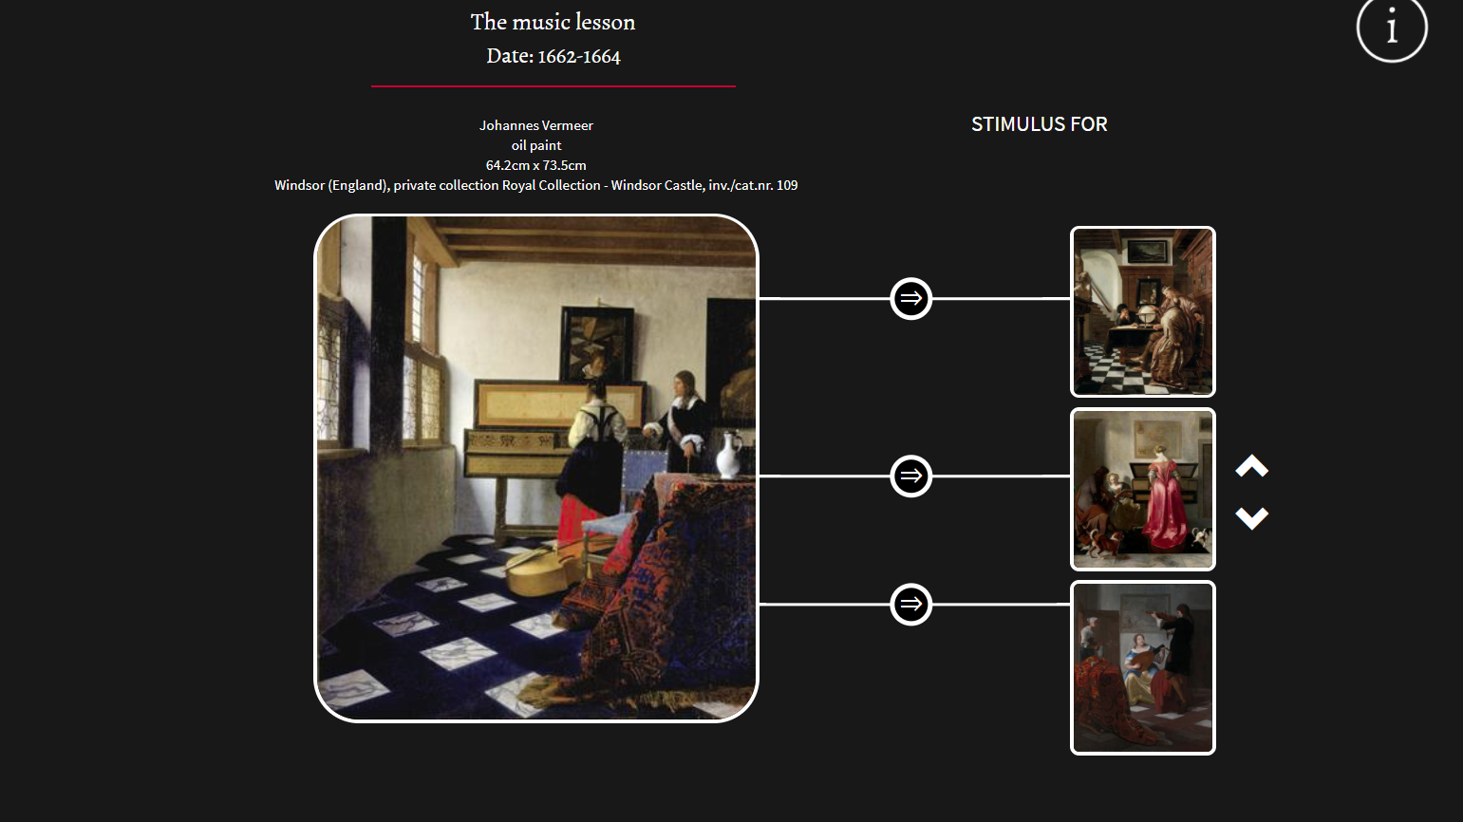
Notes:
http://connectvermeer.org/painting.php?id=RKD_ART_NUMBER-199369

Slide 12
Why linked data?
Technical services perspective:
Linked data is coming, and our old work is going away
Our skills will be transferable
It’s time to get ready

Slide 13
So what can we do?

Slide 14
The micro-projects approach
The goal is to build a foundation of familiarity, comfort, and proficiency with linked data
Focus on education and experimentation
Break things into manageable chunks
Begin to craft a long-term vision

Slide 15
The micro-projects approach
Identify the smallest useful thing you can do
Pull in different types of staff, even if just for the experience
Make connections outside of technical services
Don’t worry too much about outcomes (right now)
Keep the user in mind (long term)

Slide 16
NCSU examples

Slide 17
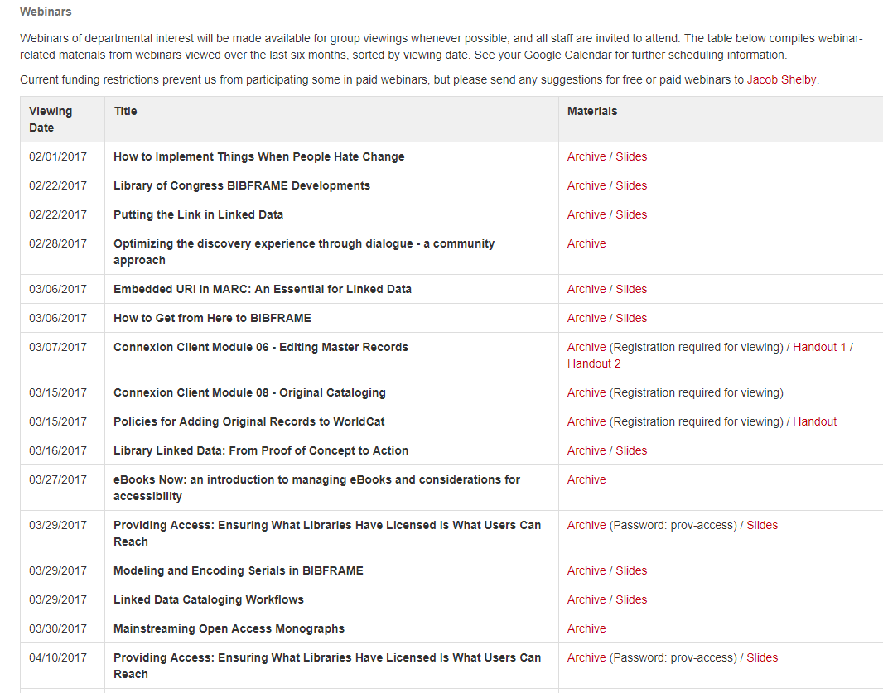
Continuing education
Coordinate shared viewing of webinars
Encourage all to attend
Low-cost, low-stakes way to engage with emerging trends and tech

Slide 18
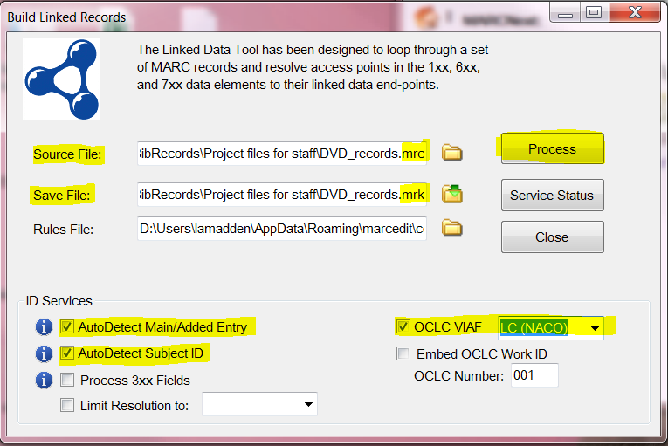
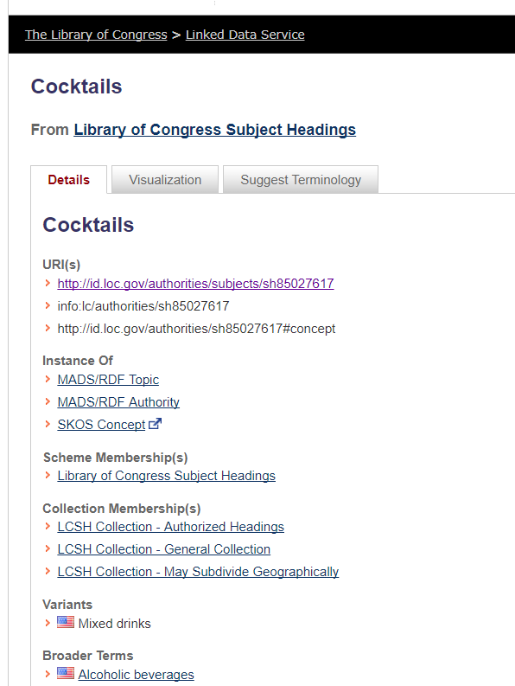
Micro-projects
Basic approach
Learn about technologies and workflows
Provide training for all department staff
Come up with a list of future projects
Examples
Adding URIs to MARC records
JSON-LD training
Entity reconciliation
Triplestore

Slide 19
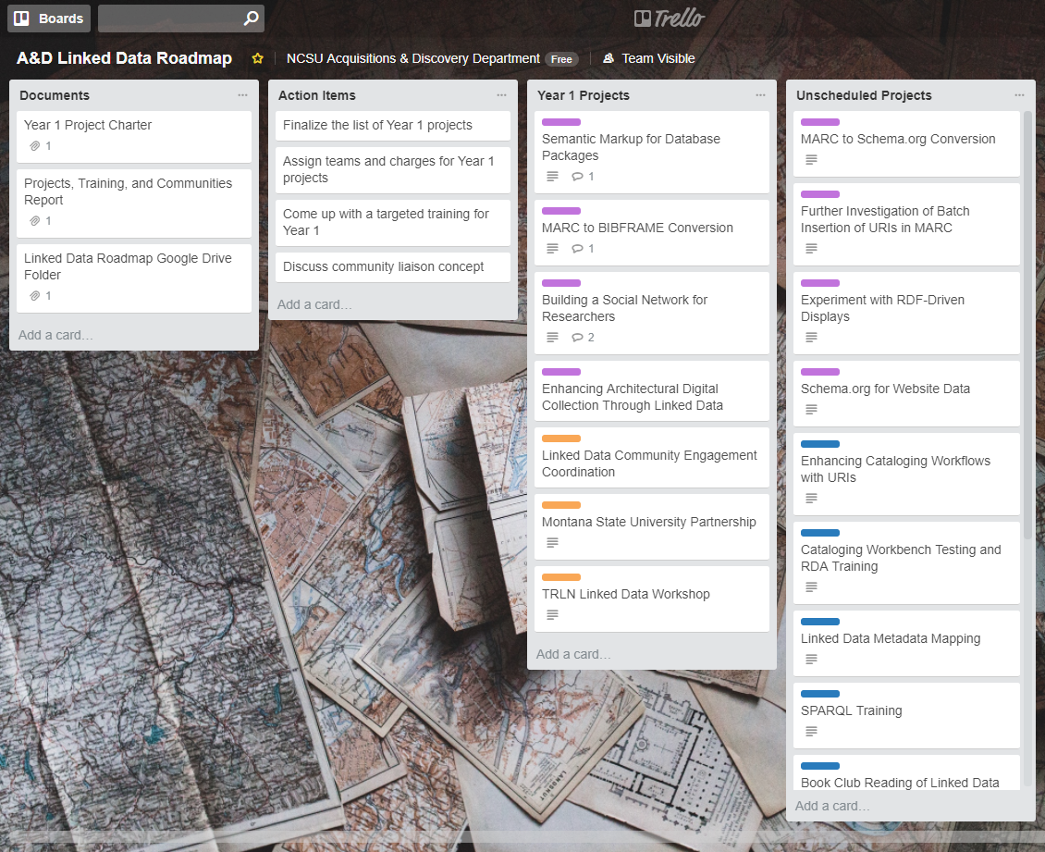
Linked data roadmap
Moving onto a bigger vision
Roadmap attempts to layout a plan for pilot projects and engagement activities over the course of 2-3 years
Pilot projects still embrace the micro-project approach

