Slide 1
Introduction to Schema.org and JSON-LD
Jacob Shelby

Slide 2

Goal of today’s session
Learn about two key tools for increasing discoverability of information on the open web
Schema.org
Semantic Markup

Slide 3
Schema.org

Slide 4
What is it?
Schema.org is a set of vocabularies for describing things in an interoperable and semantic way on the web.

Slide 5
Historical Context
Started in 2011 by Google, Yahoo, Bing
Maintained by members of Google, Yahoo, Bing, Yandex
Original scope was for businesses
Community driven
Notes:
Embedded metadata in web pages predates the Schema.org vocabulary.

Slide 6
Purpose
“[To] create and support a common set of schemas for structured data markup on web pages.”*
To make data on the web more meaningful to machines
* https://webmasters.googleblog.com/2011/06/introducing-schemaorg-search-engines.html
Notes:
Humans have one big advantage over machines: we can infer like crazy. Machines can’t. They’re so literal that you have to specify everything, including inferences. A person can look at a web page and pick out data, and understand what the page means. A machine cannot do that without guidance. This is where structured data comes into play.

Slide 7
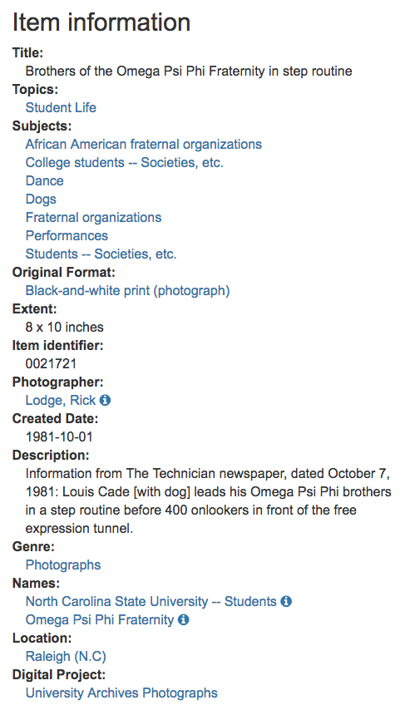
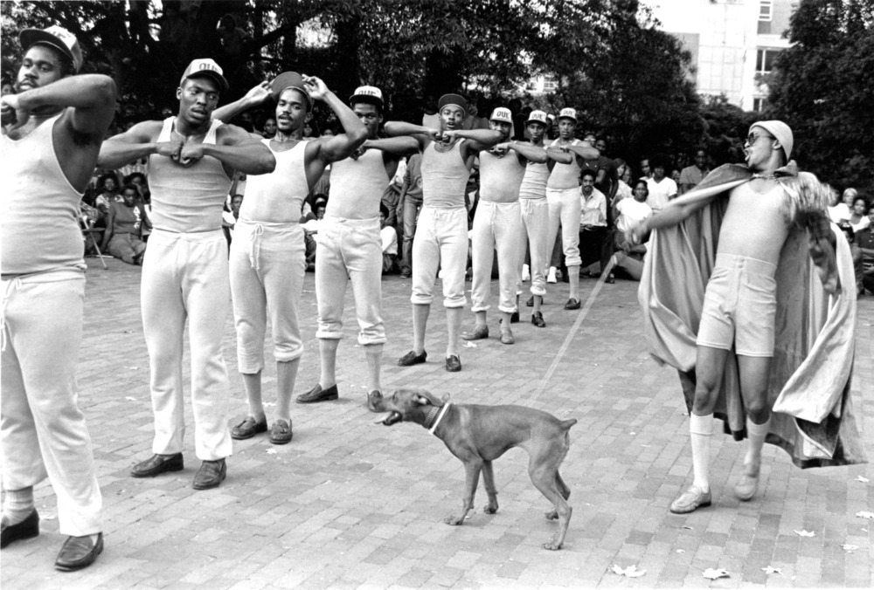
Photograph
Person
Place
Image

Slide 8
Schema.org
follows linked data principles
Notes:
Written in RDF

Slide 9
Schema
Notes:
Translates disparate data in siloed systems into a common language

Slide 10






Notes:
Documents -> Data -> Things

Slide 11
Schema.org
Notes:
Things to talk about: classes and properties, organizational breakdown, core vs extensions, nested entities

Slide 12
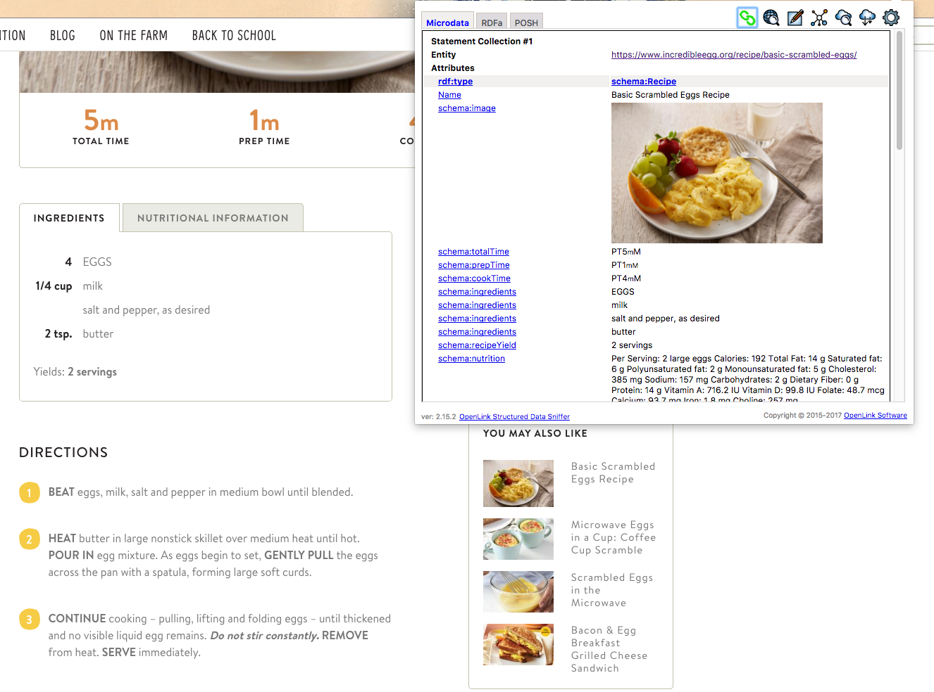
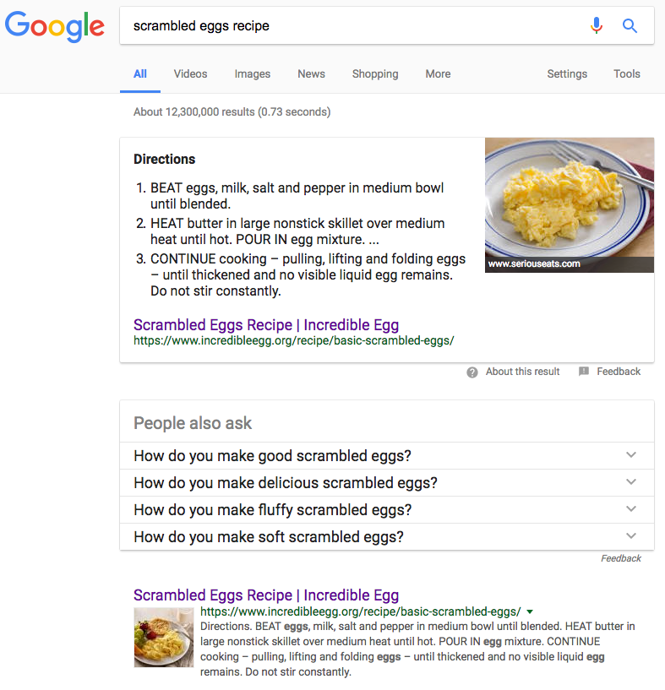
Recipe Example
https://www.google.com/search?q=scrambled+eggs+recipe
Notes:
1. Rank appropriately. 2. Rich snippet. You've seen these kinds of things before. Used to be boring list of links. What's powering these results. gives better idea what the find at the other end. More attractive search result. And you can see how the structured metadata comes through.
all recipes scrambled eggs

Slide 13
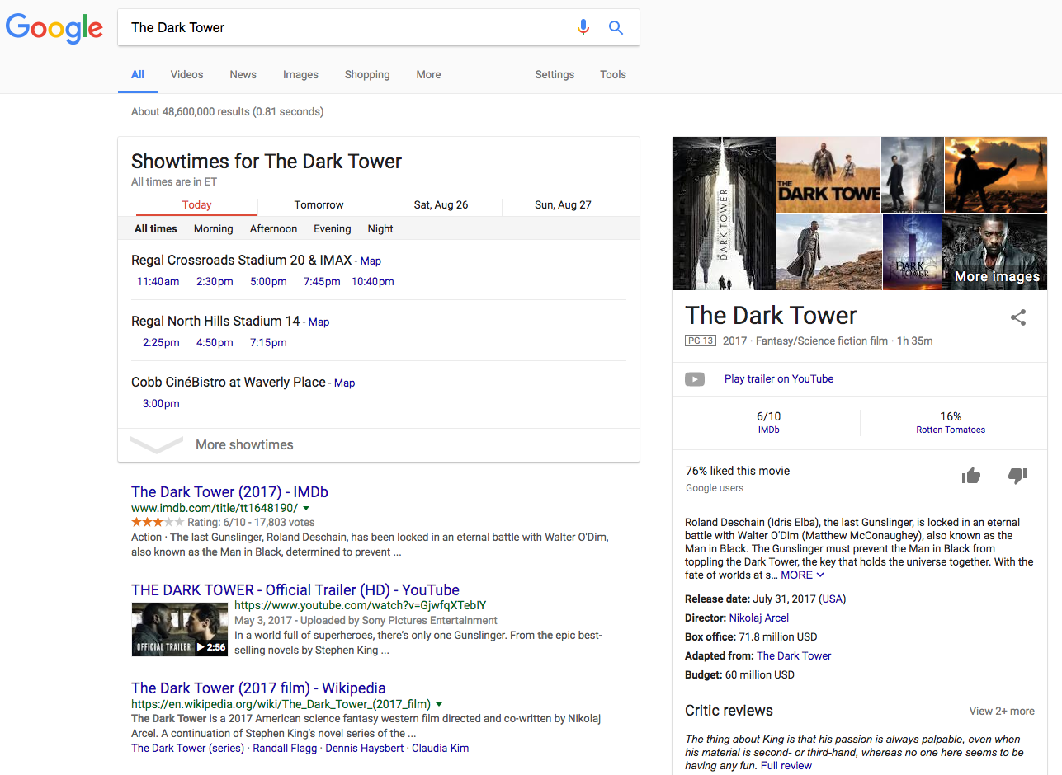
Movie Example
https://www.google.com/search?q=The+Dark+Tower
Notes:
Gives answers and not just search results. "Save the time of the user." --Raganathan

Slide 14
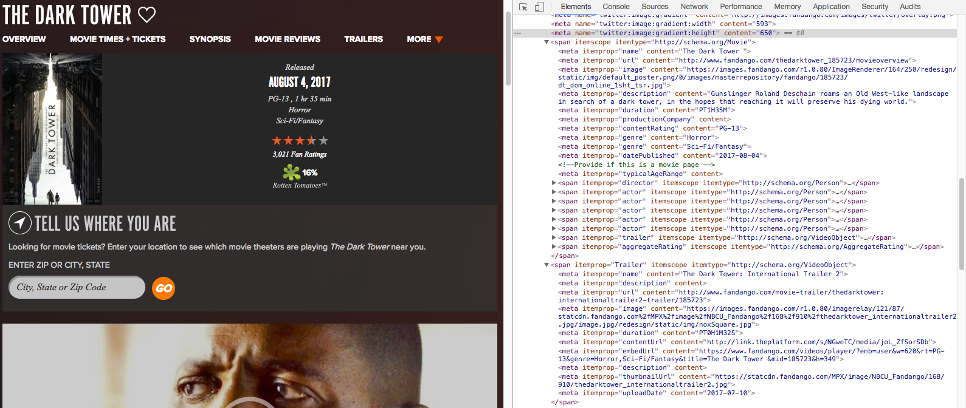
https://www.fandango.com/thedarktower_185723/movieoverview

Slide 15
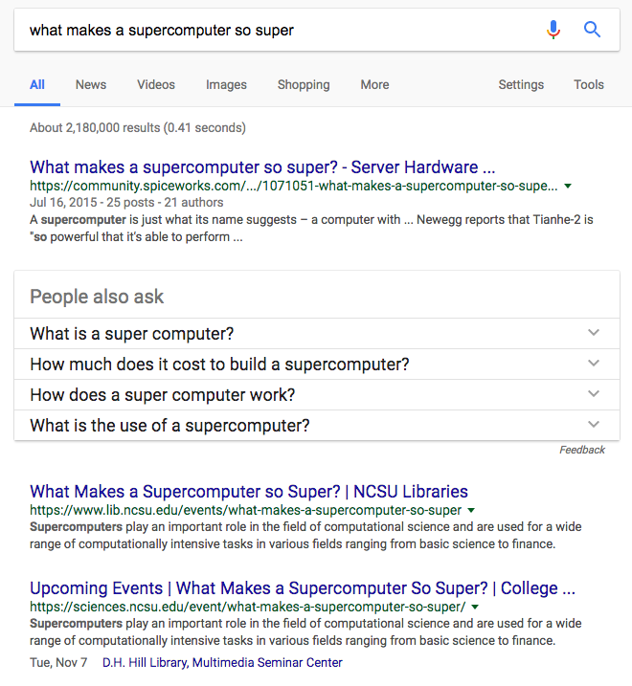
https://www.google.com/search?q=what+makes+a+supercomputer+so+super

Slide 16
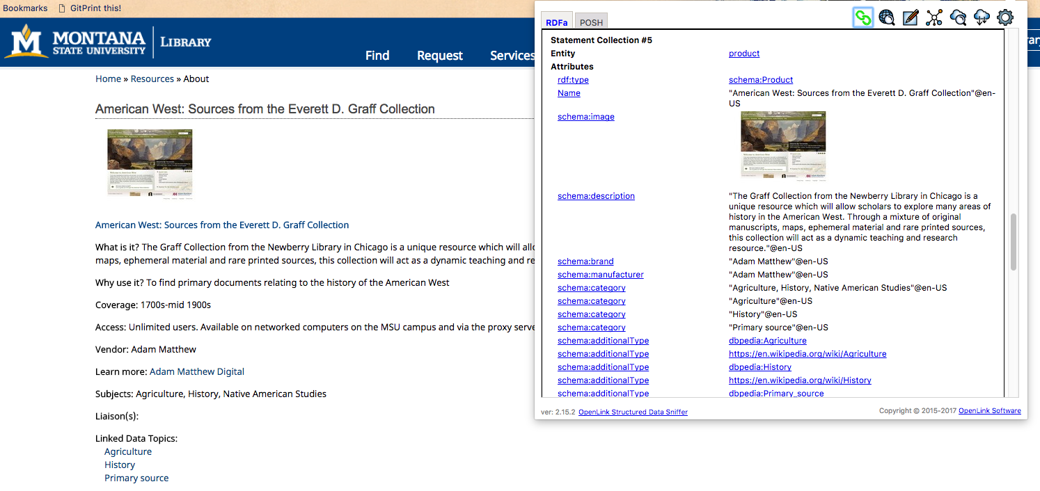
Montana State University Databases
http://www.lib.montana.edu/resources/about/482

Slide 17
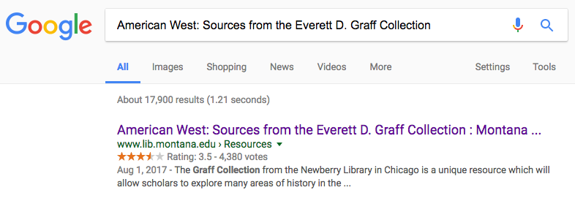

Slide 18
Usage by Big Engines
Schema.org: Evolution of Structured Data on the Web
Google - Introduction to Structured Data

Slide 19
Semantic Markup
Notes:
AKA Structured Data Markup, Embedded Structured Data

Slide 20
Notes:
And so let’s say that we have a web page. On the backend the page is marked up with HTML. HTML is designed to bring structure to a web page. This helps a machine understand the structure of the document, but it doesn’t make the data within the document understandable to a machine. Semantic markup is inserted into the backend of the page to bring meaning to the data. There are a variety of semantic markup languages that can be used to do this.

Slide 21
Person Example: Without Markup
<p>George Bush, the 41st President of the United States is the father of George W. Bush, the 43rd President of the United States.</p>
http://schema.org/Person
Notes:
Here's an example straight from the schema.org page.
These are all the same example and the user would see things looking like this in every case

Slide 22
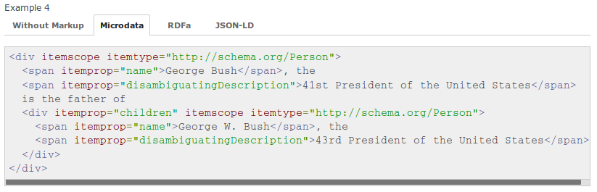
Person Example: Microdata Syntax
http://schema.org/Person
Notes:
Embedded semantic markup.
If the semantics are tied to the page content then it is more difficult to game the search engines. This is the syntax we used to have on the digital special collections site.

Slide 23
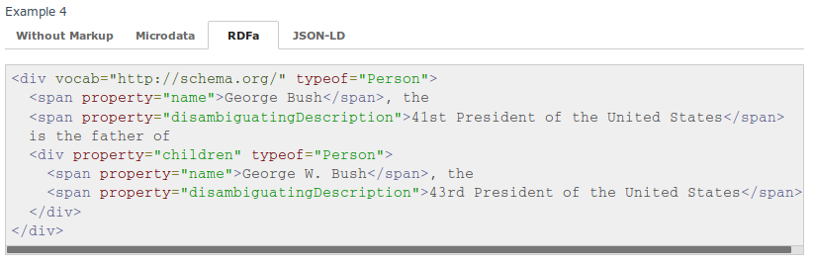
Person Example: RDFa (Lite) Syntax
http://schema.org/Person
Notes:
… I agree, when I first tried to implement embedded semantic markup. I tried RDFa and found it to difficult to implement. Since then and in reaction to Microdata…
One of the issues generally with the embedded markup approach is that you're including a lot of data in your markup and sometimes have to contort your markup to make it work.

Slide 24
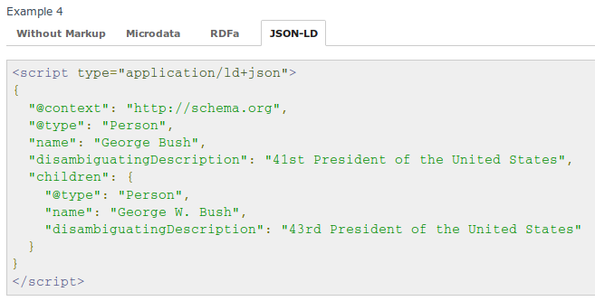
Person Example: JSON-LD Syntax
http://schema.org/Person
Notes:
Avoids issue with trying to include data within text. It decouples the markup from the
Easy for developers. Can be consumed by JavaScript clients.
JSON serialization of linked data.

Slide 25
JSON Basics
JavaScript Object Notation is a data format
Based on a subset of the JavaScript Programming Language
Text based and language independent

Slide 26
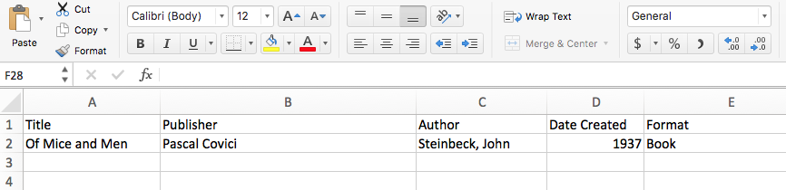
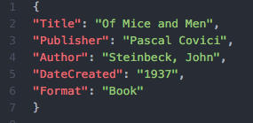
JSON Example

Slide 27
JSON-LD Extension
Lightweight linked data format
Extends JSON
JSON-LD homepage

Slide 28
Describing a Painting
with schema.org in JSON-LD
Notes:
Since we're going to do a hands-on exercise in just a few minutes I'm going to show you a bit what the syntax looks like so we can try to create our own schema.org in JSON-LD

Slide 29
JSON
{ }
Notes:
Like all JSON objects we'll start with curly braces

Slide 30
JSON-LD
{
"@context": "http://schema.org",
"@type": "Painting"
}
http://schema.org/docs/jsonldcontext.json
Notes:
Then we'll add some of the bits that make this more than just JSON and make this linked data. The @context give us the definition of what all the properties mean and allow for using properties that are defined in different places. You can think of the @context as some boilerplate you just need to add. One of the advantages of working with JSON-LD is that you can think of it at different levels. If you want to ignore that it is linked data that's fine--you still get the rigor of how the terms have been defined. Then we set the @type. This is the type of thing we're defining.

Slide 31
JSON-LD with Properties
{
"@context": "http://schema.org",
"@type": "Painting",
"name": "The Scream",
"url": "https://en.wikipedia.org/wiki/The_Scream",
"creator":
}
Notes:
The painting that we're describing is the Scream so we'll add a name for it and URL. But who painted The Scream?

Slide 32
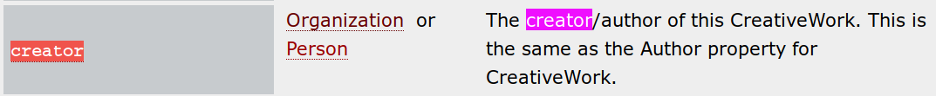
Nested Properties
Notes:
The "creator" did.
You'll sometimes see that the value of a property ought to be another thing rather than just Text.
In this case the value of "creator" ought to be an Organization or Person.

Slide 33
JSON-LD with Nesting
{
"@context": "http://schema.org",
"@type": "Painting",
"name": "The Scream",
"url": "https://en.wikipedia.org/wiki/The_Scream",
"creator": {
"@type": "Person",
"name": "Edvard Munch",
"sameAs": "https://en.wikipedia.org/wiki/Edvard_Munch"
}
}
Notes:
We we nest another object with curly braces underneath "creator". And besides his name we can also give more information like his telephone number.

Slide 34
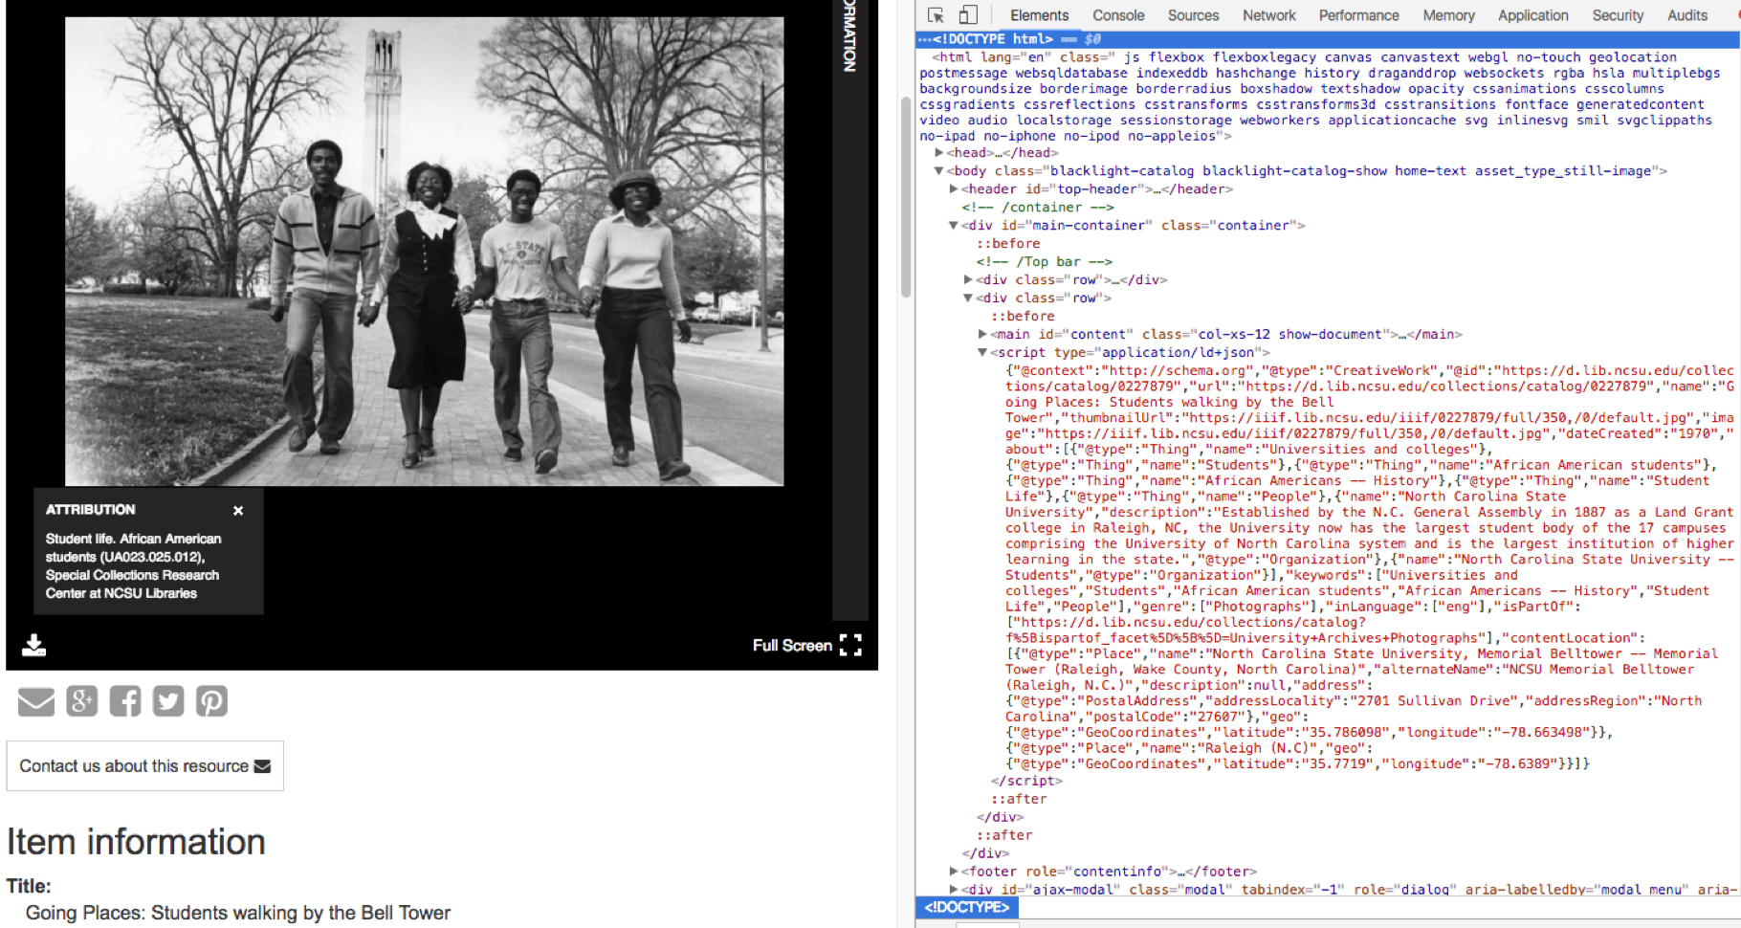
Image from https://d.lib.ncsu.edu/collections/catalog/0227879

Slide 35
Now to apply what we’ve learned

Slide 36
Activity Instructions
Download materials from GitHub
https://github.com/eightBitter/lita-schema-2017
Pick a recipe or event
Recipe: http://allrecipes.com
Event: http://www.eventbrite.com
Look up the schema.org type
Recipe: http://schema.org/Recipe
Event: http://schema.org/Event
Based on the recipe/event you selected, create basic JSON-LD using examples
Validate data and see the rich snippet it creates (use "code snippet"):
https://search.google.com/structured-data/testing-tool
Help:
https://developers.google.com/search/docs/data-types/recipes
https://developers.google.com/search/docs/data-types/events
Notes:
**half-way through** say: For an event make sure to have a nested location.
recipe should have cookeTime:duration or creator?
Don’t forget to show some examples using the Google Structured Data Testing Tool

Slide 37
What Now?

Slide 38

Publishing Workflow
Extract
Data from source
Transform
Data into schema.org + semantic markup
Load
Transformed data into HTML documents
Notes:
You *could* manually create the data, but the most common workflow for generating schema.org data is the following:
There are two main components to a batch conversion: a map to translate the metadata; a technical infrastructure for transforming the data. Good collaborative project for metadata and IT people

Slide 39
Questions?
Jacob Shelby
@jacob_shelby421
jtshelby@ncsu.edu

