Slide 1
The Effect of Backpack Loading on Kinematics, Kinetics, and GRF
Group: KAI-JEN, IAN, KEVIN

Slide 2
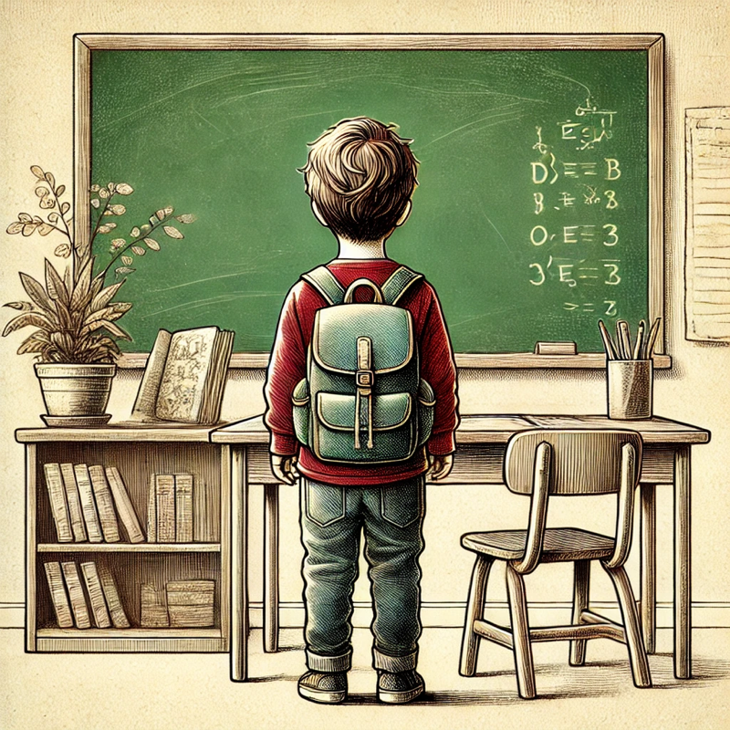
External Loading Effects
(1)
Head tilt
Shoulder pain
Cervical angle changes
(2)
(6)
(6)
Lumbar lordosis angle
changes
(1)
Back pain
(2)
Muscle soreness

Slide 3
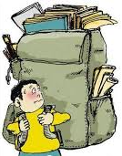
Introduction
- US children carry backpacks weighing 17% of their body weight (BW).
- Hong Kong children carry backpacks weighing 20% BW.
- Recommended: 10-15% BW for children aged 7-12 years.
(8)
(2)
(7)

Slide 4
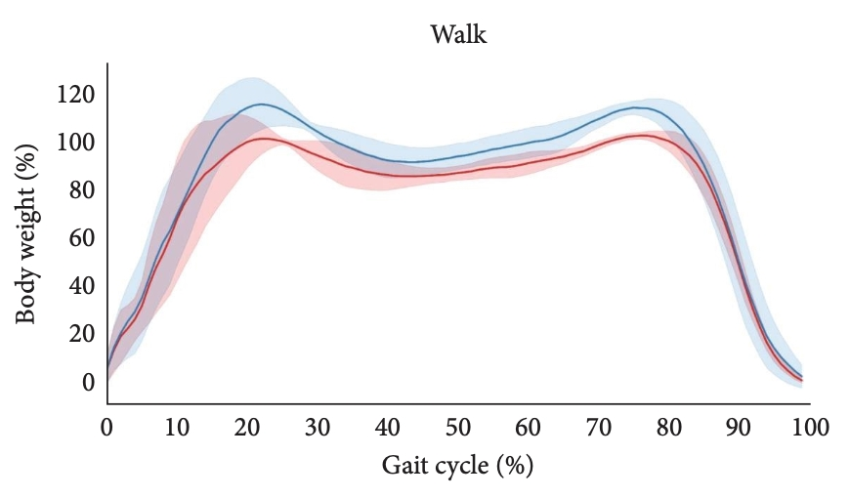
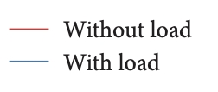
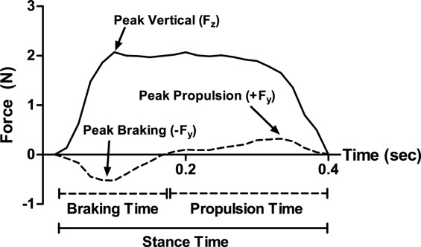
External Loading vs. GRF
- External loading increases GRF,
negatively impacting bones and joints.
- Over 10-15% BW:
- Higher vertical GRF
- Greater braking force
- Increased impact force
- Shorter time to peak
- Increased risk of lower extremity
injuries
(1, 10)

Slide 5
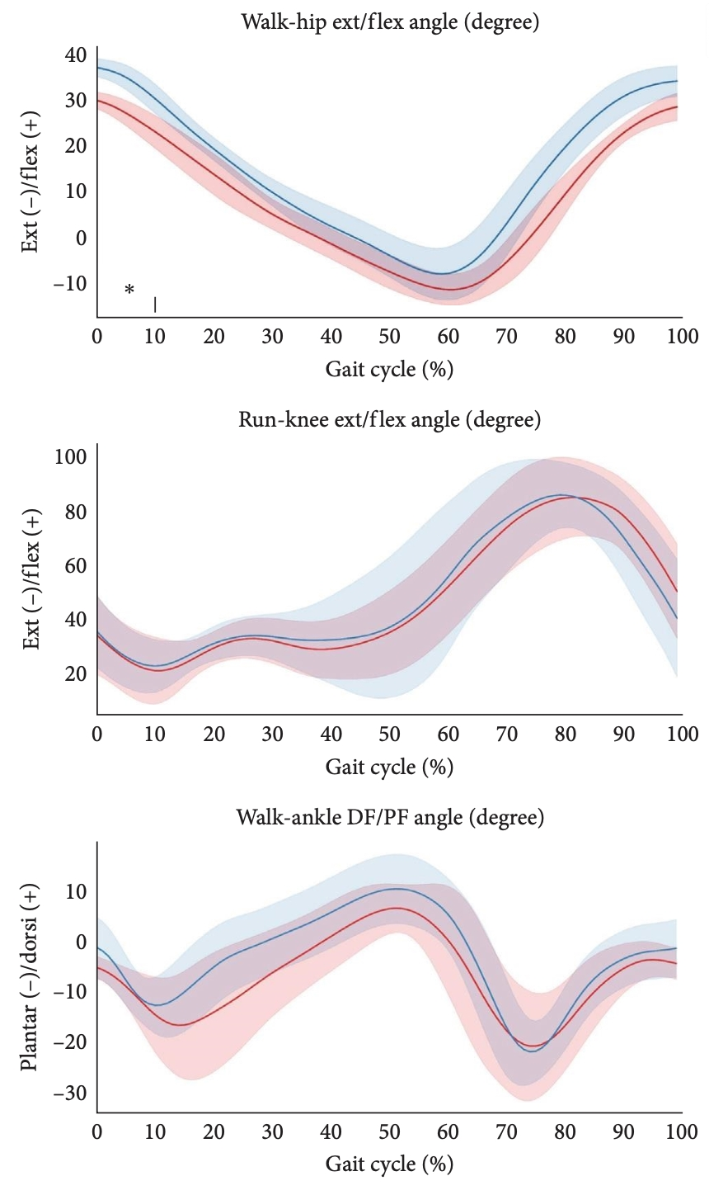
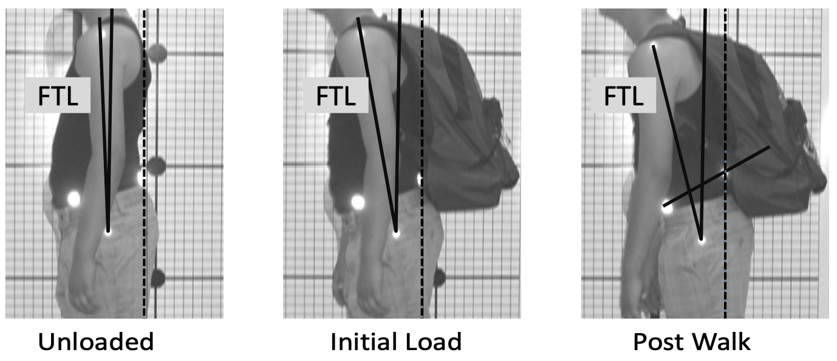
External Loading vs. Body Motion
- Backpack loading changes:
- Step length and support time increase
Neck tilt
Hip flexion / extension angle
Upper cross
- Over 10% - 15% BW:
- Alters lower limb kinematics in 7-year-olds
- Affects walking velocity, stride length, stance phase, and swing phase
(1, 5, 9)
(3)

Slide 6
purpose
Research Gap:
- Limited studies on the effect of backpack loading on ankle, pelvis, and
trunk kinetics.
- Limited studies on the effect of backpack loading in different
environments (upward slope / downward slope; diff texture of road), or
time
Purpose
1.Understand the effects of walking with a backpack on lower body kinetic in youth population.
2. Question: Does walking with a backpack that has 10% of one’s body weight for 10 minutes affect lower body kinetics in 7-10 year old ?
Hypothome
1. Walking with a backpack with 10% bodyweight for 10 minutes will increase hip, knee and ankle flexion/extension torque.

Slide 7


Method
100 Hz by a 8-camera optical motion capture system
(Theia 3D, Theia Markerless Inc., Kingston, ON )
1000 Hz by 2 force plates
(Bertec Corp.; Columbus, OH, USA )

Slide 8
Method
Protocol
Pre-test: 5 steps walking without wearing backpack with 3 trials
Post-test: 10 steps walking with wearing backpack (10 % BW)

Slide 9

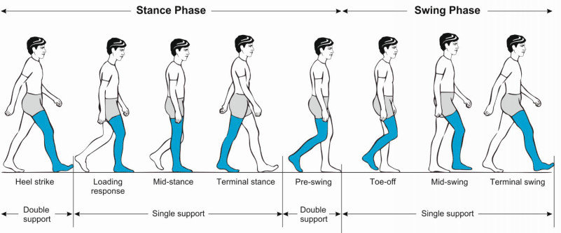
Method-Data processing
Filtering: 4th zero lag butterworth low pass filter
Cutoff frequency: 6Hz
Time normorlization : 0~100% (gait cycle)
Remable average: 3 step of pre/post test
(5)

Slide 10
Method-Data processing
The following variables were extracted from each step for statistical analysis:
Peak extension angular velocity of each joint ( in cm/s)
Time of peak extension angular velocity of each joint (time in % of gait cycle)
Peak flexion angular velocity of each joint (in cm/s)
Time of peak flexion angular velocity of each joint ( time in % of gait cycle)
Angular velocity of heel down of each joint (in cm/s)
Angular velocity of toe of each joint (in cm/s)
Stride length (in cm)
Stride time (in ms)

Slide 11
Results

Slide 12
Discussion

Slide 13
Conclusion

Slide 14
Reference
Barbosa, J. P., Marques, M. C., Neiva, H. P., Alonso-Martínez, A. M., Izquierdo, M., Alvarez, C., Marinho, D. A., Esteves, D., & Ramirez-Campillo, R. (2019). Effects of backpacks on ground reaction forces in children of different ages when walking, running, and jumping. International Journal of Environmental Research and Public Health, 16(24), 5154. https://doi.org/10.3390/ijerph16245154
Hong, Y., & Cheung, C. K. (2003). Gait and posture responses to backpack load during level walking in children. Gait & Posture, 17(1), 28–33. https://doi.org/10.1016/s0966-6362(02)00050-4
Kistner, F., Fiebert, I., Roach, K., & Moore, J. (2013). Postural compensations and subjective complaints due to backpack loads and wear time in schoolchildren. Pediatric Physical Therapy, 25(1), 15–24. https://doi.org/10.1097/PEP.0b013e31827ab2f7
Mirbagheri MM, Alibiglou L, Thajchayapong M, Rymer WZ: Muscle and reflex changes with varying joint angle in hemiparetic stroke. J Neuroeng Rehabil 2008, 27(5):6.
Neckel, N. D., Blonien, N., Nichols, D., & Hidler, J. (2008). Abnormal joint torque patterns exhibited by chronic stroke subjects while walking with a prescribed physiological gait pattern. Journal of NeuroEngineering and Rehabilitation, 5(1), 19. https://doi.org/10.1186/1743-0003-5-19
Rodríguez-Soto, A. E., Jaworski, R., Jensen, A., Niederberger, B., Hargens, A. R., Frank, L. R., Kelly, K. R., & Ward, S. R. (2013). Effect of load carriage on lumbar spine kinematics. Spine, 38(13), E783–E791.
Sander M. Weight of school bags in a Freibury elementary school: recommendations to parents and teachers. Offentliche Gesund- heitswesen 1979;41:251 /3.
Troussier B, Davoine P, De Gaudemaris R, et al. Back pain in school children a study among 1178 pupils. Scandinavian Journal of Rehabilitation Medicine 1994;26:143 /6.
Tomal, P., Fryzowicz, A., Skorupska, E., & Dworak, L. B. (2022). Influence of school backpack load as a variable affecting gait kinematics among seven-year-old children. International Journal of Environmental Research and Public Health, 19(7), 3843. https://doi.org/10.3390/ijerph19073843
Wang, H.-H., Tsai, W.-C., Chang, C.-Y., Hung, M.-H., Tu, J.-H., Wu, T., & Chen, C.-H. (2023). Effect of load carriage lifestyle on kinematics and kinetics of gait, Applied Bionics and Biomechanics, 2023(8022635). https://doi.org/10.1155/2023/8022635

