Slide 1
Play Browser
Title
Show Matching Plays
Show All Plays
Hero image credit

Slide 2
x
Logo
About
Favorites
Play Filters
List / Matches
Title
Title
Del
Title
Year
Title
Del
Hamlet
1970
❤
View
Year
Before
Much Ado
1979
❤
View
After
Genre
Winter’s Tale
2014
❤
View
Filter
Clear

Slide 3
Release date, revenue, runtime, tagline
IMDB link, TMDB link
Overview
Ratings (popularity, average, count)
Companies
- name, name, etc
Poster Image
Countries
- name, name, etc
Keywords
- name, name, etc
Genres
- name, name, etc
Title
Title
Del
Logo
About
Favorites
❤
Play Title
Details
Characters
Text
Synopsis
Likely date of composition,
Genre,
wiki link, gutenberg link, Shakespeare.org link
description
Close
❤

Slide 4
Add To Favorites
Release date, revenue, runtime, tagline
IMDB link, TMDB link
Overview
Ratings (popularity, average, count)
Companies
- name, name, etc
Poster Image
Countries
- name, name, etc
Keywords
- name, name, etc
Genres
- name, name, etc
Title
Title
Del
Logo
About
Favorites
❤
Play Title
Details
Characters
Text
Synopsis
Character
Name
Character
Name
Character
Name
Close
❤

Slide 5
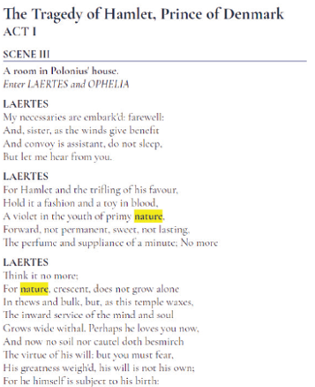
Logo
About
❤
Play Title
Details
Characters
Text
ACT I
SCENE III
LAERTES
nature
Close
❤

