Slide 1
1/2 Mile Deployment Simulation
Chris Eigner

Slide 2
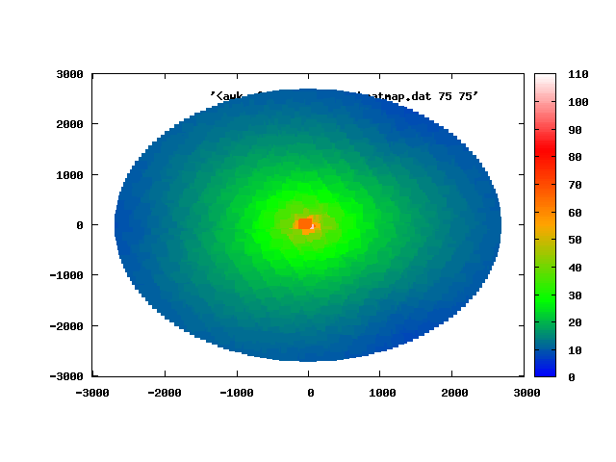
Heatmaps
40dB
30dB
Notes:
Basically Identical
* simulator sensitive enough?

Slide 3
Charts

Slide 4
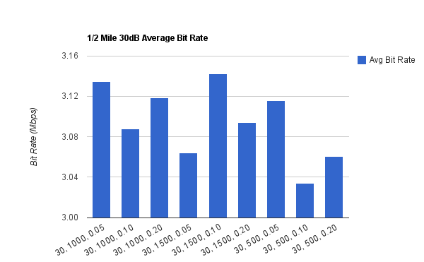
30dB Bit Rate

Slide 5
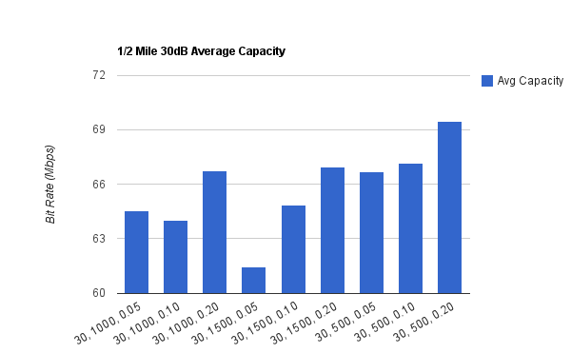
30dB Capacity

Slide 6
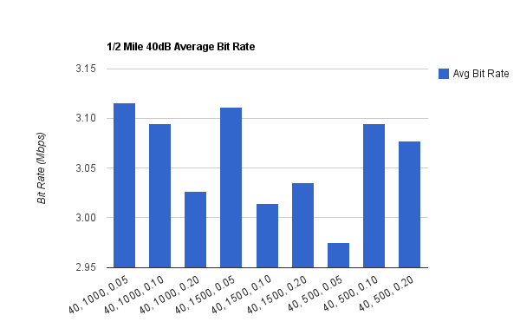
40dB Bit Rate

Slide 7
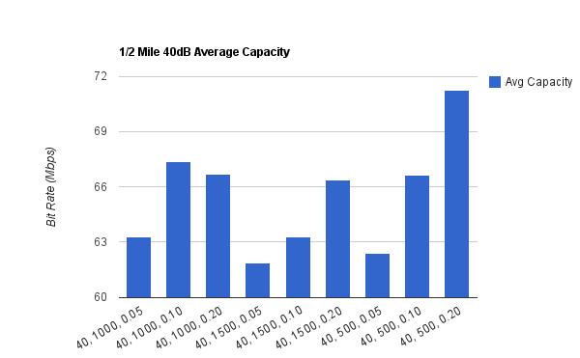
40dB Capacity

Slide 8
Comparisons

Slide 9
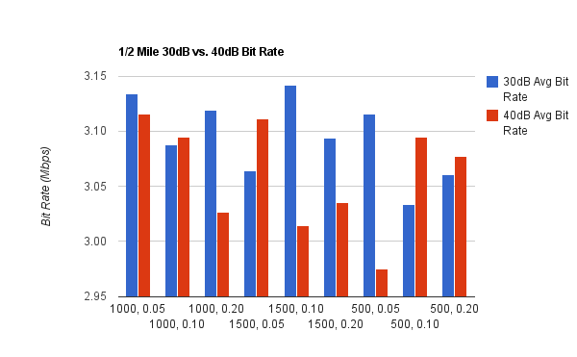
30dB vs. 40dB Bit Rate

Slide 10
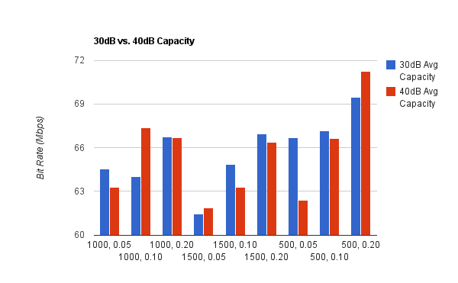
30dB vs. 40dB Capacity

Slide 11
1/2 Mile Deployment Recommendation
  Power: 40dB
  Block Size: 500 bytes
  Target BLER: 20%

Slide 12
Justification
  Greatest capacity (~71 Mbps)
    build user base
  Middle-of-the-road throughput (~3.075 Mbps)
    no one complains about average performance

Slide 13
Concerns
  Simulator sensitivity
    data is a bit noisy to make clear decision
  Decision ultimately arbitrary without more info
    demograph?
    private government network?
    civilian?
    growth projections?
    customer signup rate?
    how strict is the budget?

