Slide 1

eigr.io – Spawn Actor Mesh Serverless Platform
General Presentation Adriano Santos, November 2th 2022

Slide 2

Agenda
eigr.io – A Serverless Runtime on the BEAM
Spawn Actor Mesh Serverless Platform
A Serverless Runtime on the BEAM based on Actor Model
Anatomy of an Actor
Actor Model Features
Additional Spawn Actors Functionality
State
Inversion of State
Statestores
Spawn Actor Mesh Platform - 2022

Slide 3
Spawn Actor Mesh Serverless Platform
eigr.io – A Serverless Runtime on the BEAM
Serverless Runtime based on Kubernetes
that enables General Purpose Applications to be built
Open Source Project
Based on a Protocol
with contract-first design of services approach
Polyglot SDKs
Spawn Actor Mesh Platform - 2022

Slide 4
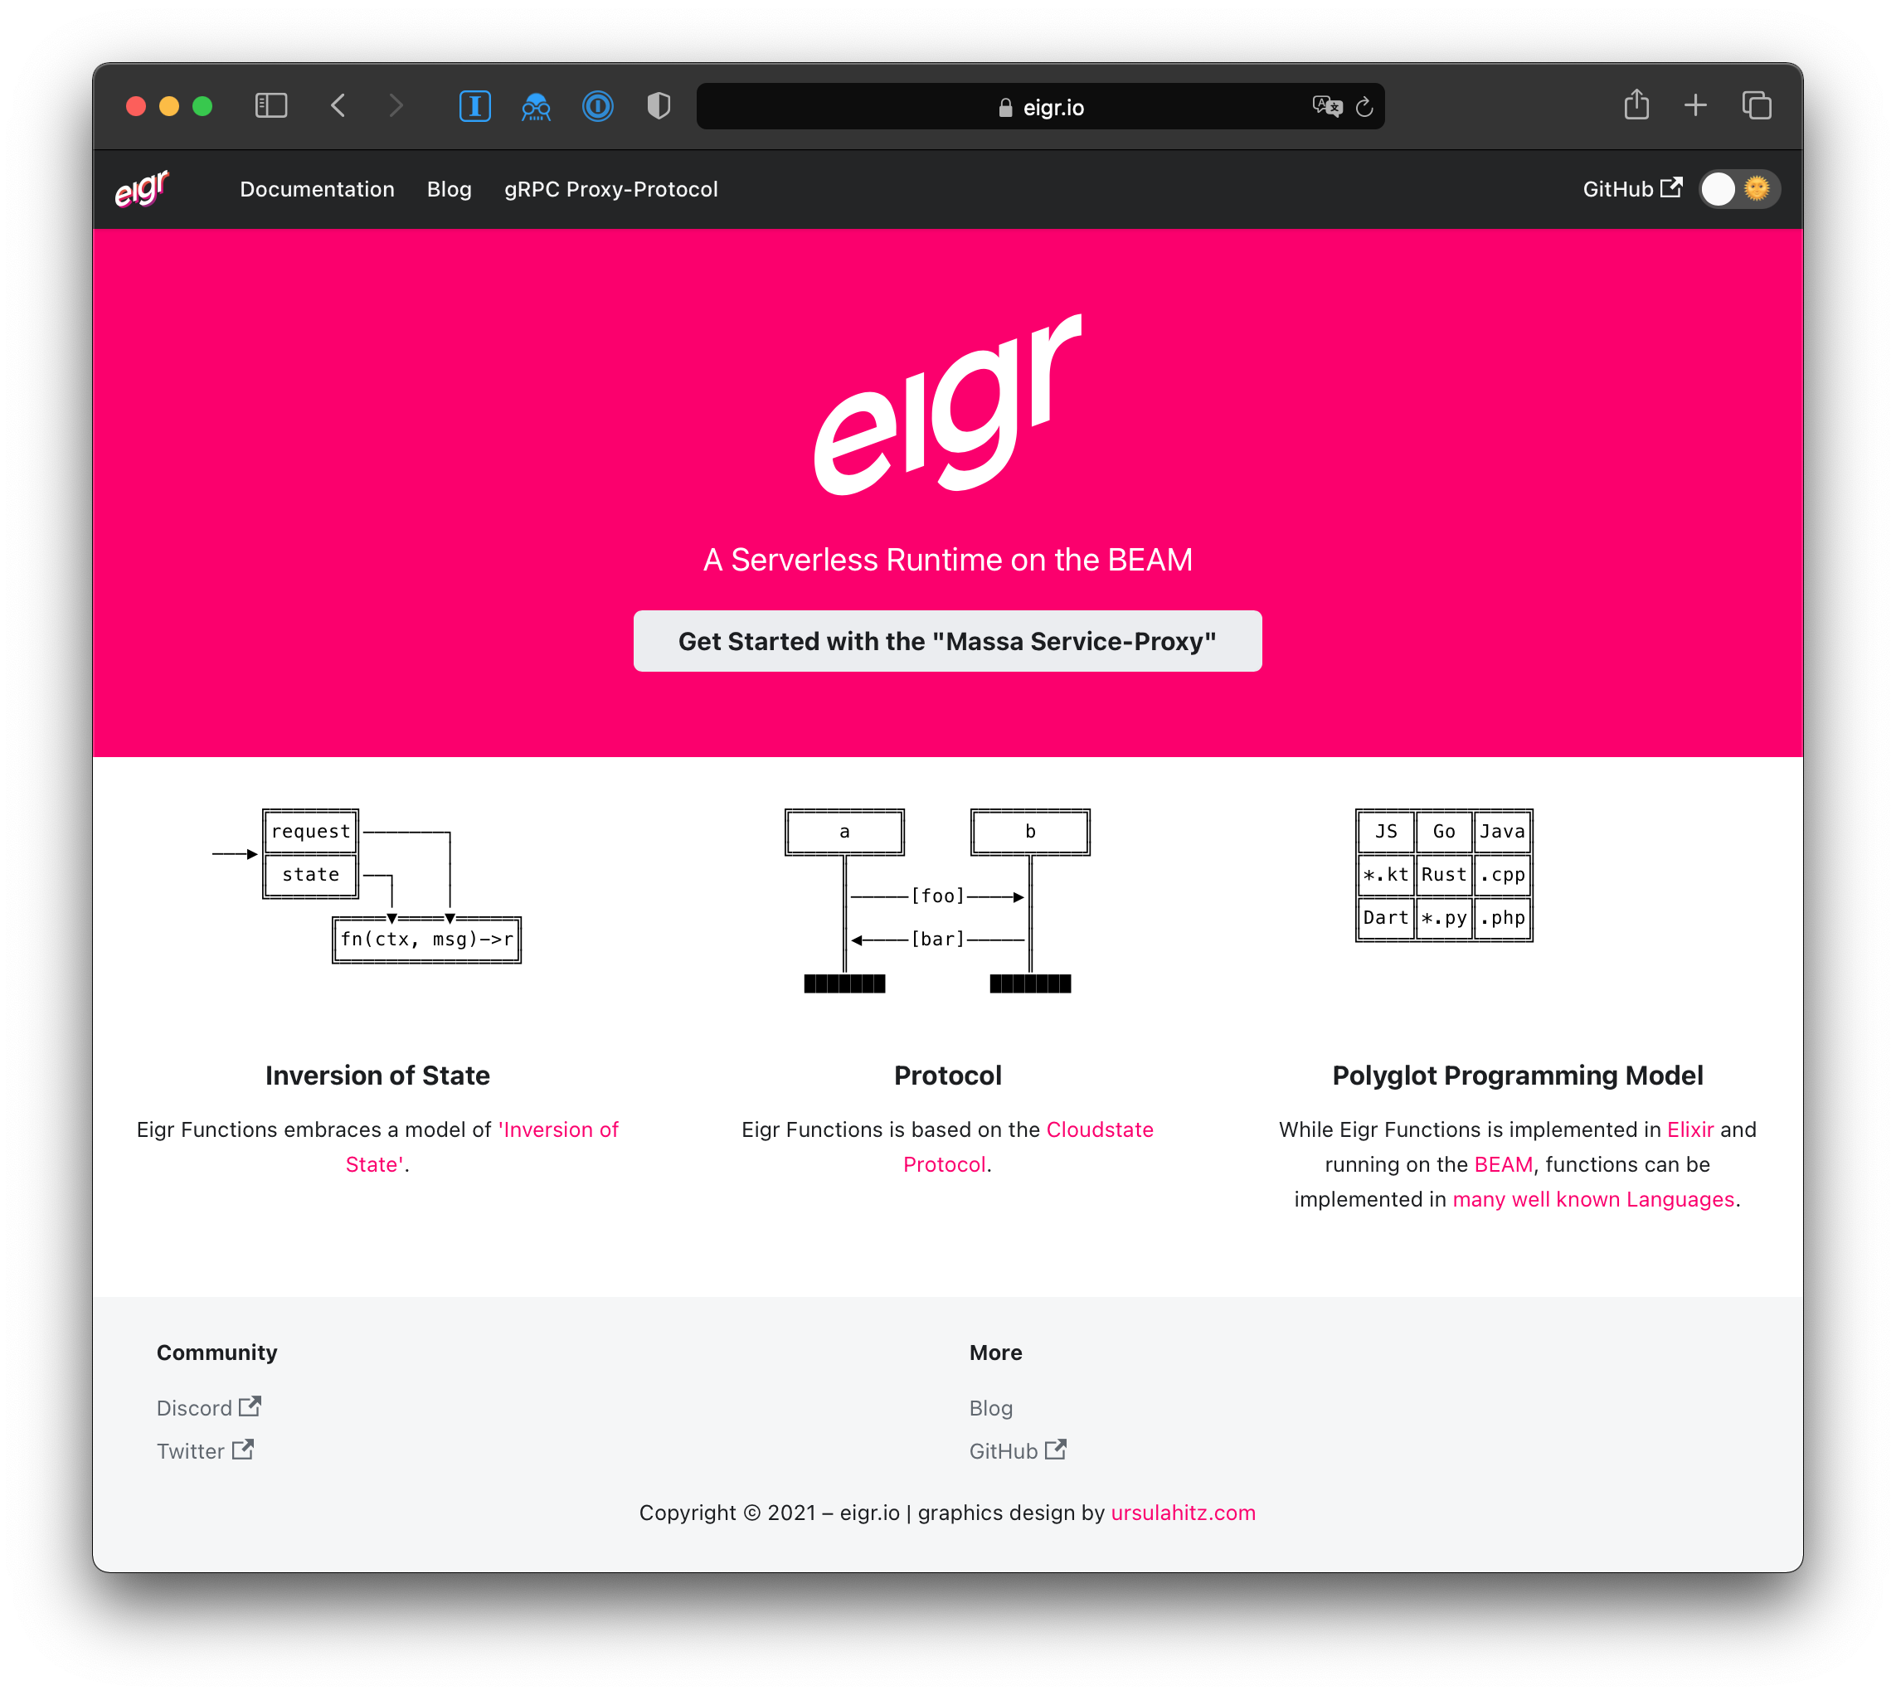
Highlights
eigr.io – A Serverless Runtime on the BEAM
A Service Proxy
with managed State
Cloud Native deployment (k8s)
A Protocol
Http+Protobuf based, with a specification
Polyglot Programming Model
SDKs in JavaScript, Java, Elixir, Go, C#, Rust, …
… and it runs on the BEAM :)
Spawn Actor Mesh Platform - 2022

Slide 5
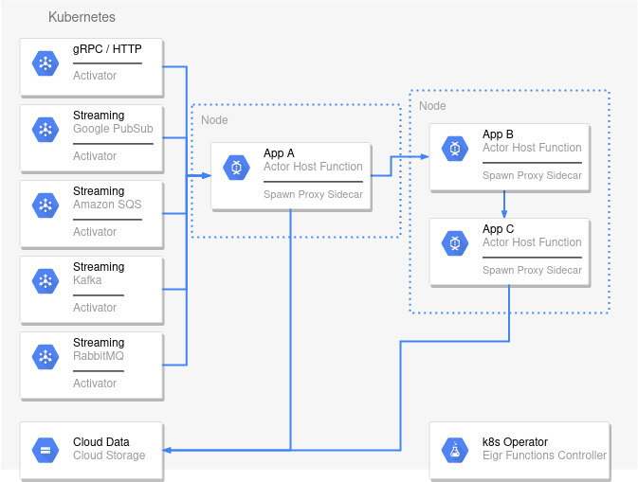
Architecture
eigr.io – A Serverless Runtime on the BEAM
A Kubernetes Cluster to Serving Nodes, Networks, Security, Discovery and Infra in general.
A Operator to manage Deploys and Configuration.
A Host Function to handle domain logic.
A Proxy to managed State and Workflows.
A BEAM VM to provide Distributed, Fault Tolerant Actors.
Activators to trigger Actions on Actors.
Spawn Actor Mesh Platform - 2022

Slide 6
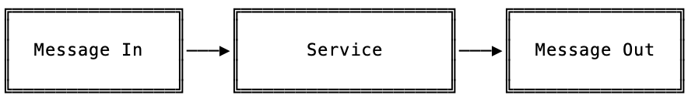
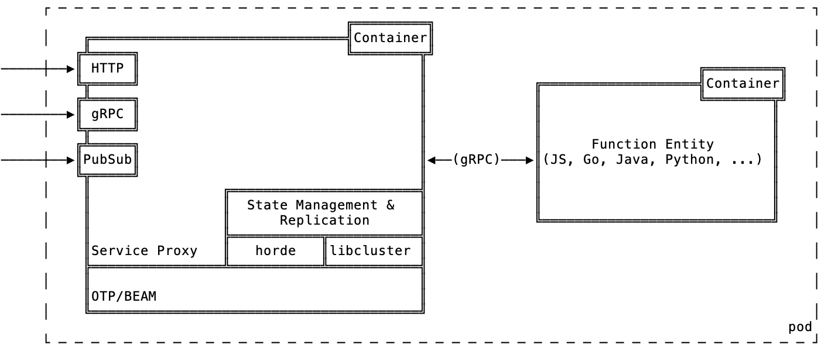
Sidecar Service Proxy
eigr.io – A Serverless Runtime on the BEAM
“Message IN, Message OUT”
eigr/spawn
Implemented in Elixir
Kubernetes Operator
With simple CRD´s to deploy apps
Spawn Actor Mesh Platform - 2022

Slide 7
Anatomy of an Actor
eigr.io – A Serverless Runtime on the BEAM
In
Spawn Actor
Mailbox
Via host functions
Domain Logic
Out
State
Statestore
Spawn Actor Mesh Platform - 2022

Slide 8
Anatomy of an Actor
eigr.io – A Serverless Runtime on the BEAM
Actors communicate with each other by sending asynchronous messages. Those messages are stored in other actors' mailboxes until they're processed. When an actor receives a message, it can do one of these 3 things:
Create more actors.
Send messages to other actors.
Designate what to do with the next message.
Spawn still allows the actor to do:
Emit side effects of your computation to other actors.
Forward an incoming message directly to another actor.
Create Pipes by forwarding your processing response as an input message to other Actors.
Broadcast events to a channel.
Manage your own state persistently and optimally saving IO, Disk and Database Processing resources.
Tracing of requests.
Metrics.
In
Spawn Actor
Mailbox
Domain Logic
Out
State
Statestore
Spawn Actor Mesh Platform - 2022

Slide 9
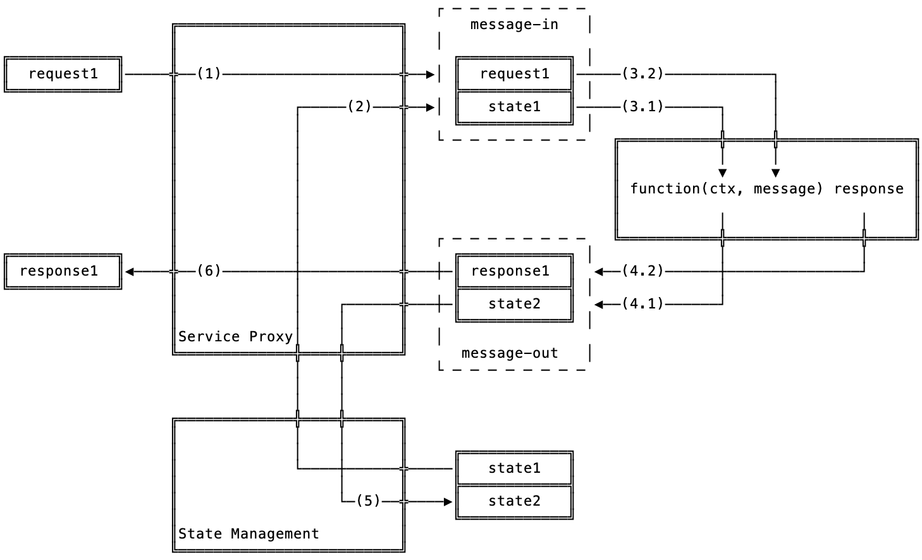
Inversion of State
eigr.io – A Serverless Runtime on the BEAM
FaaS is usually stateless
State is brought to the function.
Simple Reproducible State Model
Fast key lookup
Binary and encrypted data
Fast memory reads without network IO
Write only when necessary based on snapshots
Support for multiple databases (MySql, Postgres, CockroachDB, MSSQL, Sqlite, ElectricSql)
Spawn Actor Mesh Platform - 2022

Slide 10

Statestores
eigr.io – A Serverless Runtime on the BEAM
Spawn ensures that actor state will be saved in centralized persistent storage.
An actor's state will always be sealed with a cryptographic key.
Spawn uses key-value semantics
The Actor Id/name is the storage key.
The data is saved in binary format and its format must be previously defined via *.proto files by the user.
Uses time-configured and asynchronous snapshots for actor state replication with persistent storage. Synchronously during the deactivation or shutdown phase of the actor.
Spawn Actor Mesh Platform - 2022

Slide 11
A Protocol to use
eigr.io – A Serverless Runtime on the BEAM
Eigr Spawn Protocol
Abstracts State
model your State and your Events through *.proto files in a contract-first approach
Http + Protobuf based
Protocol spec defined in *.proto (protocol buffer)
Spawn Actor Mesh Platform - 2022

Slide 12
Polyglot Programming Model
eigr.io – A Serverless Runtime on the BEAM
SDK support for all HTTP enabled languages possible
Protobuf compiler available
JavaScript, Java and Elixir in the Beginning
Go, Python, C#, Rust, in Development
Note: Elixir SDK does not need a sidecar to operate. Any Elixir application can act as a sidecar and host function
Spawn Actor Mesh Platform - 2022

Slide 13
Current State & Challenges
eigr.io – A Serverless Runtime on the BEAM
Service Proxy in Elixir (eigr/spawn) ☑️
with support for Workflows:
Broadcast
Channels
Forwards
Pipes
Side Effects
Kubernetes Operator ☑️
Next Challenges
New Workflows
Saga, Aggregators, Splitters, etc…
Enhance and Improve SDKs
Focus on Elixir, JS, Java, Go and Python
Add Activators to trigger Actors
RabbitMQ, Kafka, gRPC, Http, and others…
Integration with ElectricSql to enable distributed persistence and edge computing.
Spawn Actor Mesh Platform - 2022

Slide 14
Thanks!
eigr.io
github.com/eigr
@eigr_io
❤️ 🙌 thanks to all contributors and supporters: Marcel Lanz, Adriano Santos, Elias Dal Ben Arruda, Guy Youansi, Weslei Juan Moser Pereira, Alain-Michel Chomnoue Nghemning, GratefulTony, Jonathan Nagy, Peter Vlugter, Ursula Hitz, Vladimir Korenev, Viktor Klang, Simon Thörnqvist, Cloudstate.io and many more…
Spawn Actor Mesh Platform - 2022 Adriano Santos, November 2th 2022

