Slide 1
IL2225 Project Presentation
SiLagoNN: From RTL Verification To Hierarchical Physical Synthesis
A full design flow covering RTL simulation, logic synthesis, physical synthesis, floorplanning, partitioning, and hierarchical implementation.
Results and scripts consolidated into one coherent presentation flow
April 9, 2026

Slide 2
Task Dependencies And Data Handoff
Flow
Each stage produces the input used by the next stage, forming one continuous implementation flow.
Task 1
RTL sim
Task 2
Flat synth
Task 3
Bottom-up synth
Task 4
Flat PnR
Task 5
Floorplan
Task 6
Hier PnR
Logical progression
Key inputs and outputs
Physical-flow transition
Task 1 validates functionality at RTL level.
Task 2 produces a flat synthesized netlist.
Task 3 produces a hierarchical synthesis handoff.
Task 4 to Task 6 move into physical implementation.
RTL hierarchy and testbench drive Task 1.
SDC constraints and DC scripts drive Task 2 and Task 3.
Synthesized netlists feed the Innovus physical flow.
Task 4 implements the full design flat.
Task 5 defines the floorplan and partitions.
Task 6 implements partitions first, then assembles the top level.
IL2225 project presentation | SiLagoNN implementation flow
3

Slide 3
Task 1: Simulation Scripts
Task 1
The simulation flow creates libraries, compiles the hierarchy and testbench, then runs vsim with the key waveforms enabled.
compile.do
simulate.do
if {[file exists work]} { vdel -lib work -all } vlib work vmap work work vcom -work dware -2008 DW/DWpackages.vhd ... set fp [open "silagonn_hierarchy.txt" r] while {[gets $fp line] >= 0} { vcom -work work -2008 $line } vcom -work work -2008 ../tb/vec_add/testbench.vhd
vsim -suppress 1549 -voptargs=+acc work.testbench set DPU_PATH {.../MTRF_cell/dpu_gen} add wave /testbench/clk add wave /testbench/rst_n add wave -radix decimal $DPU_PATH/dpu_out_0 add wave -radix decimal $DPU_PATH/dpu_out_1 add wave -radix decimal $DPU_PATH/dpu_in_0 run -all
Source: main/rtl/compile.do
Source: main/rtl/simulate.do
Simulation flow
compile.do builds the libraries and RTL hierarchy, while simulate.do launches the testbench and adds the waveform signals used for debug and result inspection.
IL2225 project presentation | SiLagoNN implementation flow
5
Notes:
The main flow is: compile.do reads silagonn_hierarchy.txt and compiles the full RTL hierarchy plus the testbench, then simulate.do launches work.testbench and adds the key waveform signals. In the testbench, reset is asserted first, then deasserted, memory and instructions are loaded, and the instruction sequence from instruction.bin configures the data path for the target operation. After that, the DPU in tile <0,0> begins to operate.

Slide 4
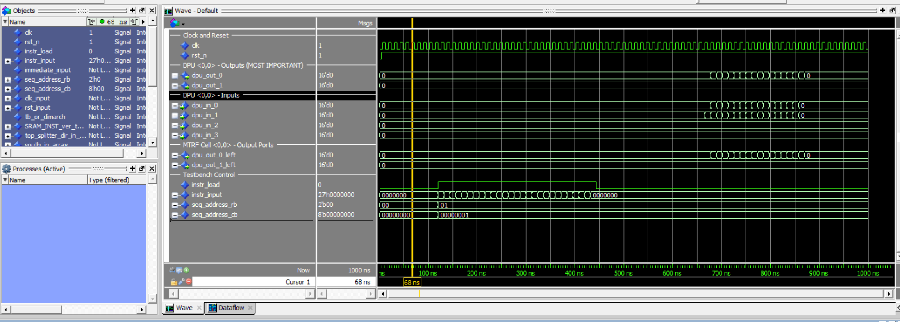
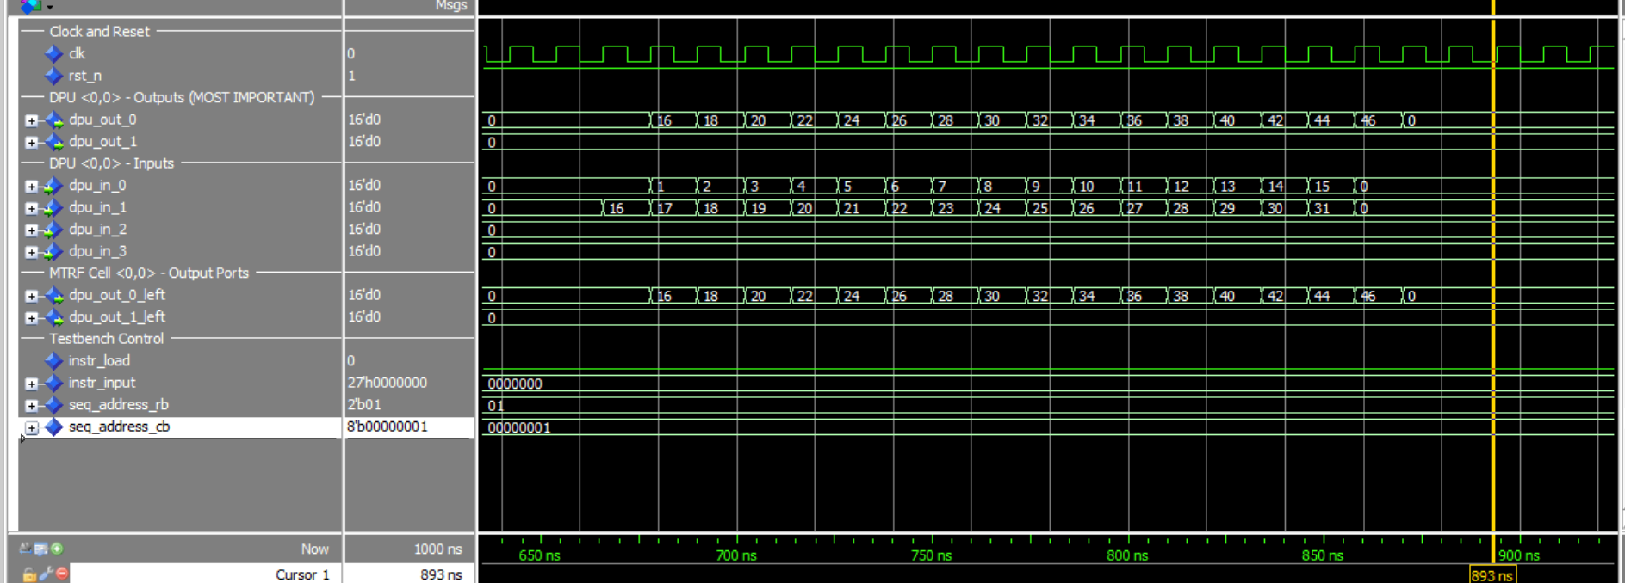
Task 1: RTL Simulation Confirms Functional Behavior
Task 1
Before synthesis, we verify that the testbench, instruction loading, and DPU outputs behave as expected.
Waveform view with reset, instruction load, and DPU signal groups
Decimal DPU outputs show the expected vector-add style data movement
Functional verification result
Task 1 establishes functional correctness before implementation: compile the RTL hierarchy, run the testbench, and inspect control signals together with DPU inputs and outputs in the waveform window.
IL2225 project presentation | SiLagoNN implementation flow
4
Notes:
The key waveform evidence is the DPU input-output relation. In the execution phase, dpu_in_0 shows values from 0 to 15 and dpu_in_1 shows values from 16 to 31. The observed dpu_out_0 values are 16, 18, 20, up to 46, which matches the expected addition result dpu_in_0 + dpu_in_1. This shows that the instruction loading and data-path configuration work correctly and that the DPU performs the intended ADD function in this testbench

Slide 5
Task 2: Flat Logic Synthesis Flow
Task 2
One top-level DC run reads the whole RTL hierarchy, applies one clock constraint, compiles the full design, and writes reports plus a netlist.
Flow steps
dc_flat.tcl
Load synopsys_dc.setup and the technology libraries.
Read the RTL hierarchy from drra_wrapper_hierarchy.txt.
Elaborate and link the top-level design drra_wrapper.
Apply SDC timing constraints and set the clock period.
Compile the whole design flat, then report area, power, and timing.
source ../syn/synopsys_dc.setup set TOP_NAME drra_wrapper set hierarchy_file "../rtl/${TOP_NAME}_hierarchy.txt" set hierarchy_files [split [read [open $hierarchy_file r]] "\n"] foreach filename [lrange $hierarchy_files 0 end-1] { if {[string trim $filename] ne ""} { analyze -format VHDL -lib WORK "../rtl/${filename}" } } elaborate $TOP_NAME ; link ; current_design $TOP_NAME ; uniquify source ../syn/constraints.sdc create_clock -name clk -period $CLOCK_PERIOD_PS $clk_ports compile -map_effort medium report_area > ... ; report_timing > ... ; report_power > ... write -format ddc ... ; write -format verilog ... ; write_sdc ...
Source: main/syn/scr/dc_flat.tcl
Main takeaway
Flat synthesis gives the tool complete visibility of the whole design. That often improves global optimization, but the run is heavier and less modular than bottom-up synthesis.
IL2225 project presentation | SiLagoNN implementation flow
6
Notes:
Task 2 performs flat logic synthesis of DRRA_wrapper in Design Compiler. Its purpose is to convert the RTL design into a synthesized gate-level implementation under a given timing constraint, and to prepare the design for later physical implementation.
The main script is syn/scr/dc_flat.tcl. It first loads syn/synopsys_dc.setup, which provides the synthesis library environment, including the technology library, search path, and link settings. Then it reads the RTL file list from rtl/drra_wrapper_hierarchy.txt, so the whole DRRA_wrapper design is synthesized as one complete top-level block.
After reading the RTL hierarchy, the script elaborates and links the top-level design drra_wrapper, applies the timing constraints from syn/constraints.sdc, and sets the target clock period for the current run. It then runs compile, which maps the RTL into standard cells from the selected library.
After synthesis, the script writes out the main reports, including timing, area, and power. It also exports the synthesized design files into syn/db, including the .ddc database, the synthesized .v gate-level netlist, and the exported .sdc constraints file. These outputs are the handoff files for later tasks.
The repository also includes helper launcher scripts such as run_task2_flat.sh, run_task2_flat_sweep.sh, and run_synthesis.sh, which make it easier to rerun the same flat synthesis flow under different clock periods. So the overall Task 2 flow is: load the library setup, read the RTL hierarchy, apply constraints, synthesize the full top-level design flat, and generate reports and handoff files.

Slide 6
Task 2: Flat Synthesis PPA Summary
Task 2
As the clock target tightens, the flat flow shows higher power and area together with a shrinking timing margin.
Clock Period (ns) | Total Power (mW) | Total Cell Area (um^2) | Slack (ps)
20 | 10.4133 | 358652 | 20.10
10 | 20.6254 | 359511 | 37.47
8 | 25.9535 | 365373 | 3.23
6 | 34.4214 | 389591 | 0.10
Clock-scaling trend
As the period becomes smaller, the design is pushed harder. Power and area rise, while slack shrinks toward zero.
Tightest summarized point
In this summary table, 6 ns is the most aggressive flat operating point that still remains slightly positive.
IL2225 project presentation | SiLagoNN implementation flow
7
Notes:
tighter clock targets increase implementation cost. Power and area go up, while timing margin shrinks. This is exactly the expected trade-off in flat synthesis, because the tool must use stronger and more timing-driven optimizations as the clock requirement becomes more demanding.

Slide 7
Task 3: Bottom-Up Logic Synthesis Flow
Task 3
Bottom-up synthesis compiles sub-designs independently, then reuses those characterized blocks when synthesizing the top level.
Why bottom-up
dc_bottomup.tcl
Reduce runtime and memory by compiling smaller modules first.
Preserve hierarchy so the design is easier to partition later.
Generate characterized sub-blocks that can be reused at top level.
Prepare a more natural handoff for hierarchical physical synthesis.
source ../syn/synopsys_dc.setup proc apply_project_constraints {syn_dir clock_period_ps} { source ${syn_dir}/constraints.sdc ; create_clock -name clk -period $clock_period_ps ... } set TOP_NAME drra_wrapper # compile shared lower blocks first analyze -format vhdl -lib WORK "../rtl/mtrf/DPU/divider_pipe.vhd" elaborate divider_pipe ; link ; apply_project_constraints ${SYN_DIR} ${CLOCK_PERIOD_PS} ; compile set hierarchy_files [split [read [open ../rtl/silego_hierarchy.txt r]] "\n"] foreach filename [lrange $hierarchy_files 0 end-1] { if {$filename != ""} { analyze -format vhdl -lib WORK "../rtl/${filename}" } } elaborate silego ; dont_touch divider_pipe true ; compile foreach tile {Silago_top Silago_bot ...} { analyze/elaborate/link/apply_constraints/compile } analyze -format vhdl -lib WORK "../rtl/mtrf/drra_wrapper.vhd" elaborate drra_wrapper ; dont_touch {divider_pipe silego ...} true ; compile write_file -format ddc ... ; write_file -format verilog ... ; write_sdc ... ; write_sdf ...
Source: main/syn/scr/dc_bottomup.tcl
Hierarchical relevance
This logic-synthesis flow preserves the hierarchy that is later reused in Task 5 floorplanning and Task 6 hierarchical physical implementation.
IL2225 project presentation | SiLagoNN implementation flow
8
Notes:
The main script is syn/scr/dc_bottomup.tcl. It first loads syn/synopsys_dc.setup to set up the synthesis libraries and environment. Then it defines the top design, the clock period, and the output directories for reports and synthesized files.
The flow starts by reading the package hierarchy files, because these provide shared type and constant definitions for the design. After that, it synthesizes key lower-level modules first, especially divider_pipe, and then synthesizes the shared core module silego. The script applies timing constraints during these steps and uses dont_touch to preserve already synthesized blocks so they are not re-optimized unnecessarily in later stages.
After the lower-level modules are synthesized, the script continues with the tile-level wrapper modules, such as Silago_top, Silago_bot, and the corner blocks. Only after these lower-level and intermediate modules are prepared does the script synthesize the top-level design drra_wrapper.
The script is also iterative. It defines a pass-based procedure and runs two synthesis passes. In the first pass, it synthesizes the important blocks and generates constraint information for reuse. It then uses characterize and writes intermediate constraint scripts, so that the second pass can reuse this information and better support the bottom-up flow.

Slide 8
Task 3: Bottom-Up Synthesis PPA Summary
Task 3
This bottom-up summary captures the same clock-scaling trend while preserving the hierarchy-oriented synthesis story.
Clock Period (ns) | Total Power (mW) | Total Cell Area (um^2) | Slack (ps)
20 | 10.4048 | 363814 | 9.22
10 | 20.6061 | 364621 | 8.61
8 | 26.8799 | 392192 | 0.12
6 | 35.3253 | 394994 | -209.41
Timing behavior
The slack trend remains the clearest result: 20 ns and 10 ns are safe, 8 ns is near the limit, and 6 ns violates timing.
PPA interpretation
Bottom-up preserves hierarchy but usually gives slightly weaker global PPA than flat synthesis because cross-boundary optimization is more limited.
IL2225 project presentation | SiLagoNN implementation flow
9
Notes:
Compared with flat synthesis, bottom-up synthesis preserves hierarchy but usually gives slightly weaker global PPA. The reason is that bottom-up synthesis first optimizes important submodules and then reuses them at the top level, so cross-boundary optimization is more limited than in a fully flat flow. In other words, bottom-up trades some global optimization for hierarchy preservation and later physical-design convenience.
6 ns violates timing, the answer is that the clock target is too aggressive for this bottom-up flow. As the required period becomes too small, the available timing margin disappears, and the design can no longer meet the constraint. If asked why bottom-up differs from flat synthesis

Slide 9
Flat Vs Bottom-Up Synthesis Comparison
Compare
The trade-off is mainly between global optimization and hierarchy preservation.
Flat synthesis
Bottom-up synthesis
Practical conclusion
Best global visibility. Usually smaller area and cleaner cross-boundary optimization. Good if runtime and memory are acceptable.
Better hierarchy preservation. Easier to reuse blocks and more suitable for later hierarchical implementation.
Task 3 is not just another synthesis experiment. It is the logical setup step for Task 5 and Task 6.
Observed trade-offs
Implementation implications
Flat sees the whole design and often wins area.
Bottom-up sacrifices some global optimization for modularity.
The tighter the clock, the more the difference matters.
Flat is well suited to top-level optimization.
Bottom-up is well suited to hierarchy preservation and block reuse.
The preferred flow depends on the implementation stage that follows.
IL2225 project presentation | SiLagoNN implementation flow
10

Slide 10
Task 4: Flat Physical Synthesis Flow
Task 4
Now we move from logic-only estimation to a layout-aware implementation flow: floorplan, placement, CTS, routing, and post-route impact.
Flow steps
Why this task matters
Initialize the Innovus environment and read the synthesized design.
Create the floorplan and power plan.
Place the standard cells.
Build the clock tree with CTS / ccopt.
Route the design and save the physical database.
Logic synthesis does not see real interconnect RC or clock-tree overhead. Task 4 reveals what the design looks like after physical effects are introduced.
Core scripts
run_flat_pnr.sh -> pnr_flat.tcl -> global_variables.tcl(netlist,sdc,lef,mmmc), read_design.tcl
Short explanation
In flat PnR, the full design is implemented as one big block. This is the physical counterpart of Task 2.
IL2225 project presentation | SiLagoNN implementation flow
11
Notes:
The main scripts are run_flat_pnr.sh, pnr_flat.tcl, global_variables.tcl, and read_design.tcl. The wrapper script run_flat_pnr.sh launches the flat physical flow. The main implementation script pnr_flat.tcl controls the actual physical-design steps. global_variables.tcl defines the input netlist, the LEF files, the MMMC file, the SDC constraints, and the output directories. read_design.tcl then reads the MMMC setup, the physical library data, and the synthesized netlist into Innovus and initializes the design.

Slide 11
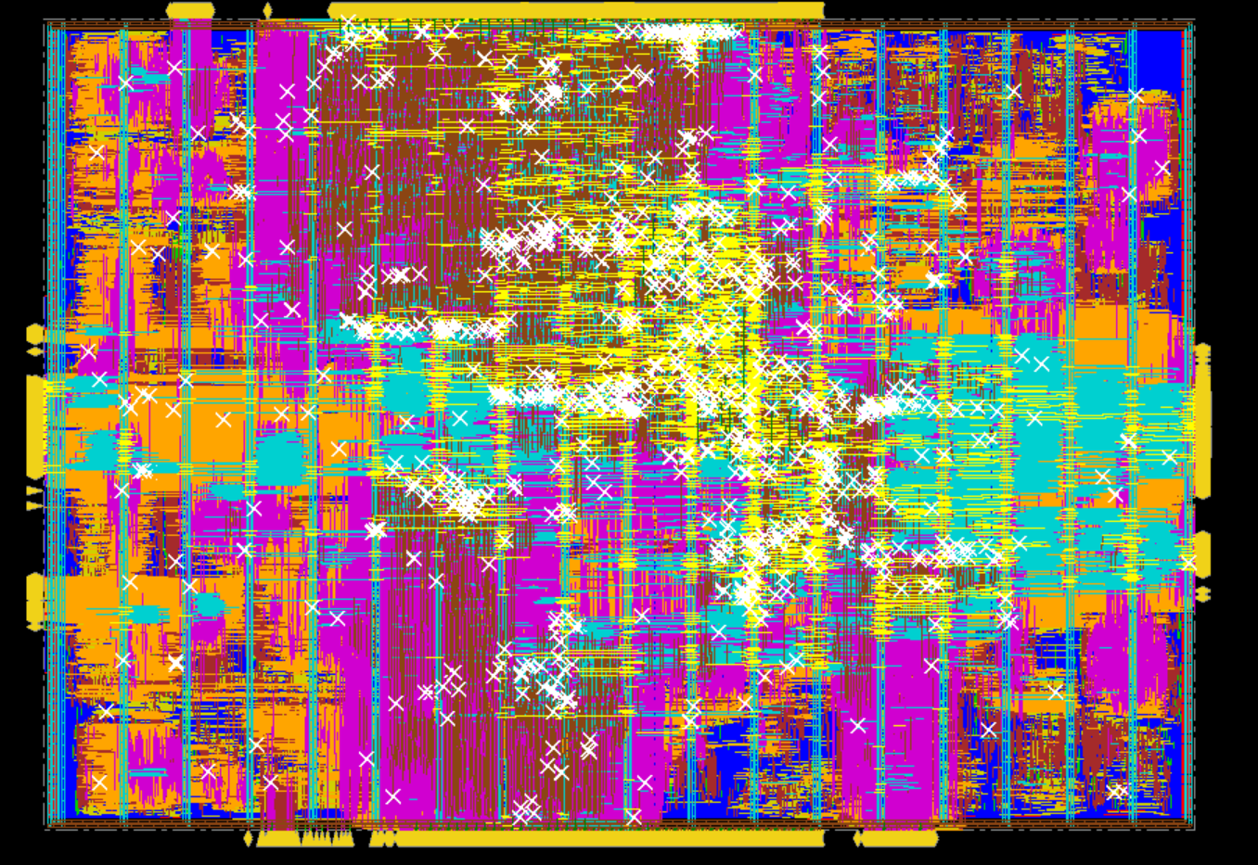
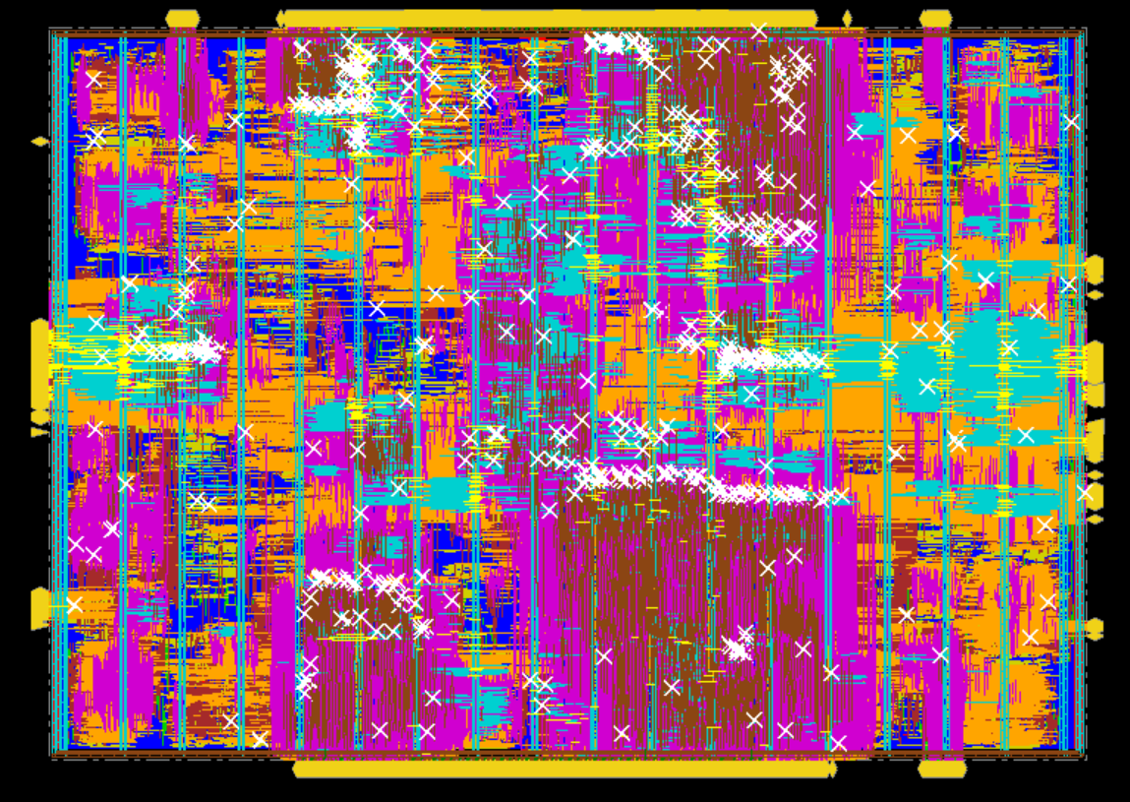
Task 4: Flat Physical Synthesis Result
Task 4
Using the 20 ns bottom-up logic-synthesis handoff, the physical flow shows the PPA cost of real layout effects.
Reasons
Real interconnect RC, clock tree insertion, buffering, and congestion-aware optimization are introduced.
Original Task 4 comparison view A
Original Task 4 comparison view B
PPA Results before/after Physical Synthesis (20ns)
Stage | Total Power (mW) | Total Cell Area (um^2) | Slack (ps)
Logic Synthesis | 10.4048 | 363814 | 29.24
Physical Synthesis | 80.4640 | 381986 | -280.85
Observation
After physical synthesis, power and area increase and timing degrades.
IL2225 project presentation | SiLagoNN implementation flow
12
Notes:
Physical synthesis considers real interconnect RC, clock-tree insertion, buffering, and congestion-aware optimization. It also uses the real physical design setup, including LEF data and MMMC timing analysis. Because of these physical effects, the total power increases significantly compared with logic synthesis, and the total cell area also increases. At the same time, the slack becomes negative, which means timing violations occur in physical synthesis, while the logic-synthesis result may still look timing-clean

Slide 12
Task 5: Floorplanning Prepares The Hierarchical Flow
Task 5
Task 5 is the bridge between bottom-up synthesis and hierarchical physical synthesis.
What Task 5 does
floorplan + partition
Create the top floorplan for the 8x2 tile array.
Assign each tile instance to its own physical fence.
Create physical partitions and pin constraints.
Generate timing budgets so the sub-blocks can be implemented separately.
create_floorplan -site SC8T_104CPP_CMOS22FDX \ -core_size [expr {8*$width + 7*$margin}] \ [expr {2*$height + 1*$margin}] 10 10 10 10 ... create_boundary_constraint -type fence -hinst $cell \ -rects [list [list $x1 $y1 $x2 $y2]] ... create_partition -hinst ${part_hinst} ... assign_partition_pins commit_partitions write_partitions -dir ${PART_DIR} -def
Source: main/phy/scr/floorplan.tcl + partition.tcl
Hierarchical role
Task 5 provides the physical partitions required by Task 6, so floorplanning becomes the setup step for divide-and-conquer implementation.
IL2225 project presentation | SiLagoNN implementation flow
13
Notes:
floorplan.tcl defines the physical layout structure and fenced regions, while partition.tcl turns those planned regions into actual physical partitions with interfaces, timing budgets, and written partition data. 主脚本create partition
The main entry script is create_partitions.tcl. This script first loads the hierarchical physical-design variables and the design-specific partition definitions, then reads the synthesized design into Innovus. After the design is initialized, the flow creates the top-level floorplan, defines fence or boundary constraints for each tile-level block, and then creates the physical partitions.

Slide 13
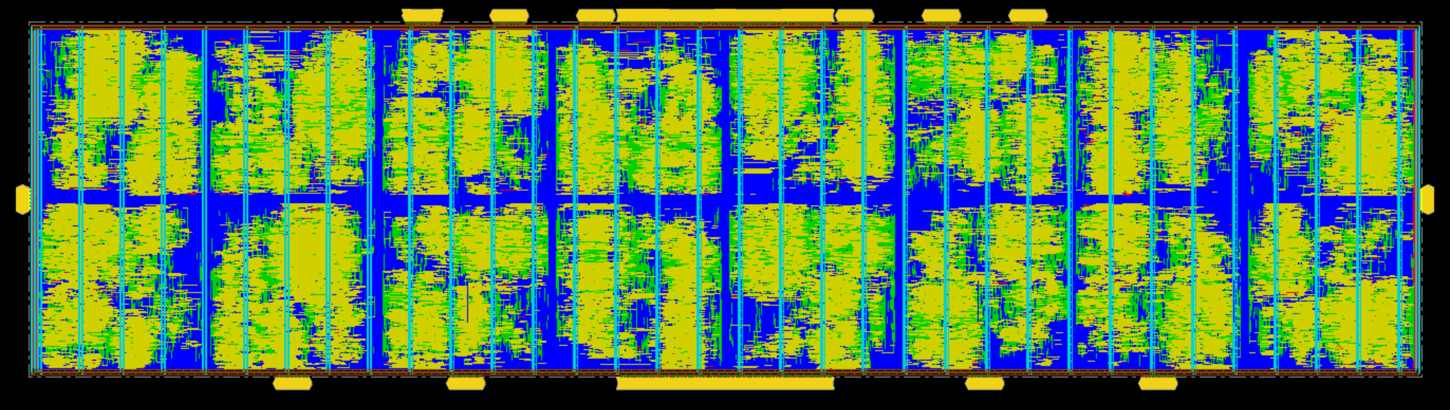
Task 5: Floorplan Result
Task 5
The diagram shows the physical structure that makes the hierarchical implementation possible.
Partition fences
Each repeated tile region is enclosed by a fence, defining the physical boundary of one partition.
Why it helps
Partitioning reduces physical problem size and lets the blocks be processed more independently.
Input to Task 6
These partitions are reused in Task 6 and then integrated again at the top level.
Partitioned 8x2 physical arrangement used as the basis for later hierarchical implementation
IL2225 project presentation | SiLagoNN implementation flow
14

Slide 14
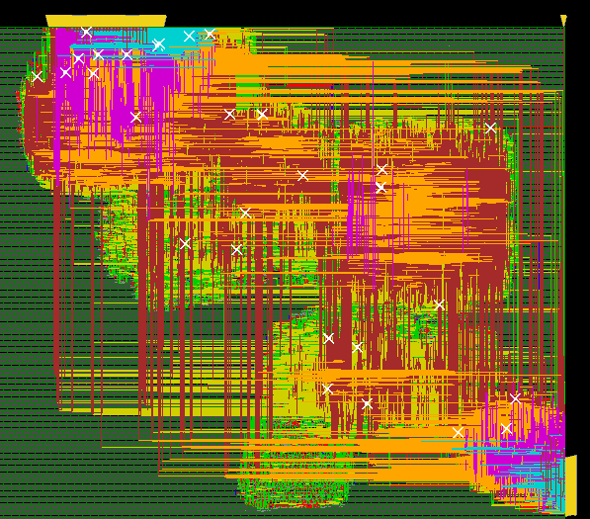
Task 6 Step 1: Block-Level Implementation
Task 6
First, each partition is implemented as its own smaller physical block.
Main story
Read one partition database at a time.
Run placement, CTS, and routing on that block.
Generate an ILM for the block boundary abstraction.
Save the block result so the top-level design can reuse it later.
This reduces the complexity compared with implementing the full chip at once.
Example submodule physical result from the original Task 6 material
IL2225 project presentation | SiLagoNN implementation flow
15

Slide 15
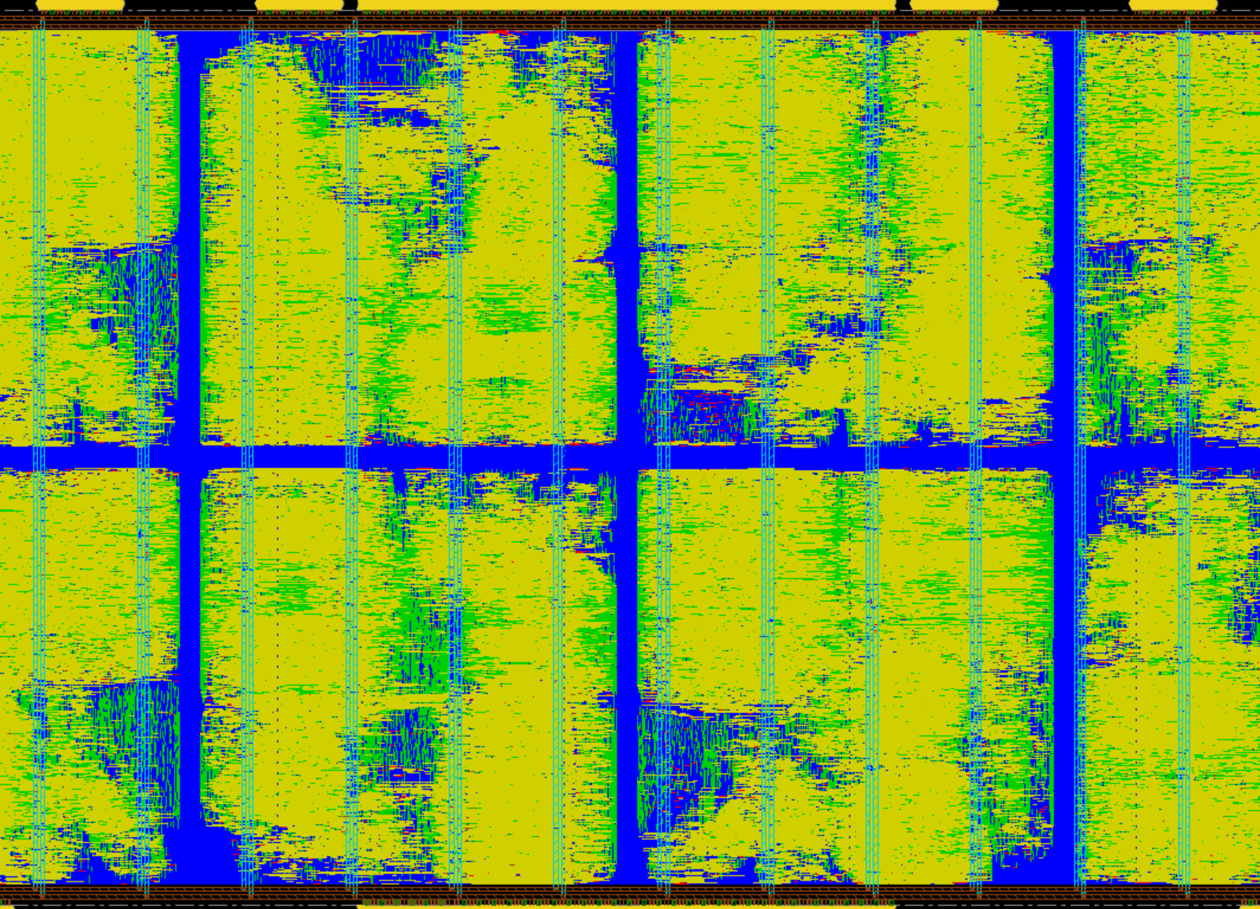
Task 6 Step 2: Top-Level Assembly With ILMs
Task 6
After block implementation, the top-level design is reopened and the partition ILMs are linked back in.
What happens here
Read the top partition DB.
Load the ILMs of the implemented blocks.
Flatten the ILMs for top-level integration.
Run top-level placement, CTS, and routing.
Save the final assembled design.
Top-level hierarchical physical view showing the assembled partitioned design
IL2225 project presentation | SiLagoNN implementation flow
16

Slide 16
Task 6: Key Hierarchical Scripts
Task 6
The wrapper script captures the full sequence from partition creation to final top-level assembly.
run_hierarchical_pnr.sh
Hierarchy flow
# Step 1: Create partitions (Task 5) innovus -stylus -batch -files ../phy/scr/create_partitions.tcl # Step 2: Run partition PnR bash ../phy/scr/pnr_partition.sh # Step 3: Top-level PnR innovus -stylus -batch -files ../phy/scr/pnr_top.tcl # Step 4: Assemble final design innovus -stylus -batch -files ../phy/scr/assemble_design.tcl
Task 5 creates partitions.
Task 6 implements the partitions individually.
ILMs let the top-level run avoid full detailed block netlists.
The final top-level stage restores the chip-wide view and closes the design.
Source: main/phy/scr/run_hierarchical_pnr.sh
IL2225 project presentation | SiLagoNN implementation flow
17
Notes:
Step 1 is partition creation, which reuses the Task 5 flow. In this step, create_partitions.tcl creates the floorplan, assigns fenced block regions, creates the physical partitions, and writes the partition data needed for the later hierarchical implementation stages.
Step 2 is partition-level PnR. Here, pnr_partition.sh automatically launches pnr_partition.tcl for the different partitions. Each partition is implemented independently as a smaller block, including placement, clock-tree synthesis, routing, and generation of block-level outputs such as ILMs. This is the core hierarchical step where the large design is split into manageable sub-blocks.
Step 3 is top-level PnR. After the block-level implementations are finished, pnr_top.tcl performs the top-level physical integration. It uses the partition results and ILMs to handle the top-level placement, clock-tree synthesis, and routing without reopening the entire detailed block internals as one flat design.
Step 4 is final assembly. The script assemble_design.tcl assembles the implemented partitions back into the complete hierarchical design and writes out the final integrated database, netlist, and reports.

Slide 17
Project Conclusions
Summary
The complete flow shows how implementation choices affect PPA, hierarchy, and physical realizability.
Technical conclusions
Main observations
RTL simulation confirms functional correctness before implementation.
Flat synthesis provides stronger global optimization.
Bottom-up synthesis preserves hierarchy and supports later partitioning.
Physical synthesis introduces realistic wire, clock, and routing overhead.
Hierarchical implementation scales the physical flow through partitions and ILMs.
As the clock target tightens, power rises and slack shrinks.
Flat and bottom-up flows show different PPA behavior under the same constraints.
Task 5 is the physical preparation step for Task 6.
Task 6 completes the flow by combining block-level implementation with top-level assembly.
The project demonstrates a full path from verified RTL to hierarchical physical design.
IL2225 project presentation | SiLagoNN implementation flow
19

Slide 18
Thank You
SiLagoNN implementation flow from RTL verification to hierarchical physical synthesis
Questions on methodology, scripts, and results are welcome.
Q&A

