Slide 1
IL2225 Project Presentation
SiLagoNN: From RTL Verification To Hierarchical Physical Synthesis
A full design flow covering RTL simulation, logic synthesis, physical synthesis, floorplanning, partitioning, and hierarchical implementation.
Results and scripts consolidated into one coherent presentation flow
April 9, 2026

Slide 2
Task Dependencies And Data Handoff
Flow
Each stage produces the input used by the next stage, forming one continuous implementation flow.
Task 1
RTL sim
Task 2
Flat synth
Task 3
Bottom-up synth
Task 4
Flat PnR
Task 5
Floorplan
Task 6
Hier PnR
Logical progression
Key inputs and outputs
Physical-flow transition
Task 1 validates functionality at RTL level.
Task 2 produces a flat synthesized netlist.
Task 3 produces a hierarchical synthesis handoff.
Task 4 to Task 6 move into physical implementation.
RTL hierarchy and testbench drive Task 1.
SDC constraints and DC scripts drive Task 2 and Task 3.
Synthesized netlists feed the Innovus physical flow.
Task 4 implements the full design flat.
Task 5 defines the floorplan and partitions.
Task 6 implements partitions first, then assembles the top level.
IL2225 project presentation | SiLagoNN implementation flow
3

Slide 3
Task 1: Simulation Scripts
Task 1
The simulation flow creates libraries, compiles the hierarchy and testbench, then runs vsim with the key waveforms enabled.
compile.do
simulate.do
if {[file exists work]} { vdel -lib work -all } vlib work vmap work work vcom -work dware -2008 DW/DWpackages.vhd ... set fp [open "silagonn_hierarchy.txt" r] while {[gets $fp line] >= 0} { vcom -work work -2008 $line } vcom -work work -2008 ../tb/vec_add/testbench.vhd
vsim -suppress 1549 -voptargs=+acc work.testbench set DPU_PATH {.../MTRF_cell/dpu_gen} add wave /testbench/clk add wave /testbench/rst_n add wave -radix decimal $DPU_PATH/dpu_out_0 add wave -radix decimal $DPU_PATH/dpu_out_1 add wave -radix decimal $DPU_PATH/dpu_in_0 run -all
Source: main/rtl/compile.do
Source: main/rtl/simulate.do
Simulation flow
compile.do builds the libraries and RTL hierarchy, while simulate.do launches the testbench and adds the waveform signals used for debug and result inspection.
IL2225 project presentation | SiLagoNN implementation flow
5

Slide 4
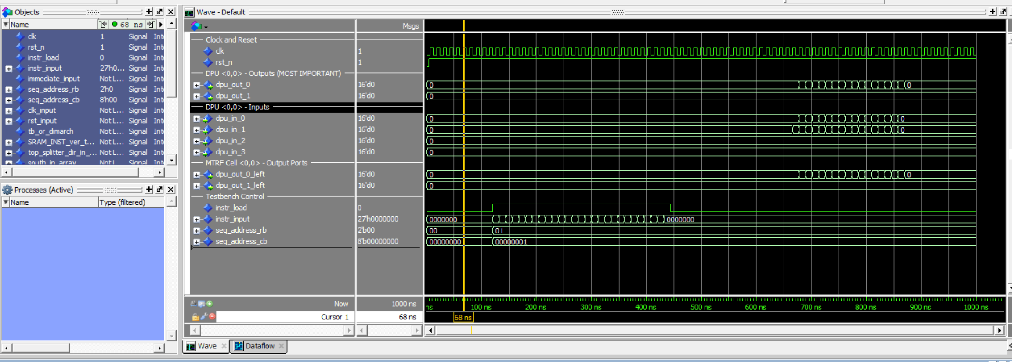
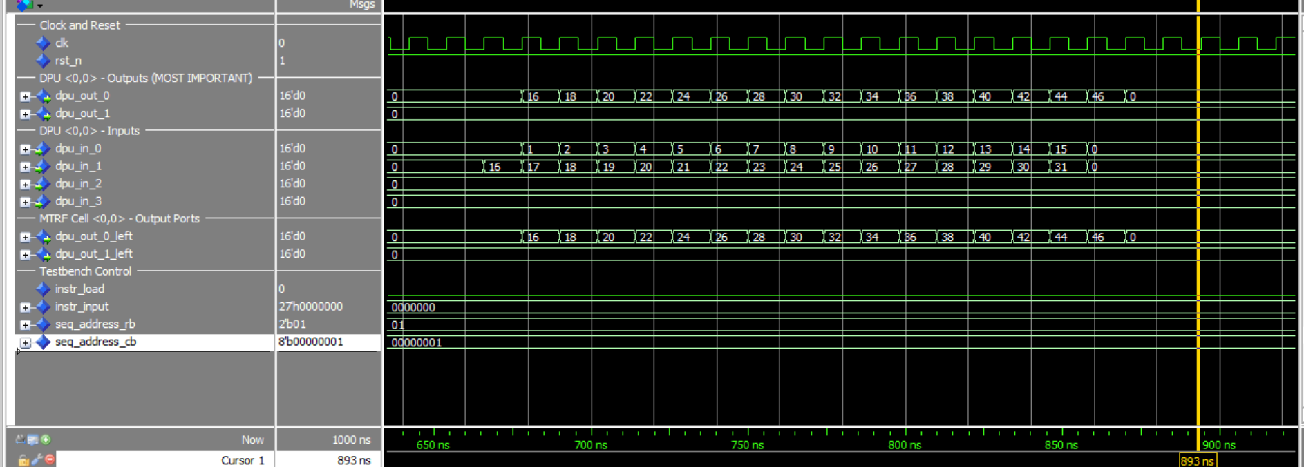
Task 1: RTL Simulation Confirms Functional Behavior
Task 1
Before synthesis, we verify that the testbench, instruction loading, and DPU outputs behave as expected.
Waveform view with reset, instruction load, and DPU signal groups
Decimal DPU outputs show the expected vector-add style data movement
Functional verification result
Task 1 establishes functional correctness before implementation: compile the RTL hierarchy, run the testbench, and inspect control signals together with DPU inputs and outputs in the waveform window.
IL2225 project presentation | SiLagoNN implementation flow
4

Slide 5
Task 2: Flat Logic Synthesis Flow
Task 2
One top-level DC run reads the whole RTL hierarchy, applies one clock constraint, compiles the full design, and writes reports plus a netlist.
Flow steps
dc_flat.tcl
Load synopsys_dc.setup and the technology libraries.
Read the RTL hierarchy from drra_wrapper_hierarchy.txt.
Elaborate and link the top-level design drra_wrapper.
Apply SDC timing constraints and set the clock period.
Compile the whole design flat, then report area, power, and timing.
source ../syn/synopsys_dc.setup set TOP_NAME drra_wrapper set hierarchy_file "../rtl/${TOP_NAME}_hierarchy.txt" set hierarchy_files [split [read [open $hierarchy_file r]] "\n"] foreach filename [lrange $hierarchy_files 0 end-1] { if {[string trim $filename] ne ""} { analyze -format VHDL -lib WORK "../rtl/${filename}" } } elaborate $TOP_NAME ; link ; current_design $TOP_NAME ; uniquify source ../syn/constraints.sdc create_clock -name clk -period $CLOCK_PERIOD_PS $clk_ports compile -map_effort medium report_area > ... ; report_timing > ... ; report_power > ... write -format ddc ... ; write -format verilog ... ; write_sdc ...
Source: main/syn/scr/dc_flat.tcl
Main takeaway
Flat synthesis gives the tool complete visibility of the whole design. That often improves global optimization, but the run is heavier and less modular than bottom-up synthesis.
IL2225 project presentation | SiLagoNN implementation flow
6

Slide 6
Task 2: Flat Synthesis PPA Summary
Task 2
As the clock target tightens, the flat flow shows higher power and area together with a shrinking timing margin.
Clock Period (ns) | Total Power (mW) | Total Cell Area (um^2) | Slack (ps)
20 | 10.4133 | 358652 | 20.10
10 | 20.6254 | 359511 | 37.47
8 | 25.9535 | 365373 | 3.23
6 | 34.4214 | 389591 | 0.10
Clock-scaling trend
As the period becomes smaller, the design is pushed harder. Power and area rise, while slack shrinks toward zero.
Tightest summarized point
In this summary table, 6 ns is the most aggressive flat operating point that still remains slightly positive.
Saved report alignment
The preserved 10 ns flat report in the consolidated main workspace supports power around 20.63 mW and area around 359.5k um^2, which matches the overall PPA trend shown in this summary.
IL2225 project presentation | SiLagoNN implementation flow
7

Slide 7
Task 3: Bottom-Up Logic Synthesis Flow
Task 3
Bottom-up synthesis compiles sub-designs independently, then reuses those characterized blocks when synthesizing the top level.
dc_bottomup.tcl
Why bottom-up
source ../syn/synopsys_dc.setup proc apply_project_constraints {syn_dir clock_period_ps} { source ${syn_dir}/constraints.sdc ; create_clock -name clk -period $clock_period_ps ... } set TOP_NAME drra_wrapper # compile shared lower blocks first
set hierarchy_files [split [read [open ${SOURCE_DIR}/pkg_hierarchy.txt r]] "\n"]
... analyze -format vhdl -lib WORK "../rtl/mtrf/DPU/divider_pipe.vhd" elaborate divider_pipe ; link ; apply_project_constraints ${SYN_DIR} ${CLOCK_PERIOD_PS} ; compile set hierarchy_files [split [read [open ../rtl/silego_hierarchy.txt r]] "\n"] foreach filename [lrange $hierarchy_files 0 end-1] { if {$filename != ""} { analyze -format vhdl -lib WORK "../rtl/${filename}" } } elaborate silego ; dont_touch divider_pipe true ; compile foreach tile {Silago_top Silago_bot ...} { analyze/elaborate/link/apply_constraints/compile } analyze -format vhdl -lib WORK "../rtl/mtrf/drra_wrapper.vhd" elaborate drra_wrapper ; dont_touch {divider_pipe silego ...} true ; compile
… write_file -format ddc ... ; write_file -format verilog ... ; write_sdc ... ; write_sdf ...
Reduce runtime and memory by compiling smaller modules first.
Preserve hierarchy so the design is easier to partition later.
Generate characterized sub-blocks that can be reused at top level.
Prepare a more natural handoff for hierarchical physical synthesis.
Source: main/syn/scr/dc_bottomup.tcl
Hierarchical relevance
This logic-synthesis flow preserves the hierarchy that is later reused in Task 5 floorplanning and Task 6 hierarchical physical implementation.
IL2225 project presentation | SiLagoNN implementation flow
8

Slide 8
Task 3: Bottom-Up Synthesis PPA Summary
Task 3
This bottom-up summary captures the same clock-scaling trend while preserving the hierarchy-oriented synthesis story.
Clock Period (ns) | Total Power (mW) | Total Cell Area (um^2) | Slack (ps)
20 | 10.4048 | 363814 | 9.22
10 | 20.6061 | 364621 | 8.61
8 | 26.8799 | 392192 | 0.12
6 | 35.3253 | 394994 | -209.41
Timing behavior
The slack trend remains the clearest result: 20 ns and 10 ns are safe, 8 ns is near the limit, and 6 ns violates timing.
PPA interpretation
Bottom-up preserves hierarchy but usually gives slightly weaker global PPA than flat synthesis because cross-boundary optimization is more limited.
Summary source
The Task 3 numbers are now kept canonically in main/syn/data/task3_bottomup_summary.csv and regenerated into the consolidated summary reports, so the PPT and main workspace stay aligned.
IL2225 project presentation | SiLagoNN implementation flow
9

Slide 9
Flat Vs Bottom-Up Synthesis Comparison
Compare
The trade-off is mainly between global optimization and hierarchy preservation.
Flat synthesis
Bottom-up synthesis
Practical conclusion
Best global visibility. Usually smaller area and cleaner cross-boundary optimization. Good if runtime and memory are acceptable.
Better hierarchy preservation. Easier to reuse blocks and more suitable for later hierarchical implementation.
Task 3 is not just another synthesis experiment. It is the logical setup step for Task 5 and Task 6.
Observed trade-offs
Implementation implications
Flat sees the whole design and often wins area.
Bottom-up sacrifices some global optimization for modularity.
The tighter the clock, the more the difference matters.
Flat is well suited to top-level optimization.
Bottom-up is well suited to hierarchy preservation and block reuse.
The preferred flow depends on the implementation stage that follows.
IL2225 project presentation | SiLagoNN implementation flow
10

Slide 10
Task 4: Flat Physical Synthesis Flow
Task 4
Now we move from logic-only estimation to a layout-aware implementation flow: floorplan, placement, CTS, routing, and post-route impact.
Flow steps
Why this task matters
Initialize the Innovus environment and read the synthesized design.
Create the floorplan and power plan.
Place the standard cells.
Build the clock tree with CTS / ccopt.
Route the design and save the physical database.
Logic synthesis does not see real interconnect RC or clock-tree overhead. Task 4 reveals what the design looks like after physical effects are introduced.
Core scripts
run_flat_pnr.sh -> pnr_flat.tcl -> global_variables.tcl
Short explanation
In flat PnR, the full design is implemented as one big block. This is the physical counterpart of Task 2.
IL2225 project presentation | SiLagoNN implementation flow
11

Slide 11
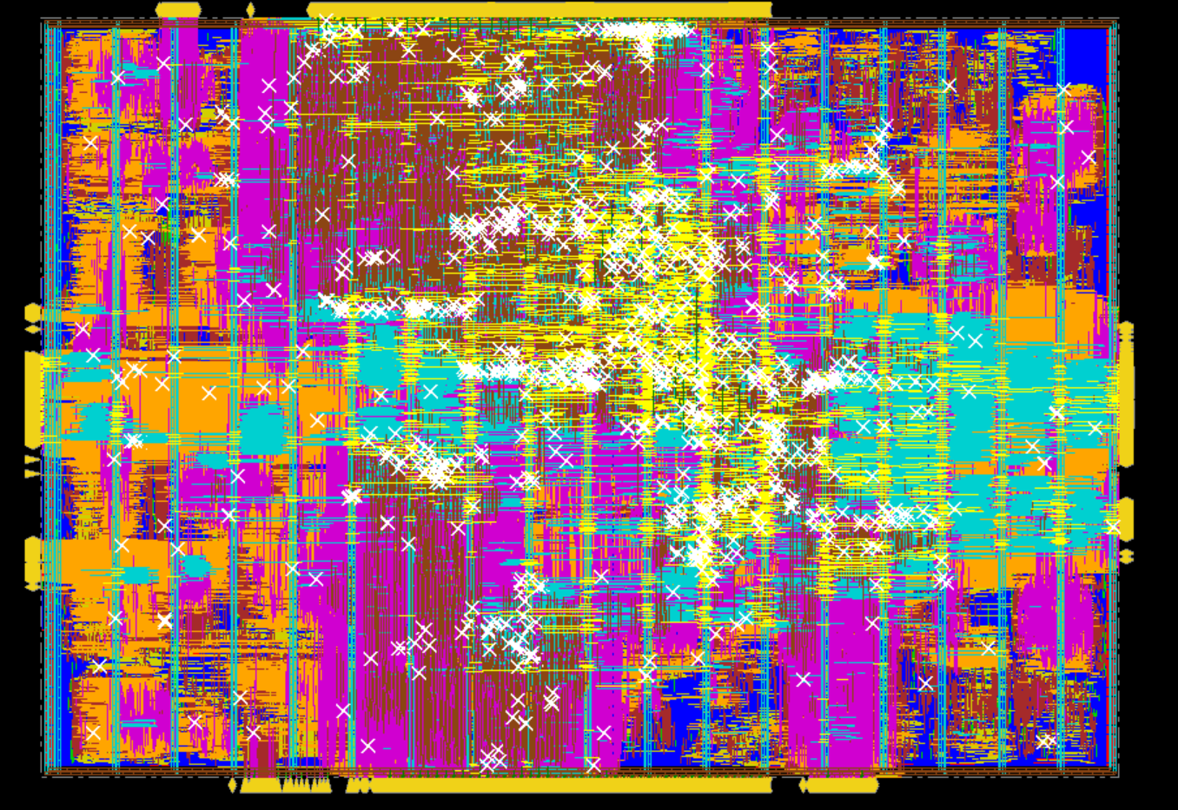
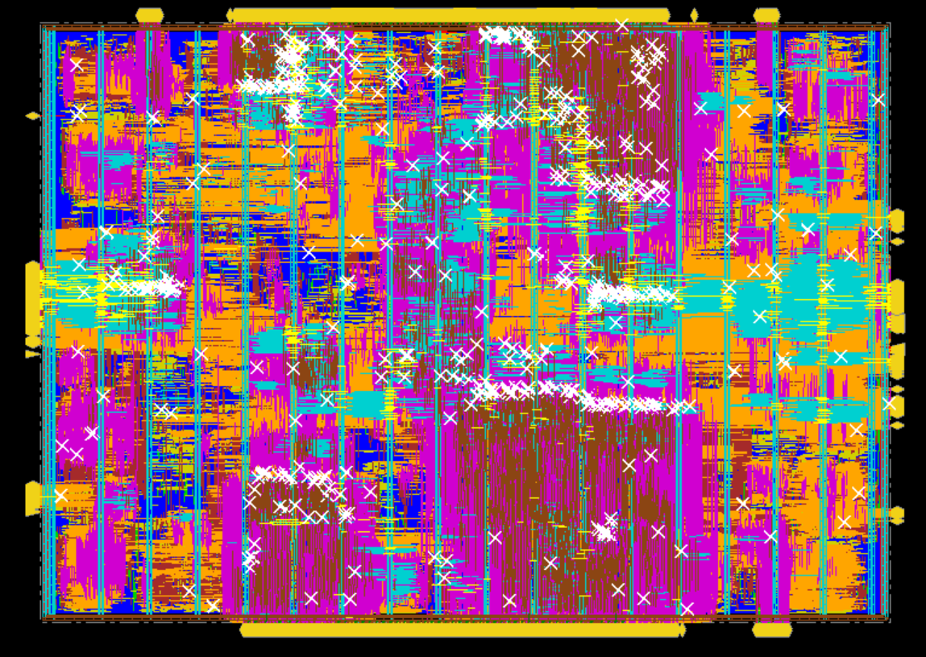
Task 4: Flat Physical Synthesis Result
Task 4
Using the 20 ns bottom-up logic-synthesis handoff, the physical flow shows the PPA cost of real layout effects.
Reasons
Real interconnect RC, clock tree insertion, buffering, and congestion-aware optimization are introduced.
Original Task 4 comparison view A
Original Task 4 comparison view B
PPA Results before/after Physical Synthesis
Stage | Total Power (mW) | Total Cell Area (um^2) | Slack (ps)
Logic Synthesis | 10.4048 | 363814 | 29.24
Physical Synthesis | 80.4640 | 381986 | -280.85
Observation
After physical synthesis, power and area increase and timing degrades.
IL2225 project presentation | SiLagoNN implementation flow
12

Slide 12
Task 5: Floorplanning Prepares The Hierarchical Flow
Task 5
Task 5 is the bridge between bottom-up synthesis and hierarchical physical synthesis.
What Task 5 does
floorplan + partition
Create the top floorplan for the 8x2 tile array.
Assign each tile instance to its own physical fence.
Create physical partitions and pin constraints.
Generate timing budgets so the sub-blocks can be implemented separately.
create_floorplan -site SC8T_104CPP_CMOS22FDX \ -core_size [expr {8*$width + 7*$margin}] \ [expr {2*$height + 1*$margin}] 10 10 10 10 ... create_boundary_constraint -type fence -hinst $cell \ -rects [list [list $x1 $y1 $x2 $y2]] ... create_partition -hinst ${part_hinst} ... assign_partition_pins commit_partitions write_partitions -dir ${PART_DIR} -def
Source: main/phy/scr/floorplan.tcl + partition.tcl
Hierarchical role
Task 5 provides the physical partitions required by Task 6, so floorplanning becomes the setup step for divide-and-conquer implementation.
IL2225 project presentation | SiLagoNN implementation flow
13

Slide 13
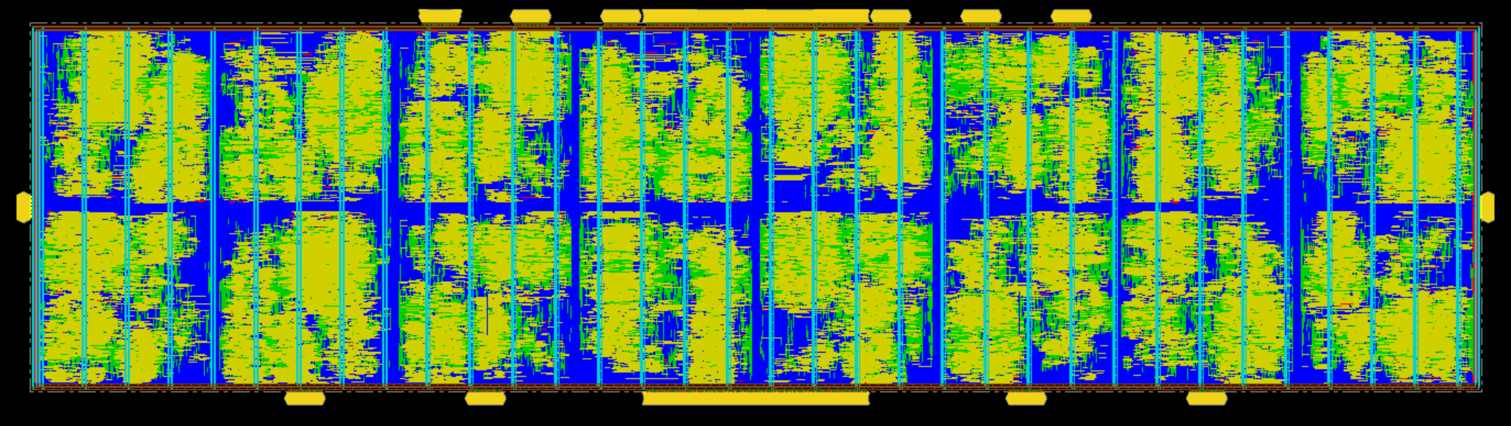
Task 5: Floorplan Result
Task 5
The diagram shows the physical structure that makes the hierarchical implementation possible.
Partition fences
Each repeated tile region is enclosed by a fence, defining the physical boundary of one partition.
Why it helps
Partitioning reduces physical problem size and lets the blocks be processed more independently.
Input to Task 6
These partitions are reused in Task 6 and then integrated again at the top level.
Partitioned 8x2 physical arrangement used as the basis for later hierarchical implementation
IL2225 project presentation | SiLagoNN implementation flow
14

Slide 14
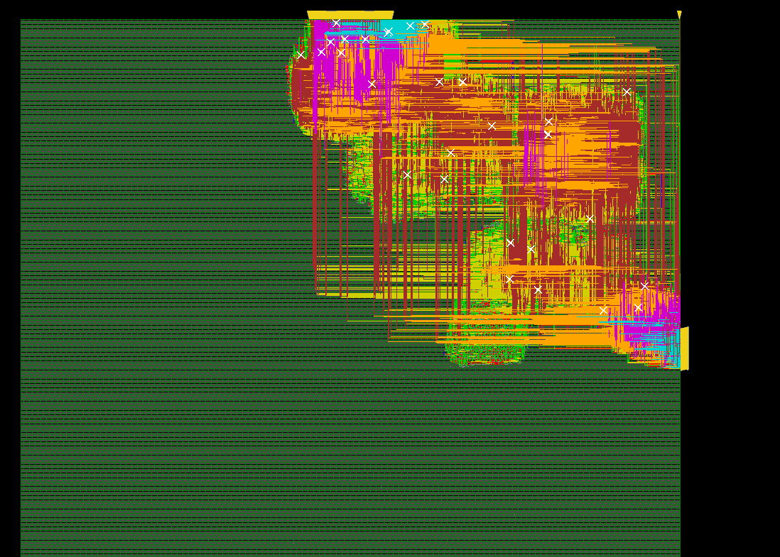
Task 6 Step 1: Block-Level Implementation
Task 6
First, each partition is implemented as its own smaller physical block.
Main story
Read one partition database at a time.
Run placement, CTS, and routing on that block.
Generate an ILM for the block boundary abstraction.
Save the block result so the top-level design can reuse it later.
This reduces the complexity compared with implementing the full chip at once.
Example submodule physical result from the original Task 6 material
IL2225 project presentation | SiLagoNN implementation flow
15

Slide 15
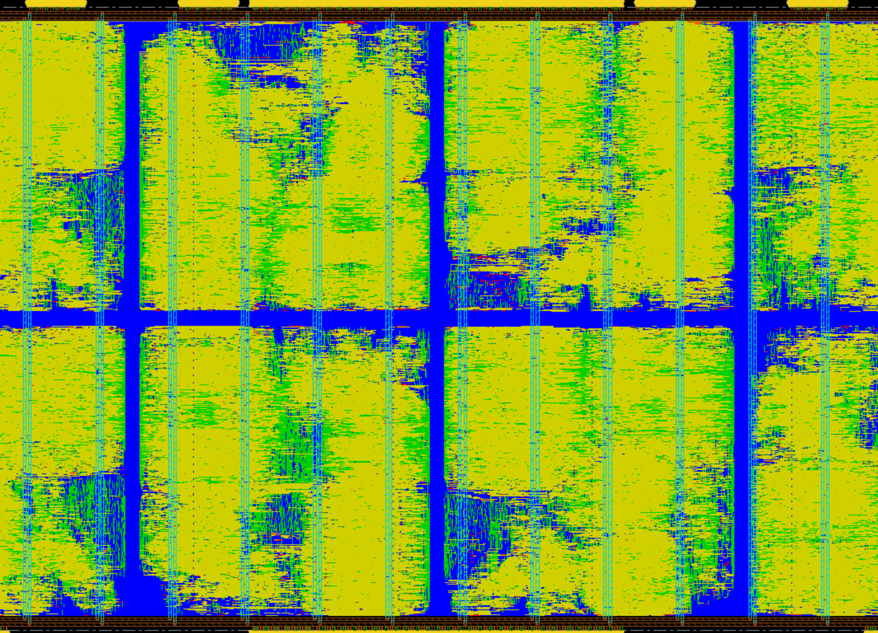
Task 6 Step 2: Top-Level Assembly With ILMs
Task 6
After block implementation, the top-level design is reopened and the partition ILMs are linked back in.
What happens here
Read the top partition DB.
Load the ILMs of the implemented blocks.
Flatten the ILMs for top-level integration.
Run top-level placement, CTS, and routing.
Save the final assembled design.
Top-level hierarchical physical view showing the assembled partitioned design
IL2225 project presentation | SiLagoNN implementation flow
16

Slide 16
Task 6: Key Hierarchical Scripts
Task 6
The wrapper script captures the full sequence from partition creation to final top-level assembly.
run_hierarchical_pnr.sh
Hierarchy flow
# Step 1: Create partitions (Task 5) innovus -stylus -batch -files ../phy/scr/create_partitions.tcl # Step 2: Run partition PnR bash ../phy/scr/pnr_partition.sh # Step 3: Top-level PnR innovus -stylus -batch -files ../phy/scr/pnr_top.tcl # Step 4: Assemble final design innovus -stylus -batch -files ../phy/scr/assemble_design.tcl
Task 5 creates partitions.
Task 6 implements the partitions individually.
ILMs let the top-level run avoid full detailed block netlists.
The final top-level stage restores the chip-wide view and closes the design.
Source: main/phy/scr/run_hierarchical_pnr.sh
IL2225 project presentation | SiLagoNN implementation flow
17

Slide 17
Project Script Map
Scripts
Each implementation stage is driven by a small set of scripts in the consolidated main workspace.
Task | Main entry scripts in main | What they do
Task 1 | rtl/compile.do rtl/simulate.do | Compile RTL + TB, then run and inspect waveforms
Task 2 | syn/run_task2_flat.sh syn/scr/dc_flat.tcl | Flat logic synthesis and PPA reports
Task 3 | syn/run_task3_bottomup.sh syn/scr/dc_bottomup.tcl | Bottom-up synthesis and hierarchical handoff
Task 4 | phy/scr/run_flat_pnr.sh phy/scr/pnr_flat.tcl | Flat physical synthesis
Task 5 | phy/scr/create_partitions.tcl phy/scr/floorplan.tcl | Floorplan, fences, partitions, budgeting
Task 6 | phy/scr/run_hierarchical_pnr.sh phy/scr/pnr_partition.sh phy/scr/pnr_top.tcl phy/scr/assemble_design.tcl | Partition PnR + top-level assembly
IL2225 project presentation | SiLagoNN implementation flow
18

Slide 18
Project Conclusions
Summary
The complete flow shows how implementation choices affect PPA, hierarchy, and physical realizability.
Technical conclusions
Main observations
RTL simulation confirms functional correctness before implementation.
Flat synthesis provides stronger global optimization.
Bottom-up synthesis preserves hierarchy and supports later partitioning.
Physical synthesis introduces realistic wire, clock, and routing overhead.
Hierarchical implementation scales the physical flow through partitions and ILMs.
As the clock target tightens, power rises and slack shrinks.
Flat and bottom-up flows show different PPA behavior under the same constraints.
Task 5 is the physical preparation step for Task 6.
Task 6 completes the flow by combining block-level implementation with top-level assembly.
The project demonstrates a full path from verified RTL to hierarchical physical design.
IL2225 project presentation | SiLagoNN implementation flow
19

Slide 19
Thank You
SiLagoNN implementation flow from RTL verification to hierarchical physical synthesis
Questions on methodology, scripts, results, or design trade-offs are welcome.
Q&A

