Slide 1
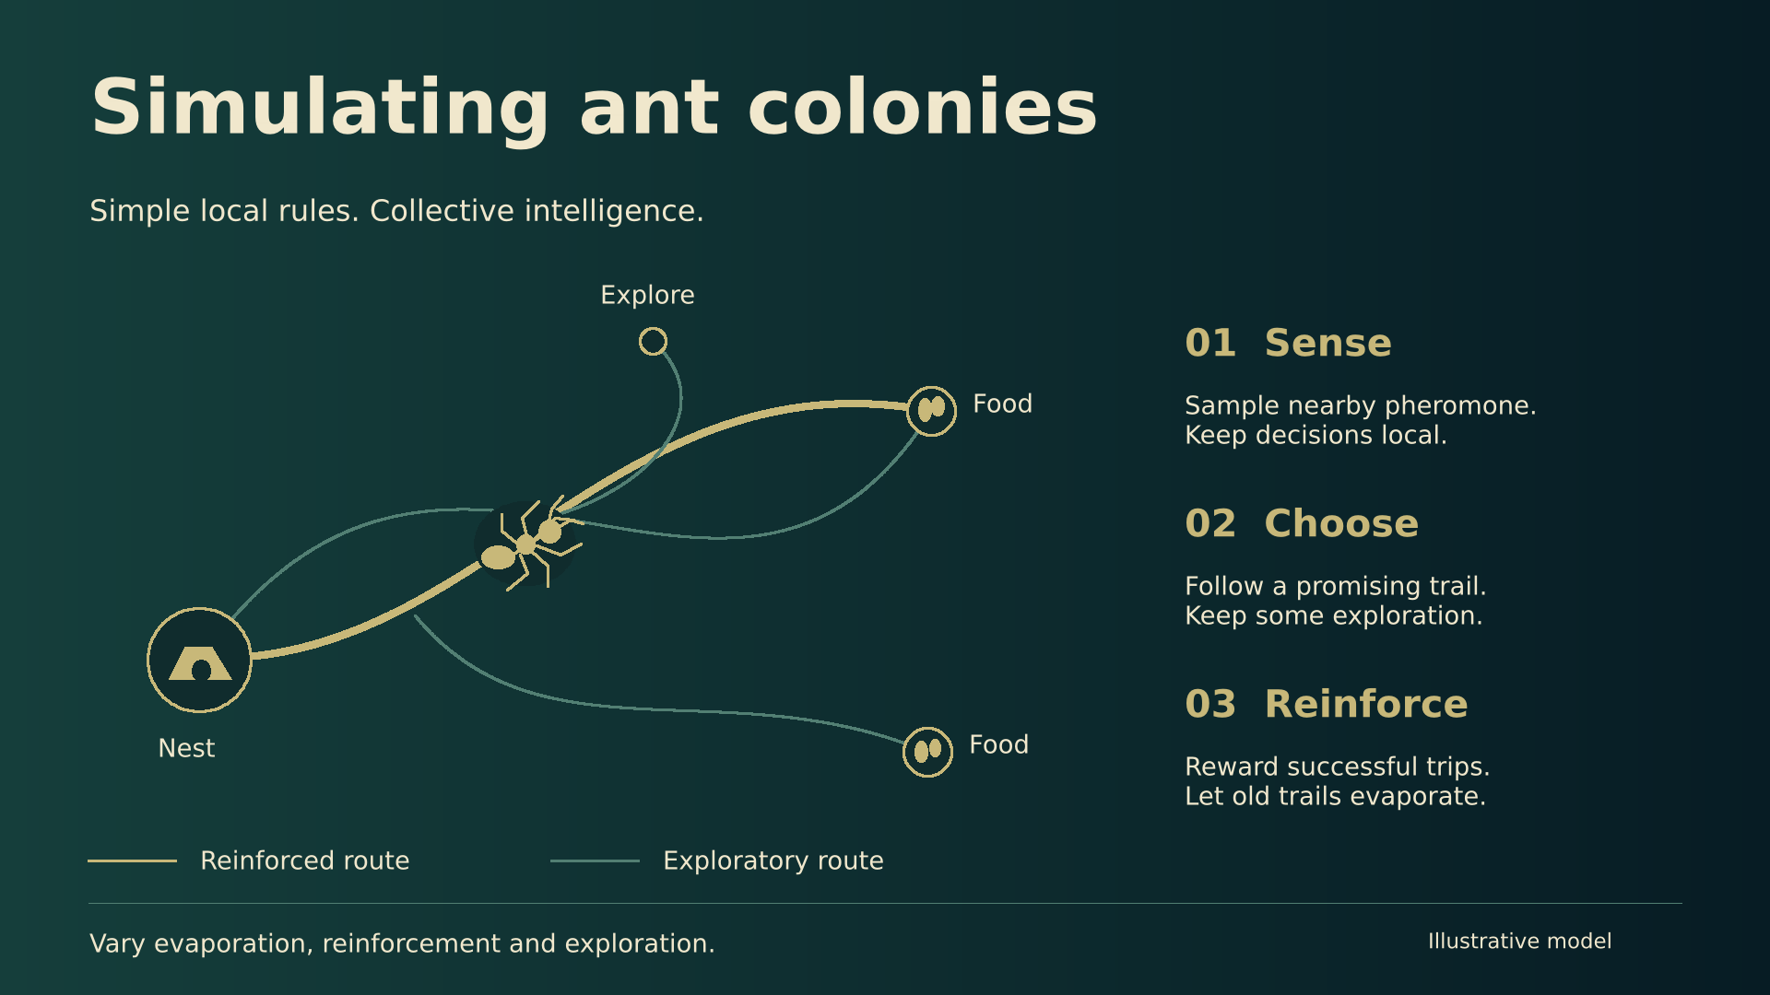
Notes:
An illustrative local-rule ant-colony diagram, painted manually in Paint 10.
The conceptual diagram concerns local pheromone sensing, trail deposition, and evaporation.
It does not report a numerical simulation, measured trajectories, benchmark results, or a calibrated biological model.
[Sources]
Marco Dorigo (2007), Ant colony optimization, Scholarpedia 2(3):1461.
https://www.scholarpedia.org/article/Ant_colony_optimization
https://doi.org/10.4249/scholarpedia.1461
Background reference for pheromone-guided choices, reinforcement, and evaporation; no external visual assets are used.
Visual source: artworks/ant-colony-simulation.png, created manually inside Paint 10.
[/Sources]

