Slide 1










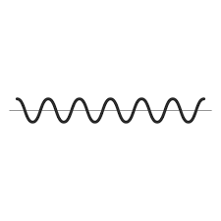





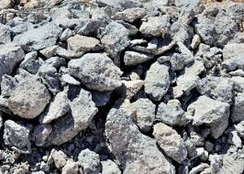
up
down
U
I’
T
D
C
J
B
down
Y
E
I
A
up
L
E’
R
M
S
Q’
W
G
F
V
N
X
O
Q
P
Z
down
up

