Slide 1


HSS C013 (Social & Business Etiquette)
Dr. Theint Theint Shwe
Professor
Faculty of Computer Science, MIIT

Slide 2
Ethics for IT Workers and IT Users
Professional Codes of Ethics
Common Ethical Issues for IT Users
Guidelines to Ethical Decision Making
IT

Slide 3

Guidelines to Ethical Decision Making Informal Guidelines
To recognize if facing an ethical problem
Is there something you or others prefer to keep quiet?
Smell Test : Does something feel wrong about this situation? If yes, take a moment to reconsider.
This is the rule that most rational people use when making decisions about how to behave. It is very easy to determine whether we would like a particular thing to happen to us – so we are able to use the “other persons shoes test” in order to determine the appropriate action.
By using both the 'smell test' and the 'other person's shoes test,' you can develop important skills for ethical thinking and making good decisions.“
Notes:
Informal Guidelines - အလွတ်သဘော လမ်းညွှန်ချက်များ, smell test- instinct ဗီဇ, rational people ဆင်ခြင်တုံတရားရှိတဲ့ လူတွေ
empathy စာနာမှု,
By using both the 'smell test' and the 'other person's shoes test,' you can develop important skills for ethical thinking and making good decisions.“
The "other person's shoes test" is about empathy—the ability to understand and share the feelings of another person.
Academic Scenario: If you’re tempted to copy someone else’s homework, think about how you’d feel if someone copied your work without permission. Would it feel unfair? Would it bother you? This reflection might guide you to avoid copying and instead seek help or put in your own effort.Personal Scenario: If you’re considering gossiping about a friend, think about how you’d feel if the roles were reversed. Would it hurt your feelings? Would it damage your trust in the friend?

Slide 4


Formal Guidelines
Is the act illegal?
Does the act violate corporate policy?
Does it violate corporate or professional code of conduct or ethics?
What if all above guidelines not helpful?
Look at ethical principles
Some key ethical principles : Respect, Honesty, Responsibility, Fairness, Caring, Integrity, Courage, Empathy

Slide 5


Formal Guidelines (Cont’d)
Is there an ethical difference between browsing through someone’s computer files and browsing through her desk drawer?
No difference
New technologies can make them seem different
Technology makes some unethical actions easier to take and easier to conceal
Technology makes it easier for people to be emotionally and physically distant from the consequences of their actions
Notes:
Conceal - ဖုံးကွယ်

Slide 6

Are “Computer” Ethics Different?
Computers may provide more opportunities to breach ethics
Opportunities: much more information is stored electronically now. Payroll data might be available more easily in a business, for example, whereas in the past it would have been locked away.
Physical distance means you don't have to open any doors marked Private. “I only looked at the file, I didn't take it.”
The volume of computer data also links to privacy issues.
Notes:
When we use computers, smartphones, or the internet, a huge amount of data is generated and collected. This data can include things like our browsing history, location, contacts, messages, photos, and even more sensitive information such as financial details or health records.
As the volume of data grows, so does the risk to our privacy. This is because:
More Data Collection: Companies, apps, and websites often collect large amounts of user data to improve their services, target advertisements, or even sell the information to third parties.

Slide 7
Difficulties Posed by Computers
Altered relationship
Personal contact reduced and the speed of the communication
Electronic information is more fragile
Easily changed
More vulnerable to unauthorized access
Easily reproduced without affect the original
Protection of information needs conflict with the benefits of information sharing.
Order of magnitude effect
Effort effect
Notes:
Fragile - ပျက်စီးလွယ်သည်။ Posedစုစည်းတင်ပြထားပါတယ်။
Order of magnitude effect -How big the difference is
Effort effect - How effort changes outcome

Slide 8

Compliance
Compliance means to be in accordance with established policies, guidelines, specifications, or legislation.
Major challenge to comply with multiple government and industry regulations that are sometimes in conflict.
To meet this challenge:
Implement software to track and record compliance actions
Hire management consultants for advice and training
Create Chief Compliance Officer position
Notes:
Hire-အရစ်ကျ compliance လိုက်နာမှု
Understanding Regulations
Government Regulations
Industry Regulations

Slide 9
Compliance (Cont’d)
Audit committee is subset of the board of directors, with oversight for the following activities:
01
Quality and integrity of accounting and reporting practices and controls
02
Compliance with legal and regulatory requirements
03
Qualifications, independence, and performance of organization’s independent auditor
04
Performance of company’s internal audit team
Notes:
Oversight-ကြီးကြပ်မှု
regulatory requirementsစည်းကမ်းသတ်မှတ်ချက်များ

Slide 10
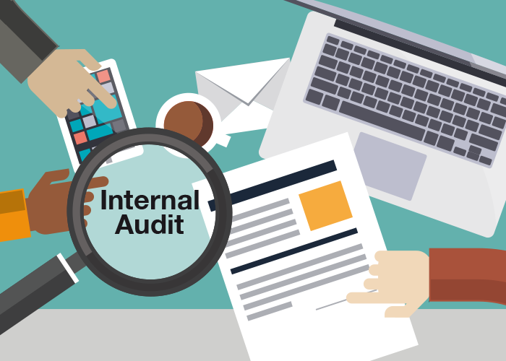
Compliance (Cont’d)
Internal audit committee responsibilities:
01
Determine that internal systems and controls are adequate and effective
02
Verify existence of company assets and maintain proper safeguards over their protection
03
Measure the organization’s compliance with its own policies and procedures
04
Insure that institutional policies and procedures, appropriate laws, and good practices are followed
05
Evaluate adequacy and reliability of information available for management decision making
Notes:
safeguardsအကာအကွယ်များ

Slide 11
Summary
Professionals
Require advanced training and experience
Must exercise discretion and judgment in their work
Their work cannot be standardized
From a legal standpoint, a professional:
Has passed the state licensing requirements
Has earned the right to practice in a state(s)
IT professionals have many different relationships
Each with its own ethical issues and potential problems
Professional code of ethics
Licensing and certification of IT professionals

Slide 12

Discussion
1
Ethical decisions impact on the quality of our lives
2
Ethical expectations are all around us and influence our behavior
3
Ethical decisions are complex and may well differ over time
4
Ethical decision making has been studied for centuries
5
Computing provides a space for poor behavior
Notes:
Injustice-မတရားမှု, cheat လိမ်တယ်။ it undermines trustယုံကြည်မှုပျက်ပြားစေသည်။prevalentပျံ့နှံ့သည်။

Slide 13
References
“Ethics in Information Technology” by George W. Reynolds, Fifth Edition
BOS Lectures
Images are from Google.

