Slide 1

The Meaning of Success and Failure

Slide 2
Introduction
Success and failure hold unique meanings for individuals. In a world often defined by financial gains and recognition, true success transcends material values. In Hemingway's 'The Old Man and the Sea,' we explore a nuanced understanding of success, rooted in resilience and dignity.

Slide 3
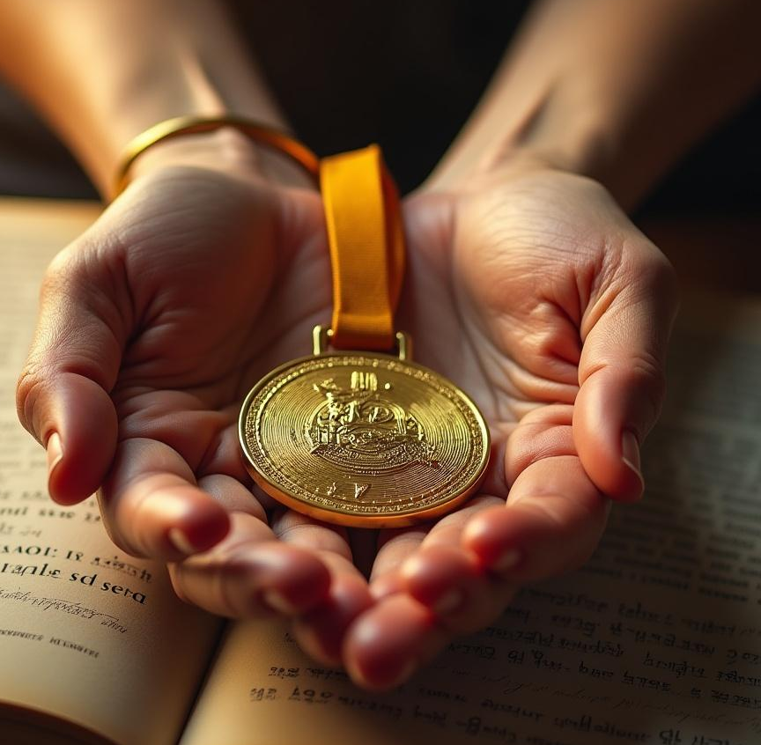
01
Defining Success

Slide 4
Cultural variations of success
Success can be perceived differently across cultures; some view it as wealth and fame, while others emphasize personal fulfillment and contributions to society. Understanding these differences allows us to appreciate broader interpretations of what it means to succeed.

Slide 5

Contemporary definitions of success
In today's society, success is often equated with high-paying jobs and social media influence. However, this narrow view raises questions about true happiness. Are wealth and fame the ultimate goals, or is there a deeper sense of fulfillment to pursue?

Slide 6
Success in The Old Man and the Sea
In 'The Old Man and the Sea', success is portrayed as a profound concept beyond mere victory. Santiago's battle with the marlin showcases strength, courage, and perseverance. Even though he returns with only the fish's bones, his tenacity and pride exemplify true success, proving that it's characterized by effort rather than outcome.

Slide 7

02
Lessons from Failure

Slide 8
Santiago's journey and resilience
Santiago embodies resilience, enduring a grueling struggle against the marlin for three days. His commitment to the fight reflects a powerful lesson: success isn't solely about trophies, but about the spirit displayed during challenges. His determination teaches us the value of not giving up, regardless of the results.

Slide 9

Real-life examples of persistence
Throughout history, many individuals exemplify the spirit of Santiago in their journeys. Thomas Edison’s relentless pursuit of innovation, despite thousands of failures, and J.K. Rowling's perseverance through numerous rejections before her success with Harry Potter, remind us that enduring setbacks can lead to monumental achievements.

Slide 10
Reframing failure as a learning opportunity
Failure is often viewed negatively, but reframing it as a learning opportunity can be empowering. Each setback offers valuable lessons that contribute to personal growth. Just as Santiago learned from his experience, embracing and reflecting on our failures positions us for future success.

Slide 11

Conclusions
The journey through success and failure reveals that victories aren't always tangible. It's the effort, spirit, and resilience, much like Santiago’s, that truly count. We must learn to pursue our passions despite obstacles and cultivate the strength to rise after every fall, embodying the essence of genuine success.

Slide 12
Thank you!
Do you have any questions?
+00 000 000 000

