Slide 1
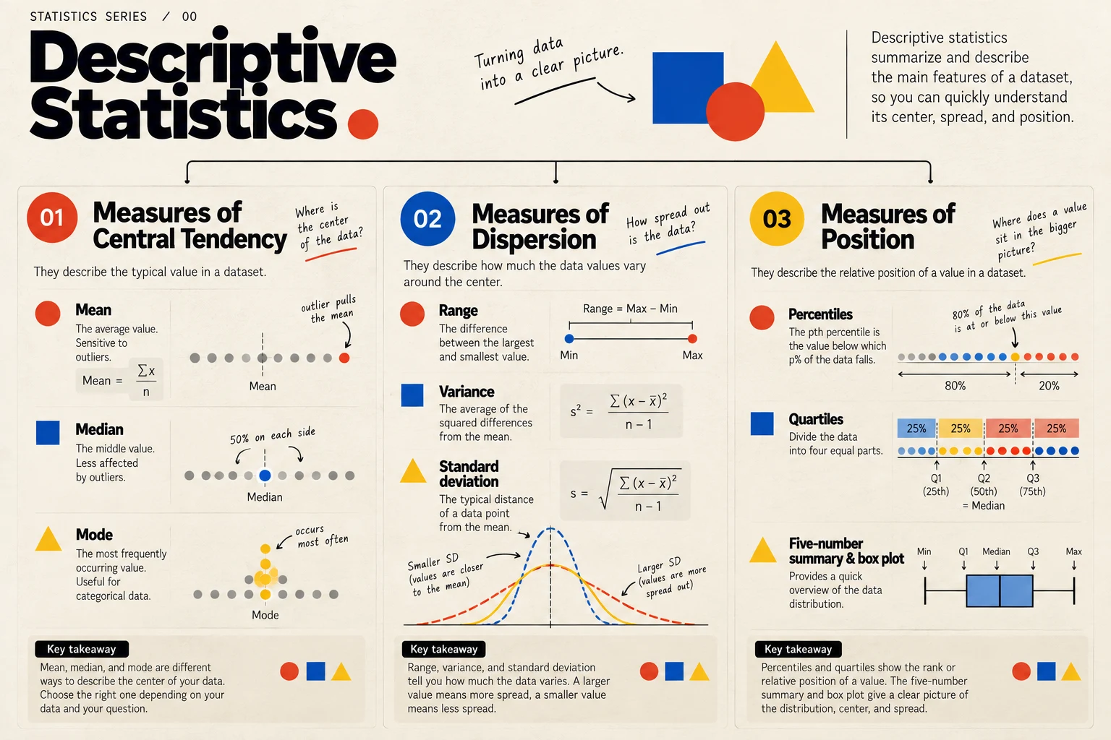
Descriptive Statistics
How to read the story hidden in data
STATISTICS · YUANYUAN ZHANG

Slide 2
Why descriptive statistics matter
Before any model, forecast, or dashboard, someone has to understand what the data actually looks like. Descriptive statistics are that first step: they summarize a dataset in a few numbers, so we can see its shape before we draw conclusions.
1
They make large datasets readable
A few measures can stand in for thousands of rows.
2
They stop us from trusting a single number
A mean of €64.18 hides that most customers spend between €40 and €60, and two stores can share a mean of €50 while behaving very differently.
3
They reveal unusual observations
A value like €180 stands out once we look at quartiles and box plots, and it raises the right question: is it an error or a real customer?
4
They prepare everything that follows
Choosing the right chart, model, or business conclusion depends on first knowing the center, spread, and position of the data.

Slide 3
Three questions every dataset can answer
CENTER
SPREAD
POSITION
Where is the data?
How much does it vary?
Where does an observation sit?
Mean · Median · Mode
Range · Variance · Standard deviation
Percentiles · Quartiles · IQR

Slide 4
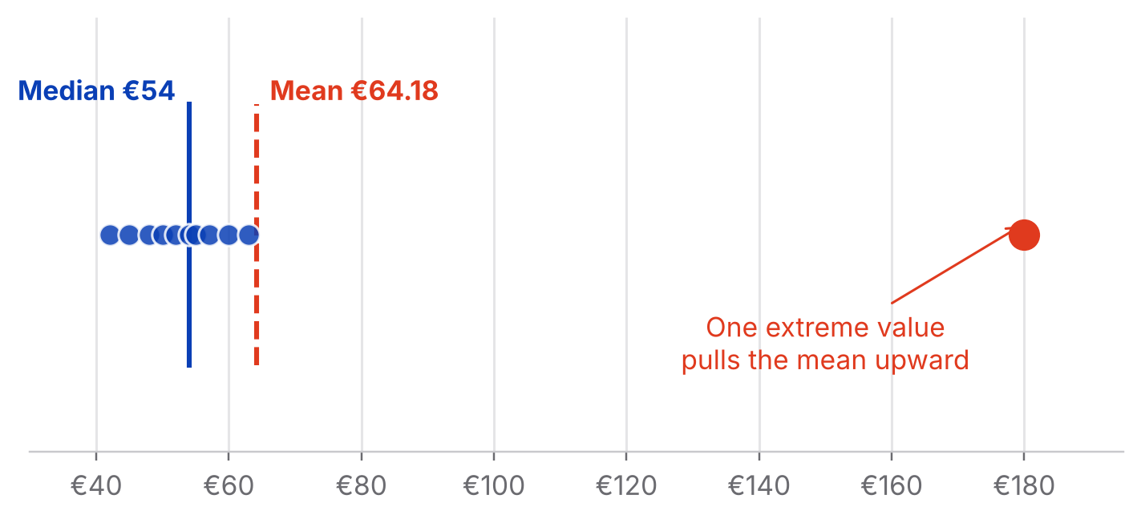
Mean — the mathematical average
CENTER
Add all observations and divide by the number of observations.
x̄ = Σxᵢ / n
Example: monthly customer spending = €42, €45, €48, €50, €52, €54, €55, €57, €60, €63, €180
Mean = €64.18
ANALYTICAL LESSON
The mean uses every observation, so it is sensitive to extreme values and skewed distributions.

Slide 5
Median — the middle of the data
CENTER
Order the observations and find the middle value. With an even number of observations, average the two middle values.
MEDIAN
€54
MEAN
€64.18
For the same spending data, the median is €54.
WHY IT MATTERS
Most customers in this example spend around €40–€60, while one customer spends €180. The median remains close to the typical customer.
USE IT WHEN
The distribution is skewed or contains meaningful outliers—for example, house prices, salaries, or customer spending.

Slide 6
Mode — what happens most often
CENTER
The mode is the most frequently occurring value. A dataset can have no mode, one mode, or multiple modes.
Example: T-shirt sizes sold = S, M, M, L, M, XL, L, M, S, M. The mode is M.
ESPECIALLY USEFUL FOR
Categorical data, where an average may not make sense. For example, the most common payment method can be Credit Card.

Slide 7
Mean, median or mode?
CENTER
Situation | Useful measure
Numeric, relatively symmetric data | Mean
Numeric data with outliers | Median
Skewed distributions | Median
Categorical data | Mode
Most common category | Mode

Slide 8
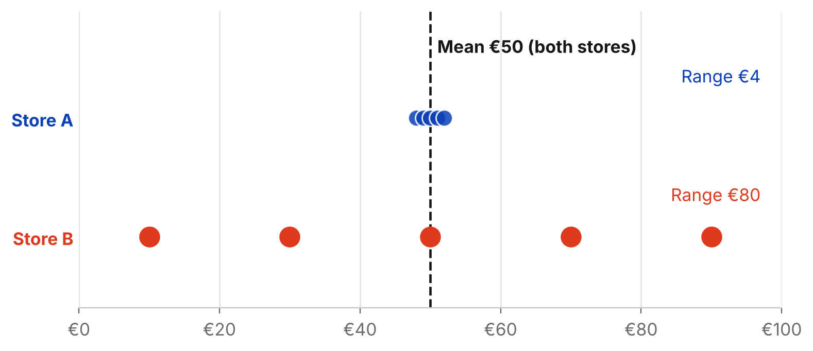
Same mean, very different spread
SPREAD
Knowing the center is not enough. Two datasets can have the same mean and completely different levels of variability.
Store A: €48, €49, €50, €51, €52
Store B: €10, €30, €50, €70, €90
Both have a mean of €50—but Store B is much more spread out.
KEY IDEA
Central tendency tells us where the data is. Dispersion tells us how much the observations vary.

Slide 9
Three ways to measure spread
SPREAD
Range
Variance
Standard deviation
Range = max − min
s² = Σ(xᵢ − x̄)² / (n − 1)
s = √variance
Store A: €52 − €48 = €4
Store B: €90 − €10 = €80
Limitation: it depends only on the minimum and maximum, so one extreme value can change it dramatically.
The average squared distance from the mean. Squaring prevents positive and negative deviations from cancelling each other out.
The square root of variance, back in the original unit.
Dataset 2, 3, 10: mean = 5, squared deviations = 9, 4, 25, variance = 19, SD ≈ 4.36

Slide 10
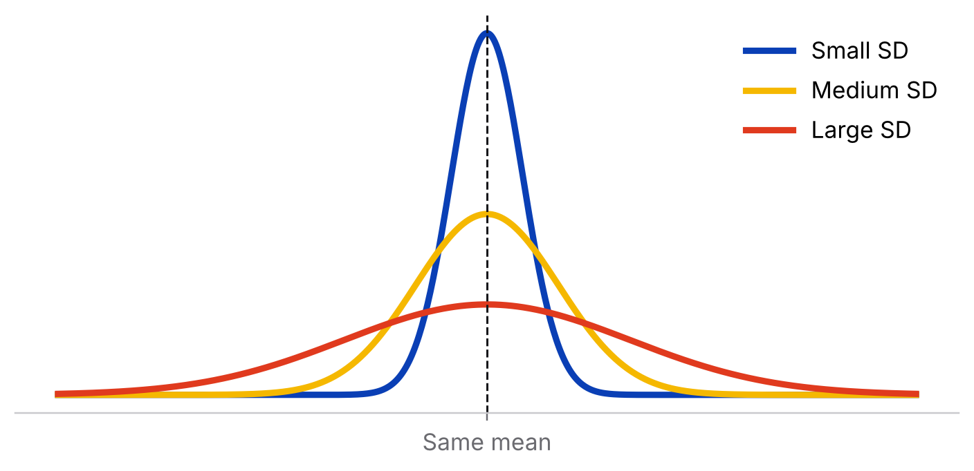
Same mean, wider curve, greater spread
SPREAD
Standard deviation returns spread to the original unit of measurement. The wider the curve, the greater the spread.
BUSINESS EXAMPLE: RENTAL PRICES
Two neighborhoods may have similar average rents but very different variability. A larger standard deviation means a wider spread of rents, which matters for price predictability.

Slide 11
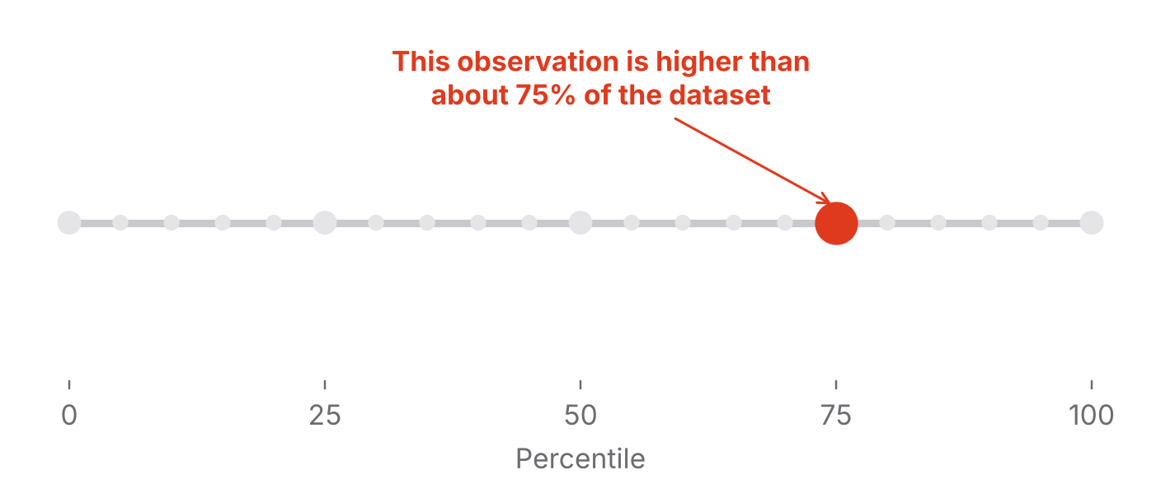
Percentiles — relative position
POSITION
Percentiles divide ordered data into 100 parts. A value at the 75th percentile is higher than approximately 75% of observations in the reference dataset.
IMPORTANT DISTINCTION
The 75th percentile does not mean 75% correct. It describes relative position, not the percentage of points achieved.

Slide 12
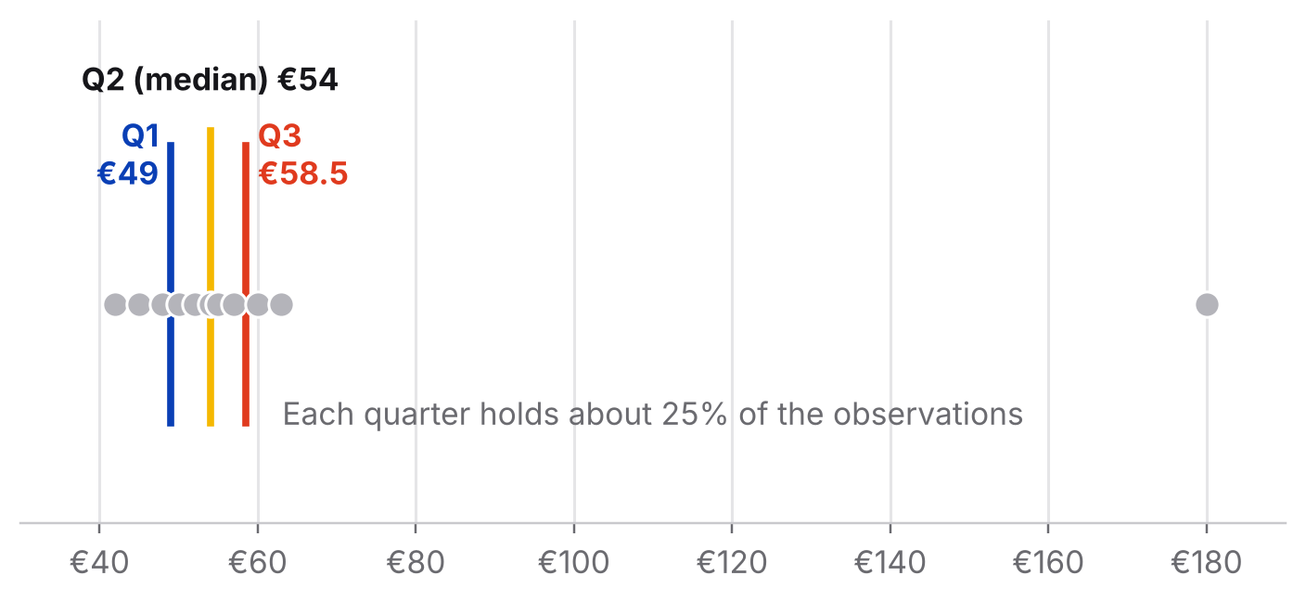
Quartiles and the IQR
POSITION
Quartiles divide the ordered dataset into four parts: Q1 = 25th percentile | Q2 = median | Q3 = 75th percentile.
IQR = Q3 − Q1
If Q1 = €35 and Q3 = €78, then IQR = €43. The middle 50% of observations occupy a €43-wide interval.
WHY IT MATTERS
The IQR is less sensitive to extreme values than the full range, making it useful for skewed data and outlier analysis.

Slide 13
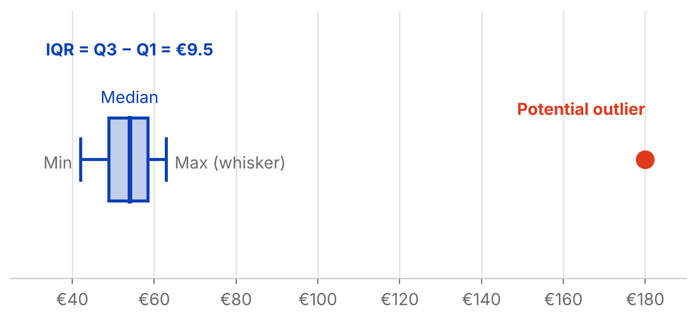
Five-number summary and box plot
POSITION
Minimum → Q1 → Median → Q3 → Maximum
The box
represents the middle 50%.
The line inside
is the median.
The whiskers
show the remaining distribution according to the chosen box-plot convention.

Slide 14
Putting everything together
Customer spending: 42, 45, 48, 50, 52, 54, 55, 57, 60, 63, 180
Question | Measure | What it tells us
Where is the center? | Mean / Median | Typical level and sensitivity to extreme values
What occurs most often? | Mode | Most common value or category
How much does it vary? | Range / Variance / SD | Overall and typical spread
Where does an observation sit? | Percentile / Quartile | Relative position
What is the middle 50%? | IQR | Robust measure of spread
Are there unusual observations? | IQR / Box plot | Potential outliers and distribution shape

Slide 15
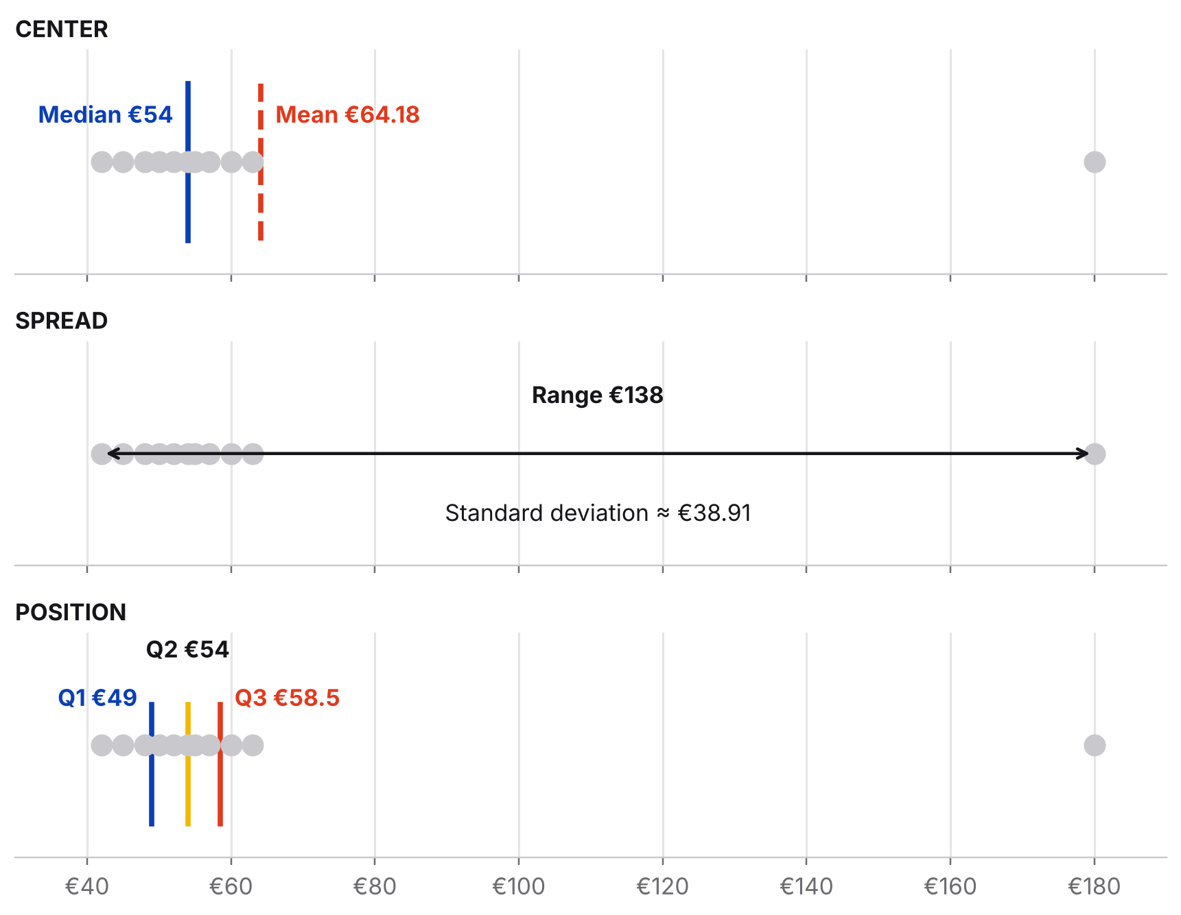
One dataset, three lenses
CENTER
The mean and median tell us where the data is centered.
SPREAD
Range and standard deviation tell us how much it varies.
POSITION
Percentiles and quartiles tell us where observations sit within the distribution.

Slide 16
Final takeaway
Descriptive statistics are not just numbers to calculate. They are different lenses for looking at the same data. The mean and median tell us where the data is centered. Range and standard deviation tell us how much it varies. Percentiles and quartiles tell us where observations sit within the distribution. Together, they turn a collection of numbers into something we can interpret.

