Slide 1

Background
Methods
Results
Discussion
Public Health Implications
Final Project
LLM-Assisted Evidence Mapping of Nature-Based Solutions for Urban Heat and Health Outcomes
Final Project for EPID695: AI for Public Health and Biomedicine, Dr. Ludwig Geistlinger
Presented By:
Eileen M. Murray

Slide 2
Background
Methods
Results
Discussion
Public Health Implications
Final Project
Background
  Extreme heat events in urban areas are associated with adverse health outcomes
  Urban environments are especially vulnerable due to heat-absorbing materials like concrete and metal, which intensify the urban heat island (UHI) effect
  Nature-based solutions (NBS) have emerged as a promising strategy for mitigating urban heat
  Large language models (LLMs) offer a novel approach to rapidly synthesizing literature
Notes:
Extreme heat events in urban areas have become an increasing public health concern, with documented associations between heat exposure and adverse health outcomes including heat stroke and mortality.1 This concern is compounded by projections that the global urban population will reach 6.7 billion by 2050, a figure that includes a growing proportion of older adults who are disproportionately vulnerable to extreme heat.1 Urban environments are particularly susceptible to heat accumulation due to the widespread use of heat-absorbing materials such as metal, concrete, and brick, which collectively contribute to the urban heat island (UHI) effect.1 In response to the public health burden posed by extreme urban heat, city planners and researchers have increasingly turned to nature-based solutions (NBS) as a potential mitigation strategy.2,3
Additionally, . Large language models (LLMs) offer a promising avenue for accelerating this synthesis. LLMs have been applied in public health and biomedical research to rapidly organize large bodies of literature, identify emerging trends, and surface gaps in evidence.⁶ One such model, BERTopic, is a topic modeling framework that extracts coherent topic representations by clustering semantically related keywords across a corpus of documents.6

Slide 3
Background
Methods
Results
Discussion
Public Health Implications
Final Project
Background
Can BERTopic can be effectively employed to identify the dominant types of NBS studied for urban heat mitigation and characterize the heat-related and health-related outcomes most commonly reported in the literature?
Notes:
Given these capabilities, this study aims to evaluate whether BERTopic can be effectively employed to identify the dominant types of NBS studied for urban heat mitigation and characterize the heat-related and health-related outcomes most commonly reported in the literature.

Slide 4
Background
Methods
Results
Discussion
Public Health Implications
Final Project
Methods
323 PubMed abstracts were retrieved using a structured Boolean query spanning NBS, urban heat, and health outcome terms; 296 remained after inclusion/exclusion filtering
Abstracts were represented using sentence embeddings (Sentence-BERT) as the primary method and TF-IDF as a baseline for comparison
BERTopic was applied to identify thematic clusters, with k-means on TF-IDF used as a baseline; GPT-4o-mini generated constrained evidence summaries per cluster with PMID traceability enforced
A manual quality audit rated summary accuracy as accurate, partially accurate, or hallucinated across a sample of 12 abstracts
Notes:
For the methods section, I started by pulling abstracts directly from PubMed using an API query. I chose PubMed because it's free, widely used in biomedical research, and contains over 40 million citations — making it ideal for a rapid evidence mapping project like this one.
To build the corpus, I developed a structured Boolean query combining four groups of terms: NBS and green infrastructure types, urban setting terms, heat-related terms, and health outcome terms. I then applied inclusion and exclusion criteria — keeping only peer-reviewed, English-language studies published between 2016 and 2026 that focused on NBS in urban contexts, and excluding anything rural, non-peer reviewed, or unrelated to heat or health. The query was set to retrieve up to 10,000 records, though the final filtered corpus of 296 abstracts fell below the proposal target of 500–1,000.
For text representation, I used two approaches. TF-IDF served as my baseline, which essentially counts how often terms appear across documents. My primary method was BERTopic, which generates sentence embeddings and clusters them using its own internal pipeline, capturing deeper semantic meaning between abstracts beyond word frequency. I also provided six predefined seed topic lists aligned with the proposal's NBS categories and health outcomes — such as green roofs, urban forests, and heat-related mortality — to help guide topic discovery.
For clustering, BERTopic handled its own internal pipeline using UMAP for dimensionality reduction and HDBSCAN for density-based clustering, with nr_topics set to a maximum of 10. As a baseline comparison, I applied k-means to the TF-IDF representations, testing k values between 6 and 10 and selecting the best configuration based on silhouette scores. I then used GPT-4o-mini to label each cluster and generate a one-to-two paragraph evidence summary per theme, with strict guardrails — the model could only use information from the provided abstracts and had to cite PMIDs in every output.
Finally, I manually audited a sample of abstracts per cluster, rating each summary as accurate, partially accurate, or hallucinated to check for reliability.

Slide 5
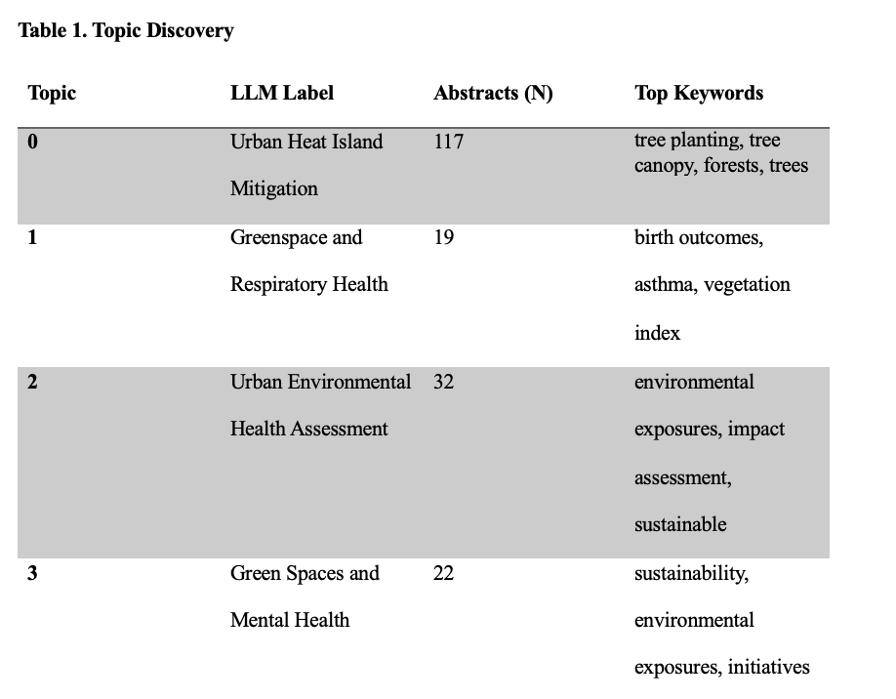
Background
Methods
Results
Discussion
Public Health Implications
Final Project
Results
Notes:
Starting with corpus construction — the PubMed query returned 323 articles. After applying our inclusion and exclusion criteria, removing duplicates, articles outside our date range, and anything focused on rural or non-urban settings, we were left with a final corpus of 296 abstracts.
From there, BERTopic identified four coherent topics, below the maximum of 10 we set, suggesting the corpus supported only four densely separable clusters. Of the 296 abstracts, 106 — about 36% — were assigned to the outlier cluster, meaning BERTopic couldn't confidently place them into a theme. Because BERTopic uses density-based clustering via HDBSCAN, abstracts that don't fall within a sufficiently dense region of the embedding space get assigned to the outlier cluster rather than forced into one, which reflects the genuinely heterogeneous nature of this literature spanning epidemiology, urban planning, and public health.
The four topics identified were: Topic 0, Urban Heat Island Mitigation, the largest cluster at 117 abstracts, centered on tree canopy cover, urban forests, species selection, and cooling effects; Topic 1, Greenspace and Respiratory Health, with 19 abstracts linking residential greenness to birth outcomes and diurnal temperature range to childhood asthma; Topic 2, Urban Environmental Health Assessment, with 32 abstracts focused on transport-integrated NBS and health impact modeling primarily from Barcelona; and Topic 3, Green Spaces and Mental Health, with 22 abstracts connecting green space access to psychological wellbeing and thermal comfort in older adults, as well as equity dimensions related to structural racism and urban health disparities.
For the quality audit, we manually reviewed 12 representative abstracts across all four topics. Five of 12 summaries were rated accurate, seven were rated partially accurate, and none were hallucinated. The most common issue was PMID misattribution — the LLM correctly captured the cluster theme but occasionally assigned specific findings to the wrong abstract within the same topic. No fabricated claims were identified.

Slide 6
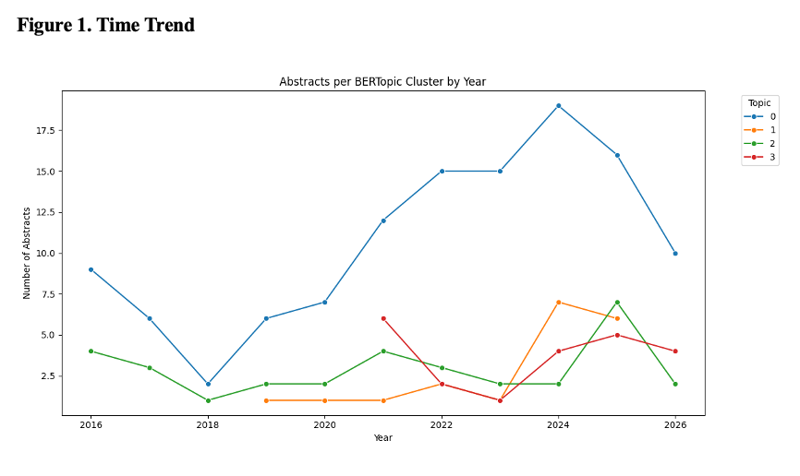
Background
Methods
Results
Discussion
Public Health Implications
Final Project
Results
TF-IDF k-means produced uniformly low silhouette scores (0.003–0.004) across all values of k, confirming sentence embeddings outperformed term-frequency representations
Publications rose sharply after 2020, peaking between 2024–2025, with Topic 0 (Urban Heat Island Mitigation) the most consistently published theme, reaching a peak of 19 abstracts in 2024
Notes:
For our TF-IDF baseline, silhouette scores were consistently low across all k values — ranging from 0.003 to 0.004 — confirming that term-frequency approaches couldn't meaningfully separate this corpus, and validating our choice to use sentence embeddings instead.
Finally, looking at the time trend, publications rose sharply after 2020 and peaked between 2024 and 2025, with Topic 0 on Urban Heat Island Mitigation being the most consistently published theme throughout the study period, peaking at 19 abstracts in 2024 before declining. Topics 1 and 3 emerged largely after 2022, suggesting that respiratory health and mental health and equity framings are more recent additions to this literature. The 2026 values should be interpreted cautiously as the search was conducted mid-year and the apparent decline likely reflects incomplete indexing rather than a true drop in output.

Slide 7
Background
Methods
Results
Discussion
Public Health Implications
Final Project
Discussion
The dominant NBS type was tree-based urban greening (Topic 0, n=117); green roofs, wetlands, and blue-green infrastructure were absent as distinct clusters
Unexpected themes emerged: Topic 1 surfaced respiratory and birth health outcomes; Topic 3 captured mental health and equity dimensions
Direct causal links between a specific NBS and a measurable health outcome were inconsistently reported
Manual audit found no hallucinated claims, but PMID misattribution within clusters was the most common accuracy issue
The final corpus of 296 abstracts fell below the 500–1,000 target
Notes:
Here is the shortened and updated script:
---
So what do these findings actually tell us? The dominant NBS type in the literature was clearly tree-based urban greening — Topic 0 was by far the largest cluster at 117 abstracts, centered on tree canopy, urban forests, and UHI cooling effects. Meanwhile, green roofs, wetlands, and blue-green infrastructure were entirely absent as distinct clusters despite being included in our query — suggesting these interventions remain understudied in the health-focused literature.
Two unexpected themes emerged. Topic 1 surfaced respiratory and birth health outcomes — asthma, preterm birth, low birth weight — pointing to a broader range of NBS-related health impacts beyond heat stroke and mortality. Topic 3 captured mental health and equity dimensions, linking green space access to psychological wellbeing in older adults and connecting structural racism to urban health disparities.
A key gap is that direct causal links between a specific NBS and a measurable health outcome were inconsistently reported, and the heat mitigation literature and the health outcomes literature are not yet well integrated.
Corpus size and publication bias: The final corpus of 296 abstracts fell below the proposal's 500–1,000 target. Since PubMed indexes primarily biomedical and clinical journals, this understandably means engineering, urban planning, and environmental science literature on NBS cooling effectiveness is likely underrepresented. Supplementing with databases such as Web of Science or Scopus would broaden coverage in future iterations. However, of concern, this may not yield to public health-specific results. However, it may also be worthwhile to increase the related terms in the corpus to obtain more abstracts.
Equity and generalizability: Topic 3 surfaced equity themes more directly than anticipated, linking structural racism, environmental hazards, and green infrastructure access to health disparities in urban communities. However, these equity-focused abstracts represented a small subset of the cluster and were not consistently paired with empirical heat or health outcome data. These gaps should be explicitly named
On hallucination — the manual audit found no fabricated claims, but the model occasionally misattributed findings to the wrong PMID within a cluster and sometimes omitted representative abstracts entirely. Citation-level accuracy needs improvement.

Slide 8
Background
Methods
Results
Discussion
Public Health Implications
Final Project
Public Health Implications
LLM-assisted topic modeling successfully organized a heterogeneous public health corpus into four interpretable themes within a single reproducible pipeline
NBS health benefits extend beyond heat stroke and mortality — birth outcomes, respiratory health, mental health, and equity dimensions all emerged as distinct themes
This approach can accelerate evidence scoping and directly inform research prioritization, intervention planning, and urban heat adaptation policy
For this topic, increased corpus size, broader search terms, and supplementary databases will be needed to generate more stable and actionable findings
Notes:
In conclusion, this project demonstrates that LLM-assisted topic modeling can successfully organize a heterogeneous public health corpus into interpretable themes — all within a single reproducible pipeline.
For this particular topic, however, a larger corpus with broader search terms and an extended date range will be needed to generate more stable and actionable findings.
That said, this approach shows real promise for accelerating evidence scoping — helping identify which NBS interventions have the strongest evidence base, where research gaps exist, and where to prioritize future work on urban heat adaptation and health outcomes.
LLM-assisted topic modeling can organize a heterogeneous public health corpus into interpretable themes within a single analytical pipeline.
However, for this particular topic, increased corpus size, terms, and range will be needed

Slide 9
Background
Methods
Results
Discussion
Public Health Implications
Final Project
Thank You

Slide 10
Background
Methods
Results
Discussion
Public Health Implications
Final Project
References & AI Use
Tong S, Prior J, McGregor G, Shi X, Kinney P. Urban heat: an increasing threat to global health. Bmj. Oct 25 2021;375:n2467. doi:10.1136/bmj.n2467
2. Štrbac S, Kašanin-Grubin M, Pezo L, et al. Green Infrastructure Designed through Nature-Based Solutions for Sustainable Urban Development. Int J Environ Res Public Health. Jan 8 2023;20(2)doi:10.3390/ijerph20021102
3. Kumar P, Debele SE, Khalili S, et al. Urban heat mitigation by green and blue infrastructure: Drivers, effectiveness, and future needs. Innovation (Camb). Mar 4 2024;5(2):100588. doi:10.1016/j.xinn.2024.100588
4. Ramakreshnan L, Aghamohammadi N. The Application of Nature-Based Solutions for Urban Heat Island Mitigation in Asia: Progress, Challenges, and Recommendations. Curr Environ Health Rep. Mar 2024;11(1):4-17. doi:10.1007/s40572-023-00427-2
5. Bhattarai S, Bokati L, Sharma S, Talchabhadel R. Understanding spatiotemporal variation of heatwave projections across US cities. Sci Rep. Mar 27 2025;15(1):10643. doi:10.1038/s41598-025-95097-5
6. Grootendorst M. BERTopic AI-Powered Topic Modeling for NLP Projects. https://bertopic.com/
7. Information NCfB. About PubMed. https://pubmed.ncbi.nlm.nih.gov/about/
A draft of this report was written without any AI-use. Claude was used to clean up and enhance the writing of this report. The initial code in Collab was inspired by Lab 6, and was edited and adjusted by myself without any AI. When encountering errors, I utilized ChatGPT and Google Gemini to debug, or explain errors pertaining to my code. Finally, for further organization and cleanup of the code I utilized Claude. The slide bullet points were originally written by myself without any AI, I then used Claude to clean up the bullet points.

