Slide 1
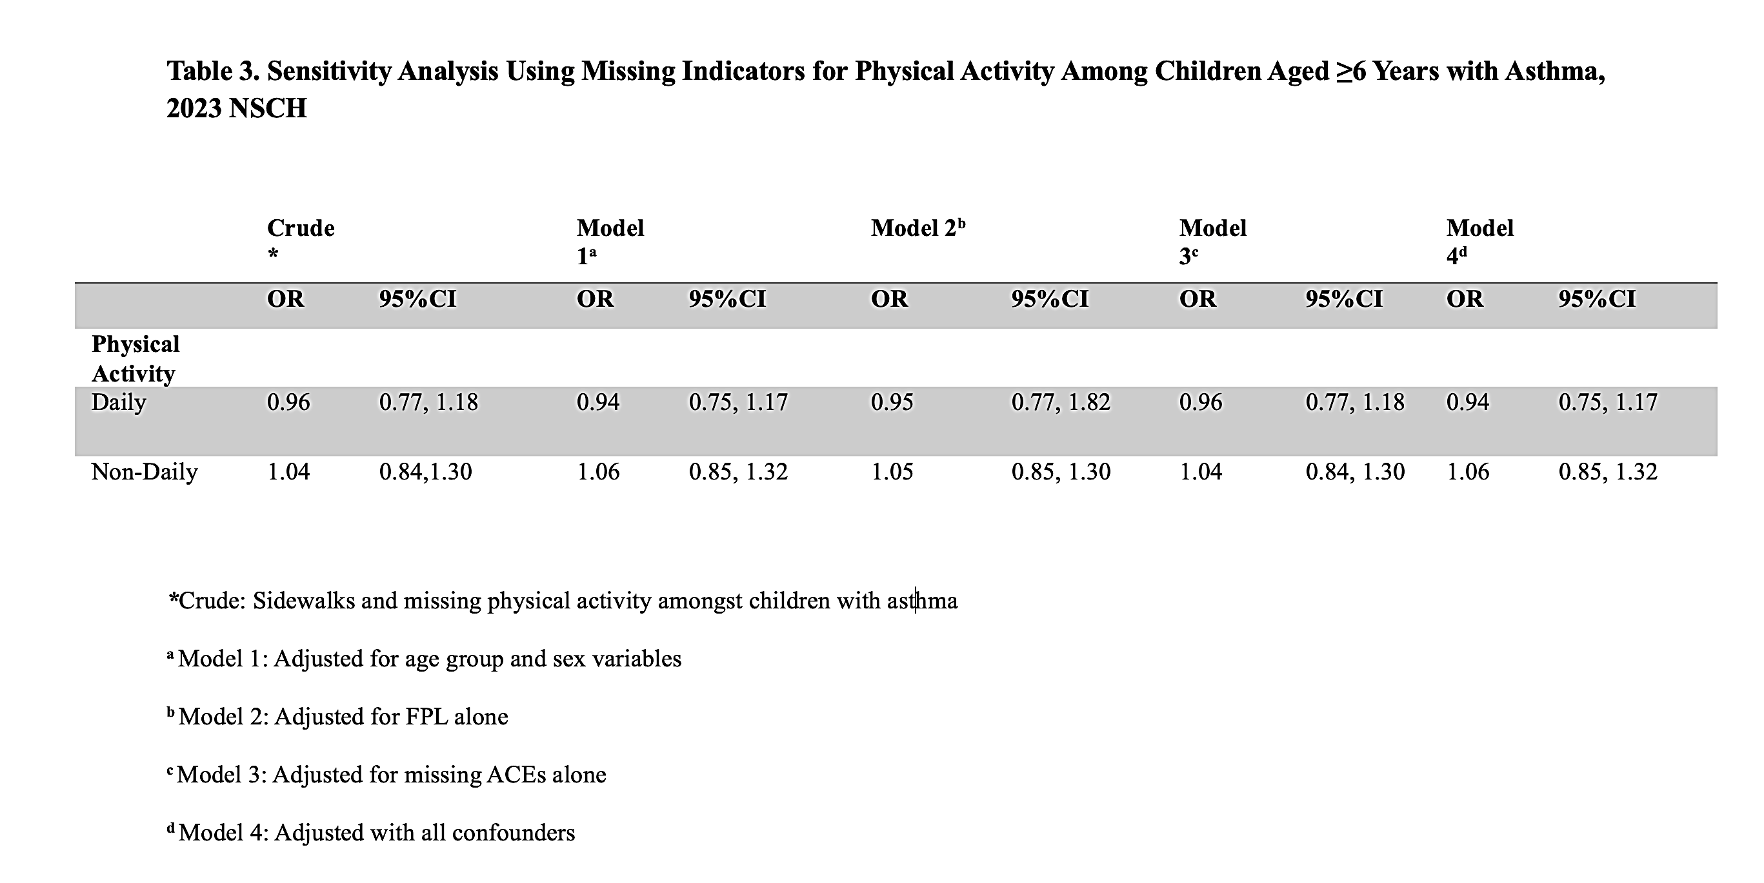
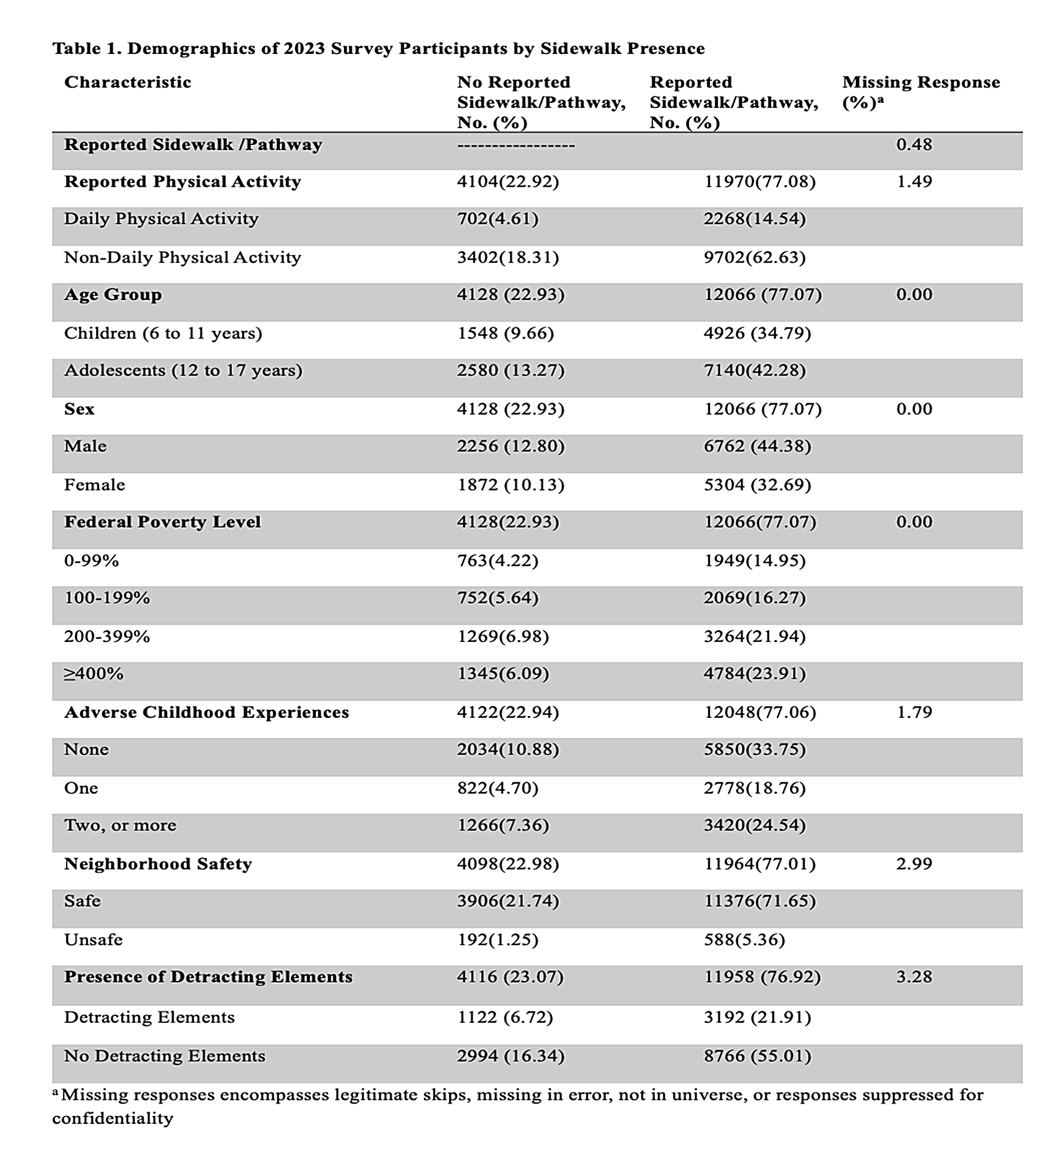
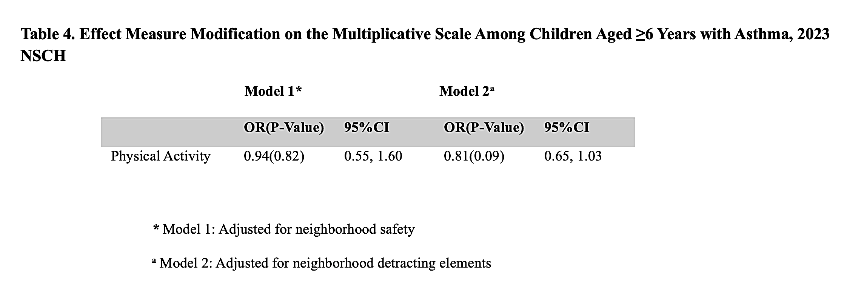
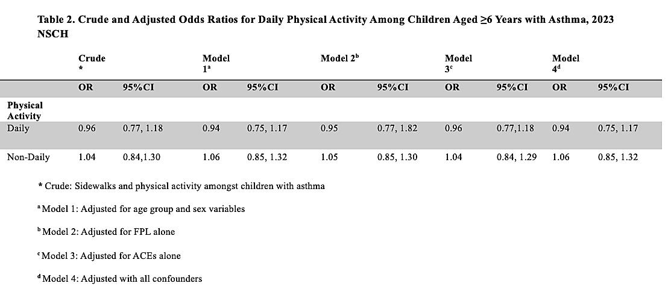


Sidewalk Access and Daily Physical Activity in Children With Asthma: A Cross-Sectional Analysis
Eileen M. Murray
CUNY Graduate School of Public Health and Health Policy, New York, NY 10027
Introduction
Childhood obesity has increased in the United States and is associated with comorbidities such as type 2 diabetes and cardiovascular disease.¹ Asthma commonly co-occurs with obesity, and evidence suggests that obesity worsens asthma severity and reduces symptom control.^{2,3} This may impair lung function and reduce the effectiveness of treatments, increasing healthcare utilization among affected children.^{3,4}
Physical activity may help reduce obesity risk and improve lung function in children with asthma, potentially decreasing asthma exacerbations.⁴⁻⁸ However, children with asthma may be less likely to engage in physical activity due to barriers such as fear of exercise-induced bronchoconstriction (EIB), caregiver concerns about symptom management, and limited adherence to treatment plans.^{5,6,9} Furthermore Psychosocial and environmental factors, including adverse childhood experiences (ACEs), lack of safe recreational spaces, and neighborhood safety concerns, further limit physical activity opportunities.^{4˒8-12}
Neighborhood infrastructure may play a key role in promoting physical activity. Greater walkability, including the presence of sidewalks, has been associated with increased physical activity among children^{.12-17} However, this relationship varies based on neighborhood safety, neighborhood aesthetics, quality of sidewalk, and socioeconomic conditions.^{12,16 18-20}
Despite existing research, no studies have specifically examined the association between sidewalk availability and physical activity among children with asthma. This study uses 2023 National Survey of Children’s Health (NSCH) data to assess whether sidewalk presence is associated with daily physical activity. ²¹ It is hypothesized that children with access to sidewalks are more likely to engage in daily physical activity.
Results
Among 16,194 children with asthma, 77.1% reported neighborhood sidewalks. Sidewalk presence was more common among adolescents, males, higher-income households, and those reporting safer neighborhoods and fewer detracting elements.
No significant association was found between sidewalk presence and daily physical activity across all models. In crude analysis, sidewalks were associated with slightly lower odds of daily activity (OR: 0.96; 95% CI: 0.77–1.18), which remained non-significant after adjustment. Sensitivity analyses showed consistent results.
No effect modification was observed by neighborhood safety or conditions, and stratified analyses remained non-significant across all subgroups.
Public Health Implications
No evidence was found that exposure to reported sidewalks is significantly associated with daily physical activity among children with asthma in the NSCH 2023 survey data. The results did not support the hypothesized relationship and instead suggested a trend opposite to expectations, though it was not statistically significant.
Limitations such as reliance on parent-reported data and lack of objective measures may have influenced the findings. Future research should focus on using more precise and objective methods to assess both environmental exposure and physical activity.
Overall, the study highlights the need for improved measurement approaches in examining the relationship between neighborhood infrastructure and physical activity amongst children with asthma, and implications for their health outcomes such as obesity risk.
Literature Cited
1. Arubuolawe OO, Gabriel OT, Anats CJ, et al. Demographic and Socioeconomic Disparities in Adolescent Obesity: Insights From the National Survey of Children's Health Database. Cureus. Oct 2024;16(10):e72150. doi:10.7759/cureus.72150
2. Stratakis N, Garcia E, Chandran A, et al. The Role of Childhood Asthma in Obesity Development: A Nationwide US Multicohort Study. Epidemiology. Jan 1 2022;33(1):131-140. doi:10.1097/ede.0000000000001421
3. Peters U, Dixon AE, Forno E. Obesity and asthma. J Allergy Clin Immunol. Apr 2018;141(4):1169-1179. doi:10.1016/j.jaci.2018.02.004
4. Koinis-Mitchell D, Kopel SJ, Dunsiger S, et al. Asthma and Physical Activity in Urban Children. J Pediatr Psychol. Aug 19 2021;46(8):970-979. doi:10.1093/jpepsy/jsab023
5. Marios Panagiotou NGK, Nikoletta Rovina. Physical Activity: A Missing Link in Asthma Care. Clincial Review. Journal of Clinical Medicine March 5, 2020 2020;9(3):19.
6. Balatoni I, Kiss T, Balla G, Papp Á, Csernoch L. Assessment of the Physical Activity of Children with Asthma Bronchiale. Sports (Basel). Apr 22 2024;12(4)doi:10.3390/sports12040114
7. Lu K, Sidell M, Li X, et al. Self-Reported Physical Activity and Asthma Risk in Children. J Allergy Clin Immunol Pract. Jan 2022;10(1):231-239.e3. doi:10.1016/j.jaip.2021.08.040
8. González-Devesa D, Carballo-Afonso R, Sanchez-Lastra MA, Ayán-Pérez C. Barriers and facilitators to physical activity and exercise among individuals with asthma: a systematic review. Performance Enhancement & Health. 2025/10/01/ 2025;13(4):100371. doi:https://doi.org/10.1016/j.peh.2025.100371
9. Kornblit A, Cain A, Bauman LJ, Brown NM, Reznik M. Parental Perspectives of Barriers to Physical Activity in Urban Schoolchildren With Asthma. Acad Pediatr. Apr 2018;18(3):310-316. doi:10.1016/j.acap.2017.12.011
10. Al-Shoaibi AAA, Iyra P, Raney JH, et al. Associations Between Adverse Childhood Experiences and Early Adolescent Physical Activity in the United States. Acad Pediatr. May-Jun 2024;24(4):662-668. doi:10.1016/j.acap.2023.10.004
11. Hadwen B, Pila E, Thornton J. The Associations Between Adverse Childhood Experiences, Physical and Mental Health, and Physical Activity: A Scoping Review. J Phys Act Health. Dec 1 2022;19(12):847-854. doi:10.1123/jpah.2022-0298
12. D'Agostino EM, Zhang S, Day SE, et al. The longitudinal association between asthma severity and physical fitness among new York City public school youth. Prev Med. May 2023;170:107486. doi:10.1016/j.ypmed.2023.107486
13. Acciai F, DeWeese RS, Lloyd K, et al. The relationship between changes in neighborhood physical environment and changes in physical activity among children: a prospective cohort study. Int J Behav Nutr Phys Act. Jul 7 2023;20(1):82. doi:10.1186/s12966-023-01478-2
14. Wagner BE, Zong Z, Neshteruk CD, D'Agostino EM. Association Between School Neighborhood Walkability and Adolescent Physical Activity. J Healthy Eat Act Living. 2025;5(2):161-170.
15. Yang S, Xiang, C, Wang, L, Wu, T., Fei, T., Xiao, Q, Zhang, G., Jia, Y. N. Walkability indices and childhood obesity: A review of epidemiologic evidence. Obesity Reviews. July 27 2020;22(Suppl 1)doi:10.1111/obr.13096
16. Wei J, Wu Y, Zheng J, Nie P, Jia P, Wang Y. Neighborhood sidewalk access and childhood obesity. Obes Rev. Feb 2021;22 Suppl 1(Suppl 1):e13057. doi:10.1111/obr.13057
17. Carlson JA, Sallis JF, Kerr J, et al. Built environment characteristics and parent active transportation are associated with active travel to school in youth age 12-15. Br J Sports Med. Dec 2014;48(22):1634-9. doi:10.1136/bjsports-2013-093101
18. Zhu J, Kodali H, Wyka KE, Huang TT. Perceived neighborhood environment walkability and health-related quality of life among predominantly Black and Latino adults in New York City. BMC Public Health. Jan 18 2023;23(1):127. doi:10.1186/s12889-022-14973-1
19. Rajaee M, Echeverri B, Zuchowicz Z, Wiltfang K, Lucarelli JF. Socioeconomic and racial disparities of sidewalk quality in a traditional rust belt city. SSM Popul Health. Dec 2021;16:100975. doi:10.1016/j.ssmph.2021.100975
20. Conderino SE, Feldman JM, Spoer B, Gourevitch MN, Thorpe LE. Social and Economic Differences in Neighborhood Walkability Across 500 U.S. Cities. Am J Prev Med. Sep 2021;61(3):394-401. doi:10.1016/j.amepre.2021.03.014
21. Initiative CaAHM. Data from: 2023 National Survey of Children’s Health (NSCH). 2023. United States Census Bureau.
22. Simons E, Dell S, Moineddin R, To T. Longitudinal associations between neighbourhood walkability and incident childhood asthma. Allergy Asthma Clin Immunol. 2014;10(Suppl 1):A8. doi:10.1186/1710-1492-10-s1-a8
23. Simons E, Dell SD, Moineddin R, To T. Associations between Neighborhood Walkability and Incident and Ongoing Asthma in Children. Ann Am Thorac Soc. Jun 2018;15(6):728-734. doi:10.1513/AnnalsATS.201708-693OC
24. An R, Yang Y, Li K. Residential Neighborhood Amenities and Physical Activity Among U.S. Children with Special Health Care Needs. Maternal & Child Health Journal. 2017;21(5):1026-1036. doi:10.1007/s10995-016-2198-3
Objective
To assess the association between self-reported neighborhood sidewalks and daily physical activity among children with asthma.
Methods
Data Source & Sample
2023 National Survey of Children’s Health (NSCH)
Nationally representative, parent-reported survey
Included children ages 6–17 with current asthma
Final analytic sample: N = 16,194 (weighted)
Measures
Exposure: Neighborhood sidewalk presence (yes/no)
Outcome: Daily physical activity (≥60 min/day, yes/no)
Covariates:
Demographics: age (6–11, 12–17), sex
Socioeconomic status: federal poverty level (FPL; 4 categories)
Adverse childhood experiences (ACEs; 0, 1, ≥2)
Effect Modifiers
Neighborhood safety (safe vs. unsafe)
Neighborhood detracting elements (e.g., litter, vandalism; yes/no)
Statistical Analysis
Survey-weighted descriptive statistics
Survey-weighted logistic regression to estimate odds of daily physical activity
Sequential models: crude, adjusted, fully adjusted
Interaction terms tested for neighborhood safety and detracting elements
Stratified and sensitivity analyses conducted
All analyses were conducted using SAS Studio OnDemand for Academics (SAS Institute Inc., Cary, NC).
Ethics
Exempt (public-use, de-identified data)
Discussion
Sidewalk presence was not associated with daily physical activity. However, direction of association was unexpected as it was a slightly lower odds of reported daily physical activity amongst children with asthma who reported sidewalks.
The results may be interpreted as sidewalks alone may be insufficient to promote physical activity. Rather, broader neighborhood factors such as safety, quality, and infrastructure most likely play a larger role. Prior research further affirms this such as studies that have utilized walkability indices which show positive associations with physical activity and asthma outcomes. ^{4,12-15,22,23} Furthermore, these measures like walkability indices included multiple features like density, connectivity, and access, not sidewalks alone. ^{4,12-15,22,23} Of note, some survey-based studies report similar null, or inverse findings.²⁴
Strengths
Nationally representative sample (NSCH)
Focus on children with asthma
Adjustment for demographic, SES, and psychosocial factors
Limitations
Parent-reported data (recall/social desirability bias)
No objective neighborhood or physical activity measures
Cross-sectional design
Acknowledgments
I’d like to thank C. Mirzayi for her feedback.
For further information
Please contact eileen.murray46@sphmail.cuny.edu

