Slide 1


Presented by :
Eileen M. Murray
Sidewalk Access & Daily Physical Activity in Children With Asthma
A Cross-Sectional Analysis
PUBH698: Capstone Project
Capstone Professor: Dr. Chloe Mirzayi
Notes:
Hello, my name is Eileen Murray, and I will be presenting my capstone research on sidewalk access and daily physical activity among children with asthma.

Slide 2
Background
Childhood obesity has increased in prevalence in the United States.¹ Childhood asthma occurs alongside childhood obesity.²
Obesity impacts asthma symptom control. ^{3,4}
Physical activity may be a critical preventative strategy. ⁴⁻⁶
Children with asthma are less likely to engage in physical activity. ^{4,8-10}
.
Notes:
To begin with, childhood obesity has been increasing in prevalence in the United States, and it often co-occurs alongside childhood asthma. For children with asthma, having obesity may further impact their symptom management. Notably. leading to lack of symptom control, increased medication use, exacerbations and emergency department visits. However, for children with asthma partaking in physical activity can both decrease their obesity risk, and help improve their symptom control. Yet due to a variety of reasons, children with asthma are less likely to engage in physical activity.

Slide 3
Background
Improved walkability may be one pathway toward increasing physical activity. ¹⁰⁻¹⁵
  There is conflicting evidence regarding asthma outcomes, and physical activity amongst children with asthma.^{16,17,18}
  Walkability and physical activity studies agree increased walkability improves physical activity. ^{11, 14, 15}
Question: Do reports of neighborhood sidewalks lead to reports of daily physical activity among children with asthma?
Data: National Survey on Children’s Health (NSCH) 2023 survey data. ^{16,}
Hypothesis: Reported neighborhood sidewalks will be positively associated with odds of reporting daily physical activity.
.
Notes:
One pathway toward increasing daily physical activity may come through neighborhood-level interventions such infrastructures that promote walkability. Previous research found that increased neighborhood walkability was associated with a decrease in asthma incidence, and on-going asthma diagnoses. However, others studies that of which focused on neighborhood amenities broadly and physical activity among children with chronic health needs like asthma did not find a significant association. However, research focusing on neighborhood walkability infrastructures and physical activity broadly found that these infrastructures do promote physical activity amongst children broadly. Especially at the street-level.
There this informed the research question of this study: Do reports of neighborhood sidewalks lead to reports of daily physical activity among children with asthma? To achieve, this I utilized the 2023 National Survey on Children’s Health data. And I hypothesized that reported neighborhood sidewalks will be positively associated with odds of reporting daily physical activity.

Slide 4
Methods
Data: 2023 NSCH Survey Data
  N= 16,074 (analytic), 3,640 (observed).
Variables:
  Exposure: Sidewalks (yes/no)
  Outcome: Physical Activity (daily/non-daily)
  Covariates: Age group (Children, Adolescents⁾¹⁸⁻²¹, Sex (Male/Female⁾¹⁸⁻²¹, Adverse Childhood Experiences (ACEs)²²⁻²³ (None, One, Two or more), imputed Federal Poverty Level (FPL) (0–99%, 100–199%, 200–399%, and ≥400%)^{17,20-21}, Neighborhood safety (safe/unsafe^{)13,24} neighborhood detracting elements (detracting elements present/detracting elements not present)^{13,24}
  Missing indicator variables
.
Notes:
This study used data from the 2023 National Survey of Children’s Health, which is a nationally representative survey that captures a wide range of child health and environmental factors in the United States.
The analytic sample was restricted to children ages 6 to 17 whose caregivers reported that the child currently had asthma and had complete data on sidewalks and physical activity. The observed sample included 3,640 children, and after applying multiple imputation for income, the final analytic sample was 16,074.
The exposure variable was parent-reported presence of sidewalks or walking paths in the neighborhood, measured as a yes or no response.
The outcome variable was physical activity, based on the number of days per week the child engaged in at least 60 minutes of activity. This was recoded into a dichotomous variable comparing daily activity versus non-daily activity.
Several covariates were included:
Age groups (children 6-10, adolescents 11-17) and sex due to interactions of sex and puberty on asthma status
Socioeconomic status using federal poverty level (FPL) due to influence SES can have on neighborhood conditions
Adverse childhood experiences (ACES), categorized as 0, 1, or 2+ out of the ten total ACES ask . this was included as it can negatively impact physical activity
Neighborhood safety, categorized as safe or unsafe. This was derived from a question that had 4 levels of safety regarding neighborhood safety, but was made dichotomous
Neighborhood detracting elements, were derived from questions regarding litter, vandalism, and rundown housing. A two level variable was creating indicating if any of those elements were present, or not present.

Slide 5
Methods
Descriptive statistics: unweighted frequencies, and survey-weighted percentages of participant characteristics
Survey-weighted logistic regression models, complex-survey design
  Models: crude, adjusted for demographic variables, FPL, and ACEs, and fully adjusted
Sensitivity analyses with missing indicator variables, complex-survey design
  Models: crude, adjusted for demographic variables, FPL, and ACEs, and fully adjusted
Effect Measure Modification on the multiplicative scale, complex-survey design
  Models: Neighborhood safety, neighborhood detracting elements
SAS Studio OnDemand for Academics (SAS Institute Inc., Cary, NC).
.
Notes:
Descriptive statistics were first generated to summarize the sample. Then, survey-weighted logistic regression models were used to estimate the association between sidewalks and physical activity. Models were run as crude, partially adjusted, and fully adjusted.
Additional analyses included sensitivity analyses for missing data and tests for interaction on the multiplicative scale with neighborhood safety and detracting elements. All analyses accounted for the survey design and were conducted in SAS on demand for academics

Slide 6
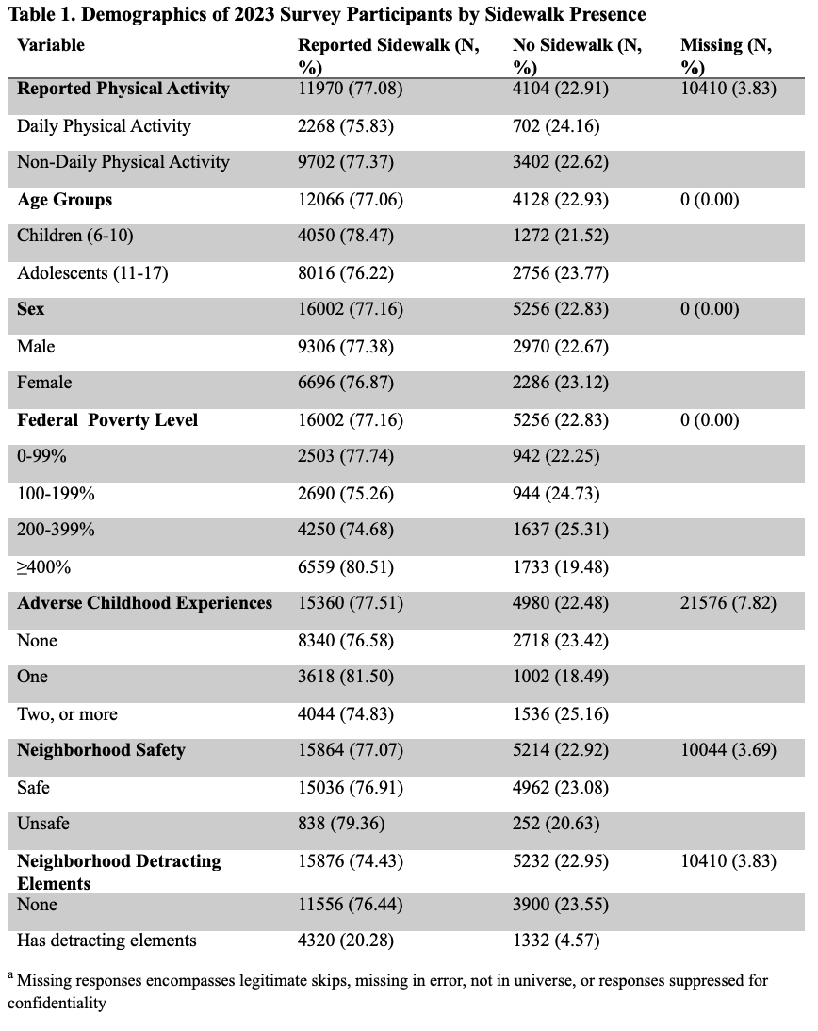
Results
77.08% reported a sidewalk
Missing data across all covariates ranged from 0.00% to 3.83%
Adolescents (12-17 years), and males represented the largest proportions reporting sidewalks
Notes:
In the final sample, about 77% of children were reported to live in neighborhoods with sidewalks, and missing data across variables was low.
Adolescents and males represented the largest proportions of those reporting sidewalk presence. Higher-income households and those in safer neighborhoods were also more likely to report sidewalks.

Slide 7
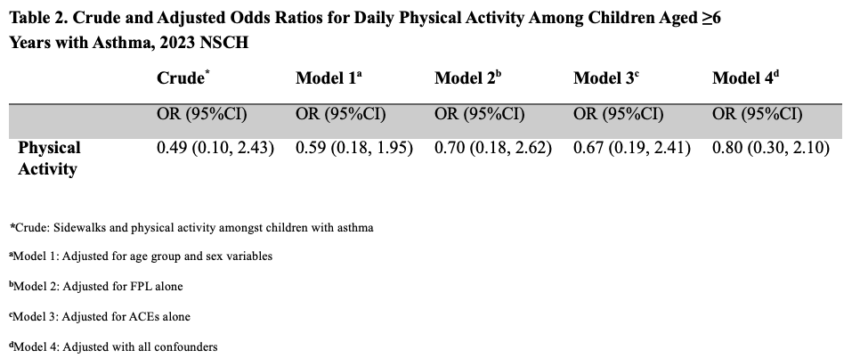
Results
No statistically significant associations across all analyses, and models. All confidence intervals overlapped with the null value (OR=1)
Crude model suggests lower odds of physical activity. Yet fully adjusted model suggest a higher odds of physical activity.
Notes:
When examining the association between sidewalks and physical activity, no statistically significant relationships were found across any of the models. All confidence intervals overlapped with the null value.
The crude model suggested lower odds of daily physical activity among those with sidewalks. However, after adjusting for demographic, socioeconomic, and neighborhood factors, the direction shifted slightly toward higher odds—but remained non-significant.
Sensitivity analyses and interaction tests with neighborhood safety and detracting elements also showed no meaningful changes in the results.
Overall, the findings consistently indicated no clear association between sidewalk presence and daily physical activity in this population.

Slide 8
Discussion
Previous research suggests a broader interplay of neighborhood conditions.^{10,25,26}
Consistent with similar studies using NSCH data. ²⁷
Strengths:
  Large nationally representative sample
  Population: Children with asthma
  Accounted for various covariates such as sex and age ^{18-21,} FPL²⁰⁻²¹,ACEs^{22-23,} safety^{13,24},and neighborhood detracting elements.^{13,24}
Limitations:
  Parent-reported survey data.²⁷
  Lack of objective measures. ^{11,14,16 25,26}
Future Research: Needs more detailed and objective measures
.
Notes:
Overall, this study found no association between neighborhood sidewalks and daily physical activity among children with asthma, which did not support the hypothesis. Although results slightly suggested lower activity with sidewalks, they were not statistically significant, and neighborhood factors did not modify the relationship.
While prior research generally shows that walkability improves asthma and physical activity outcomes, those studies use more detailed measures like geographic data or walkability indices—suggesting a broader interplay of neighborhood conditions beyond sidewalks alone. These findings are consistent with other studies using NSCH data.
Strengths include a large, nationally representative sample and adjustment for key factors like age, sex, socioeconomic status, ACEs, and neighborhood conditions.
However, limitations include reliance on parent-reported data and lack of objective measures. Future research should use more detailed and objective methods to better understand these relationships.

Slide 9
Conclusion
No evidence was found that reported sidewalks is significantly associated with daily physical activity among children with asthma
Future research should focus on more detailed and objective measures
Study highlights need for improved approaches for investigating this relationship
.
Notes:
There was no evidence that reported sidewalk presence is associated with daily physical activity among children with asthma.
These findings suggest that sidewalks alone may not be sufficient to influence physical activity in this group. Instead, broader neighborhood conditions and more precise measurement approaches may be needed to better understand what supports physical activity.
Future research should incorporate objective environmental data and direct measures of physical activity to better capture these relationships.

Slide 10
References
1. Arubuolawe OO, Gabriel OT, Anats CJ, et al. Demographic and Socioeconomic Disparities in Adolescent Obesity: Insights From the National Survey of Children's Health Database. Cureus. Oct 2024;16(10):e72150. doi:10.7759/cureus.72150
2. Stratakis N, Garcia E, Chandran A, et al. The Role of Childhood Asthma in Obesity Development: A Nationwide US Multicohort Study. Epidemiology. Jan 1 2022;33(1):131-140. doi:10.1097/ede.0000000000001421
3. Peters U, Dixon AE, Forno E. Obesity and asthma. J Allergy Clin Immunol. Apr 2018;141(4):1169-1179. doi:10.1016/j.jaci.2018.02.004
4. Koinis-Mitchell D, Kopel SJ, Dunsiger S, et al. Asthma and Physical Activity in Urban Children. J Pediatr Psychol. Aug 19 2021;46(8):970-979. doi:10.1093/jpepsy/jsab023
5. Marios Panagiotou NGK, Nikoletta Rovina. Physical Activity: A Missing Link in Asthma Care. Clincial Review. Journal of Clinical Medicine March 5, 2020 2020;9(3):19.
6. Balatoni I, Kiss T, Balla G, Papp Á, Csernoch L. Assessment of the Physical Activity of Children with Asthma Bronchiale. Sports (Basel). Apr 22 2024;12(4)doi:10.3390/sports12040114
7. González-Devesa D, Carballo-Afonso R, Sanchez-Lastra MA, Ayán-Pérez C. Barriers and facilitators to physical activity and exercise among individuals with asthma: a systematic review. Performance Enhancement & Health. 2025/10/01/ 2025;13(4):100371. doi:https://doi.org/10.1016/j.peh.2025.100371
8. Lu K, Sidell M, Li X, et al. Self-Reported Physical Activity and Asthma Risk in Children. J Allergy Clin Immunol Pract. Jan 2022;10(1):231-239.e3. doi:10.1016/j.jaip.2021.08.040
9. Kornblit A, Cain A, Bauman LJ, Brown NM, Reznik M. Parental Perspectives of Barriers to Physical Activity in Urban Schoolchildren With Asthma. Acad Pediatr. Apr 2018;18(3):310-316. doi:10.1016/j.acap.2017.12.011
10. D'Agostino EM, Zhang S, Day SE, et al. The longitudinal association between asthma severity and physical fitness among new York City public school youth. Prev Med. May 2023;170:107486. doi:10.1016/j.ypmed.2023.107486
11. Acciai F, DeWeese RS, Lloyd K, et al. The relationship between changes in neighborhood physical environment and changes in physical activity among children: a prospective cohort study. Int J Behav Nutr Phys Act. Jul 7 2023;20(1):82. doi:10.1186/s12966-023-01478-2
12. Wagner BE, Zong Z, Neshteruk CD, D'Agostino EM. Association Between School Neighborhood Walkability and Adolescent Physical Activity. J Healthy Eat Act Living. 2025;5(2):161-170.
13. Yang S, Xiang, C, Wang, L, Wu, T., Fei, T., Xiao, Q, Zhang, G., Jia, Y. N. Walkability indices and childhood obesity: A review of epidemiologic evidence. Obesity Reviews. July 27 2020;22(Suppl 1)doi:10.1111/obr.13096
14. Wei J, Wu Y, Zheng J, Nie P, Jia P, Wang Y. Neighborhood sidewalk access and childhood obesity. Obes Rev. Feb 2021;22 Suppl 1(Suppl 1):e13057. doi:10.1111/obr.13057
.

Slide 11
References
15. Carlson JA, Sallis JF, Kerr J, et al. Built environment characteristics and parent active transportation are associated with active travel to school in youth age 12-15. Br J Sports Med. Dec 2014;48(22):1634-9. doi:10.1136/bjsports-2013-093101
16. . Initiative CaAHM. Data from: 2023 National Survey of Children’s Health (NSCH). 2023. United States Census Bureau.
17. Bureau USC. National Survey of Children’s Health Analysis with Multiply Imputed Data. United States Census Bureau.
18. Chiarella SE, Garcia-Guaqueta DP, Drake LY, et al. Sex differences in sociodemographic, clinical, and laboratory variables in childhood asthma: A birth cohort study. Annals of Allergy, Asthma & Immunology. 2024/10/01/ 2024;133(4):403-412.e2. doi:https://doi.org/10.1016/j.anai.2024.07.005
19. Fu L, Freishtat RJ, Gordish-Dressman H, et al. Natural progression of childhood asthma symptoms and strong influence of sex and puberty. Ann Am Thorac Soc. Jul 2014;11(6):939-44. doi:10.1513/AnnalsATS.201402-084OC
20. McKernan KE, Pilier EH, Newcomb DC. Sex Differences in Asthma Pathogenesis. Immunol Rev. Jan 2026;337(1):e70100. doi:10.1111/imr.70100
21. Devonshire AL, Kumar R. Pediatric asthma: Principles and treatment. Allergy Asthma Proc. Nov 1 2019;40(6):389-392. doi:10.2500/aap.2019.40.4254
22. Al-Shoaibi AAA, Iyra P, Raney JH, et al. Associations Between Adverse Childhood Experiences and Early Adolescent Physical Activity in the United States. Acad Pediatr. May-Jun 2024;24(4):662-668. doi:10.1016/j.acap.2023.10.004
23. Hadwen B, Pila E, Thornton J. The Associations Between Adverse Childhood Experiences, Physical and Mental Health, and Physical Activity: A Scoping Review. J Phys Act Health. Dec 1 2022;19(12):847-854. doi:10.1123/jpah.2022-0298
24. Zhu J, Kodali H, Wyka KE, Huang TT. Perceived neighborhood environment walkability and health-related quality of life among predominantly Black and Latino adults in New York City. BMC Public Health. Jan 18 2023;23(1):127. doi:10.1186/s12889-022-14973-1
25. Simons E, Dell SD, Moineddin R, To T. Associations between Neighborhood Walkability and Incident and Ongoing Asthma in Children. Ann Am Thorac Soc. Jun 2018;15(6):728-734. doi:10.1513/AnnalsATS.201708-693OC
26. Simons E, Dell S, Moineddin R, To T. Longitudinal associations between neighbourhood walkability and incident childhood asthma. Allergy Asthma Clin Immunol. 2014;10(Suppl 1):A8. doi:10.1186/1710-1492-10-s1-a8
27. An R, Yang Y, Li K. Residential Neighborhood Amenities and Physical Activity Among U.S. Children with Special Health Care Needs. Maternal & Child Health Journal. 2017;21(5):1026-1036. doi:10.1007/s10995-016-2198-3
.

Slide 12
Acknowledgements
Dr. Chloe Mirzayi
TA: Eslam Abousamra
My family, friends, and co-workers
My peers especially Makayla, and Deep
.

Slide 13
Presented by :
Eileen M. Murray
Thank You

