Slide 1
Finding Open Data

Slide 2

Finding Open Data
First, go to the ATLAS Open Data website:
https://opendata.atlas.cern/

Slide 3
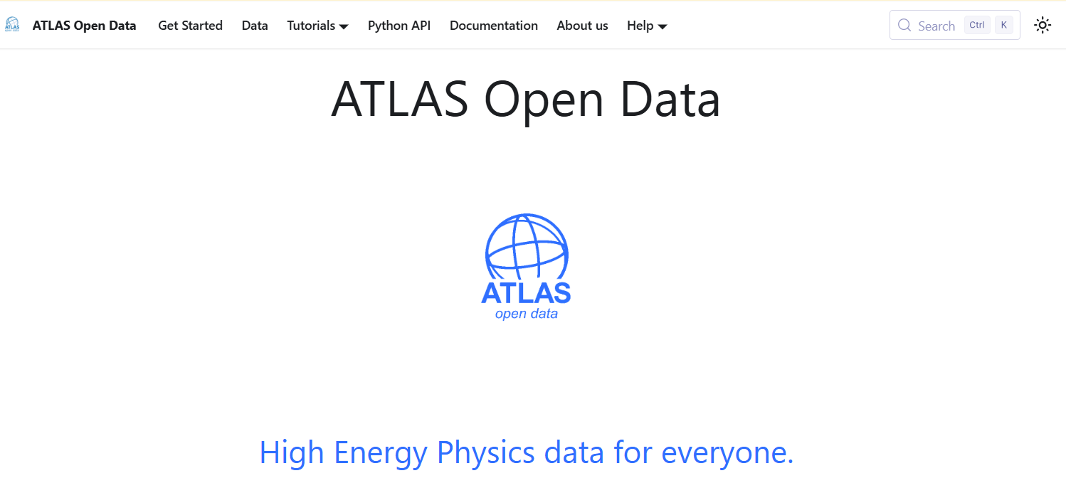
Finding Open Data
We will click “Data” to explore the data collections.
You should also explore the “Documentation” tab

Slide 4
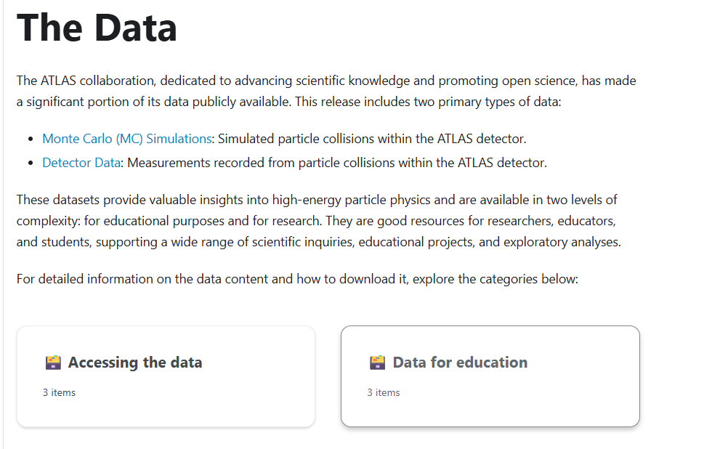
Finding Open Data
Read through the information linked here.
Then click on Data for Education

Slide 5
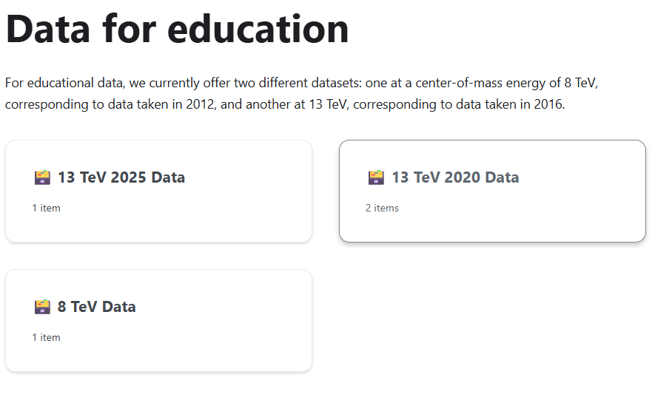
Finding Open Data
We will initially be using the 2020 data.
If you want to you can explore other data sets when conducting your own research in Phase 3

Slide 6
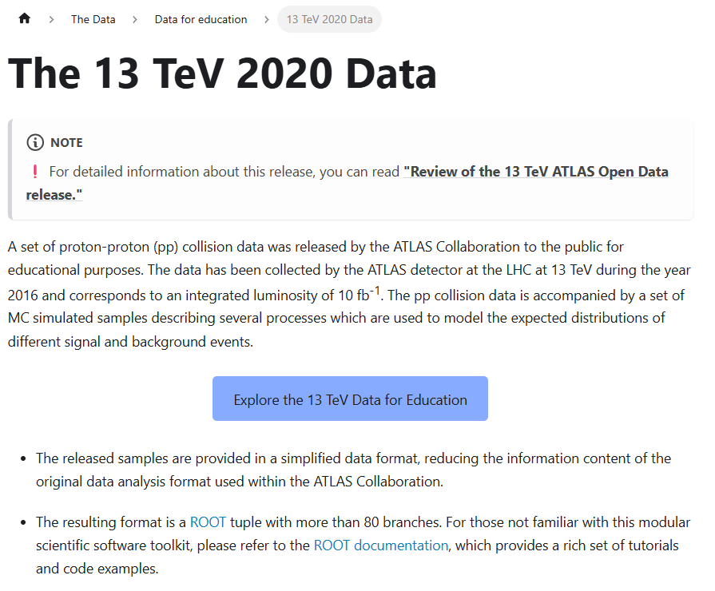
Finding Open Data
Read down through this page. Some parts might be confusing, but you will gradually develop familiarity with the notation and the contents of the files.
You will likely revisit it and the documentation tab a few times to read about the different types of analysis you can do and to find the numbers/names of datafiles for those analyses.
When you’re ready, click the blue button to navigate to the files themselves.

Slide 7
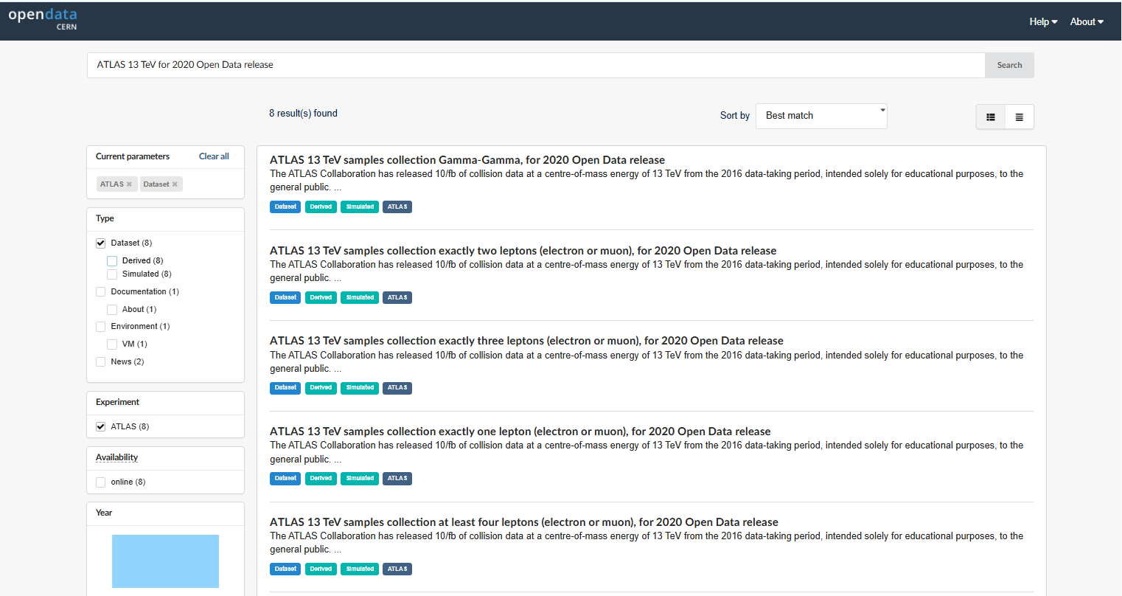
Finding Open Data
You can use filters to narrow your search, e.g. if you want Monte Carlo simulated data you can select “Derived”
Then you can click on a row to look at it in detail.

Slide 8
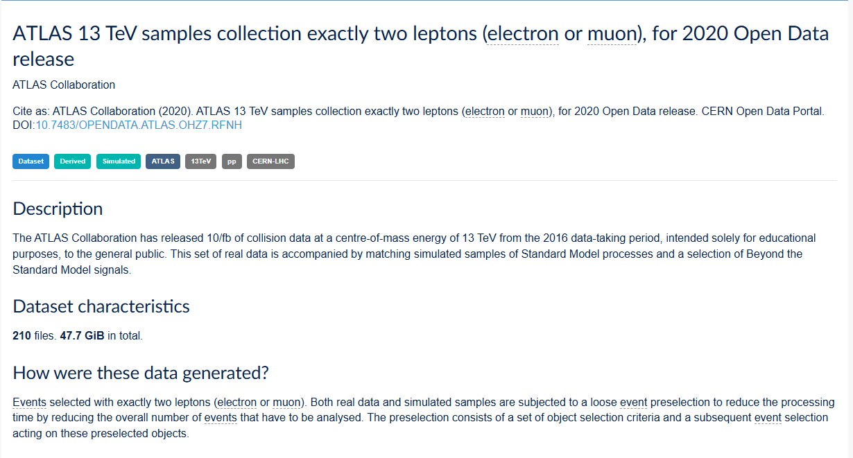
Finding Open Data
These DOI links are unique identifiers that can be used with the opendata client and the FileRetriever.py “print_files” method.

Slide 9
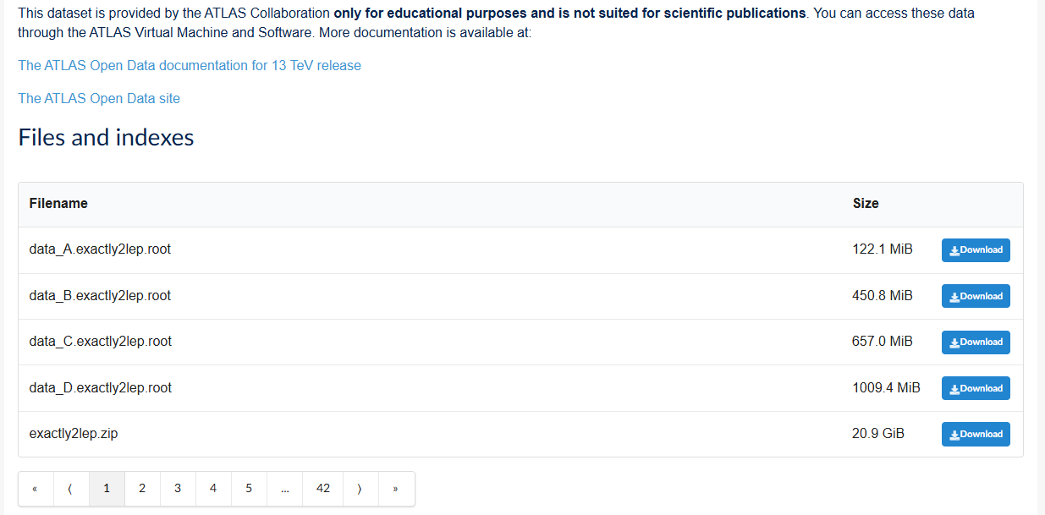
Finding Open Data
It is possible to download the files and work with them locally, but as they are very large this is inefficient. It also doesn’t work well with the Monty server.
There are links to the documentation
Sometimes there are a lot of tiles!

Slide 10
Finding Open Data
So instead, copy and paste this DOI and bring it back to your notebook.

Slide 11
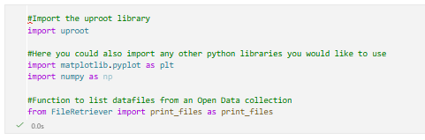
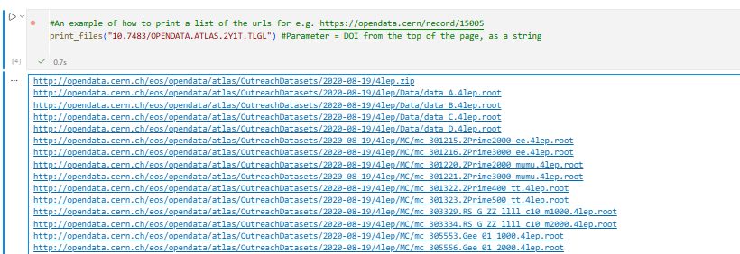
Finding Open Data
In Notebook 3 we show you how to import the print_files method from the FileRetriever
This is how to use the DOI from the top of the page to retrieve the list of urls for the data files.
Copy the link of the file that you want.

Slide 12
Finding Open Data
Then paste it into the uproot.open method as a string (i.e. between two double quotes “ “)
Congratulations! You’ve successfully loaded a data file into your Jupyter Notebook!

