Slide 1


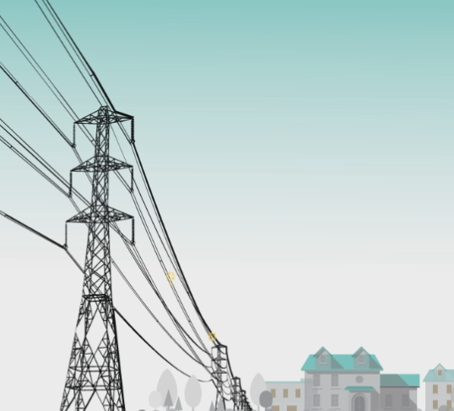
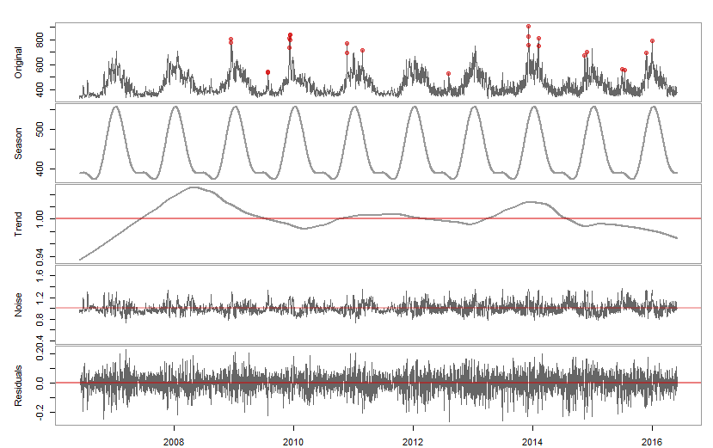
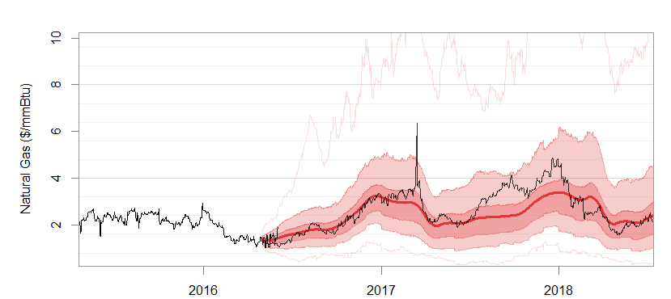
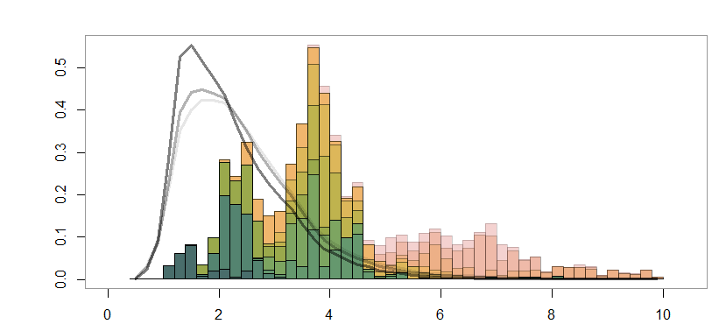
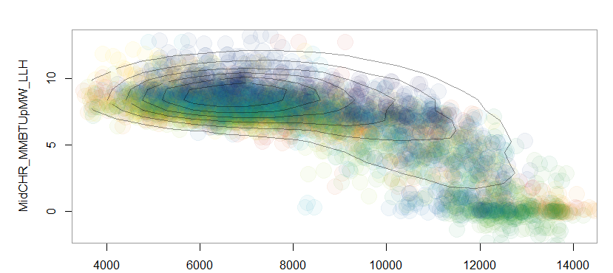
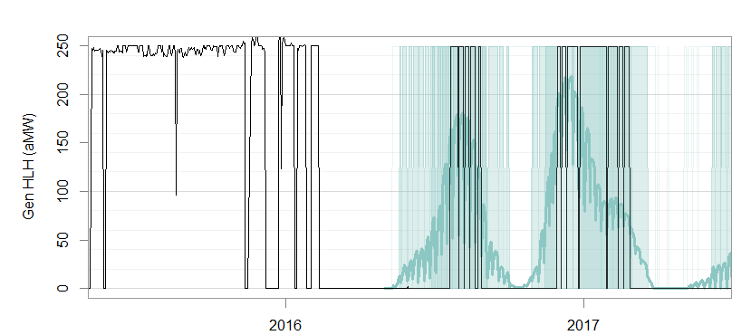
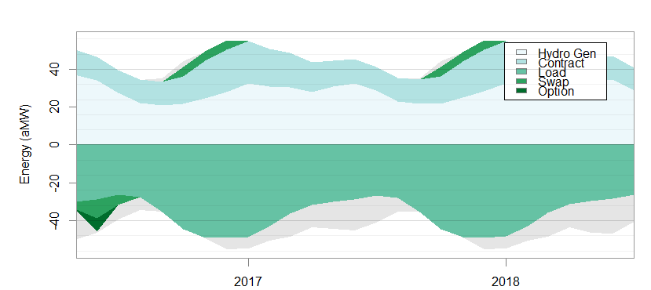
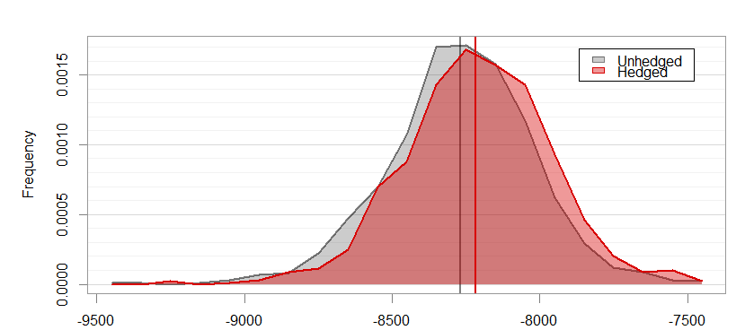
All-Inclusive but Practical Multivariate Stochastic Forecasting for Electric Utility Portfolio
AUTHOR: Eina Ooka
Sr. Structure and Pricing Analyst
The Energy Authority
eooka@teainc.org
https://github.com/einaooka/useR2016
(See this link for references)
Scheduled Tasks
Stochastic Variable Generation
DATA
[objective]
STEPS
METHODS
Time Series Decomposition
1. Data Scraping
Hierarchical Clustering
Collinear variables are taken out of the main AR model and derived later using predictive models.
Daily historical data
- On-peak Load
- Off-peak Load
- Hydro generations
- Natural gas prices
- Power prices
[i – viii]
2. Collinearity and Dependency Detection
Grubb’s Outlier Test
Applied twice before and after decomposition.
Fourier series
LOESS
Subset Regression
Weekly shapes and auto-regression factors are captured here after decomposition.
Objective
3. Multiplicative Decomposition
Outlier + Seasonality x Trend x Noise
Quantify market risk that utilities are exposed to, through stochastic simulation of loads, resources and market prices.
Portray appropriate tail risk with 1,000 or more stochastic iterations.
Capture the following data characteristics:
Autocorrelation
Heteroscedasticity
Seasonal and weekly shape
Mutivariate cross-correlation and non-linear dependency
Non-normal distributions
Extreme peaks and drops
Negative prices
Max and min caps
Reasonable long-term distributions
Consistency with market and utility expectations
External LT forecasts in monthly granularity.
- Econometric load forecasts
- Metrological hydro forecasts
[i – v, viii – x]
Simulated Time Series
4. Long-Term Stochastic Forecasting
Multivariate Gaussian Model
Héston Model
ARIMA(1,2,0)
If an external LT forecast does not exist, it is derived from trend and seasonality components (step 3).
Market settlement data
- Forward prices
[x]
5. Daily Volatility & Spike Model
Historical vs. Simulated
Seasonal Block Bootstrapping
Multiple Regression
6. Disaggregation and Combination
Denton Disaggregation
Monthly LT forecasts (step 4) need to be disaggregated into daily time series, before combining with daily noise (step 5).
Wind data is independent and does not fit AR model.
[iii, v, viii]
7. Judgmental Adjustment
Temporal Hierarchical Reconciliation
Generated stochastic data is reconciled so that means match with market expectations.
Non-linear Multivariate Dependency
Hourly congestion price shapes at multiple (10 - 30) nodes. [i – viii]
Random Forest
Feature Selection
Collinear or dependent variables (step 2) are derived using predictive models. All trees of RF are utilized to capture variability.
8. Markov Chain Model
Resource Dispatch Optimization
Resource Dispatch
Generation by thermal resources are determined economically based on prices and its capability. Need to take into account of future outage schedules set by utilities.
[iv, x]
9. Predictive Modeling
Background Facts
10. Hourly-Shape Analysis
Logical Dispatch Calculation
Given resource unit specifications, determine the optimal economic dispatch schedule for each stochastic iteration. This achieves the perfect hindsight dispatch.
Logistic Regression/Random Forest
In reality, resources does not dispatch like the logical model, due to lack of knowledge in future prices. Predictive models simply derive dispatch patterns from the historical generation, instead of optimizing the cash flow.
The wholesale power market is the most volatile market of all commodity markets.
Consumers pay a relatively flat electricity rate to utilities. This means that utilities need to manage market risks.
Some utilities set annual budgets probabilistically, meaning that the chance of insolvency given a specified cash reserve must be below a certain threshold.
Many utilities hedge risk by trading forwards or options.
11. Resource Dispatch
Energy Balance
Hedge Analysis
Ultimately, we want some Risk Metrics that guide us to avert risks.
12. Cash Flow Aggregation
On Demand
Portfolio Analysis through R-Shiny App
A user can interactively analyze stochastic scenarios and run hypothetical forward or option trades through shiny app.
13. Scenario & Hedge Analysis
Hedged vs. Unhedged Portfolio Cash Flow
14. Portfolio Optimization
Report through Rmarkdown
Hedge analysis can be made into a html report through the app.

