Slide 1


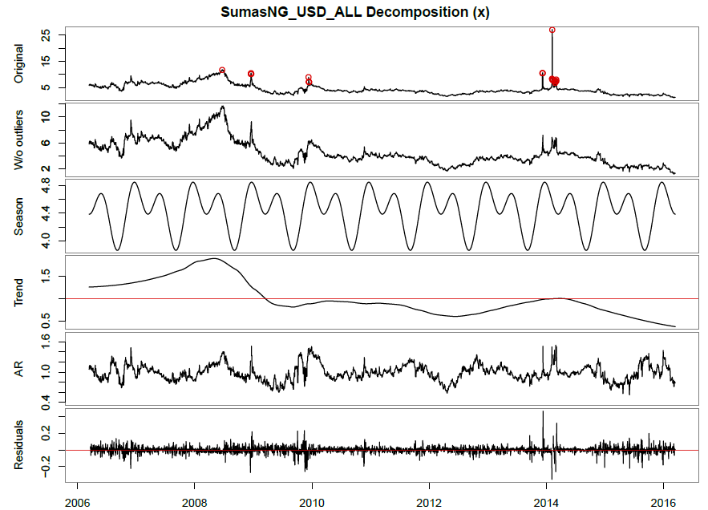
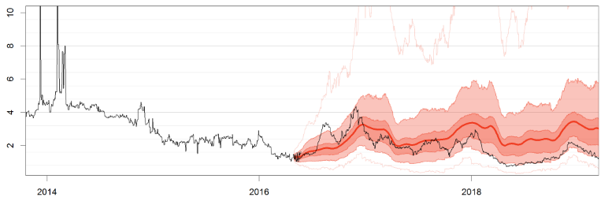
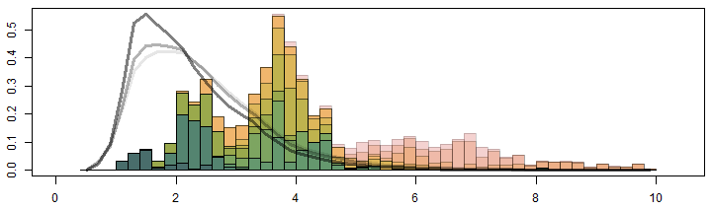
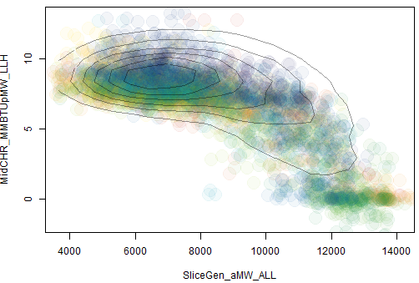
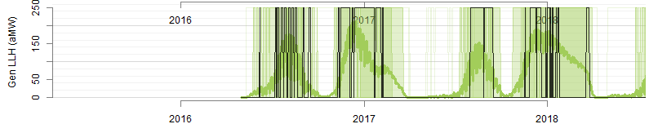
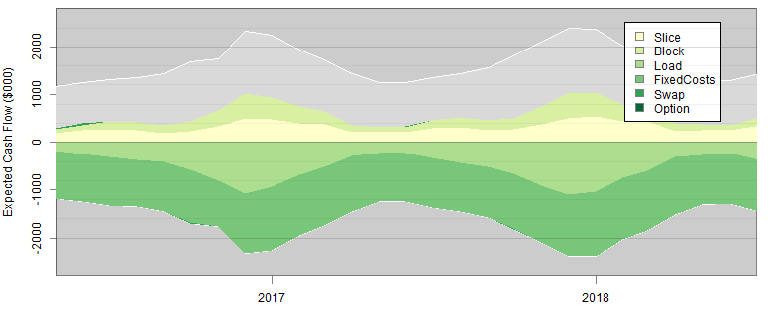
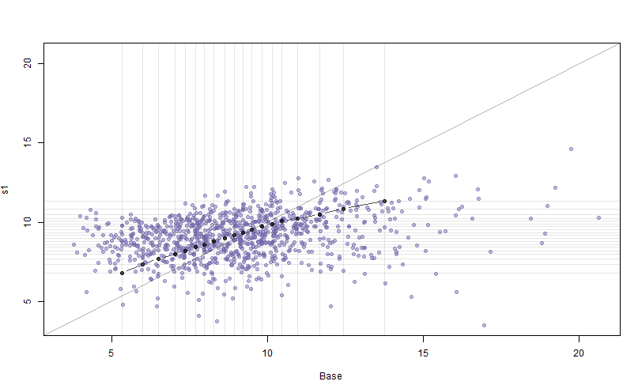
All-Inclusive but Practical Multivariate Stochastic Forecasting for Electric Utility Portfolio
AUTHOR: Eina Ooka
Sr. Structure and Pricing Analyst
The Energy Authority
eooka@teainc.org
https://github.com/einaooka/useR2016
Scheduled Tasks
Stochastic Variable Generation
DATA
STEPS
METHODS
Time Series Decomposition
Daily historical data
- On-peak Load
- Off-peak Load
- Hydro generations
- Natural gas prices
- Power prices
That exhibits strong auto-correlations. Power and gas may include extreme peaks, and load may include drops.
Power prices can become negative.
1. Data Scraping
Hierarchical clustering
Collinear variables are taken out of the main simulation model and derived later using predictive models.
2. Collinearity and Dependency Detection
Grabb’s outlier detection
Fourier series (2nd degree)
LOESS
Subset regression
Weekly shapes and auto-regression factors are captured here.
Objective
3. Multiplicative Decomposition
Outlier + Seasonality x Trend x Noise
Quantify market risks that utilities are exposed to, through stochastic simulation of loads, resources and market prices.
Tail risks are important, and we need at least 1000 iterations of realistic time series scenarios.
Simulated Stochastic data needs to capture all of the following characteristics:
Autocorrelation
Daily volatility
Heteroscedasticity
Seasonal and weekly shape
Mutivariate cross-correlation
Non-normal distributions
Extreme peaks and drops
Negative prices
Reasonable long-term distributions
Consistency with market and utility expectations
ARIMA(1,2,0)
Héston model
Gaussian Model
Generation of stochastic forecasts (monthly), external source or derived from trend and seasonality time series from step 3.
Simulated Time Series
External forecast data, both deterministic and stochastic, and usually in monthly granularity.
- Hydro generation forecast
- Utility load projections
We need to make sure that assumptions are consistent with all other model results.
4. Long-Term Stochastic Forecasting
5. Daily Volatility & Spike Model
Seasonal block bootstrapping
Multiple regression
Generation of daily noise component.
Historical vs Simulated
6. Disaggregation and Combination
Denton disaggregation
Monthly forecast from step 4 needs to be disaggregated into a daily time series, before combined with daily noise.
Market settlement data, particularly forward and option prices.
The model results need to be consistent with market implied risks.
7. Judgmental Adjustment
Hierarchical model
Expected values are adjusted to match market expectations.
Non-linear Multivariate Dependency
Wind and solar data. Behavior of variable generation does not fit well with autoregressive models. Thus modeled separately.
8. Predictive Modeling
Random Forest (utilize all trees for variability)
Feature selection through subset regression
Collinear or dependent variables (selected in step 2) are derived using predictive models with errors.
Resource Dispatch Optimization
9. Markov Chain Model
Logical dispatch calculation
Given resource unit specifications, determine the optimal economic dispatch schedule for each stochastic iteration. This achieves perfect hindsight dispatch.
Logistic regression/Random Forest
Real resources does not run perfectly like the method described above, since we do not know the future prices. Predictive models simply derive dispatch pattern from the historical generation.
Resource Dispatch
Historical hourly congestion prices. Some resources are sensitive to hourly power prices.
10. Hourly-Shape Analysis
Background Facts
Wholesale power market is the most volatile market of all commodity markets.
We pay relatively flat electricity rate to utilities. This means that utilities needs to manage market risks.
Some utilities set annual budgets probabilistically; the chance of insolvency, given certain cash reserve, must be certain percentage or lower.
Most utilities hedge themselves by trading forward or options.
Generation by thermal resources are set economically based on prices and its capability. Need to take into account of future schedules set by utilities.
Cash Flow Balance
11. Thermal Resource Dispatch
Hedge Analysis
12. Forward and Option Analysis
Portfolio Analysis through R-Shiny app
Portfolio cash flow is aggregated and presented in R-Shiny app. A user can interactively analyze stochastic scenarios and run hypothetical forward or option trades.
On Demand
Ultimately, we want some Risk Metrics that guide us to avert risks.
Hedged vs Unhedged Portfolio Cash Flow
13. Scenario Analysis
14. Portfolio Optimization
Report through rmarkdown
Results for a base case is automatically saved. Hedge analysis done through the app can be made into a html document through the app.

