Slide 1


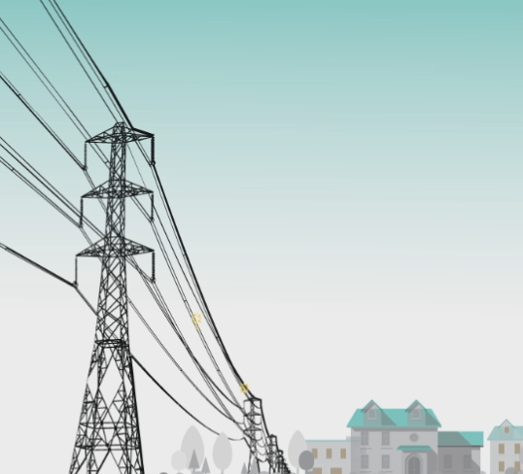
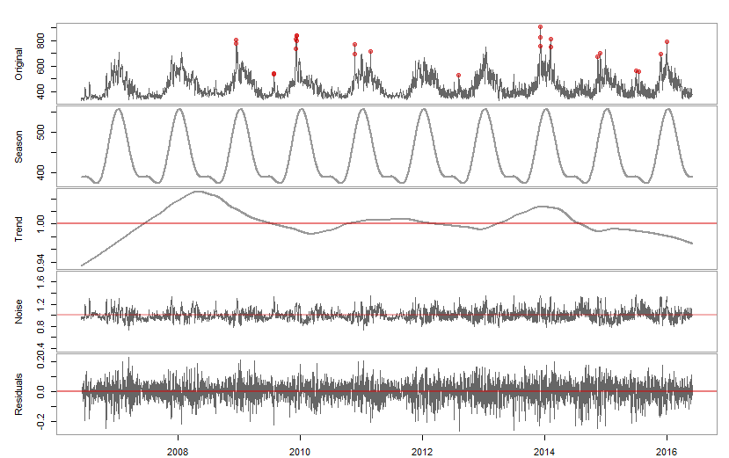
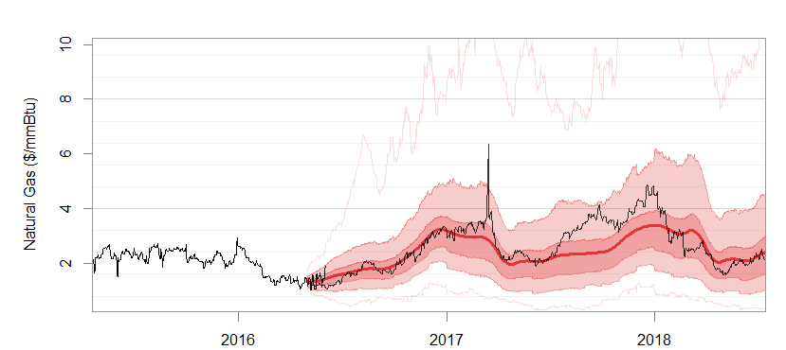
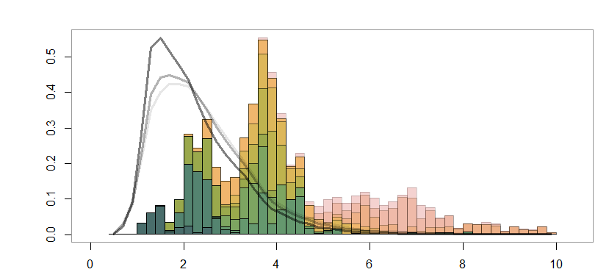
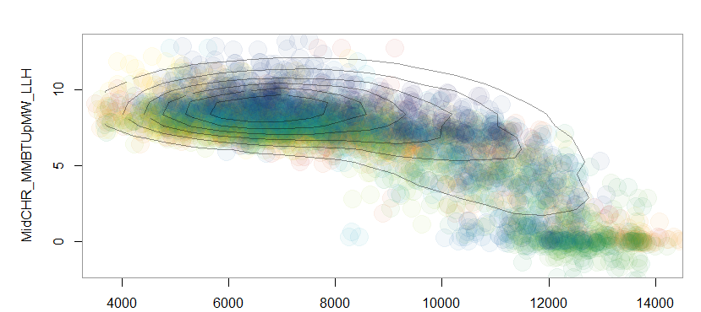
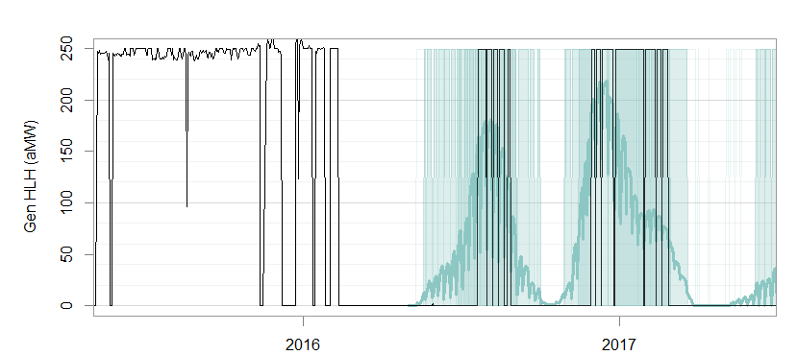
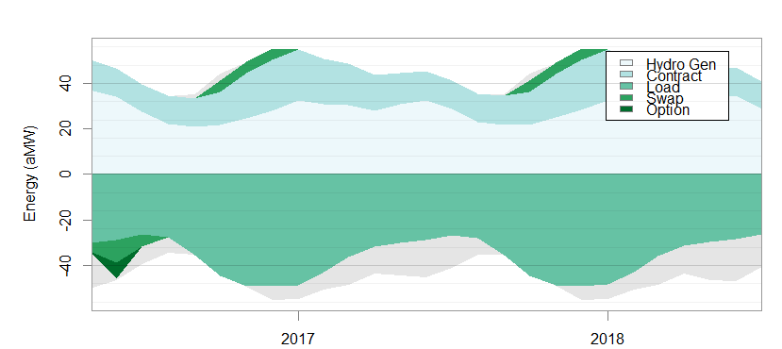
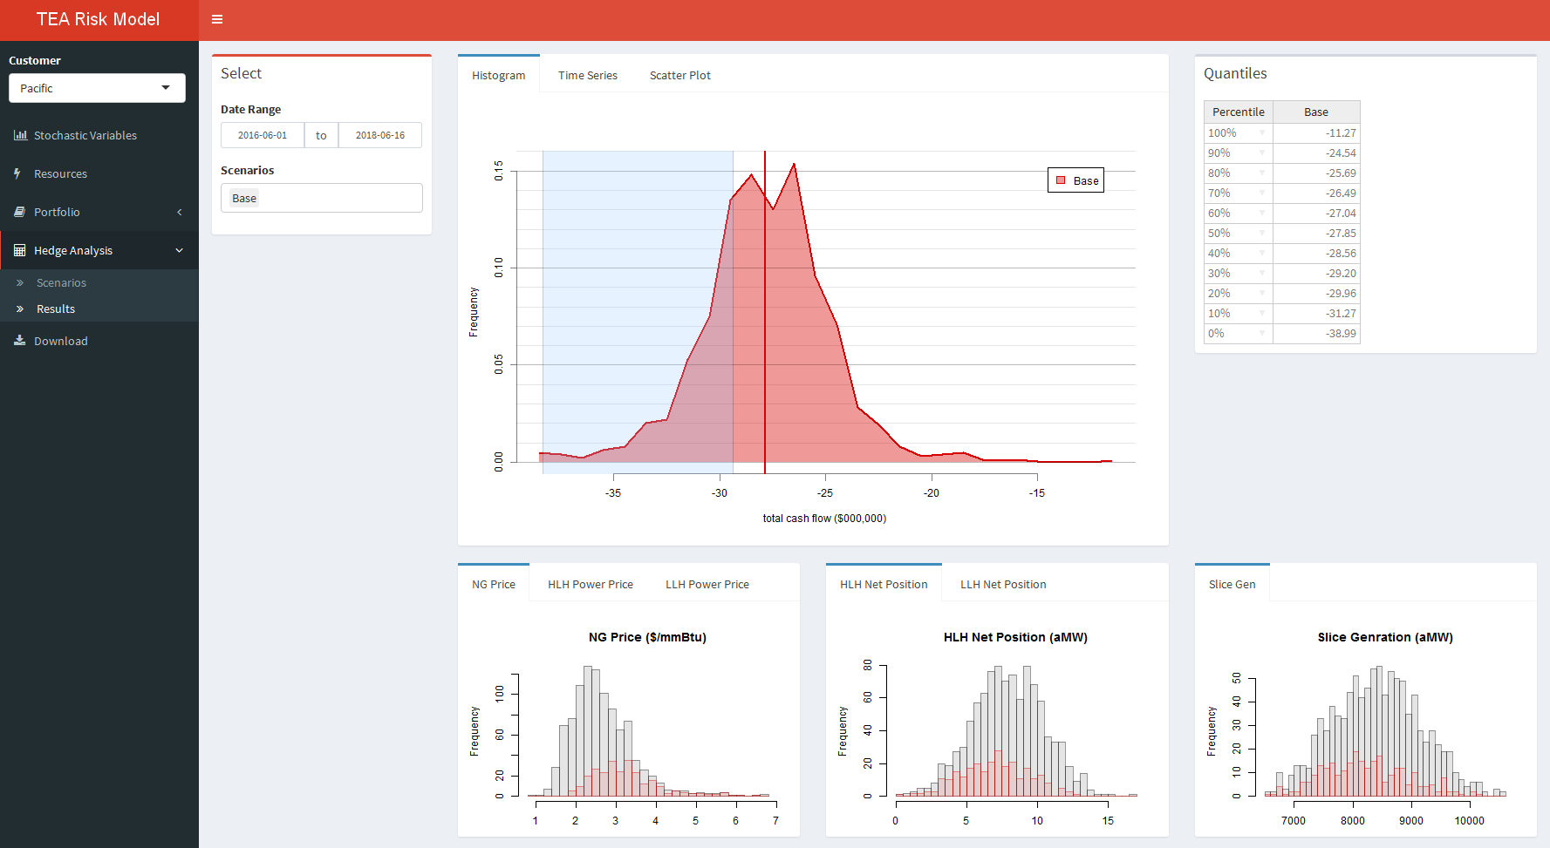
All-Inclusive but Practical Multivariate Stochastic Forecasting for Electric Utility Portfolio
AUTHOR: Eina Ooka
Sr. Structure and Pricing Analyst
The Energy Authority
eooka@teainc.org
https://github.com/einaooka/useR2016
(See this link for references)
Scheduled Tasks
Stochastic Variable Generation
DATA
[objective]
STEPS
METHODS
[packages::function]
Time Series Decomposition
1. Data Scraping
Hierarchical Clustering
Collinear variables are taken out of the main AR model and derived later using predictive models. [stats::hclust]
Daily historical data
- On-peak Load
- Off-peak Load
- Hydro generations
- Natural gas prices
- Power prices
[i – viii]
2. Collinearity and Dependency Detection
Grubb’s Outlier Test
Applied twice before and after decomposition. [outliers::grubbs.test]
Fourier series
LOESS [stats::loess]
Subset Regression
Weekly shapes and auto-regression factors are captured here. [leaps::regsubsets]
Objective
3. Multiplicative Decomposition
Outlier + Seasonality x Trend x Noise
Simulated Time Series
Quantify market risk that utilities are exposed to, through stochastic simulation of loads, resources and market prices.
Portray appropriate tail risk with 1,000 or more stochastic iterations.
Capture the following data characteristics:
Autocorrelation
Heteroscedasticity
Seasonal and weekly shape
Mutivariate cross-correlation and non-linear dependency
Non-normal distributions
Extreme peaks and drops
Negative prices
Max and min caps
Reasonable long-term distributions
Consistency with market and utility expectations
External LT forecasts in monthly granularity.
- Econometric load forecasts
- Metrological hydro forecasts
[i – v, viii – x]
4. Long-Term Stochastic Forecasting
Multivariate Gaussian Model
Héston Model
ARIMA(1,2,0)
If an external LT forecast does not exist, it is derived from trend and seasonality components (step 3).
5. Daily Volatility & Spike Model
Historical vs. Simulated
Market settlement price data
- Forward prices
[x]
6. Disaggregation and Combination
Seasonal Block Bootstrapping
Multiple Regression
Wind data is independent and does not fit AR model.
[iii, v, viii]
Denton Disaggregation
Monthly LT forecasts (step 4) need to be disaggregated into daily time series, before combining with daily noise (step 5). [modified ‘tempdisagg’]
Non-linear Multivariate Dependency
7. Judgmental Adjustment
Hourly congestion price shapes at multiple (10 - 30) nodes. [i – viii]
Temporal Hierarchical Reconciliation
Generated stochastic data is reconciled so that means match with market expectations.
8. Markov Chain Model
Regional Hydro Generation (aMW)
Resource Dispatch Optimization
Random Forest/GLM
Collinear or dependent variables (step 2) are derived using predictive models. All trees of RF are utilized (with Bayesian inference) to capture variability. [caret::train, stats::glm, randomForest::randomForest]
Resource Dispatch
Generation by thermal resources are determined economically based on prices and its capability. Need to take into account of future outage schedules set by utilities.
[iv, x]
9. Predictive Modeling
Background Facts
10. Hourly-Shape Analysis
The wholesale power market is the most volatile market of all commodity markets.
Consumers pay a relatively flat electricity rate to utilities. This means that utilities need to manage market risks.
Some utilities set annual budgets probabilistically, meaning that the chance of insolvency given a specified cash reserve must be below a certain threshold.
Many utilities hedge risk by trading forwards or options.
K-Means Clustering [stats::kmeans]
Multinominal Logistic Regression
Each day is categorized to a particular hourly shape based on daily averages. [nnet::multinom]
Energy Balance
11. Resource Dispatch
Logical Dispatch Calculation
Given resource unit specifications, determine the optimal economic dispatch schedule for each stochastic iteration.
Hedge Analysis
Ultimately, we want some Risk Metrics that guide us to avert risks.
12. Cash Flow Aggregation
Shiny App
On Demand
Portfolio Analysis through R-Shiny App
A user can interactively analyze stochastic scenarios and run hypothetical forward or option trades through shiny app. [shiny, shinhdashboard, rhandsontable]
Utility A
13. Scenario & Hedge Analysis
14. Portfolio Optimization
Report through Rmarkdown
Hedge analysis can be made into a html report through the app. [knitr]

