Slide 1
DEATH OF A CRAFTSMAN
@EINARWH

Slide 2
HELLO
Notes:
…So, hello everyone! Thank you for coming to my talk, and thanks for having me here at KanDDDinsky. My name is Einar. I work for NRK, which is the national public broadcaster in Norway. For a living, I design and write software. That is, you could call me a software developer, a coder, a programmer, and also a software designer, I guess. Those are all things I do and labels you could put on me.

Slide 3
I AM NOT A SOFTWARE CRAFTSMAN
Notes:
But I’m not a software craftsman. And this is a talk about why that is.

Slide 4
THIS IS DIFFICULT
Notes:
All the same, I must say, this is pretty difficult, and I’m a bit nervous. This is probably the most difficult talk I’ve done.

Slide 5
CLARIFICATION
Notes:
In particular it’s difficult because I don’t want to insult or belittle other people and the things they believe in. So I really want to clarify, this is not “death to all craftsmen”, “craftsmen are bad”, “craftsmen are stupid” or anything like that. In fact, and this is super super important, if you think of yourself as a crafter, and this gives you energy and inspires you, if it gives you the drive to improve and do better, that’s great. Never mind me! I’m just one guy! This talk is just about why *I* don’t think of myself as a software craftsman. That’s all. The title of the talk is taken from a stage play by Arthur Miller, called Death of a Salesman, which deals with identity crisis and the relationship between dreams and reality. So it seemed a fitting title for a talk about my own identity crisis. Now of course I wouldn’t be here if I didn’t think that some of the things I’m going to say is going to resonate with some of you, or at least trigger some reflection. But we’ll see.

Slide 6
ACKNOWLEDGMENT
Notes:
I also want to acknowledge all the great work done by many people who *do* identify as software craftsmen or software crafters. There are conferences and unconferences and meetups where people learn from and inspire each other. That’s great. I don’t want to belittle that. What’s more, we agree on a lot of things about software development. We follow many of the same practices.

Slide 7
I AM NOT A SOFTWARE CRAFTSMAN
Notes:
And yet I am not a software craftsman.

Slide 8
I AM NOT EVEN A SOFTWARE CRAFTER
Notes:
It’s actually worse. I’m not even a software crafter. Because you know, there is a growing awareness that maybe the label “craftsman” isn’t such a good label in an industry that has too few women. So that’s good, but I’m not really a crafter either. The reason for that is that I find the entire craft metaphor problematic in ways that I’ll explain in this talk.

Slide 9
CRAFTSMAN
CRAFTER
↓
Notes:
As I said, I am aware that some people in the craft community have been working hard to transform the notion of a craftsman into a crafter. I think that’s a very good thing. It doesn’t turn me into a crafter, but it’s a good thing.

Slide 10
CRAFTSMANSHIP
CRAFT
↓
Notes:
And similarly craftsmanship into craft. And that’s great too. I think also that some of these people, if they hear this talk, that they might think it’s a bit unfair, or that at least some of the issues I’m going to talk about are no longer relevant. But I’m not so sure. These things take time and craftsmanship is a concept with a lot of mindshare. For a litmus test, consider this: do you think there are more software developers out there today that identity as software crafters or software craftsmen? There are multiple books of software craftsmanship, none on software craft that I’ve found.

Slide 11
Notes:
And similarly craftsmanship into craft. And that’s great too. I think also that some of these people, if they hear this talk, that they might think it’s a bit unfair, or that at least some of the issues I’m going to talk about are no longer relevant. But I’m not so sure. These things take time and craftsmanship is a concept with a lot of mindshare. For a litmus test, consider this: do you think there are more software developers out there today that identity as software crafters or software craftsmen? There are multiple books of software craftsmanship, none on software craft that I’ve found.

Slide 12
I AM NOT A SOFTWARE CRAFTSMAN
Notes:
So I’m going to use the old craftsman term in this talk. The reason is that my identity crisis has been with the craftsman concept, not with crafting, which came later. Though I will say that I have problems with the metaphor of craft itself that cause me to reject the identity as crafter as well, and I’m going to touch on some of those. So. I am not a software craftsman.

Slide 13
WHY NOT?
Notes:
Now the obvious question is, well, why not?

Slide 14
I USED TO BE A SOFTWARE CRAFTSMAN
Notes:
Well I used to be. I used to think of myself as a software craftsman. Until maybe, what, five years ago? It’s hard to tell, time goes fast.

Slide 15
A PERSONAL STORY
Notes:
So I’d like to tell you my personal story with craftsmanship. Back in 2002, I was fresh out of the university with my Master’s degree in Computer Science and got my first job as a programmer. And I was delighted to learn of all kinds of interesting stuff concerning software development that wasn’t taught at the University. Agile obviously was the hot new thing that everyone was talking about. I remember attending a conference in 2003 and Kent Beck was there, Robert Martin, Ward Cunningham, Rebecca Wirfs-Brock, even Eric Evans. I worked hard and read a lot of books and blogs as well. It was exciting times. I was looking to prove myself I guess, looking for who I was as a programmer and software developer. I wanted to be good.

Slide 16
CRAFTSMANSHIP
Notes:
And then I heard about craftsmanship and it clicked. I’m guessing I first read about it in The Pragmatic Programmer book. The title page with a woodworker’s tool on it, and the subtitle “from journeyman to master”. It resonated. I wanted to master programming. So you might say I tried on the craftsman’s cloak, and my god, it fit me! It looked good on me! It was home! I was a “journeyman” on my way to mastery. And of course I also liked this idea that craftsmanship seemed to solve the age-old question: is programming art or engineering? It was neither and both: it was a craft! I could be half engineer, half artist, and sort of make up the mix myself. Of course, what exactly that meant was a bit unclear, but it felt good.

Slide 17
EXPERIENCE
Notes:
Over time, I gained much practical experience with software development in practice, and the forces that influences it. I learned a lot about myself and about others. I learned about my capabilities and limitations, my strengths and weaknesses. I learned that my brain and my ability to understand complex code is finite, for instance. Not only that, it’s shrinking. I also learned that my self-discipline and my rationality are pretty fixed entities. I’m disciplined most of the time, rational most of the time, but not always. But that was OK, I could live with being human and a craftsman, even though I started to realize that I might not actually be able to level up indefinitely. But there was a bigger problem. I was starting to feel that there were vitally important things influencing the success and failure of the software I worked on that had nothing to do with craftsmanship. There were both things out of my control, and things that I could potentially influence, but that craftsmanship said nothing about.

Slide 18
IDENTITY CRISIS
Notes:
Eventually this led to an identity crisis. You might say that the cloak of craftsmanship was starting to itch and no longer felt right. It no longer fit me. So finally, I had to take it off. But of course, this left me with a dilemma. If I’m not a craftsman, who or what am I then?

Slide 19
IS THERE LIFE BEYOND CRAFTMANSHIP?
Notes:
I had to figure out if there is life beyond craftsmanship?

Slide 20
WHAT IS A GOOD DEVELOPER?
Notes:
Now the original problem that faced me was that I wanted to be a good developer. What does that mean? What is a good developer?

Slide 21
AM I A GOOD DEVELOPER?
Notes:
And that’s an important question to answer, so that you can answer this question, which is even more important. Am *I* a good developer. Because this has to do with sense of worth. Am I valuable?

Slide 22
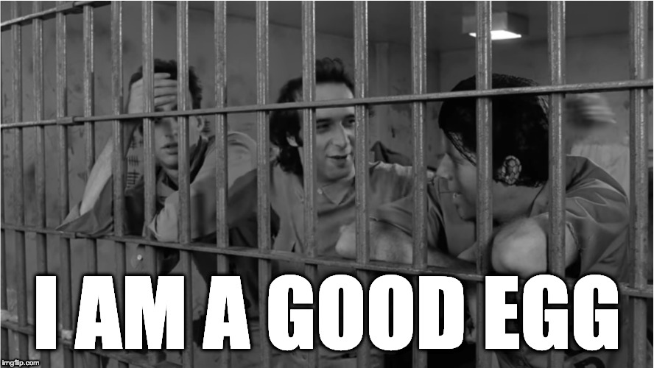
Notes:
Or as Roberto Benigni puts it, am I a good egg? We all want to be good eggs.

Slide 23
SOFTWARE CRAFTSMANSHIP PROVIDES ANSWERS
Notes:
And that was the original lure of software craftsmanship for me. Software craftsmanship provides answers to these questions, right? So that’s good.

Slide 24
WHAT IS SOFTWARE CRAFTSMANSHIP?
Notes:
But well, what is this thing then? What is software craftsmanship?

Slide 25
SOFTWARE CRAFTSMANSHIP IS A MEME
Notes:
According to Robert Martin, software craftsmanship is a meme that contains values, disciplines, techniques, attitudes and answers.

Slide 26
SOFTWARE CRAFTSMANSHIP IS AN IDENTITY
Notes:
I’m going to say that software craftsmanship is an identity.

Slide 27
SOFTWARE CRAFTSMANSHIP IS A NARRATIVE ABOUT SOFTWARE DEVELOPMENT
Notes:
It is an identity because it offers a narrative about software development. It offers a narrative about what matters in software development, and a way to distinguish yourself.

Slide 28
IT IS A NARRATIVE OF PRIDE AND PROFESSIONALISM
Notes:
It is a narrative that talks about pride and professionalism. You’ll find that craftsmanship and professionalism is used more or less as synonyms in the literature. In fact you can get the impression that craftsmanship is just a slightly kitchy word for professionalism. And this is actually quite sneaky and one of the things I don’t like so much. Because when you start to use those terms interchangeably, then suddenly you can’t be professional unless you’re a craftsman. And that’s problematic.

Slide 29
> THE CRAFTSMAN’S TALE <
Notes:
Well, let’s consider the craftsman’s tale.

Slide 30
IT IS A STORY OF HEROES AND ADVERSARIES
Notes:
The way I hear it, it’s a story of heroes and adversaries. What do I mean by that?

Slide 31
WHO IS THE HERO OF SOFTWARE DEVELOPMENT?
Notes:
Let’s start with the hero. Who is the hero of software development in the craftsmanship narrative?

Slide 32
THE PROGRAMMER OF COURSE!
Notes:
Well it’s the programmer of course! The programmer is the main character in this story.

Slide 33

PRAGMATIC GOOD SOFTWARE CRAFTSMAN
PRAGMATIC GOOD SOFTWARE CRAFTSMAN
Notes:
It’s this guy. The pragmatic good software craftsman, who relies on his skill and training and his own good judgment to do good in the world. Armed with TDD and SOLID, drilled through countless katas. He’s a trained coding machine.

Slide 34
MASTERY OF THE CRAFT
Notes:
Being a good developer in the craftsmanship narrative means seeking mastery of the craft.

Slide 35
TECHNICAL EXCELLENCE
Notes:
Technical excellence. Flawless execution.

Slide 36
DISCIPLINE CAN FIX SOFTWARE
Notes:
Underlying is a belief that discipline can fix software. If we are just disciplined enough, we will do well.

Slide 37
BEST PRACTICES CAN FIX SOFTWARE
Notes:
If we follow the best practices we can fix software.

Slide 38
VIRTUE CAN FIX SOFTWARE
Notes:
Virtue can fix software.

Slide 39
I CAN SLAY THE DRAGON!
Notes:
I can slay the dragon!

Slide 40
IF I’M HIGH LEVEL ENOUGH THE SOFTWARE WILL BE GREAT
Notes:
So it all comes down to me. Me and my skills. If I’m good, the software is good. And in some ways, that’s a great, because it is within my power to determine the outcome. It’s empowering.

Slide 41
IF THE SOFTWARE IS BROKEN IT IS MY FAULT
Notes:
Of course if that’s the case, then it also goes the other way around. If the software is broken, I wasn’t not good enough. My coding skills weren’t up to the task, or I wasn’t disciplined enough in my practices, or I wasn’t professional enough in my communication.

Slide 42
WRONG
Notes:
And this is where the cloak starts to itch for me. I think this is just wrong.

Slide 43
DANGEROUS
Notes:
And since it’s wrong, it’s also dangerous. Because now you have a narrative of software development that sells you a false promise and sets you up to feel bad about yourself. And you know Gerry Weinberg warned us about this 50 years ago, in the psychology of computer programming, when he talked about egoless programming.

Slide 44
WHY?
Notes:
But why is it wrong? Isn’t it just the harsh, cold truth that if I fail, I’m not good enough? Shouldn’t I just face reality, accept the challenge, buckle down and work harder? Be better? Get good?

Slide 45
WHO MAKES SOFTWARE?
Notes:
Well, who makes software? That’s a trick question, right? We all know who makes software, right? It’s us, the programmers, we sit at the keyboard, we type the code, we test it, we ship it to production, it’s us? Surely it’s us! No one else can make software!

Slide 46
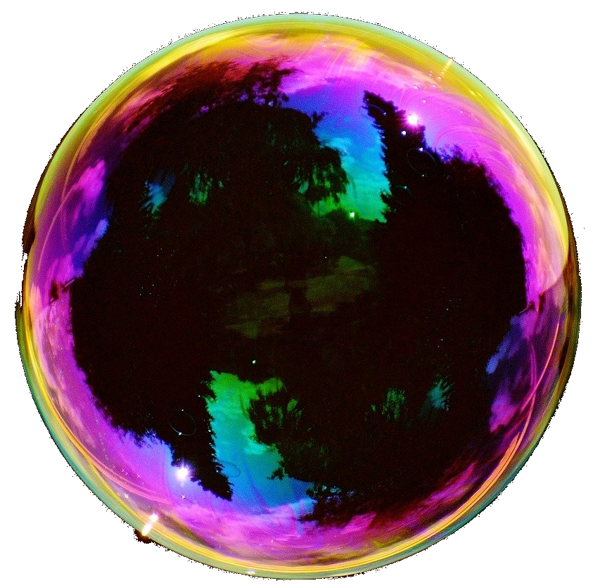
Notes:
I present this bubble as an illustration of the craftsman’s model of software development. Coding happens inside this bubble. This is where software is created. You have a border of professionalism to protect against the outside, and you have passion on the inside. It’s very inward-facing.

Slide 47
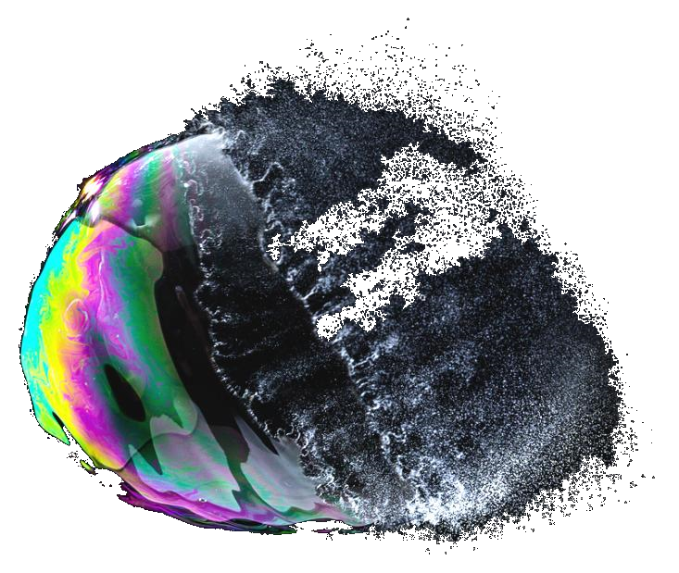
Notes:
The problem is that the border isn’t going to hold. It’s super-weak. The bubble is going to burst. No amount of skills or professionalism is going to change that. Because the outside forces you’re dealing with are much much stronger than that. What kind of forces are that?

Slide 48
ORGANIZATIONS MAKE SOFTWARE
Notes:
Organizational forces. The reason is that programmers don’t make software. Organizations make software. Conway’s Law, so popular in DDD contexts, is one expression of this. You’ll find that despite your values and disciplines and practices, the health of the organization will be an upper bound on the health of your code. Communication patterns, weak concepts, ambiguity, conflicts, conflict avoidance, all that is going to affect your code. Moreover, your code or your teams code doesn’t live in isolation. Most modern software talks to other software, made by other teams and organizations. To make good software, you need to direct your attention outward and work on the conditions for making software. You need to address the organizational forces head-on, build culture and understanding, spread your ideas of what healthy software development looks like. You might still fail because there are many things beyond your control, but at least you’ve entered the playing field.

Slide 49
WHAT IS THE CRAFT?
Notes:
And a seemingly simple question is suddenly difficult. If organizations rather than programmers make software - What is the craft of making software? Is it coding? Deploying software? Or is it simply using your skill, knowledge and influence to shape software that somehow benefits your organization? Because you can do that without writing code, can’t you?

Slide 50
WHO PERFORMS THE CRAFT?
Notes:
Who performs the craft? Who can be a software crafter? Who is the hero? Isn’t it true that any work that affects the finished product must be considered part of the craft of making software? How is coding special?

Slide 51
WHAT IS THE CRAFT MATERIAL?
Notes:
You know there’s an interesting dynamic when we program, when we write code, between our intent and the reality of the code. The code offers resistance to being formed, so we try different strategies, making tradeoffs. And that’s part of why the craft metaphor is so compelling to us. But that’s not the only malleable material involved in making software. Consider user experience work. Visual design. There is also the organization itself that can be changed, as well as the business it engages in and the products it makes.

Slide 52
MULTIPLICITY OF CRAFTS
Notes:
If there is craft involved, there is a multiplicity of crafts. It’s not just the craft performed by coders. So how come we are the craftsmen?

Slide 53
> THE CODE FETISH <
Notes:
The craftman narrative fails to see this because it is caught up in this fetish about code. Like the code is the only thing that matters. Everything else is noise and waste and irrationality.

Slide 54
”THE CODE IS THE TRUTH”
Notes:
The code is the truth! And you have to say that in like a deep masculine voice.

Slide 55
THERE IS NO TRUTH IN THE CODE
Notes:
But there is no truth about anything interesting in the code.

Slide 56
THE CODE CAN ONLY TELL YOU WHAT IT DOES
Notes:
Apart from tautology. The code can only tell the truth about what the code does. For instance, it can’t tell you what it should have done, how to make users happy, how to provide value to someone, how to earn money. It can’t even tell you if it’s in production!

Slide 57
THE CODE HAS NO DIRECTION
Notes:
We know that software is organic, it’s alive and changing, but the code at any given time doesn’t point in any particular direction. It has no idea of what’s going to happen next.

Slide 58
THE CODE DOESN’T WANT ANYTHING
Notes:
The code doesn’t want anything.

Slide 59
THE CODE IS NOT STRATEGIC
Notes:
It’s not strategic. It doesn’t have plans. It doesn’t know how to improve itself. It doesn’t know how to make priorities. But these are super-important things to talk about.

Slide 60
WHO CAN READ CODE?
Notes:
And you know, the idea that “the truth is in the code” it’s sort of a passive-aggressive power trick as well. Because only we, the coders, can read the code. So if the code is the truth, then we are keepers of the truth, aren’t we. Not those other people. They might hold other kinds of power and prestige but they don’t wield the truth.

Slide 61
DO WE WANT TO COMMUNICATE?
Notes:
So the question becomes: do we want to communicate? Or do we want this sort of leverage.

Slide 62
> THE RPG MODEL OF SKILL <
Notes:
Another problem is what I call the RPG model of skill acquisition. An RPG is a role-playing game. In your typical RPG you find yourself in a medieval setting, just like a software craftsman, and your character has a level. You start at level 1 and then you kill some rats to gain experience because you don’t have many hit points yet, and eventually you reach level 2 and maybe you kill some bigger rats and you get to level 3 and you can kill I don’t know undead rats or something.

Slide 63
LINEAR LEVELING UP
Notes:
And you have the same thing in the craft narrative. There’s a linear notion of leveling up, step-wise, as you gain experience.

Slide 64
MASTER
JOURNEYMAN
APPRENTICE
↑
↑
Notes:
So there’s this model that was there from the start of the craftsman narrative, taken from medieval guilds. There’s a book by Pete Breen that discusses it in detail, and you’ll also find it referenced lots of other places. Recall that the subtitle of first edition of the The Pragmatic Programmer was “from Journeyman to Master”. I think they changed it for the new edition, now it says “your journey to mastery”.

Slide 65
MASTER
JOURNEYMAN
APPRENTICE
↑
↑
Notes:
So you start out as an apprentice.

Slide 66
MASTER
JOURNEYMAN
APPRENTICE
↑
↑
Notes:
And then you progress to journeyman and I think this is basically where every crafter I’ve ever met puts themselves, because they’re to modest to claim to be a master and too experienced to be a mere apprentice.

Slide 67
MASTER
JOURNEYMAN
APPRENTICE
↑
↑
Notes:
But of course this is the goal.

Slide 68
HIERARCHY OF PRACTITIONERS
Notes:
So it establishes a hierarchy of practitioners.

Slide 69
MENTORS AND MENTEES
Notes:
Now since many craftsmen are helpful and want to share their knowledge, some people form mentorships or apprenticeships. Which is great, it’s great that people want to help others level up. But there’s something here that’s strange to me, in that the relationship has such a clear direction. Knowledge flows from the mentor to the mentee. Now I’m sure that mentors will say that they also learn from that process, that teaching clarifies their understanding or something, but it’s still directional. There is an ordering in the relationship.

Slide 70
CONTRAST WITH CAMERATA OF PEERS
Notes:
Contrast that with a camerata of peers, to use Jessica Kerrs term. The relationships I’ve learned the most from have always been bi-directional, between people with mutual respect and complimenting skills. That enables a group dynamic that lifts everyone up.

Slide 71
> MONOPOLY ON VIRTUE <
Notes:
And then there’s the monopoly on virtue. It’s really this thing where being a craftsman is a the same as, or a prerequisite of, being professional.

Slide 72
THE THREE KINDS OF PROGRAMMERS
Notes:
In the craftsman’s tale, there are three kinds of programmers.

Slide 73
THE UNWASHED MASSES
Notes:
There are the unwashed masses, programmers who don’t care, who have no passion for programming, lazy, undisciplined filth! Apparently there are many of these, I personally haven’t met too many of them, lucky me.

Slide 74
THE UNWASHED MASSES BAD
Notes:
But these are bad. Obviously.
Luckily if you merely _attend_ a talk on craftsmanship or buy and perhaps even _read_ a book on craftsmanship, you’re not one of them!

Slide 75
SOFTWARE CRAFTSMEN
Notes:
Because then you’re a software craftsmen. Then there are the software craftsmen.

Slide 76
SOFTWARE CRAFTSMEN GOOD
Notes:
These are good. By definition you might say. Could be an apprentice, could be a journeyman, could be a master, doesn’t matter, on the virtuous path!

Slide 77
IVORY TOWER ZEALOTS
Notes:
And then there are these.

Slide 78
IVORY TOWER ZEALOTS BAD
Notes:
These are terrible! They have passion but they use it all wrong! They have principles but they are wrong! They could be into category theory instead of patterns! Unrealistic! Unpragmatic! Proofs! Maths! Maybe they write comments!

Slide 79
BANISHED FROM THE REAL WORLD
Notes:
They must be banished from the real world!

Slide 80
THREAT TO THE MONOPOLY
Notes:
Because they represent a threat to the monopoly on virtue.

Slide 81
SOFTWARE CRAFTSMANSHP IS CONSERVATIVE
Notes:
Craftsmanship is really surprisingly conservative!

Slide 82
DOGMATIC PRAGMATISTS
Notes:
Let’s take a topic that presumably all programmers care about, which is software correctness.

Slide 83
SOFTWARE CORRECTNESS
Notes:
Let’s take a topic that presumably all programmers care about, which is software correctness.

Slide 84
TDD
Notes:
Now one practice that is always mentioned by craftsmen is TDD. Of course, it’s hailed as something much more than just a testing technique. It’s also a design technique, and the by-product of that technique is a comprehensive test suite. So that’s fine. Many people find TDD to be a valuable practice.

Slide 85
EXAMPLE-BASED TESTING
Notes:
That test suite uses what is called example-based testing. Which helps for ensuring software correctness and offers some protection against regression in the face of changes. What’s weird is that software craftsmen seem generally uninterested in other approaches.

Slide 86
PROPERTY-BASED TESTING
Notes:
But there are other approaches that aim to help ensure software correctness. One example is property-based testing, where you verify properties that will hold for all inputs to your code. It’s also a powerful design technique as well, as it guides you to think in terms of properties and invariants.

Slide 87
TYPE SYSTEMS
Notes:
There are advanced static type systems aim to make software correct by construction, by disallowing illegal states in the software.

Slide 88
FORMALS METHODS
Notes:
Finally there are formal methods, which are mathematically based techniques for the specification and verification of software. But craftsmen seem completely uninterested.

Slide 89
TLA+
Notes:
For instance, I haven’t heard of a single craftsman with any interest in a tool like TLA+. What is TLA+? It’s a language for modelling concurrent and distributed systems, developed by Leslie Lamport. Is it an ivory tower language? Is it for academics? Well Microsoft has used to find bugs in the Xbox and Azure. Amazon has used it to verify AWS. So it’s pretty real world. Is it overkill for your application? Perhaps, I don’t know, it depends on your context. Wouldn’t you want to find out? Most applications these days are concurrent and distributed in some way.

Slide 90
SOFTWARE CRAFTSMANSHIP IS STATIC
Notes:
Craftsmanship is really surprisingly conservative!

Slide 91
KNOWLEDGE IS PASSED ON
Notes:
They already have all the knowledge written on a scroll.

Slide 92
PROGRESSIVE LEARNING MEANS LOOK FOR COUNTER-EXAMPLES RATHER THAN CONFIRMATION
Notes:
It’s not terribly progressive.

Slide 93
RADICAL IMPROVEMENT IS LIKELY TO COME FROM THE OUTSIDE
Notes:
Improvement must challenge best practices.

Slide 94
DO CRAFTSMEN QUESTION THEIR BELIEFS?

Slide 95
DO CRAFTSMEN WELCOME DIFFERENCES OF OPINION?

Slide 96
DO CRAFTSMEN LIKE THIS TALK?

Slide 97
DISAGREEMENT IS GOOD!
Notes:
I don’t know, but I think disagreement is good! We need disagreement!

Slide 98
DISAGREEMENT HAS ENERGY!
Notes:
Disagreement has energy!

Slide 99
TENSION!
Notes:
…

Slide 100
DISSONANCE!
Notes:
…

Slide 101
WHO ARE THE ADVERSARIES?
Notes:
Speaking of dissonance. Let’s backtrack. If the programmer is the hero in the craftsman’s tale about software, who are the adversaries? Apart from the ivory tower people.

Slide 102

Notes:
They look like this. The business. The suits. The accursed clueless managers. People who have never coded in their life! People who are also part of your organization. People who have an interest in the software we help make. Sometimes they’re called stakeholders, because they have a stake in the software. Just like we do.

Slide 103
RESPECT
Notes:
And you know, software craftsmen speak a lot about respect.

Slide 104
RESPECT
SELF
Notes:
But it seems pretty one-sided. I mean, it’s mostly about programmers respecting themselves. Which is fine and good and important.

Slide 105
RESPECT
LESS
Notes:
But it’s not so great when it means respecting others less. Have you seen and heard how craftsmen speak about non-programmers? It’s not pretty.

Slide 106
BUSINESS VS CRAFTSMAN
Notes:
So that’s not a very good way of forming productive partnerships. Instead it deepens the divide between the so-called business and the craftsman.

Slide 107
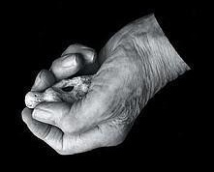
YE OLDE CRAFTSMAN’S SHOPPE
Notes:
The business people, the suits, can visit the craftsman’s shoppe, where everything is neat and tidy, a stronghold of sanity.

Slide 108
THE STRONGHOLD OF SANITY
Notes:
It’s a stronghold of sanity in a crazy world.

Slide 109
HAND-CRAFTED ARTISAN SOFTWARE MADE TO ORDER
Notes:
And there the business can order software of the highest quality, and maybe there’s some negotiation and the craftsman can offer alternatives at various costs, according to need.

Slide 110
COMMUNICATION BECOMES NEGOTIATION
Notes:
So it’s a client-supplier kind of relationship and communication becomes negotiation.

Slide 111
BUT WE ARE THE BUSINESS
Notes:
But we, developers, are the business, just as much as anyone else. There are no business people! There are other people doing things besides programming in the same business. We’re all in this together. We have the same goals. If we don’t there’s going to be problems.

Slide 112
COMMUNICATION SHOULD BE COLLABORATION
Notes:
Software development is a cross functional team effort to achieve a business goal. And communication should be collaboration.

Slide 113
WHAT IS SOFTWARE DEVELOPMENT?
Notes:
Software development is a cross functional team effort to achieve a business goal. And communication should be collaboration.

Slide 114
HOW TO BE VALUABLE?
Notes:
So in this environment, how can we be valuable? How can we be good eggs?

Slide 115
BEYOND TECHNICAL SKILL
Notes:
I would like to see more programmers looking beyond technical skill.

Slide 116
DOMAIN MODELLING
Notes:
So in my work, I try to bring value by being doing domain modelling, because I believe that poor modelling and weak, ambiguous language is the primary cause of complexity and technical debt.

Slide 117
STORYTELLING AND CULTURE
Notes:
I also work on storytelling and culture, by which I mean, I try to shape the story of how we do software development and help grow a healthy and safe culture to work in.

Slide 118
MOB PROGRAMMING
Notes:
You can introduce and champion mob programming, where the mob includes so-called non-technical people.

Slide 119
CONWAY’S MOB
Notes:
I have high hopes for what I call Conway’s Mob as a way to overcome organizational silos and work across existing team and system boundaries.

Slide 120
ORGANIZATIONAL REFACTORING
Notes:
You could engage yourself in organizational refactoring, you know trying to influence how you are organized to provide better solutions to the right problems.

Slide 121
STRATEGIC ARCHITECTURE
Notes:
You could do strategic architecture work, working iteratively to improve the architecture to support evolving business needs. Of course, that requires that you know what those evolving business needs are, so you need to learn about that.

Slide 122
SO MANY VALUABLE SKILLS!
Notes:
There are so many valuable skills for a software developer besides writing code.

Slide 123
WHAT IS A GOOD DEVELOPER?
Notes:
Which brings us back to the original question.

Slide 124
AM I A GOOD DEVELOPER?
Notes:
Am I a good developer?

Slide 125
WHAT IS MY IDENTITY?
Notes:
What is my identity?

Slide 126
SOFTWARE INFIDELS
Notes:
I for one want to see more heresy, more software infidels! I want us to fear orthodoxy.

Slide 127
SOFTWARE JESTERS
Notes:
Perhaps even software jesters.

Slide 128
SOFTWARE ABSURDISTS
Notes:
Software absurdists – maybe that’s really all of us.

Slide 129
SOFTWARE ENGINEERS
Notes:
I wouldn’t mind meeting an actual software engineer!

Slide 130
SOFTWARE SCIENTISTS
Notes:
I wouldn’t mind meeting an actual software engineer!

Slide 131
SOFTWARE ARTISTS
Notes:
Or even a proper software artist.

Slide 132
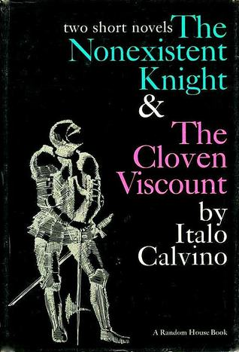
Notes:
I would like to leave you with a book recommendation. There’s a great story by Italo Calvino called the non-existent knight. It was written in 1959, but it’s clearly about software development.

Slide 133
SIR AGILULF
Notes:
The main character is Sir Agilulf Emo Bertrandin of the Guildivern.

Slide 134
THE PERFECT KNIGHT
Notes:
He is the perfect knight in white armor, he knows all the duties and routines and keeps everything clean.

Slide 135
AN EMPTY ARMOR
Notes:
The only problem is that he doesn’t exist, there’s no body inside the armor. When he takes off his armor, he disappears. So whether or not we are software craftsmen, I think it’s important that we think about what our identities should be, and if we really need that armor.

