Slide 1
DEATH OF A CRAFTSMAN
@EINARWH

Slide 2
I AM NOT A SOFTWARE CRAFTSMAN
Notes:
I am not a software craftsman.

Slide 3
AWKWARD!
Notes:
…

Slide 4
TENSION!
Notes:
…

Slide 5
CLARIFICATION
Notes:
I want to clarify, this is not “death to all craftsmen”, “craftsmen are bad”, “craftsmen are stupid” or anything like that. It’s just about why *I* don’t think of myself as a software craftsman. That’s all.

Slide 6
ACKNOWLEDGMENT
Notes:
I also want to acknowledge all the great work done by many people who *do* identify as software craftsmen. Some of my best friends are software craftsmen.

Slide 7
I AM NOT A SOFTWARE CRAFTSMAN
Notes:
But I am not, and this talk is about why.

Slide 8
WHY NOT?
Notes:
And this talk is about why not.

Slide 9
WHAT IS A GOOD DEVELOPER?
Notes:
A fundamental question you might ask yourself as a developer is “what is a good developer”.

Slide 10
AM I A GOOD DEVELOPER?
Notes:
And that’s an important question to answer, so that you can answer this question, which is even more important. Am *I* a good developer. Because this has to do with sense of worth. Am I valuable?

Slide 11
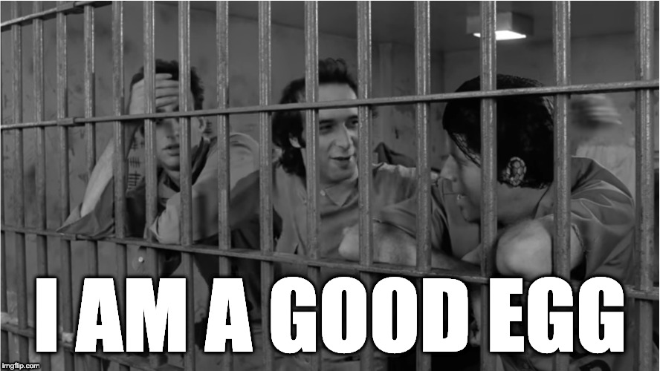
Notes:
Or as Roberto Benigni puts it, am I a good egg? We all want to be good eggs.

Slide 12
SOFTWARE CRAFTSMANSHIP PROVIDES ANSWERS
Notes:
And software craftsmanship provides answers to these questions, right? So that’s good.

Slide 13
SOFTWARE CRAFTSMANSHIP IS AN IDENTITY
Notes:
Software craftsmanship is an identity.

Slide 14
SOFTWARE CRAFTSMANSHIP IS A NARRATIVE ABOUT SOFTWARE DEVELOPMENT
Notes:
It is an identity because it offers a narrative about software development.

Slide 15
IT IS A NARRATIVE OF PRIDE AND PROFESSIONALISM
Notes:
It is a narrative that talks about pride and professionalism. You’ll find that craftsmanship and professionalism is used more or less as synonyms. In fact you can get the impression that craftsmanship is just a slightly kitchy word for professionalism.

Slide 16
IT IS A NARRATIVE OF HEROES AND ADVERSARIES
Notes:
It is also a narrative of heroes and adversaries. What do I mean by that?

Slide 17
WHO IS THE HERO OF SOFTWARE DEVELOPMENT?
Notes:
Who is the hero of software development in the craftsmanship narrative?

Slide 18
THE PROGRAMMER OF COURSE!
Notes:
Well it’s the programmer of course!

Slide 19
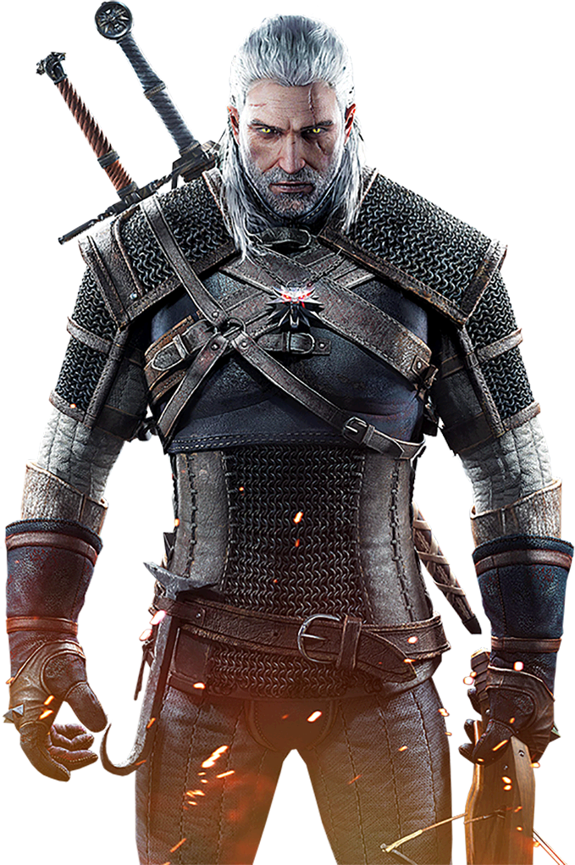
PRAGMATIC GOOD SOFTWARE CRAFTSMAN
Notes:
It’s this guy. The pragmatic good software craftsman, who relies on his skill and training and his own good judgment to do good in the world. Armed with TDD and SOLID, drilled through countless katas.

Slide 20
MASTERY OF THE CRAFT
Notes:
Being a good developer in the craftsmanship narrative means seeking mastery of the craft.

Slide 21
TECHNICAL EXCELLENCE
Notes:
Technical excellence. Flawless execution.

Slide 22
DISCIPLINE CAN FIX SOFTWARE
Notes:
Underlying is a belief that discipline can fix software. If we are just disciplined enough, we will do well.

Slide 23
BEST PRACTICES CAN FIX SOFTWARE
Notes:
If we follow the best practices we can fix software.

Slide 24
VIRTUE CAN FIX SOFTWARE
Notes:
Virtue can fix software.

Slide 25
I CAN SLAY THE DRAGON!
Notes:
I can slay the dragon!

Slide 26
IF I’M HIGH LEVEL ENOUGH THE SOFTWARE WILL BE GREAT
Notes:
So it all comes down to me. Me and my skills. If I’m good, the software is good.

Slide 27
WRONG
Notes:
Which I think is wrong.

Slide 28
WHY?
Notes:
Why?

Slide 29
WHO MAKES SOFTWARE?
Notes:
Who makes software? That’s a trick question, right? We all know who makes software, right? It’s us, the programmers, we sit at the keyboard, we type the code, we test it, we ship it to production, it’s us? Surely it’s us!

Slide 30
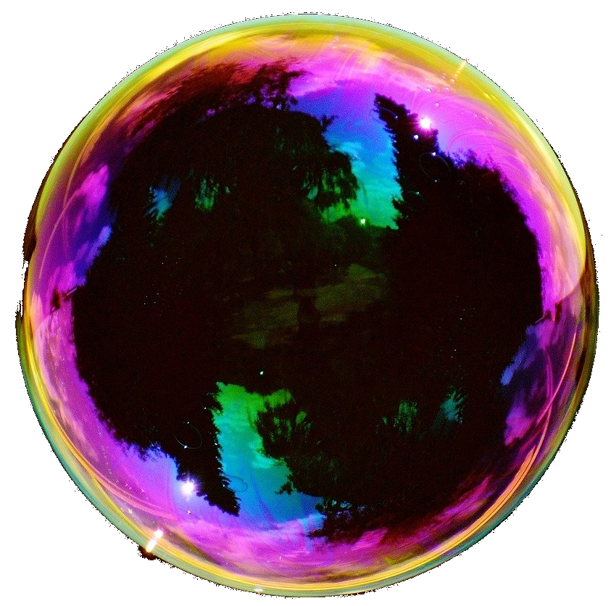
Notes:
So here is the craftsman model of software development. You have a border of professionalism on the outside, and you have passion on the inside. It’s very inward-facing.

Slide 31
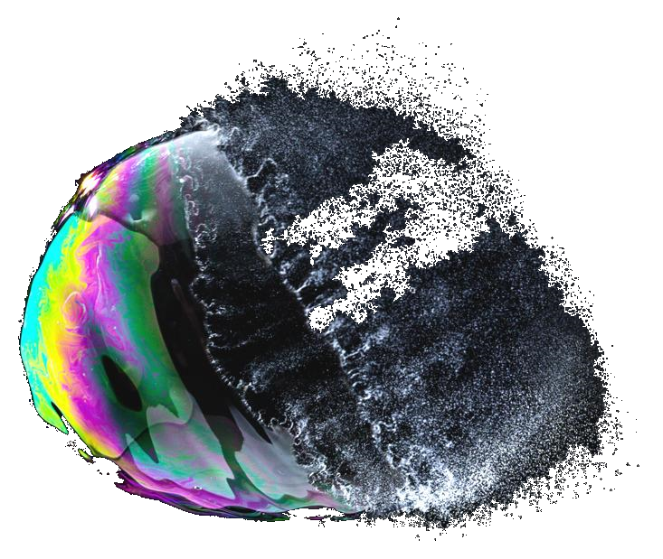
Notes:
The problem is that the bubble is going to burst.

Slide 32
ORGANIZATIONS MAKE SOFTWARE
Notes:
Programmers don’t make software. Organizations make software, and the health of the software is going to be determined by the health of the organization. You can’t make good software in a toxic organization. You can’t even make good software in an organization that is well-meaning but naïve to the forces that shape software. Your software development efforts will be dominated by forces outside the code. To make good software, you need to direct your attention outward and work on the conditions for making software.

Slide 33
WHAT IS THE CRAFT?
Notes:
And a seemingly simple question is suddenly difficult.

Slide 34
THE CODE FETISH
Notes:
Craftsmanship fails to see this because it is caught up in this fetish about code. Like the code is the only thing that matters.

Slide 35
”THE CODE IS THE TRUTH”
Notes:
The code is the truth!

Slide 36
THERE IS NO TRUTH IN THE CODE
Notes:
But there is no truth about anything interesting in the code.

Slide 37
THE CODE CAN ONLY TELL YOU WHAT IT DOES
Notes:
Apart from tautology. The code can only tell the truth about what the code does. For instance, it can’t tell you what it should have done, how to make users happy, how to provide value to someone. It can’t even tell you if it’s in production!.

Slide 38
THE CODE HAS NO DIRECTION
Notes:
The code as such has no direction. It has no opinions.

Slide 39
THE CODE DOESN’T WANT ANYTHING
Notes:
It doesn’t want anything.

Slide 40
THE CODE IS NOT STRATEGIC
Notes:
It’s not strategic.

Slide 41
WHAT IS VIRTUOUS PROGRAMMING ANYWAY?
Notes:
And what is virtuous programming anyway?

Slide 42
THE THREE KINDS OF PROGRAMMERS
Notes:
In the craftsman’s tale, there are three kinds of programmers.

Slide 43
THE UNWASHED MASSES
Notes:
There are the unwashed masses, programmers who don’t care, who have no passion for programming, lazy, undisciplined filth! Apparently there are many of these, I personally haven’t met too many of them, lucky me.

Slide 44
THE UNWASHED MASSES BAD
Notes:
But these are bad. Obviously.

Slide 45
SOFTWARE CRAFTSMEN
Notes:
Then there are the software craftsmen.

Slide 46
SOFTWARE CRAFTSMEN GOOD
Notes:
These are good. Could be an apprentice, could be a journeyman, could be a master, doesn’t matter, on the virtuous path!

Slide 47
IVORY TOWER ZEALOTS
Notes:
And then there are these.

Slide 48
IVORY TOWER ZEALOTS BAD
Notes:
These are terrible! They have passion but they use it all wrong! They have principles but they are wrong! They could be into category theory instead of patterns! They could be into formal verification, static typing and property-based testing in addition to unit tests! Proofs! Maths! They could be writing long methods, thinking abstractions should be deep!

Slide 49
BANISHED FROM THE REAL WORLD
Notes:
They must be banished from the real world

Slide 50
CRAFTSMANSHIP IS CONSERVATIVE
Notes:
Craftsmanship is really surprisingly conservative!

Slide 51
KNOWLEDGE IS PASSED ON
Notes:
They already have all the knowledge written on a scroll.

Slide 52
PROGRESSIVE LEARNING MEANS LOOK FOR COUNTER-EXAMPLES RATHER THAN CONFIRMATION
Notes:
It’s not terribly progressive.

Slide 53
RADICAL IMPROVEMENT MUST ALWAYS COME FROM THE OUTSIDE
Notes:
Improvement must challenge best practices.

Slide 54
DO CRAFTSMEN QUESTION THEIR BELIEFS?

Slide 55
DO CRAFTSMEN WELCOME DIFFERENCES OF OPINION?

Slide 56
DO CRAFTSMEN LIKE THIS TALK?

Slide 57
DISAGREEMENT IS GOOD!
Notes:
I don’t know, but I think disagreement is good! We need disagreement!

Slide 58
DISAGREEMENT HAS ENERGY!
Notes:
I don’t know, but I think disagreement is good! We need disagreement!

Slide 59
TENSION!
Notes:
…

Slide 60
DISSONANCE!
Notes:
…

Slide 61
WHO ARE THE ADVERSARIES?
Notes:
Speaking of dissonance. Let’s backtrack. If the programmer is the hero in the craftsman’s tale about software, who are the adversaries? Apart from the ivory tower people.

Slide 62

Notes:
They look like this. The business. The suits. The accursed clueless managers. People who have never coded in their life! People who are also part of your organization.

Slide 63
RESPECT
Notes:
And you know, software craftsmen speak a lot about respect.

Slide 64
RESPECT
SELF
Notes:
But it seems pretty one-sided. I mean, it’s mostly about programmers respecting themselves. Which is fine and good and important.

Slide 65
RESPECT
LESS
Notes:
But it’s not so great when it means respecting others less. Have you seen and heard how craftsmen speak about non-programmers? It’s not pretty.

Slide 66
BUSINESS VS CRAFTSMAN
Notes:
So that’s not a very good way of forming productive partnerships. And you have this divide between the so-called business and the craftsman.

Slide 67
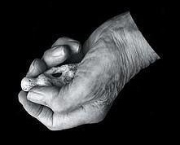
YE OLDE CRAFTSMAN’S SHOPPE
Notes:
The business people, the suits, can enter the craftsman’s shoppe, where everything is neat and tidy, a stronghold of sanity.

Slide 68
HAND-CRAFTED ARTISAN SOFTWARE MADE TO ORDER
Notes:
And there the business can order software of the highest quality, and maybe there’s some negotiation and the craftsman can offer alternatives at various costs, according to need.

Slide 69
COMMUNICATION BECOMES NEGOTIATION
Notes:
So it’s a client-supplier kind of relationship and communication becomes negotiation.

Slide 70
BUT WE ARE THE BUSINESS
Notes:
But we, developers, are the business, just as much as anyone else. There are no business people! There are other people doing things besides programming in the same business.

Slide 71
COMMUNICATION SHOULD BE COLLABORATION
Notes:
Software development is a cross functional team effort. And communication should be collaboration.

Slide 72
HOW TO BE VALUABLE?
Notes:
So how can we be valuable? How can we be good eggs?

Slide 73
BEYOND TECHNICAL SKILL
Notes:
I would like to see more programmers looking beyond technical skill.

Slide 74
DOMAIN MODELLING
Notes:
So in my work, I try to bring value by being doing domain modelling, because I believe that poor modelling and weak, ambiguous language is the primary cause of complexity and technical debt.

Slide 75
SYSTEMS THINKING
Notes:
You could be good a systems thinking, how complex systems interact.

Slide 76
STRATEGIC ARCHITECTURE
Notes:
You could do strategic architecture work, working iteratively to improve the architecture to support evolving business needs.

Slide 77
SO MANY VALUABLE SKILLS!
Notes:
There are so many valuable skills for a software developer besides writing code.

Slide 78
WHAT IS A GOOD DEVELOPER?
Notes:
Which brings us back to the original question.

Slide 79
AM I A GOOD DEVELOPER?
Notes:
Am I a good developer?

Slide 80
WHAT IS MY IDENTITY?
Notes:
What is my identity?

Slide 81
SOFTWARE INFIDELS
Notes:
I for one want to see more heresy, more software infidels!

Slide 82
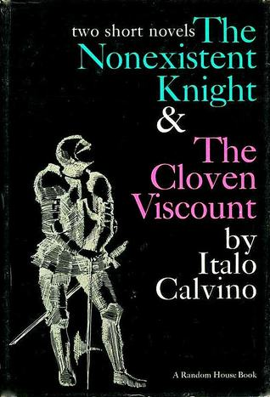
Notes:
I would like to leave you with a book recommendation. There’s a great story by Italo Calvino called the non-existent knight. It was written in 1959, but it’s clearly about software development.

Slide 83
SIR AGILULF
Notes:
The main character is Sir Agilulf Emo Bertrandin of the Guildivern.

Slide 84
THE PERFECT KNIGHT
Notes:
He is the perfect knight in white armor, he knows all the duties and routines and keeps everything clean.

Slide 85
AN EMPTY ARMOR
Notes:
The only problem is that he doesn’t exist, there’s no body inside the armor. When he takes off his armor, he disappears. So whether or not we are software craftsmen, I think it’s important that we think about what our identities should be, and if we really need that armor.

