Slide 1
NAMES & THINGS
@EINARWH

Slide 2
NAMING IS IMPORTANT

Slide 3
NAMING IS DIFFICULT

Slide 4
BUT WHY?

Slide 5
WHY IS NAMING DIFFICULT?

Slide 6
IS NAMING ALWAYS DIFFICULT?

Slide 7
WHAT MAKES NAMING DIFFICULT?

Slide 8
WHAT IS NAMING?

Slide 9
THINGS MAKE NAMING DIFFICULT

Slide 10

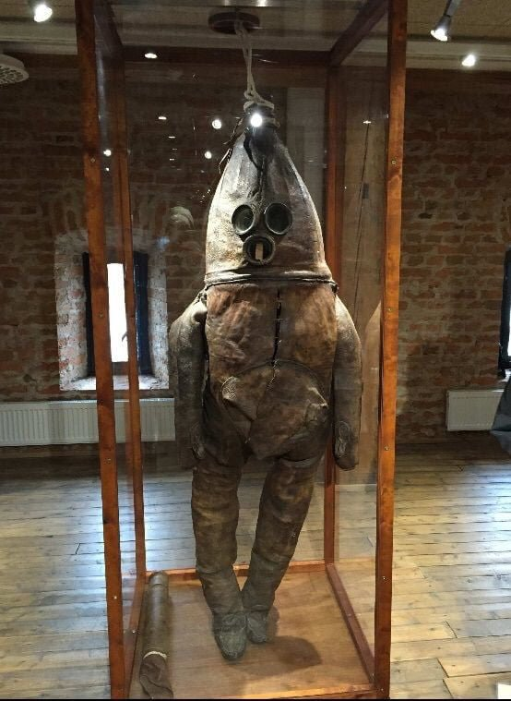
Jared Pechacek
@vandroidhelsing
Why did they NAME IT you don’t NAME THINGS LIKE THIS you BURY THEM and HOPE THEY CAN’T DIG
41 Strange @41Strange
The ‘Old Gentleman’ of Raahe - the oldest surviving Diving Suit in the world, early 18th Century Finland
8:24 PM - 10 Mar 2019
1,731 Retweets
7,119 Likes

Slide 11
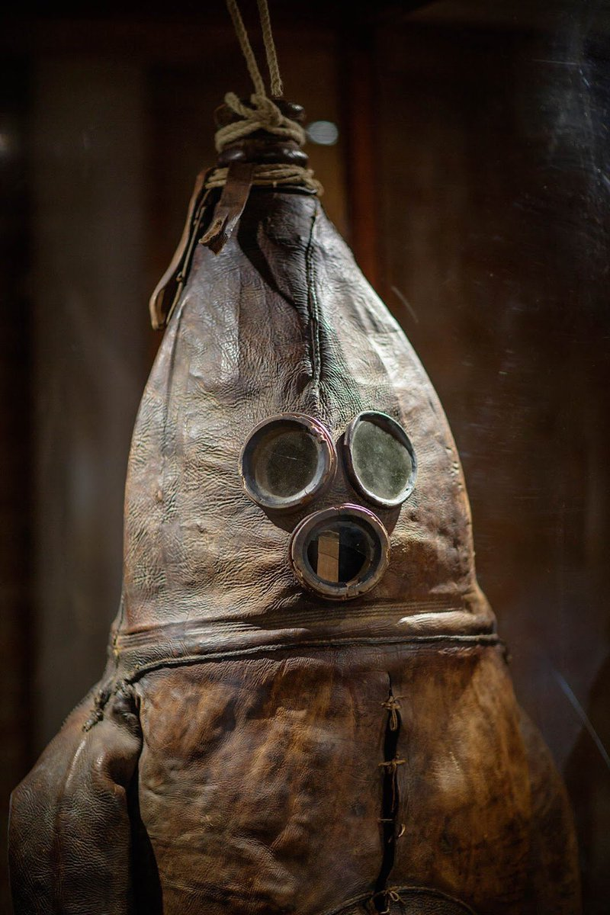

Slide 12
IS IT A…

Slide 13
IS IT A…
MANAGER?

Slide 14
IS IT A…
SERVICE?

Slide 15
IS IT A…
HELPER?

Slide 16
WRONG QUESTION!

Slide 17
SOME THINGS SHOULD NOT BE NAMED

Slide 18
SOME THINGS SHOULD NOT BE MENTIONED

Slide 19
SOME THINGS SHOULD NOT EVEN EXIST

Slide 20
A BETTER QUESTION

Slide 21
WHY DOES IT EXIST?

Slide 22
WHY DID YOU MAKE IT?

Slide 23
STOP MAKING THE STUFF OF NIGHTMARES

Slide 24
MAKE THINGS THAT ARE EASY TO NAME

Slide 25
NAMING & THINGING

Slide 26
IS THINGING DIFFICULT?

Slide 27
WHAT IF NAMING ISN’T THE PROBLEM?

Slide 28
WHAT IF THE REAL PROBLEM IS COMING UP WITH GOOD ABSTRACTIONS?

Slide 29
WHY DO WE ABSTRACT?

Slide 30
TO DIVIDE AND CONQUER

Slide 31
TO CONTAIN COMPLEXITY

Slide 32
…

Slide 36
WHAT DO WE CALL THIS PROCESS?

Slide 37
MODELLING

Slide 38
MODELLING IS THE PROBLEM

Slide 39
NAMING ISN’T DIFFICULT

Slide 40
MODELLING IS DIFFICULT

Slide 41
NAMING IS A TERRIBLE NAME FOR MODELLING

