Slide 1
DEARTH OF A DRAFTER
@EINARWH
Notes:
Hi, thanks for having me. My name is Einar, I’m a software developer. I work for NRK TV, the public broadcaster in Norway.

Slide 2
TOO MANY CRAFTERS
Notes:
I don’t have much time, so let’s get right to it. I think we have too many crafters in the industry.

Slide 3
DEATH OF A CRAFTSMAN
Notes:
I did a talk at Kandddinksy called death of a craftsman, where I talked about my identity crisis as a software developer, and why I’m a recovering crafter.

Slide 4
WHAT IS THE CRAFT?
Notes:
One of the questions I asked in that talk was, what is the craft? Who is the crafter? Because it seems to me that there are multiple crafts involved in software development. But craft is always code-centric. Only programmers can be crafters. And I think that’s wrong.

Slide 5
NOT ENOUGH DRAFTERS
Notes:
So I think we still have too much focus on crafting code. I want more focus on drafting.

Slide 6
WHAT IS A DRAFTER?
Notes:
When I say I want more drafters, I mean more people who are good at externalizing mental models. Doesn’t have to be programmers, could be, ideally everyone.

Slide 7
COLLABORATIVE MODELLING
Notes:
If we agree that software development is a multi-disciplinary cross-team effort, then collaborative modelling is at the core of it. It needs to be a meeting of minds. Our success relies on the ability to compare and reconcile our mental models, and for that they need to be made as visible and tangible as possible.

Slide 8
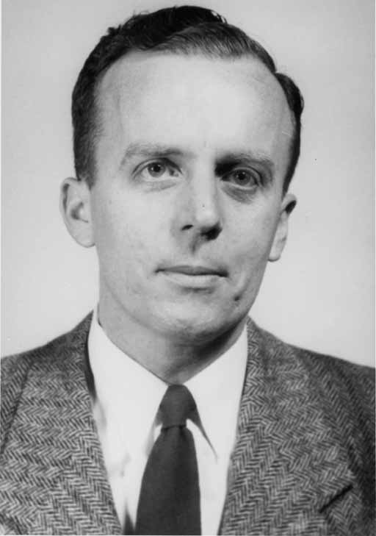
THE COMPUTER AS A COMMUNICATION DEVICE
JCR LICKLIDER
Notes:
There’s a wonderful paper from 1968 by JCR Licklider that I recommend reading called the computer as a communication device, where Licklider defines communication as the comparison of models.

Slide 9
A DRAFTER IS A CATALYST FOR COMMUNICATION
Notes:
So if a drafter is someone who is good at externalizing mental models, both their own and those of others, then a drafter can act as a catalyst for the communication necessary for successful software development.

Slide 10
WRITING SOFTWARE IS EASY
Notes:
Writing software is easy.

Slide 11
THE PROBLEM IS TO KEEP WRITING
Notes:
The problem is to be able to keep writing software. To evolve and refine the product.

Slide 12
TETRIS
Notes:
I think of it as Tetris. It’s a fast-paced game that can’t be won, is easy to lose, and the goal is to play as long as possible.

Slide 13
CONFLICT
MISUNDERSTANDING
AMBIGUITY
GENERALIZATION
INDECISION
Assumption
Notes:
Unwitting assumption.
Some indecision about architecture
Bet against the future
Some ambiguity of domain terms
Misunderstanding between teams
Conflict of vision

Slide 14
CONFLICT
MISUNDERSTANDING
AMBIGUITY
GAME OVER
GENERALIZATION
INDECISION
Assumption

Slide 15
NOT ABOUT FACTORING CODE
Notes:
It’s important to realize that this isn’t about factoring code the right way. There is no right factoring when people’s mental models are out of sync.

Slide 16
CONFLICT
MISUNDERSTANDING
AMBIGUITY
GENERALIZATION
INDECISION
Assumption
Notes:
If we look at the things that cause problems over time, it’s the sediments of communication problems, organization dysfunctions and broken models.

Slide 17
COMMUNICATION
Notes:
So it’s really about facilitating communication, that’s our only hope, because communication is comparing mental models. And I must say that personally, that’s a huge disappointment. I didn’t become a software developer because I love to talk to people. I don’t. People exhaust me. But it must be done. Experience has taught me that pretending that the problem is technical is not going to help.

Slide 18
A DRAFTER SEEKS TO EXPOSE PROBLEMS
Notes:
So it’s better to be honest about it and try to tackle it head-on. To me, a drafter is someone who actively seeks out these problems in order to mitigate them.

Slide 19
DRAFT IS CRAFT TOO
Notes:
And if you’re disappointed because you really want to be a crafter, rest assured that drafting is craft too. There’s real skill involved, and we need to practice it to do better. Thank you.

