Slide 1
PROGRAMMING AS OTHER
@EINARWH
Notes:
Hi. So what I wanted to talk about, I’m not quite sure, but I’ve been angry and upset, and that seems like a good starting point. That’s usually how I write blog posts or talks. I sometimes think of myself as the pebble in the shoe programmer, constantly finding things that annoy me and then talking about those.

Slide 2
IS PROGRAMMING ART OR SCIENCE?
Notes:
And in this case it is this. This evergreen question, «is programming art or science?»

Slide 3
HAPOC 2020 CFP
Notes:
I was reading the CFP for HAPOC 2020, and there it was again. The very first question:
Can/has been/should be programming understood as an art, a craft and/or a science?

Slide 4
ET TU, BRUTE?
Notes:
And I was like, really? Even here? Even you?

Slide 5
NO!
Notes:
So my immediate response was just no! I reject the question! I hate it! And I didn’t necessarily know why, but I knew very well that I did, and so I quickly wrote an incoherent rant in my TiddlyWiki, where I keep drafts and submissions for talks. And I guess this talk is just going to be that rant in oral form.

Slide 6
PREPARATION
Notes:
This actually happened a year ago, it’s old stuff in a sense. But when I started my tiny preparations for this talk, I made a few google searches and read a few things about that question and now my anger and frustration is all fresh. Nothing has changed in the meantime.

Slide 7
WHERE DOES THE ANGER COME FROM?
Notes:
But just being angry or upset isn’t very fruitful. At least I have to explain myself, perform a little introspection. Where does the anger come from? What is it that annoys me? What’s wrong with this question? Maybe I can turn this frustration into something more useful.

Slide 8
IS PROGRAMMING ART OR SCIENCE?
Notes:
What is it about this question that is so annoying to me?

Slide 9
MEMES
Notes:
One way to look at is, is to consider it as a meme. As you may know, memetics is the idea that memes – ideas or soundbites – are like genes, in that they replicate, mutate and compete for attention. Of course, the idea of memes is itself a meme.

Slide 10
THE VALUE OF MEMES
Notes:
How valuable is a particular idea or meme? One way you might measure its value is by looking at the output it generates. And this I think is the main problem for me.

Slide 11
IS PROGRAMMING ART OR SCIENCE?
Notes:
I’m frankly very disappointed by the output.
This is a very old meme in terms of the history of programming. You can at least trace it back to Dijkstra and Knuth, and possibly even longer than that. I think Knuth wrote the original «Is programming art or science» article in 1974. Now if you read that article, called «Computer programming as art», and compare it to whatever people are writing today – at least in the blog posts I found - you’ll see that there is nothing new being offered! In fact, you’ll find them to be very poor echoes of what Knuth tried to say in 1974, pathetic ghosts of the same points. That’s a terrible track record for an idea. That’s close to 50 years of stagnation, of rehashing the same stale points over and over. And yet we continue to treat that question with reverence, as if it were somehow an important question, one that is worthwhile to keep asking.

Slide 12
THE HISTORY OF «IS PROGRAMMING ART OR SCIENCE?»
Notes:
This is a very old meme in terms of the history of programming. You can at least trace it back to Dijkstra and Knuth, and possibly even longer than that. And of course the question of art vs science predates the application to programming.

Slide 13
KNUTH 1974 COMPUTER PROGRAMMING AS AN ART
Notes:
I think Knuth wrote the original «Is programming art or science» article in 1974, or at least the most famous one. Now if you read that article, called «Computer programming as art», and compare it to whatever people are writing today – at least in the blog posts I found - you’ll see that there is nothing new being offered!

Slide 14
1975 – 2021 ECHOES OF KNUTH
Notes:
If you look at what has been written in the years after 1974 – which just so happens to mean by entire life, you’ll find them to be very poor echoes of what Knuth tried to say. Pathetic ghosts of the same points. That’s a terrible track record for an idea. That’s close to 50 years of stagnation, of rehashing the same stale points over and over. And yet we continue to treat that question with reverence, as if it were somehow an important question, one that is worthwhile to keep asking.

Slide 15
HOW MEMES COMPETE
Notes:
Unfortunately, memes don’t compete by the usefulness of their output. That’s not the way things actually work. To the extent that there is a «marketplace of ideas», the market isn’t about usefulness.

Slide 16
WHAT FEELS GOOD?
Notes:
What feels good is much more important. And I guess that’s the appeal of «is programming art or science?» Merely asking that question makes us feel slightly deep, slightly philosophical, we can sip a little wine, stare into the horizon and nod as we contemplate the depth of our own souls.

Slide 17
A MAN GOES TO PRISON…
Notes:
I think there’s also a part of it that has to do with community and recognition. I don’t know if you’re all familiar with the joke about the guy who goes to prison and finds that the inmates are saying seemingly random numbers to each other and roaring with laughter, but then when he says a number, all he gets is a groan and someone says «some people can tell a joke, some can’t». One of the things that unite us as programmers is that we are constantly discussing if we’re doing art or science.

Slide 18
WHAT IS THE ANSWER?
Notes:
And the answer that we have all memorized, and yet at intervals we feel the need to repeat to each other, is this: «it is neither, and both, and isn’t it grand». But you need to go about that in a slightly roundabout fashion, which involves a google search for definitions of art and science, and then meandering a bit back and forth before concluding with what was already known. And again, that pattern was laid down by Knuth in the 1974 article.

Slide 19
INTELLECTUAL POSTURING
Notes:
And that is really provoking to me. I see it as a form of pseudo-intellectal posturing. It’s just show, there is no substance to it.

Slide 20
INTELLECTUAL LAZINESS
Notes:
In particular it’s very very easy, there is no actual intellectual effort involved.

Slide 21
INTELLECTUAL STAGNATION
Notes:
And while dressing up as somehow intellectual, it really represents the opposite. It’s stagnation.

Slide 22
WE NEED NEW QUESTIONS
Notes:
We need new questions, questions that will stimulate actual intellectual effort.

Slide 23
MEME SPACE
Notes:
Because memes do compete for attention and replication, and if we’re constantly asking the same old question, which generates no new output, no new insights into what programming is or isn’t, then it would be nice to free up that space to ask some different questions, that might actually produce some useful output.

Slide 24
OPPORTUNITY COST
Notes:
There’s an opportunity cost to asking unproductive questions over and over again, as if they were interesting. The unproductive questions occupy brain real estate that could be used for something productive instead.

Slide 25
SO MUCH FOR MEMES
Notes:
So much for memes.

Slide 26
LINGUISTICS
Notes:
Another perspective has to do with linguistics. At least it seems that way to me, a non-linguist. I really should have been there for Alvaro’s presentation on semiotics, so you’ll have to forgive my ignorance and naive thoughts.

Slide 27
IS PROGRAMMING ART OR SCIENCE?
Notes:
I think we use the word «is» too much, and when we do, we’re not very explicit about what we mean.

Slide 28
«PROGRAMMING IS ART»
Notes:
Consider a sentence like «programming is art». What is the significance of such a sentence? What could it mean?

Slide 29
«PROGRAMMING IS ART»
Notes:
In particular what is the role of the word «is», what does it mean. Do we mean it descriptively, as a fact – I think programming _is_ art in an objective sense, or normatively, as something that I wish were so – I think programming _should be_ art, programming would be better if it were art.

Slide 30
PROGRAMMING EQUALS ART?
Notes:
We can’t possibly mean that programming actually equals art, they’re not synonyms. So there is some other relationship between the words.

Slide 31
READINGS
Notes:
So it must be more about readings or perspectives. We’re perhaps trying to paint the meaning of the word programming by applying the paint of other words, which seems to be the way language works.

Slide 32
PROGRAMMING AS ART
Notes:
So we can ask, for instance, what happens if we consider programming as art, what insights might follow from that. And to be fair to Knuth, that was actually the title of his 1974 article: Computer programming as an art. He didn’t say that programming was art, he said that programming could be and perhaps should be viewed as art.

Slide 33
PROGRAMMING AS SCIENCE
Notes:
Or we can ask, what happens if we consider programming as science, what insights might follow from that.

Slide 34
WHY ALWAYS TOGETHER?
Notes:
But interestingly, we don’t seem to do that. We always consider programming as art and as science at the same time, together. They’re tied together. We never go deep on either one.

Slide 35
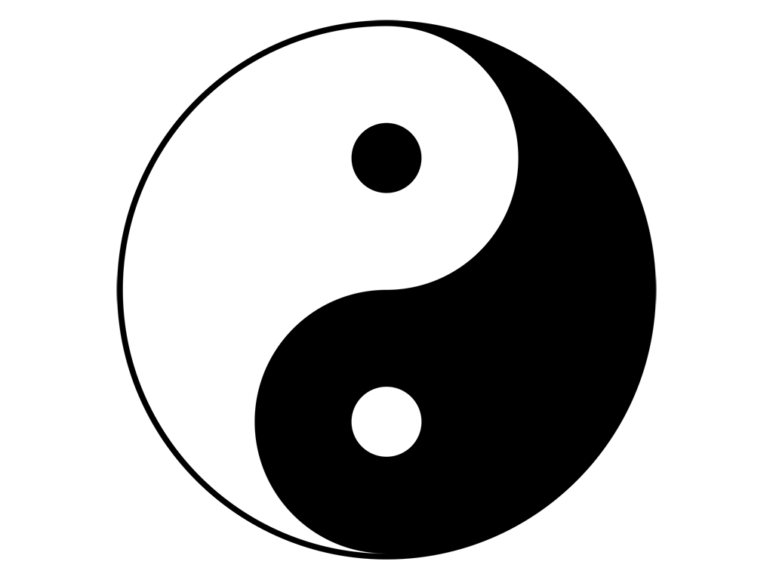

Notes:
I think there is something yin and yang like going on. A little bit of mysticism, a little bit of orientalism. We in the west love eastern philosophy because we can mould it to fit our needs. We like this compare and contrast between art and science, where art is a symbol for creativity, gut feeling, the humane, and science represents cool reason, logic, the mechanical.

Slide 36
ART AND SCIENCE AS METAPHORS
Notes:
We’re using art and science as metaphors for these opposing forces.

Slide 37
CONTRAST AS GENERATOR
Notes:
So in a sense that’s a generative contrast. There is something to be said in using two more or less opposing perspectives to describe something. But at the same time, Knuth has already done that exercise, sort of, and apparently we don’t have much more to say.

Slide 38
CONTRAST AS LIMITATION
Notes:
Viewing art only in contrast to science and science only in contrast to art is also very limiting to what we might accomplish.

Slide 39
PROGRAMMING AS ART
Notes:
Let’s go back to the reading of programming as art. Such a perspective could be expanded upon, but it’s unlikely that it will happen as long as it is forever joined at the hip to that other question. If art is always considered in contrast to science, then we won’t ever delve very deeply into programming as art

Slide 40
TAKING «PROGRAMMING AS ART» SERIOUSLY
Notes:
But we could. I’m not going to try to do it for real, because I don’t really feel qualified, and it’s not really the topic of this talk. But it would be very easy to ask some basic questions that still never come up in these endless repetitions of the art-vs-science meme.

Slide 41
WHAT IS THE ARTWORK?
Notes:
For instance «what is the artwork?» To Knuth, the answer is the source code, the «listing» as they called it back then, presumably because you had it printed out, a physical artifact. And it’s kind of interesting to think of it that way, it’s like considering the sheet of music to be the artwork or something. But since no-one has expanded on anything in Knuth’s original article, that’s the only perspective I’ve seen. But it’s certainly not the only possible answer. What about the runtime? What about performance art? The ontological status of programs is actually very interesting. What even is the program? What about the program’s evolution? What about self-modifying programs? What about groups of programs?

Slide 42
WHO IS THE ARTIST?
Notes:
Who is the artist? In Knuth’s time, it seems, it was implicit that there was a single author for programs, and so a single artist for the artwork. But much if not most programming today is collaborative. Does the artist matter? Is the artist interesting? What about mob programming?

Slide 43
HOW CAN I EXPERIENCE IT?
Notes:
If programming is art – how can I experience it? Obviously it’s related to what the artwork is, what the artful artifact is.

Slide 44
WHERE IS THE EXHIBITION?
Notes:
Where is the exhibition? If programming can be seen as art, can be artful, surely there should be art exhibitions, where I can appreciate the art of programming? Is it GitHub?

Slide 45
DEMOSCENE
https://en.wikipedia.org/wiki/Demoscene
Notes:
There are actually a few exhibition-like things that spring to mind. In particular the demoscene. I think you could argue that the demoscene is all about the art of programming. https://en.wikipedia.org/wiki/Demoscene
But I don’t think programmers think of the demoscene when they talk about programming as art. Maybe they’ll mention it when pushed. But it’s mostly «I think my program is pretty».

Slide 46
FARM
https://functional-art.org/2021/
Notes:
There is also FARM which I think is interesting. The ACM SIGPLAN International Workshop on Functional Art, Music, Modelling and Design. That’s partially about producing artful output, programs that produce art in a sense, but not only.

Slide 47
Ckalcuλator
https://codeklavier.space
Notes:
And I have to mention CodeKlavier. https://codeklavier.space/
Which is about doing lambda-calculus with the piano.

Slide 48
TAKING «PROGRAMMING AS SCIENCE» SERIOUSLY
Notes:
And we could do the same for science. And in a sense, here we have computer science, but I’m not sure that’s the same thing.

Slide 49
PROGRAMMING AS WHATEVER
Notes:
And anyway, why would we stop at just those two? It seems to me that we suffer from extreme lack of imagination if those are the only two readings that we could give, and that we are somehow condemned to repeat those two readings forever. It’s like you could *never* analyze Hamlet from anything else than a Freudian angle, as an Oedipus drama.

Slide 50
BREAKING OUT
Notes:
I think we need to break out and look at other perspectives.

Slide 51
PROGRAMMING AS NEITHER
Notes:
What is programming as neither art nor science, what is it then?

Slide 52
PROGRAMMING AS OTHER
Notes:
What happens if we think of programming as something else entirely, or even as the negation or absence of something.
Now is a good time to take a sip of wine if you have a glass.

Slide 53
WHAT IS THE PURPOSE OF READING?
Notes:
We might ask ourselves – as we perform these readings, of these attempts to highlight some aspect of what programming might be – what is the purpose? Why are we doing it?

Slide 54
READING TO UNDERSTAND
Notes:
That might seem silly, because surely it’s to somehow understand, right?

Slide 55
READING AS INTERPRETATION
Notes:
It’s an interpretation.

Slide 56
WHAT IS PROGRAMMING?
Notes:
We’re really trying to understand «what is programming?» Which is a much more open-ended question.

Slide 57
READING TO BE
Notes:
But another way to look at it, which I think follows from the characterization of what programming is, is that we are reading – interpreting – programming to be something ourselves. Because programming is something that we, programmers, do.

Slide 58
IDENTITY
Notes:
It has to do with our identities as programmers.

Slide 59
PROGRAMMING MAKES THE PROGRAMMER
Notes:
Whatever programming is determines what we are.

Slide 60
METAPHOR AS MIRROR
Notes:
So the metaphor is a mirror, and we want to like what we see in the mirror.

Slide 61
PROGRAMMING AS ART MAKES THE PROGRAMMER AN ARTIST
Notes:
Programming as art makes the programmer an artist.

Slide 62
«A PROGRAMMER WHO SUBCONSCIOUSLY VIEWS HIMSELF AS AN ARTIST WILL ENJOY WHAT HE DOES AND WILL DO IT BETTER»
Notes:
And Knuth actually wrote about this too. This is from the summary of his 1974 article.

Slide 63
PROGRAMMING AS SCIENCE MAKES THE PROGRAMMER A SCIENTIST
Notes:
And of course interpreting programming as science turns us into scientists. And that might appeal to some people too.

Slide 64
WHO DO WE WANT TO BE?

Slide 65
ALTERNATIVE READINGS?
Notes:
What are some alternative readings of programming?

Slide 66
PROGRAMMING AS PHILOSOPHY MAKES THE PROGRAMMER A PHILOSOPHER
Notes:
What about programming as philosophy? That would make us philosophers. Very nice!

Slide 67
ON THE IMPOSSIBILITY OF READING
Notes:
To be a complete pseudo-intellectual myself: How does programming escape our attempts to read it? What about programming escapes our attempts to capture it with metaphors?

Slide 68
PROGRAMMING AS PROGRAMMING
Notes:
Every classification or metaphor is a reduction. In a sense we are left with tautology if we are to say what programming is.
What is irreducible about programming?

Slide 69
DISCUSS?
Notes:
And that’s all I have.

