Slide 1
The family of F#

Slide 2
ML
SML
OCaml
F#

Slide 3
In the beginning was…

Slide 4


Slide 5
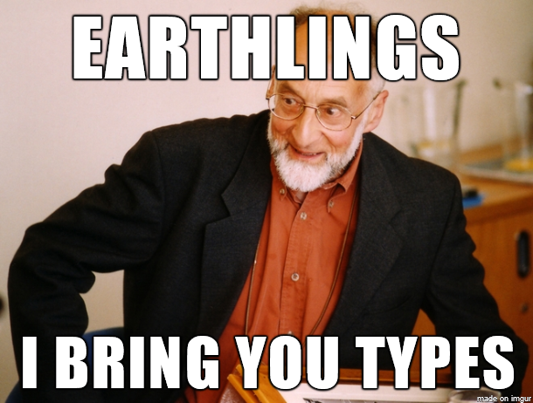

Slide 6
ML

Slide 7
Static typing

Slide 8
Type inference
Notes:
let ten = 5 + 5;;
let inc = fun n -> n + 1;;
let dbl = fun n -> n * 2;;

Slide 9
Parametric polymorphism
Notes:
# [];;
- : 'a list = []
# 1::[];;
- : int list = [1]
# "foo"::[];;
- : string list = ["foo"]

Slide 10
Algebraic data types
Notes:
type suit = Club | Diamond | Heart | Spade;;
type rank = Ace | King | Queen | Jack | Numeric of int;;
type card = Card of suit * rank;;

Slide 11
Pattern matching
Notes:
# let motorhead c = match c with
| (Spade, Ace) -> true
| _ -> false
;;
val motorhead : suit * rank -> bool = <fun>

Slide 12
Garbage collection

Slide 13
OCaml

Slide 14
|>
Notes:
[2;3;4] |> List.map (fun x -> x + x)

Slide 15
Objects*
Notes:
http://stackoverflow.com/questions/179492/f-changes-to-ocaml
Meta-programming using quotations
Active patterns
Computation expressions
.NET compatible object-system
Overloaded operators

Slide 16
F#

Slide 17
.NET-style objects
Notes:
http://stackoverflow.com/questions/179492/f-changes-to-ocaml
Meta-programming using quotations
Active patterns
Computation expressions
.NET compatible object-system
Overloaded operators

Slide 18
Overloaded operators
Notes:
http://stackoverflow.com/questions/179492/f-changes-to-ocaml
Meta-programming using quotations
Active patterns
Computation expressions
.NET compatible object-system
Overloaded operators

Slide 19
Active patterns
Notes:
http://stackoverflow.com/questions/179492/f-changes-to-ocaml
Meta-programming using quotations
Active patterns
Computation expressions
.NET compatible object-system
Overloaded operators

Slide 20
Computation expressions
Notes:
http://stackoverflow.com/questions/179492/f-changes-to-ocaml
Meta-programming using quotations
Active patterns
Computation expressions
Query expressions
.NET compatible object-system
Overloaded operators

