Slide 1


Israel JBoss User Group
Session 11 / 25.05.2009
Outside The Java Box
By :
Zvika Markfeld,
Java Architect,
Tikal Knowledge
Hosted by Tikal. w w w . t i k a l k . c o m Cost-Benefit Open Source

Slide 2
Agenda
Israel JBUG
Language Matters
Past, Present, Future
Key Players
Market Considerations
Alternatives
Forecasts
Hosted by Tikal www.tikalk.com

Slide 3

Origin of Java
Israel JBUG
C++ Replacement
Clearer Syntax
Omitted ambiguities & pitfalls
(multiple inheritance, operator overloading, ...)‏
Conscious verbosity
Hosted by Tikal www.tikalk.com

Slide 4

Java Today
Israel JBUG
Backward compatibility => Feature freeze
Closures? Generics? Metaprogramming? DSLs?
too late...
TOO verbose: millions of lines of code in real apps (IDEs don't solve that!)‏
Not enough traction, no hype
Static type system - too rigid?
Semi-conclusion: 13 years is a long time!
(long enough for a bat to become a rat)‏
Hosted by Tikal www.tikalk.com

Slide 5
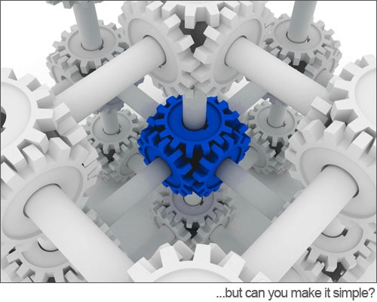
Complexity Matters
Israel JBUG
The overall complexity of a new language feature correlates with the interactions the new feature has with existing features...
Hosted by Tikal www.tikalk.com

Slide 6
The Java 7 Closure Act
Israel JBUG
Runnable r = { => System.out.println(i); }
with (FileInputStream input : new FileInputStream(fileName)) {
// use input
}
public static void with(FileInputStream t, {FileInputStream==>void} block) {
try {
block.invoke(t);
} finally {
try {
t.close();
} catch (IOException ex) {
logger.log(Level.SEVERE, ex.getMessage(), ex);
}
}
}
Hosted by Tikal www.tikalk.com

Slide 7
The Java 7 Closure Act
Israel JBUG
public static <T,throws E extends Exception>
T withLock(Lock lock, {=>T throws E} block) throws E {
lock.lock();
try {
return block.invoke();
} finally {
lock.unlock();
}
}
withLock(lock, {=>
System.out.println("hello");
});
final double highestGpa = students
.filter({ Student s => s.graduationYear == THIS_YEAR })
.map( {Student s => s.getGpa() })‏
.max();
();
Hosted by Tikal www.tikalk.com

Slide 8
The Java 7 Closure Act
Israel JBUG
{ int => int } sum = { int n => n == 1 ? 1 : n + sum.invoke(n - 1) };
Integer i = { => throw new NullPointerException(); }.invoke();
{ String => Set<String> } singleton =
Collections#<String>singleton(String);
Set<String> set = singleton.invoke("single");
{ String => { int => String } } concat =
{ String s =>
{ int n => String r = ""; for ( ; n > 0; n--) r += s; r } };
{ String => Number } p = { Object o => Integer.valueOf(o.hashCode()) };
System.out.println(p.invoke("haf"));
Hosted by Tikal www.tikalk.com

Slide 9
The Java 7 Closure Act
Israel JBUG
Java
Closures
Production Language
Research Language
Object Oriented
Functional
Simplicity
Power, Conciseness
Static
Dynamic
Hosted by Tikal www.tikalk.com

Slide 10
The Java 7 Closure Act
Israel JBUG
As backwards compatibility increases, elegance decreases
As languages evolve, each new addition becomes more complicated, because it has to interact with more conflicting constructs
At some point, the additions are no longer worth their price
Hosted by Tikal www.tikalk.com

Slide 11

The Java 7 Closure Act
Israel JBUG
3 implementation proposals, none passed...
Hosted by Tikal www.tikalk.com

Slide 12
What Have We Learned?
Israel JBUG
Multi-billion dollar industry
cannot afford risky changes
Mission critical assignments
cannot afford risky changes
Blue-collar developer base
cannot afford risky changes
Hosted by Tikal www.tikalk.com

Slide 13
Multi Language JVM
Israel JBUG
The JVM, On The Other Hand...
  Well known, proven libraries
  Standardized
  Secure, robust, scalable
  Serves the “Different languages for different purposes” idiom (CLR? What’s that?)‏
  As opposed to some of the alternatives, which go by:
  "My son-in-law wrote a great interpreter, it just needs a few more features"...
  Break the development cycle: “write-compile-package-deploy-test” no longer applies
Hosted by Tikal www.tikalk.com

Slide 14
Multi Language JVM
Israel JBUG
Downsides:
Language-VM Mismatch
Translation Artifacts
Semantic Mismatch
Performance
Conservatism
Hosted by Tikal www.tikalk.com

Slide 15
Market Considerations
Israel JBUG
Blogosphere != Real World
Language developers:
High rollers involved: Former-Sun, Oracle, IBM, ...
Heavyweight users:
Telco’s, Insurance, Billing, Banking, Financial...
Various Technologies:
APIs, libraries, open source projects - these will not convert overnight
Hosted by Tikal www.tikalk.com

Slide 16
Java Language Centric Approach
Israel JBUG
On the other hand, some claim the opposite:
Take Java and throw away the runtime
GWT: runs Java on Javascript engine
Android: runs Java on Dalvik
Alternative VMs: IBM, Oracle, OpenJDK, ...
Hosted by Tikal www.tikalk.com

Slide 17
Language Characteristics
Israel JBUG
Dynamic?
Static?
Execution Environment?
Old?
New?
Renewed?
Functional? OO?
Frameworks?
JVM Ports?
Homegrown?
Polyglot Programming?
But how to pick the right tool for the right job?
Hosted by Tikal www.tikalk.com

Slide 18

Scala
Israel JBUG
Scala is both OO and functional, while keeping a static type system (as c, c++, java, haskell, pascal...)‏
It blends a number of modern language features, while maintaining close compatibility with Java.
Born on the JVM - Attractive to Java developers
Tool support, Libraries
Strongly, statically typed
Used by ...
Initial Release: 2003
Books: 6
Hosted by Tikal www.tikalk.com

Slide 19
Groovy
Israel JBUG
“An agile and dynamic language for the JVM”
Java code is valid Groovy...
JVM-friendly
Inspired by languages like Python, Ruby and Smalltalk
Part of the SpringSource portfolio
Grails web app framework: killer-app?
Initial Release: 2004
Books: 8
Hosted by Tikal www.tikalk.com

Slide 20
Ruby
Israel JBUG
Extremely dynamic language
Strongly typed
Excellent DSL capabilities
(Rails, Rake, Builders, ...)‏
Initial Release: 1995!
Books: > 30
Still, some performance issues
(green threads on 1.8 interpreter)‏
Still, mainly used for small web-apps...
Hosted by Tikal www.tikalk.com

Slide 21
Python
Israel JBUG
Modern, advanced OO language
Power tool language used for science, military...
Used massively by Google -
both internally and on the GAE
Many software stacks,
both web and full applicative
Concurrency capabilities
Initial Release: 1991
Books: 12
Hosted by Tikal www.tikalk.com

Slide 22
Clojure
Israel JBUG
Dynamic programming language that targets the JVM
Multithreading capabilities (multi-cores etc.)‏
Lisp Dialect/Extension
Easy DSL creation
Initial Release: 2007
Books: 1
Hosted by Tikal www.tikalk.com

Slide 23
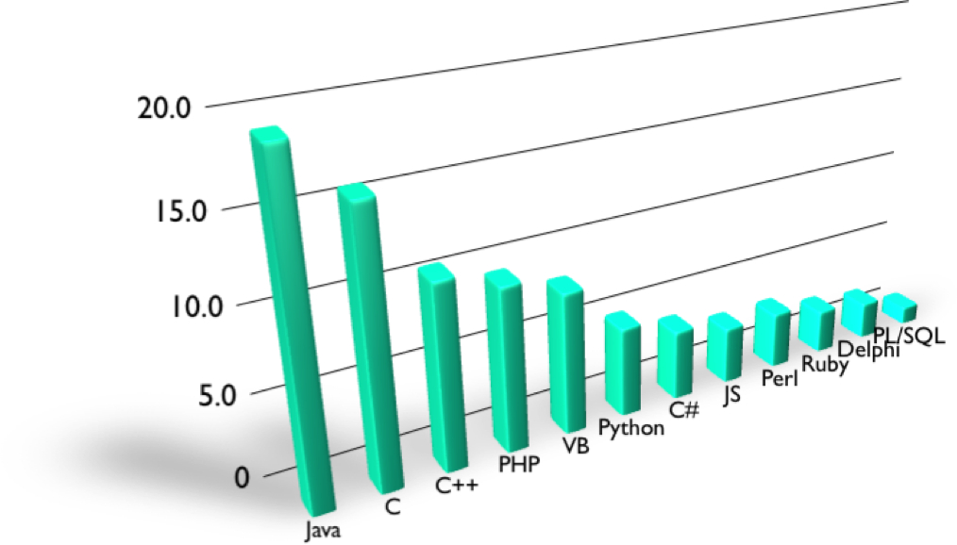
Trends And Adoption
Israel JBUG
Based on Tiobe index, May 2009
Hosted by Tikal www.tikalk.com

Slide 24
Israel JBUG
Thank You!
zvika@tikalk.com
Hosted by Tikal www.tikalk.com

