Slide 1
Spring Batch
An introduction to Spring Batch.

Slide 2
Agenda
Java Batch – A Missing Enterprise Capability
Objectives, Scenarios, and Features
Spring Batch Overview
Spring Batch domain detail and code samples
Item readers and item writers
Parallel processing
Roadmap and product development process

Slide 3
Missing Java Batch
Batch jobs are part of most IT projects and currently no commercial or open source framework provides a robust, enterprise-scale solution/framework
Batch processing is an Application Style for data processing pipelines (e.g. payment and settlement systems)‏
The lack of a standard architecture has led many projects to create their own custom architecture at significant development and maintenance costs

Slide 4
Accenture and Interface21 Partnership
Why is Accenture contributing to open source?
• Consolidating decades worth of experience in building high-performance batch solutions
• Driving standardization in batch processing
Why Spring?
• Established, active, and leading community with significant momentum
• Logical home for a batch architecture framework as part of the Spring Portfolio
End Goal
• Provide a highly scalable, easy-to-use, customizable, industry-accepted Batch architecture framework

Slide 5
Agenda
Java Batch – A Missing Enterprise Capability
Objectives, Scenarios, and Features
Spring Batch Overview
Spring Batch domain detail and code samples
Item readers and item writers
Parallel processing
Roadmap and product development process

Slide 6
Batch Processing Style
What is a batch?
– Start and end
– Read from input – write to output
– Datasets too large to read and process all items at once
– Optimize by committing periodically: chunk

Slide 7
Technical and Architecture Objectives
Clear separation of concerns – application developer concentrates on business logic
Provide common, architecture layer services as interfaces
Provide simple and default implementations of the layers that are easy to configure, customize, and extend
Batch services should be easy to replace or extend, without impact to the infrastructure or application layers

Slide 8
Business Scenarios
Commit batch process periodically
Concurrent batch processing: parallel processing of a jobs
Manual or scheduled restart after failure
Partial processing: skip records (e.g., on rollback)‏
Sequential processing of dependent steps
Staged, enterprise message-driven processing
Whole-batch transaction for simple data models or small batch size
Massively parallel batch processing

Slide 9
Features
Support for multiple file formats:flat, xml..
Automatic retry after failure
Job control language for monitoring and operations: start, stop, suspend, cancel
Execution status and statistics during a run and after completion
Multiple ways to launch a batch job: http, Unix script, incoming message, etc.
Ability to use multiple transaction resources
Support core batch services: logging, resource management, restart, skip, etc.

Slide 10
Agenda
Java Batch – A Missing Enterprise Capability
Objectives, Scenarios, and Features
Spring Batch Overview
Spring Batch domain detail and code samples
Item readers and item writers
Roadmap and product development process

Slide 11
Infrastructure
All the business scenarios can be implemented in terms of lower level concepts
All can be nested and composed together to build batch execution environment features
Identify three such infrastructure concepts:
• Transaction – atomic, consistent, isolated, durable
• Repeat – automatically repeat an operation unless it fails, e.g. a fixed number of times
• Retry – automatically retry an operation until it succeeds, e.g. no more input

Slide 12
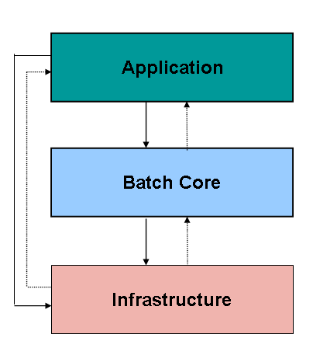
Layered Architecture
Business Domain
- Record-level
data (e.g. Trade)‏
Publicly exposed
Batch Execution
Environment APIs
Batch Domain - Job, Chunk, Step, Partition,
Repeat, Retry,
Infrastructure Transaction

Slide 13
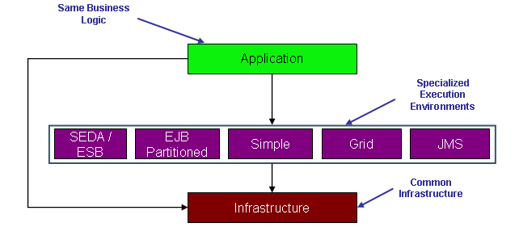
Execution Environment

Slide 14
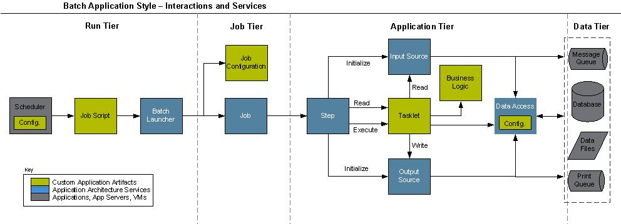
Execution Flow

Slide 15
Agenda
Java Batch – A Missing Enterprise Capability
Objectives, Scenarios, and Features
Spring Batch Overview
Spring Batch domain detail and code samples
Item readers and item writers
Parallel processing
Roadmap and product development process

Slide 16
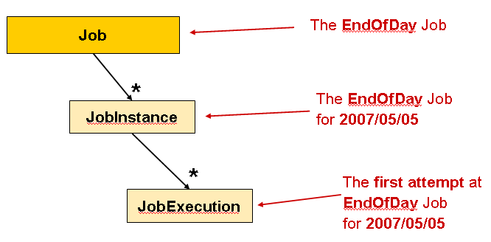
Job Stereotypes

Slide 17
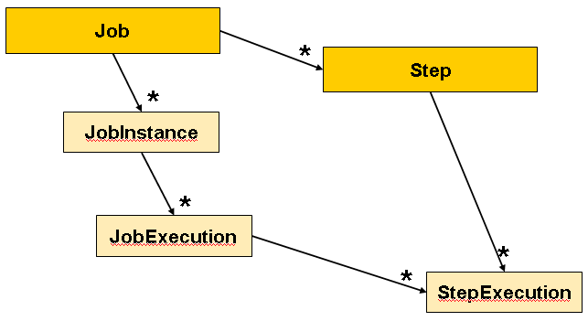
Step Stereotypes

Slide 18
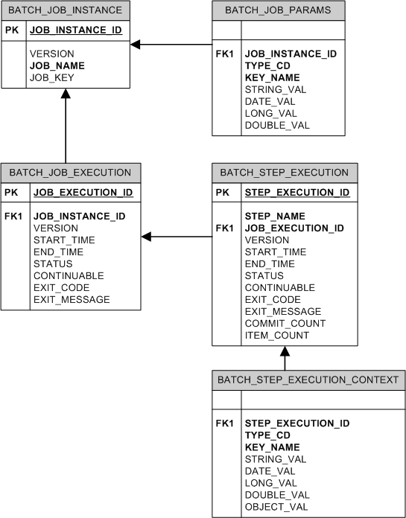
Metadata Schema

Slide 19
Other Facilities
JobRepository - the persistence mechanism for all of the Stereotypes mentioned above.
JobLauncher - represents a simple interface for launching a Job with a given set of JobParameters
JobLocator - represents an interface for locating a Job
Item Reader - an abstraction that represents the retrieval of input for a Step
Item Writer - an abstraction that represents the output of a Step
Item Processor - an abstraction that represents the business processing of an item
Tasklet - represents the execution of a logical unit of work

Slide 20
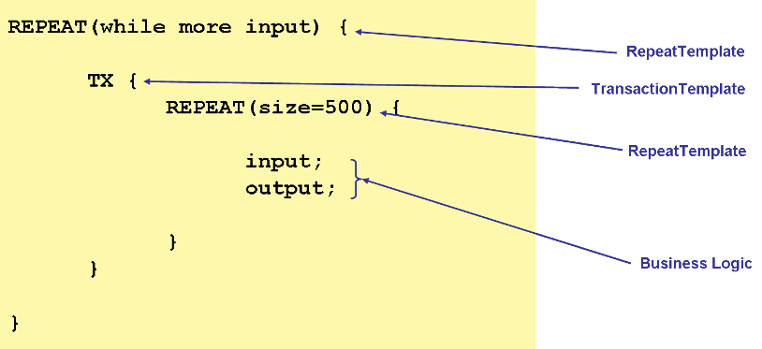
Simple Batch Pseudo Code

Slide 21
Config sample – base components
<bean name="jobRunner" class="com.digitaltrowel.batch.core.launch.SimpleJobRunner">
<property name="jobLauncher" ref="jobLauncher"></property>
<property name="jobLocator" ref="jobLocator"></property>
</bean>
<bean name="jobLocator" class="com.digitaltrowel.batch.core.launch.ChildContextJobLocator">
<property name="jobsContextPath" value="classpath*:/spring/jobsChildContextPath/**/applicationContext*.xml"></property>
</bean>
<bean id="jobLauncher" class="org.springframework.batch.core.launch.support.SimpleJobLauncher">
<property name="jobRepository" ref="jobRepository" />
</bean>
<bean id="jobRepository" class="org.springframework.batch.core.repository.support.JobRepositoryFactoryBean">
<property name="transactionManager" ref="txManager"/>
<property name="databaseType" value="${database.type}"/>
<property name="dataSource" ref="dataSource"/>
</bean>
<bean id="simpleJob" class="org.springframework.batch.core.job.SimpleJob"
abstract="true">
<property name="jobRepository" ref="jobRepository" />
<property name="restartable" value="true" />
</bean>
<bean id="simpleStep" class="org.springframework.batch.core.step.item.SimpleStepFactoryBean"
abstract="true">
<property name="transactionManager" ref="txManager" />
<property name="jobRepository" ref="jobRepository" />
<property name="startLimit" value="100" />
<property name="commitInterval" value="50" />
</bean>

Slide 22
Job Config sample
<!-- ===================== Email Refinery JOB ======================= -->
<bean id="emailRefineryJob" parent="simpleJob" >
<property name="steps">
<bean id="emailRefineryJobStep" parent="simpleStep">
<property name="itemReader" ref="emailRefineryHibernateCursorItemReader" />
<property name="itemWriter" ref="emailRefineryItemWriter" />
<property name="commitInterval" value="1" />
</bean>
</property>
</bean>
<!-- ============================ Reader ============================== -->
<bean id="emailRefineryHibernateCursorItemReader" class="com.digitaltrowel.batch.item.reader.factory.DTHibernateCursorItemReader">
<property name="sessionFactory" ref="sessionFactory" />
<property name="queryString">
<value>
<![CDATA[from Organization]]>
</value>
</property>
</bean>
<!-- ============================ Writer ============================== -->
<bean id="emailRefineryItemWriter" class="com.digitaltrowel.refinery.emailrefinery.EmailRefineryItemWriter">
<property name="sessionFactory" ref="sessionFactory"/>
<property name="emailRefinery" ref="emailRefinery"/>
<property name="delegate" ref="updateOrganizationCascadePersonsItemWriter"></property>
</bean>

Slide 23
Repeat
RepeatTemplate - Batch processing is about repetitive actions - either as a simple optimisation, or as part of a job. To strategise and generalise the repetition, and provide what amounts to an iterator framework, Spring Batch has the RepeatOperations interface. The RepeatOperations interface looks like this:
public interface RepeatOperations {
ExitStatus iterate(RepeatCallback callback) throws
RepeatException;
}

Slide 24
ExitStatus
ExitStatus is used by Spring Batch to indicate whether processing has finished, and if so whether or not is was successful. It is also used to carry textual information about the end state of a batch or iteration, in the form of an exit code and a description of the status in freeform text. These are the properties of an ExitStatus:
Continuable – boolean - true if there is more work to do
ExitCode – String - Short code describing the exit status, e.g. CONTINUABLE, FINISHED, FAILED
ExitDescription – String - Long description of the exit status, could be a stack trace for example.

Slide 25
Exception Handling
If there is an exception thrown inside a RepeatCallback, the RepeatTemplate consults an ExceptionHandler which can decide whether or not to re-throw the exception.
A common use case is to count the number of exceptions of a given type, and fail when a limit is reached. For this purpose Spring Batch provides the SimpleLimitExceptionHandler and slightly more flexible RethrowOnThresholdExceptionHandler. The SimpleLimitExceptionHandler has a limit property and an exception type that should be compared with the current exception - all subclasses of the provided type are also counted. Exceptions of the given type are ignored until the limit is reached, and then rethrown. Those of other types are always rethrown.

Slide 26
Listeners
Often it is useful to be able to receive additional callbacks for cross cutting concerns across a number of different iterations. For this purpose Spring Batch provides the RepeatListener interface. The RepeatTemplate allows users to register RepeatListeners, and they will be given callbacks with the RepeatContext and ExitStatus where available during the iteration.

Slide 27
Skip Logic
There are many scenarios where errors encountered while processing should not result in Step failure, but should be skipped instead. This is usually a decision that must be made by someone who understands the data itself and what meaning it has.
<bean id="skipSample" class="SkipLimitStepFactoryBean">
<property name="skipLimit" value="10" />
<property name="itemReader" ref="flatFileItemReader" />
<property name="itemWriter" ref="itemWriter" />
<property name="skippableExceptionClasses"
value="FlatFileParseException">
</property>
</bean>

Slide 28
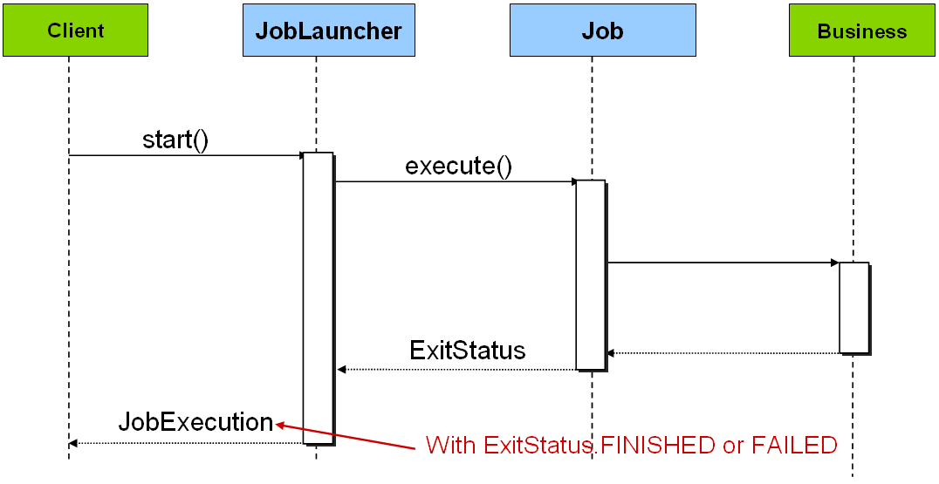
Launching a Job

Slide 29
Agenda
Java Batch – A Missing Enterprise Capability
Objectives, Scenarios, and Features
Spring Batch Overview
Spring Batch domain detail and code samples
Item readers and item writers
Parallel processing
Roadmap and product development process

Slide 30
Item readers and writers
All batch processing can be described in its most simple form as reading in large amounts of data, performing some type of calculation or transformation, and writing the result out. Spring Batch provides two key interfaces to help perform bulk reading and writing: ItemReader and ItemWriter.

Slide 31
Item readers
Flat File- Flat File Item Readers read lines of data from a flat file that typically describe records with fields of data defined by fixed positions in the file or delimited by some special character (e.g. Comma).
XML - XML ItemReaders process XML independently of technologies used for parsing, mapping and validating objects. Input data allows for the validation of and XML file against an XSD schema.
Database - A database resource is accessed that returns resultsets which can be mapped to objects for processing. The default SQL ItemReaders invoke a RowMapper to return objects, keep track of the current row if restart is required, basic statistics, and some transaction enhancements that will be explained later.

Slide 32
Item writers
ItemWriter is similar in functionality to an ItemReader, but with reversed operations. Resources still need to be located, opened and closed but they differ in that an ItemWriter writes out, rather than reading in. In the case of databases or queues these may be inserts, updates or sends. The format of the serialization of the output is specific for every batch job.

Slide 33
HibernateCursorItemReader
<bean id="hibernateCursorItemReader"
class="org.springframework.batch.item.database.HibernateAwareItemWriter" >
<property name="sessionFactory" ref="sessionFactory" />
<property name="useStatelessSession" value="false"/>
<property name="fetchSize" value="1000"/>
<property name="queryString">
<value>
<![CDATA[from Organization o]]>
</value>
</property>
</bean>

Slide 34
FlatFileItemReader
<bean id="companyNameInputFileReader" class="org.springframework.batch.item.file.FlatFileItemReader">
<property name="resource" value="file:/home/shalom/input.txt" />
<property name="lineTokenizer">
<bean class="org.springframework.batch.item.file.transform.DelimitedLineTokenizer">
<!-- property name="names" value="ID,Name,City,State" /-->
<property name="delimiter" value="|" />
</bean>
</property>
<property name="fieldSetMapper">
<bean class="com.digitaltrowel.refinery.companyname.CompanyNameInputFileFieldSetMapper" />
</property>
</bean>

Slide 35
Driving query Item readers
Many database vendors, such as DB2, have extremely pessimistic locking strategies that can cause issues if the table being read also needs to be used by other portions of the online application. Furthermore, opening cursors over extremely large datasets can cause issues on certain vendors. Therefore, many projects prefer to use a 'Driving Query' approach to reading in data. This approach works by iterating over keys, rather than the entire object that needs to be returned.

Slide 36
Agenda
Java Batch – A Missing Enterprise Capability
Objectives, Scenarios, and Features
Spring Batch Overview
Spring Batch domain detail and code samples
Item readers and item writers
Parallel processing
Roadmap and product development process

Slide 37
Parallel
The Chunking model dynamically assigned chunks of items to
be processed and sends them to durable middleware. Worker processes pick them up and process them, sending back a message about the status. This approach works best if the dispatching is efficient compared to the processing.
The Partitioning approach is more like running multiple jobs in parallel, with input data partitioned into larger pieces, and not split any further by the dispatcher. The item reading happens in the worker processes. This approach is necessary if the dispatcher in the <Chunking> model becomes a bottle neck.

Slide 38
Partitioning
PartitionStep – a Step implementation which partitions the execution.
PartitionHandler – called by the PatitionStep to create the actual partitions.
Partitioner – a strategy interface for creating input parameters for partitioned step.
StepExecutionSplitter – strategy interface for generating input contexts for partitioned step.

Slide 39
Agenda
Java Batch – A Missing Enterprise Capability
Objectives, Scenarios, and Features
Spring Batch Overview
Spring Batch domain detail and code samples
Item readers and item writers
Parallel processing
Roadmap and product development process

Slide 40
Roadmap
Release 1.1.3 – Infrastructure support of the development of batch execution environments. Item Oriented, very poor parallel support.
Future Spring Batch 2 might include Partitioned Launcher, SEDA, Grid, ESB support, and more...
M2.0.0 already released.
Depends on spring 3

Slide 41
Resources
Spring Batch Home page: http://static.springframework.org/spring-batch/
Introduction: http://www.infoq.com/presentations/lund-spring-batch
Introduction video: http://www.parleys.com/display/PARLEYS/Home#slide=1;title=Spring%20Batch;talk=4653172

Slide 42
Resources
Spring Batch Source Code: https://springframework.svn.sourceforge.net/svnroot/springframework/spring-batch/trunk/
Forum: http://forum.springframework.org/forumdisplay.php?f=41
Mailing List: http://lists.interface21.com/listmanager/listinfo/spring-batch-announce
Issue Tracking (Jira) http://opensource.atlassian.com/projects/spring/browse/BATCH
CI Server(Bamboo) http://build.springframework.org:8085/bamboo/browse/BATCH

Slide 43
Q&A

