Slide 1
BlazeDS
Notes:
Best viewed with notes pages.
For more information please see www.optier.com
or contact info@optier.com.

Slide 2
Agenda

Slide 3
What is... ?

Slide 4
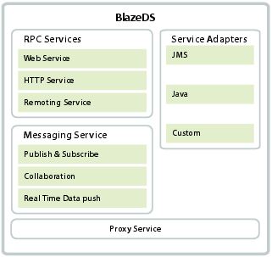
BlazeDS features

Slide 5
BlazeDS features

Slide 6
Example Application – Echo Server

Slide 7
Example Application – Echo Server

