Slide 1



Django
The Web Framework for Perfectionists with Deadlines
By: Udi h Bauman, BeeTV

Slide 2
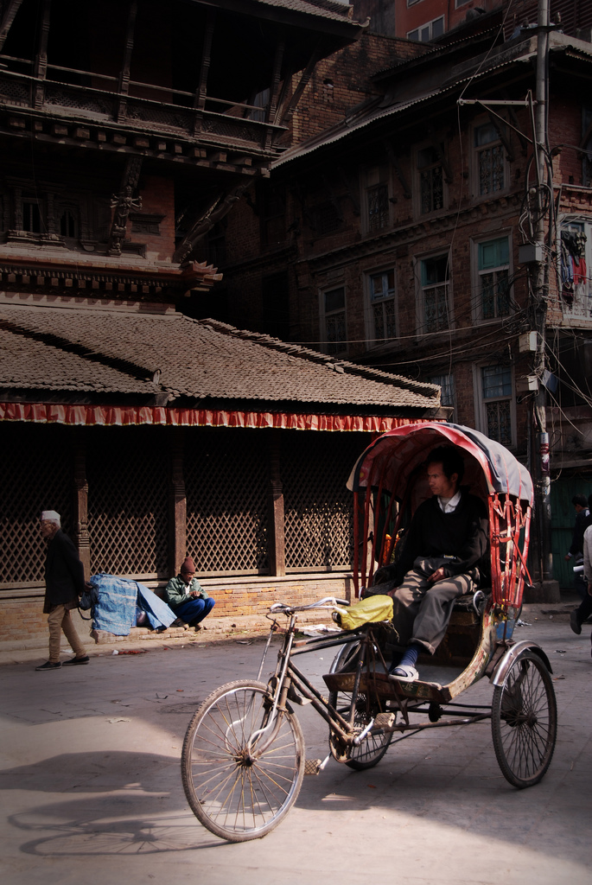
This guy is happy
with his vehicle
http://www.flickr.com/photos/24859010@N05/2350218142/

Slide 3
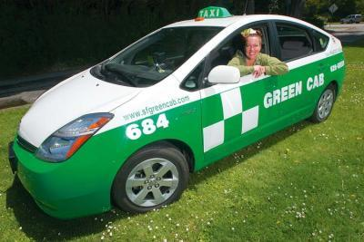
If only he knew of the alternatives
http://www.flickr.com/photos/26418031@N04/2485301661/

Slide 4


consider your last software project
without alternatives as reference, you can’t estimate:
Effort
Pain
Time waste
Complexity
Cost of change

Slide 5
so, just consider the Time it took to get to a Happy Customer
Time

Slide 6

& also the time it took to develop version 2, with different requirements & scale:
Time

Slide 7

Introducing

Slide 8
A Web Framework that shortens the Time
it takes to develop software in at least an
Order of Magnitude

Slide 9
while also tremendously minimizing:
Effort
Pain
Time waste
Complexity
Cost of change
& more

Slide 10
How can Django do it?
Django automates the stuff repeating in every software project
& let’s you only work on what differentiates them

Slide 11
Metaphor
Suppose you were a constructing company
You get a customer request & spend a few months building what he wants

Slide 12
Metaphor
Although every building is different, there are things repeating themselves every time
  Ground works
  Electricity
  Water
  Skeleton
  &c
  &c

Slide 13
Metaphor
Suppose some infra company came & said:
  Just define to us what the customer need
  Within few hours we’ll build the basic building
  & in another day or so, we’ll help you complete it by answering all of the customer specific needs
  So, you can deliver the building in <3 days

Slide 14
Metaphor
You’ll probably laugh at them & say:
  It’s probably pre-built/pre-assembled stuff
  That limits what I can do
  With low quality & scalability
  & I’ll also need to pay you a lot

Slide 15
Metaphor
What if the company will answer
  It’s not pre-built - we build it by your definition
  It doesn’t limit you to do anything, on the contrary it helps you do whatever you want
  It has better quality & scalability than what you can build
  It costs you nothing

Slide 16
Metaphor
What can you say to that?

Slide 17
Demo
Let’s develop an Issue Tracking system
  Issues data model
  Users management (permissions, groups)
  Rich Web UI (search, filters, last actions)
  Scalable deployment (any # of users)

Slide 18
Demo
& let’s try to do it in 20 minutes

Slide 19
Start timer

Slide 20
Try it out
http://jbug-issues.appspot.com

Slide 21
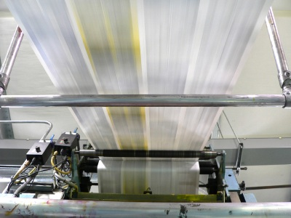
Django was born here

Slide 22
Meaning: Deadlines
Example: highest paid gov. officials analytics site
  Requested at saturday night (22:00)
  Skeleton ready & data entry start (23:00)
  Site complete & in production (24:00)

Slide 23
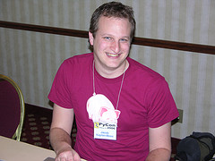
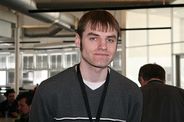
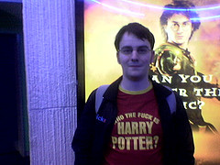
By a group of perfectionists
Jacob Kaplan-Moss
@jacobian
Adrian Holovaty
@adrianholovaty
Simon Willison
@simonw

Slide 24
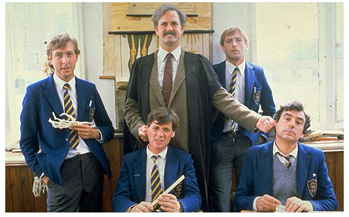
Using the language
named after these guys

Slide 25



Language of choice in
The organizations attracting the best programmers in the world
  Such as:

Slide 26


More than a scripting language
Pure OOP
Native threading
Functional features
Runs some of the largest Web sites
  Such as:

Slide 27
Why do I love Python?
  Succinct yet very readable syntax
  Very fast code-run-test cycle (no build)
  Great introspection (saves tons of time)
  Built-in data structures (Map, Immutable List)
  Syntax sugar features (list mapping, &c)
  Shell

Slide 28
Programming Languages Evolution Tree
Regarding “Evolutionary dead end” of Java
  If you’ll check out history, the languages that are designed by a company or committee, such as Java & Cobol, are usually the evolutionary dead-ends
  See also Paul Graham’s famous article: http://www.paulgraham.com/javacover.html

Slide 29
Optimized for Perfect OOP Design
Inheritance (Data Model, Templates &c)
Enforced MVC
Reusable APPS
DRY

Slide 30
Reusable Apps?
Your modules are very loose coupled, & can be used in other projects
You can plug into your project many 3rd party reusable apps, immediately adding to your product complex functionality
  No need for coding

Slide 31
Some reusable apps
django-ratings | django-ajax-validation | django-google-analytics | django-mailer
django-queue-service | django-announcements | django-email-confirmation | django-jits
django-liveblogging | django-atompub | django-discussion | django-galaxy
django-messages | django-audioplayer | django-db-log | django-evolution
django-authopenid | django-googlemap | django-compress | django-dynamic-media-serve
django-avatar | django-graphs | django-oembed | django-clevercss
django-basic-blog | django-microformats | django-object-view-tracking | django-chunks
django-basic-library | django-tagging | django-navbar | django-ads
django-basic-people | django-survey | django-orm-cache | django-rest-interface
django-basic-places | django-voting | django-page-cms | django-registration
django-cron | django-wiki | django-photologue | django-mobileadmin
django-favorites | satchmo | django-pingback | django-openid
django-forum | sorl-thumbnail | django-pressroom | django-oauth
django-gcal | django-mailfriend | django-mmo | django-recommender

Slide 32
Example: Pinax
A project containing many reusable apps you can immediately use to start with a full-featured web site, without a line of code
  Using it you can get a full-pledged Web2.0 social networking site, as basis for your web site (Example” http://cloud27.com)
  1st version developed over a weekend

Slide 33
Django features
Django has a lot of built-in stuff, to boost productivity
  Nevertheless, it strives to remain as small as possible, to support any extension & not limit what you can do

Slide 34
ORM
title, year = row[0], row[1]
query = Show.objects.filter(title=title)
if query.count() > 0:
show = query[0]
else: # if not found, create one
show = Show()
show.title = title.encode('utf-8')
show.prod_year = year
show.save()

Slide 35
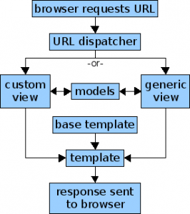
MVC

Slide 36
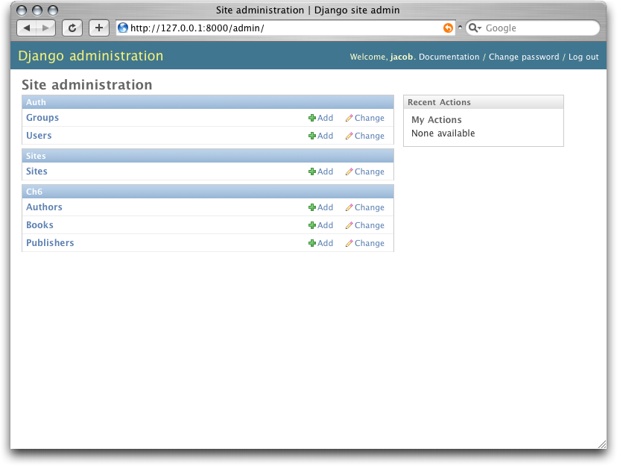
Automatic Admin UI

Slide 37
Generic Views
def list_people(request):
return object_list(request, Person.all(), paginate_by=10)
def show_person(request, key):
return object_detail(request, Person.all(), key)
def add_person(request):
return create_object(request, form_class=PersonForm,
post_save_redirect=reverse('myapp.views.show_person',
kwargs=dict(key='%(key)s')))

Slide 38
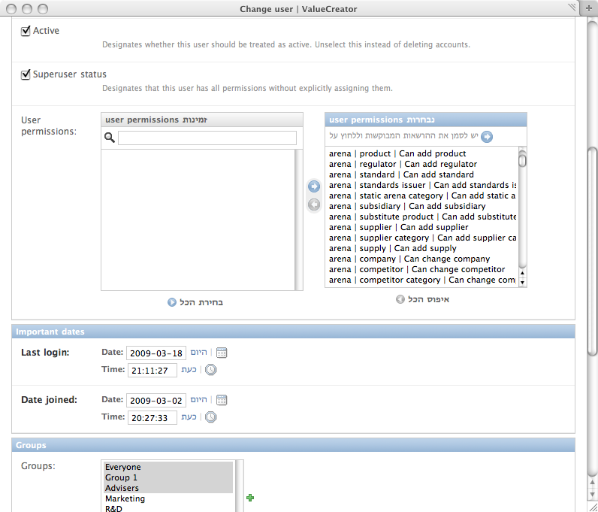
Auth & user mgmt

Slide 39
Forms
class FileForm(forms.ModelForm):
name = forms.CharField(required=False, label='Name')
def clean(self):
file = self.cleaned_data.get('file')
if not self.cleaned_data.get('name'):
if isinstance(file, UploadedFile):
self.cleaned_data['name'] = file.name
else:
del self.cleaned_data['name']
return self.cleaned_data
class Meta:
model = File

Slide 40
URL config
from django.conf.urls.defaults import *
urlpatterns = patterns('',
(r'^articles/(\d{4})/$', 'mysite.news.views.year_archive'),
(r'^articles/(\d{4})/(\d{2})/$', 'mysite.news.views.month_archive'),
(r'^articles/(\d{4})/(\d{2})/(\d+)/$', 'mysite.news.views.article_detail'),
(r'^comments/', include('django.contrib.comments.urls')),
)

Slide 41
Templates
{% extends 'base.html' %}
{% block title %}Person listing{% endblock %}
{% block content %}
<h1>Person listing</h1>
<a href="{% url myapp.views.add_person %}">Create person</a>
<ul>
{% for person in object_list %}
<li>
<a href="{% url myapp.views.show_person key=person.key %}">{{ person.first_name }} {{ person.last_name }}</a>
<a href="{% url myapp.views.edit_person key=person.key %}">Edit</a>
<a href="{% url myapp.views.delete_person key=person.key %}">Delete</a>
</li>
{% endfor %}
</ul>

Slide 42
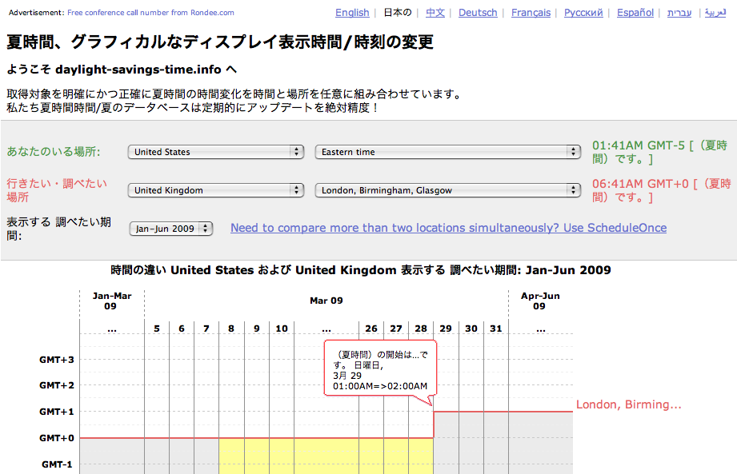
I18n

Slide 43
Geo
class District(models.Model):
name = models.CharField(max_length=35)
num = models.IntegerField()
poly = models.PolygonField()
objects = models.GeoManager()
class School(models.Model):
name = models.CharField(max_length=35)
point = models.PointField()
objects = models.GeoManager()

Slide 44
More built-in stuff
Feeds
Comments
Flat pages
Middleware
Caching
Signals
s

Slide 45
Django powered sites
Many newspapers (LA Times, Washington Post, NY Times projects, Guardian API)
  A django based site even won a Politzer!
BitBucket (mercurial OSS repository)
Pounce, Fluther, SuggestionBox, Tabblo, Revver (popular Web2.0 services)
Curse (very high-traffic gaming site)

Slide 46
Scalability
Django runs on regular web servers, such as Apache, Lighty or Ngynx, using a built-in Python or WSGI adapter
This makes it very lightweight & scalable, as any LAMP deployment
  There are examples of sites that handle MM reqs/hour, using less than 10 servers

Slide 47
Google AppEngine
Based on Django
Django apps can be easily deployed

Slide 48
IT acceptance
IT environments today are mostly familiar with Java
Solution: use Jython that compiles Python to bytecode
  Package a Django project as .war
  Sun constantly improves Jython & maintains compatibility /w Django

Slide 49
Implications
On Outsourcing (no need for many out-sourced/off-shore programmers)
On Build-vs-Buy (why buy when you can build any information system in an hour?)

Slide 50
Why not Rails?
Rails is also great, great people love it
However, I've got several things in which I think Rails is inferior, which people should consider
  Performance & scalability
  Emphasis on good design (no Magic in Django)
  Maturity
  Underlying language

Slide 51
Wanna start?
Django Book (free, online, amazing)
Dive into Python (free, online, amazing)
Django Tutorial

Slide 52
IDE’s & Build tools
I use Eclipse, using the PyDev plugin
  NetBeans & IntelliJ also have Python support
  Other commercial Python IDE’s are also excellent: Wingware, Komodo
No need for build tools, it’s Python...

Slide 53
Links
Django Sites
Django People
Django Project
“Why I hate Django” keynote from DjangoCon

Slide 54
Q&A

