Slide 1
Effects of Stimuli Contrast and Pre-cueing Attention in Crowding
Notes:
Today I will present a project I had conducted with Dr. Yaffa Yeshurun at the university of haifa, on the effects of stimuli contrast and pre-cueing attention in crowding.

Slide 2
What is crowding?
A difficulty in identification (but not detection) of a peripherally presented target when it is surrounded by flankers.
Crowding increases with target eccentricity (e.g., Bouma, 1970).
+
F
T
F
+
F
T
F
Notes:
What is crowding?
Crowding is a difficulty in identification (but not detection) of a peripherally presented target when it is surrounded by flankers. ((point at the fixation and target))
Crowding increases with target eccentricity. ((point to the distance between fixation and target))

Slide 3
What is crowding?
Crowding also decreases as the distance between the target and flankers increases (e.g., Bouma, 1970).
Critical Distance: The spatial extent of crowding, typically about half the target’s eccentricity (e.g. Bouma, 1970; Latham & Whitaker 1996; Pelli et al., 2004; Strasburger, 2005).
+
F
T
F
+
F
T
F
Notes:
Crowding also increases as function of target-flanker distance. ((point to the distances between target and flankers))
An important feature of the crowding phenomenon is the critical distance, which is the distance between target and flankers from which identification is equal to that of an uncrowded target.
Hence, the critical distance reflects the spatial extent of crowding, which is typically about half of the target eccentricity.
Demonstrate the CD

Slide 4
What causes Crowding?
A number of explanations were suggested:
a loss of individual feature information over a defined spatial area at a preattentive stage (e.g., Parkes, Lund, Angelucci, Solomon & Morgan, 2001; Pelli et al., 2004).
a loss of positional information after feature integration is completed (e.g., Strasburger 2005).
a spatial limitation of attentional selection, independent of spatial resolution (i.e., acuity) (Intriligator & Cavanagh, 2001).
Notes:
What causes crowding?
A number of explanations were suggested:
Crowding results from a loss of individual feature information over a defined spatial area at a preattentive stage.
Another possibility is that crowding results from a loss of positional information after feature integration is completed.
It was also suggested that crowding is caused due to a spatial limitation of attentional selection.

Slide 5
Pre-cueing a crowded target
Yeshurun and Rashal (2010)
Notes:
Study 1 examined the effects of pre-cueing a crowded target.

Slide 6
Pre-cueing transient attention
Directing covert attention to the location of the proceeding target via a peripheral cue.
Pre-cueing attention was found to improve target identification (e.g., Prinzmetal, Presti, & Posner, 1986), and to enhance apparent contrast (e.g. Carrasco et al., 2004).
It was suggested that transient attention enhances spatial resolution by reducing the size of receptive fields (Yeshurun & Carrasco, 1998).
Notes:
Pre-cueing transient attention refers to the direction of covert attention to the location of the proceeding target via a peripheral cue.
Pre-cueing attention was found to improve target identification, and to enhance apparent contrast.
It was suggested that transient attention enhances spatial resolution by reducing the size of receptive fields.

Slide 7
Study 1: Pre-cueing a crowded target
Previous studies found an overall improvement of performance when a crowded target was pre-cued, but (almost) no reduction in the critical distance (e.g., Huckauf and Heller, 2002; Strasburger, 2005; Scolari, Kohnen, Barton and Awh, 2007).
A possible explanation – the pre-cues masked the target.
Notes:
Previous studies found an overall improvement of performance when a crowded target was pre-cued, but almost no reduction in the critical distance. A reduction in the critical distance was found only for targets presented relatively close to the fovea.
A possible explanation to the lack of pre-cueing effects on the critical distance was that the cues were too small or incorrectly placed, and thus masked the target.

Slide 8
Study 1: Pre-cueing a crowded target
Goal:
To re-examine the effect of pre-cueing on the critical distance using a different cue.
In the current study, a small dot pre-cue was presented on the inner side of the target display (Yeshurun & Rashal, 2010).
Notes:
Our goal was to re-examine the pre-cueing effect on the critical distance with a different cue.
In the current study, a small dot pre-cue was presented on the inner side of the target display.

Slide 9
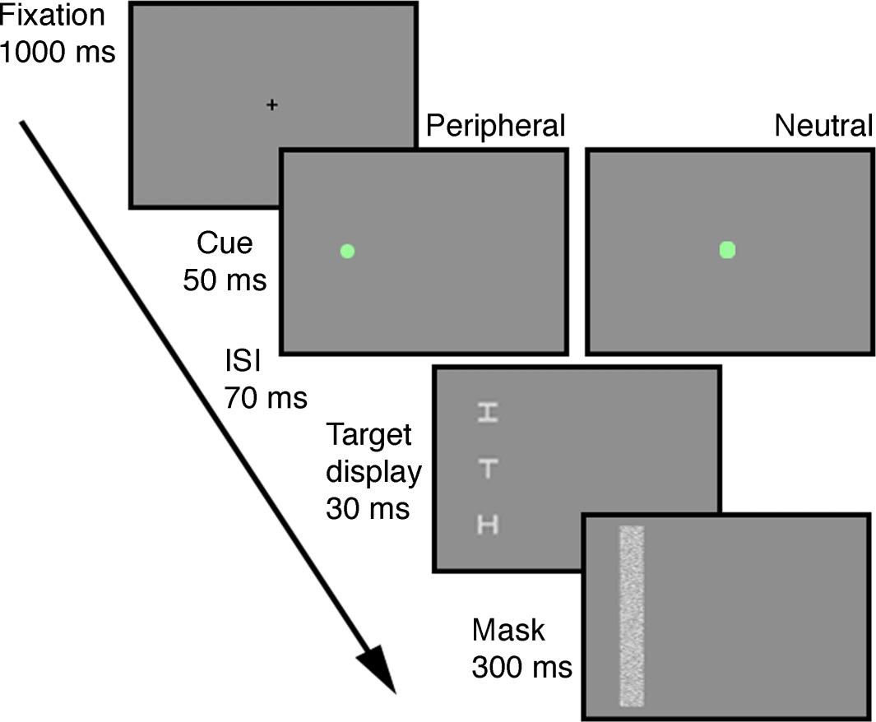
Experiment 1: Method
Task: orientation identification of the letter T.
Cue: valid or neutral
Eccentricity: 3, 5, 9°.
Target-Flanker Distance: 1-9, no flankers.
Time
Notes:
The participants’ task was to identify the orientation of a target letter T.
Each trial began with a fixation point, followed by a peripheral cue that indicated the target location, or a neutral cue that conveyed no positional information.
The target appeared randomly in the left or right visual field at different eccentricities, either in isolation or with two flankers.
The flankers appeared at different distances between trials, one above and one below the target.
Finally, the target and flankers were masked.

Slide 10
Experiment 1: Results Accuracy
Notes:
In this plot, crowding is evident from the rise in accuracy ((point to y axis)) as the distance between target and flankers increases ((point to x axis)).
This plot presents the pre-cueing effect on overall accuracy, across eccentricities.
As you can see, accuracy was higher when the target was pre-cued than when it was not, except for in the smallest target-flanker distance, where accuracy was at chance level for both conditions.

Slide 11
Calculating the Critical Distance:
The target-flanker-distance at which accuracy achieved 90% of the asymptotic value (after Scolari et al., 2007).
90% of
asymptotic value
Accuracy
Critical Distance
Target-Flanker Distance
Notes:
As you might remember, the critical distance is the target-flanker distance from which identification is equal to that of an uncrowded target.
In order to calculate the critical distance we fitted the individual data from each observer in each condition to an exponential function. ((point to the curve, y, x))
The critical distance was defined as the target-flanker distance at which accuracy achieved 90% of the asymptotic value.

Slide 12
Study 1: Results Accuracy

Slide 13
Experiment 1: Results critical distance
Notes:
Importantly, we found an effect of contrast condition on the critical distance, which was smaller when the target was pre-cued, than when it wasn’t.
This effect did not interact with target eccentricity.

Slide 14
Experiment 2: Results critical distance
Notes:
We replicated these results in another experiment, in which the target and flankers were not masked, indicating that attention reduced crowding and not backward masking.

Slide 15
Experiment 2: Results critical distance
Notes:
Also, the effect was replicated in yet another experiment, where the neutral cue was replaced with a peripheral invalid cue, confirming that the decrease in crowding was due to transient attention rather than voluntary allocation of attention to the possible target’s locations.

Slide 16
Study 1: Theoretical implications
Crowding can be reduced by the allocation of transient attention:
Crowding cannot be a product of a preattentive faulty feature integration process.
Crowding does not reflect the limitation of attentional selection.
Attention reduces crowding by reducing the area over which information is integrated (possibly via a reduction in receptive fields’ size).
Notes:
So, what did we learn?
Crowding can be reduce by the allocation of transient attention.
This suggests that crowding is not a product of a preattentive faulty feature integration process.
It also means that crowding does not reflect the limitation of attentional selection.
We suggest that attention reduces crowding by reducing the area over which information is integrated, possibly via a reduction in receptive fields’ size.

Slide 17
Effects of target contrast
Rashal and Yeshurun (2014)
Notes:
Our second study examined the effects of target contrast on crowding

Slide 18
Effects of Target saliency
Target saliency was suggested to relief crowding by attracting attention to the target (Kooi, Toet, Tripathy & Levi, 1994; Poder, 2006; Scolari et al., 2007).
Crowding was found to decrease when the target was dissimilar to its flankers in color, size or shape (e.g., Kooi et al., 1994; Poder, 2007).
Contrast dissimilarity was shown to decrease crowding when the target had higher contrast than the flankers, but only sometimes when the target’s contrast was lower (e.g., Kooi et al., 1994).
Notes:
Target saliency was suggested to relief crowding by attracting attention to the target.
Crowding was found to decrease when the target was dissimilar to its flankers in color, size or shape.
The case of contrast is more complicated: contrast dissimilarity was shown to decrease crowding when the target had higher contrast than the flankers, but only sometimes when the target’s contrast was lower.

Slide 19
Study 2: Effects of Target Contrast
Goals:
To examine the effect of target contrast on the critical distance.
To explore the interplay between contrast and attention in crowding.
Notes:
First, we wanted to examine the effect of target contrast on the critical distance, which hasn’t been done systematically up to that point.
Second, because attention was found to enhance apparent contrast, and high target contrast may attract attention due to saliency, we wanted to explore the interplay between contrast and attention in crowding.

Slide 20
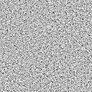
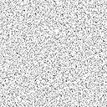
Study 2: Method
Experiments 1 & 2 – contrast conditions:
Target and flankers 20% (i.e., equal-high).
Target and flankers 10% (i.e., equal-low).
Target 20% Flankers 10% (i.e., high-target, Exp.1)
Target 10% Flankers 20% (i.e., low-target, Exp.2)
+
Fixation
1000 ms
Target Display
20-80 ms
H
H
Mask
300 ms
Time
Notes:
The procedure was the same as in study 1, except there was no pre-cue.
Three contrast conditions were used in experiments 1 and 2:
In two conditions the target and flankers had equal contrasts, which was either high or low.
In the third condition in experiment 1 the target had higher contrast than the flankers, and in experiment 2 the target had lower contrast than the flankers.
This is an example of the high-target condition in experiment 1. ((point to figure))

Slide 21
Experiment 1: method
contrast conditions:
Equal-High
Equal-Low
High-Target
+
Fixation
1000 ms
Target Display
20-80 ms
H
H
Mask
300 ms
Time
H
H
H
T
T
T
H
H
H
Notes:
The procedure was the same as in study 1, except there was no pre-cue.
Three contrast conditions were used in experiments 1 and 2:
In two conditions the target and flankers had equal contrasts, which was either high or low.
In the third condition in experiment 1 the target had higher contrast than the flankers, and in experiment 2 the target had lower contrast than the flankers.
This is an example of the high-target condition in experiment 1. ((point to figure))

Slide 22
Experiment 1: results Accuracy
H
H
H
T
T
T
H
H
H
Notes:
This plot show the results of experiment 1.
It clearly shows that crowding was affected by the different contrast conditions:
When the target had higher contrast than the flankers accuracy increased, compared with when they had equal contrast.
[There was a significant difference in overall accuracy between the two equal contrast conditions, showing higher accuracy in the equal-high contrast condition.
However, this effect was more prominent in experiment 1, where accuracy in the equal-high condition reached the same level as in the high-target condition in the larger target-flanker distances.]

Slide 23
Experiment 1: results Critical distance
n.s.
Notes:
Importantly, the different contrast conditions affected the critical distance.
When the target had higher contrast than the flankers, the critical distance was significantly reduced.((point to left plot))
There was no difference in the critical distance in the two equal contrast conditions, in either experiment.

Slide 24
Experiment 2: method & Results Accuracy
Experiment 2 – contrast conditions:
Equal-High
Equal-Low
Low-Target
H
H
H
T
T
T
H
H
H
Notes:
This plot shows the results of experiment 2.
Here too crowding was affected by the different contrast conditions:
When the target had lower contrast than the flankers accuracy decreased.
In addition, ts there was a significant difference in overall accuracy between the two equal contrast conditions, showing higher accuracy in the equal-high contrast condition.

Slide 25
Experiment 2: Results Critical distance
n.s.
Notes:
Importantly, the different contrast conditions affected the critical distance.
When the target had higher contrast than the flankers, the critical distance was significantly reduced.((point to left plot))
When the target had lower contrast than the flankers, the critical distance was significantly increased.((point to right plot)).
There was no difference in the critical distance in the two equal contrast conditions, in either experiment.

Slide 26

Experiment 3: Pre-cueing high-contrast targets
Method
Contrast conditions:
Equal-Low
High-Target
Pre-cue conditions:
Valid
Neutral
Time
H
T
H
Notes:
Our last experiment examined the combined effects of pre-cueing attention and high target contrast.
Two contrast conditions and two cueing conditions were administered:
The target had higher contrast than the flankers, or they all had low contrast.
The pre-cue was either valid or neutral.

Slide 27
Experiment 3: Results Accuracy
Notes:
The results of experiment 3 showed significant effects of pre-cue and contrast on crowding.
The two contrast conditions are presented in this plot by the different colors: high-target contrast in red, and equal-low contrast in blue.
The dashed lines represent the pre-cue condition, and the solid lines represent the neutral condition.
As you can see, accuracy was higher for validly compared with neutrally pre-cued targets, and also for high-target compared with equally low targets.
[These effects varied with target-flanker distance, indicating the pre-cue was beneficial at smaller distances in the high-target condition, and at larger distances in the equal-low condition.]

Slide 28
Study 2: Results exp. 3 Accuracy

Slide 29
Experiment 3: results critical distance
Notes:
Importantly, the two factors had significant effects on the critical distance, and they did not interact.

Slide 30
Study 2: Theoretical implications
Crowding decreases with higher-contrast targets, and increases with lower-contrast targets.
Dissimilarity between target and flankers by itself is not the source of crowding relief.
Target contrast does not interact with pre-cueing the target location.
The effect of target contrast on crowding does not merely reflect attraction of attention due to saliency.
The effect of attention on crowding does not merely reflect enhancement of apparent contrast.
Notes:
To summarize, we found that crowding decreases with higher contrast targets and increases with lower contrast targets.
Thus, dissimilarity between target and flankers by itself is not the source of crowding relief.
In addition, target contrast does not interact with pre-cueing the target location:
High target contrast reduced crowding even when attention was already attracted to the target location by the cue.
Also, attending the target reduced crowding even when the target had higher contrast than the flankers.
This suggests that the effect of target contrast on crowding does not merely reflect attraction of attention due to saliency, and that the effect of attention on crowding does not merely reflect enhancement of apparent contrast.

Slide 31
Thank you!

