Slide 1
Destructive Little-Parks Effect in a Full-Shell Nanowire-based Transmon
( arXiv:2005.01748v1 [cond-mat.mes-hall] 4 May 2020 )

Slide 2
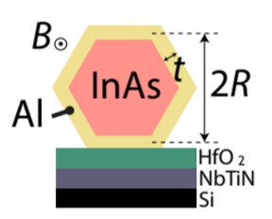
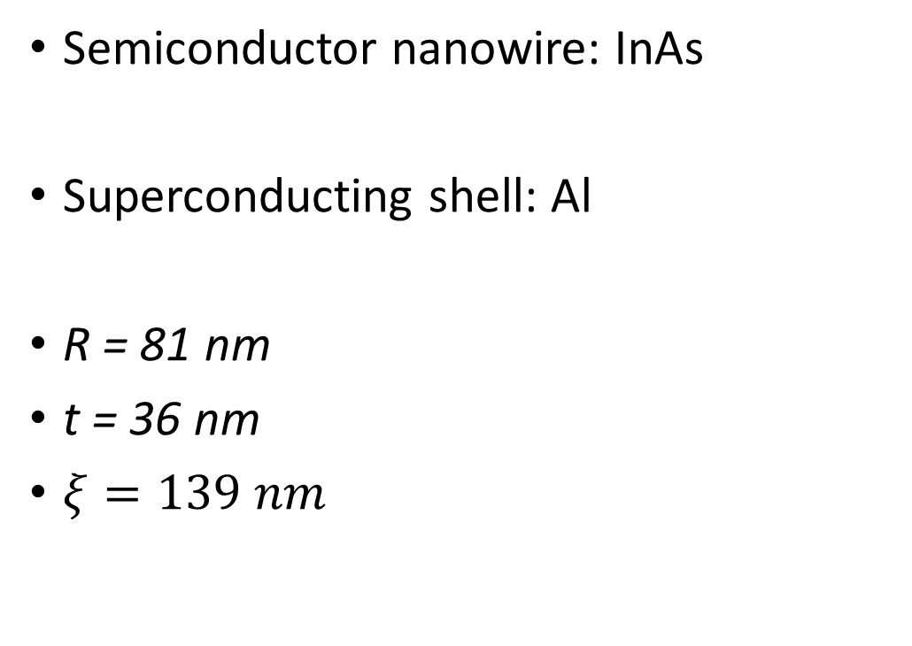
Semiconductor-Superconductor Hybrid

Slide 3
Challenge
To realize transmon based on topological SC: Magnetic field ~ 1T
Alternative
First lobe of Reentrant Destructive Little-Parks regime
Nano wire with fully surrounding SC shell, by winding the superconducting phase around the wire by using magnetic flux

Slide 4
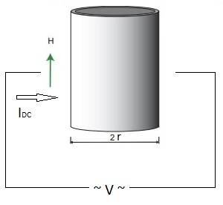
Little-Parks effect:
When a thin walled SC shell is subjected to parallel magnetic field, the critical temperature Tc oscillates.
Destructive LP effect: With changing magnetic field, there is destruction and reentrance of superconductivity.

Slide 5
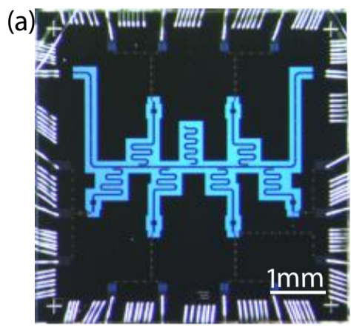
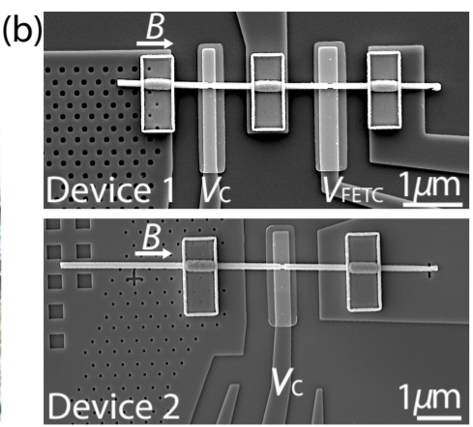
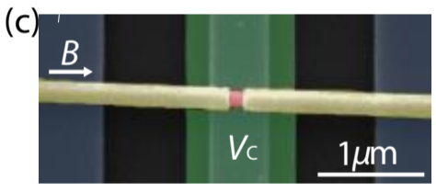
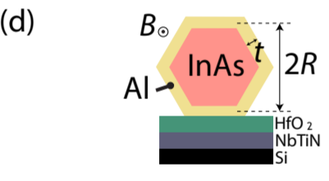

Slide 6
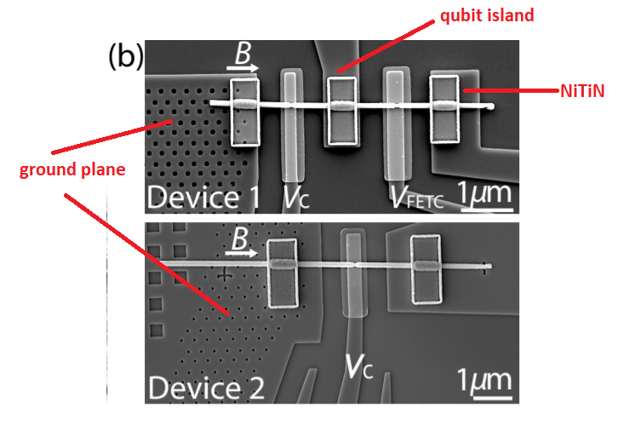

Slide 7
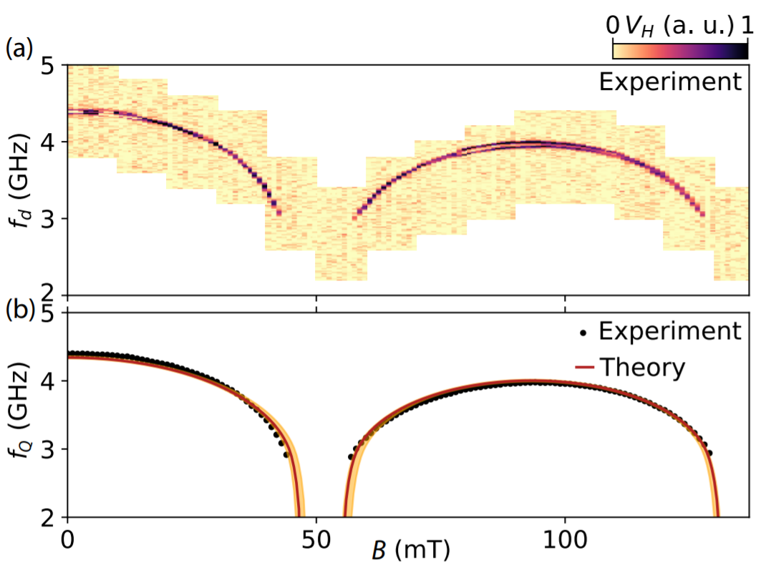
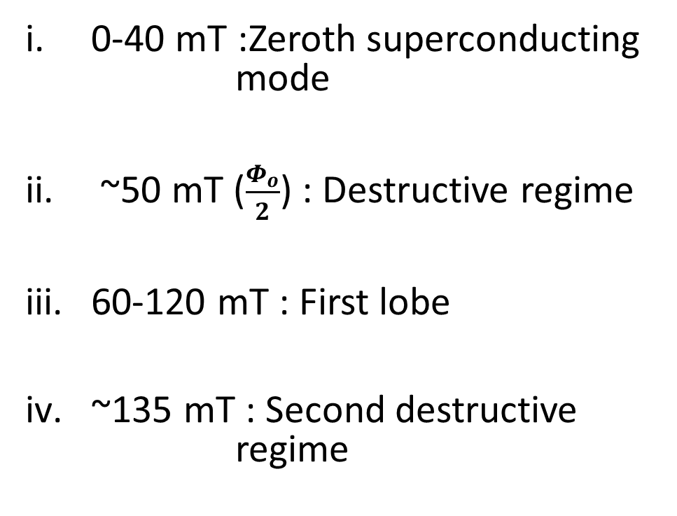
2D map of two-tone spectroscopy

Slide 8
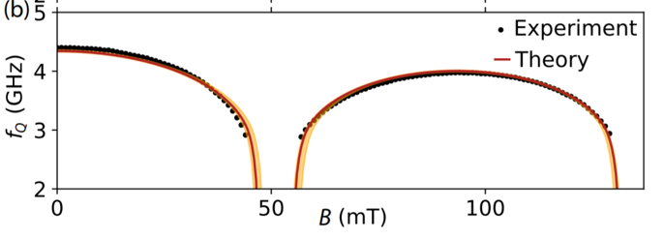
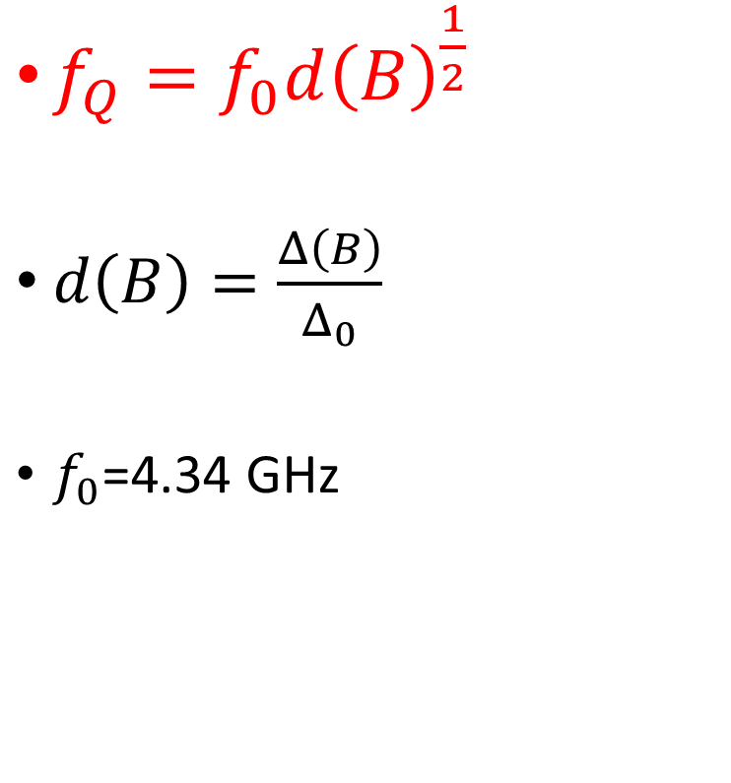
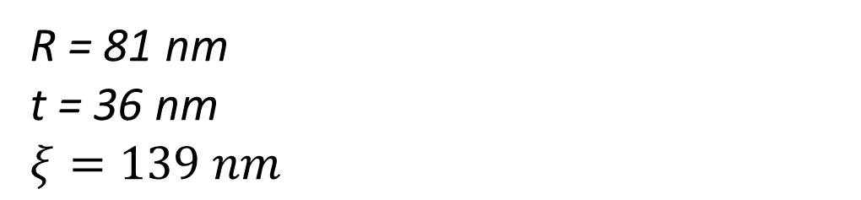

Slide 9
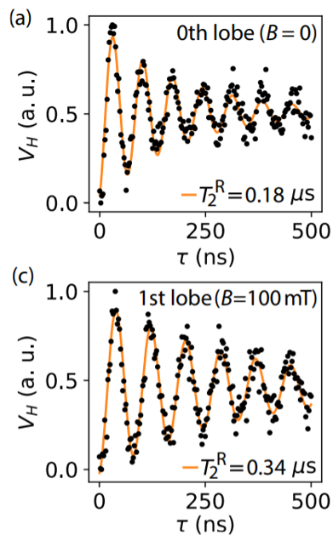
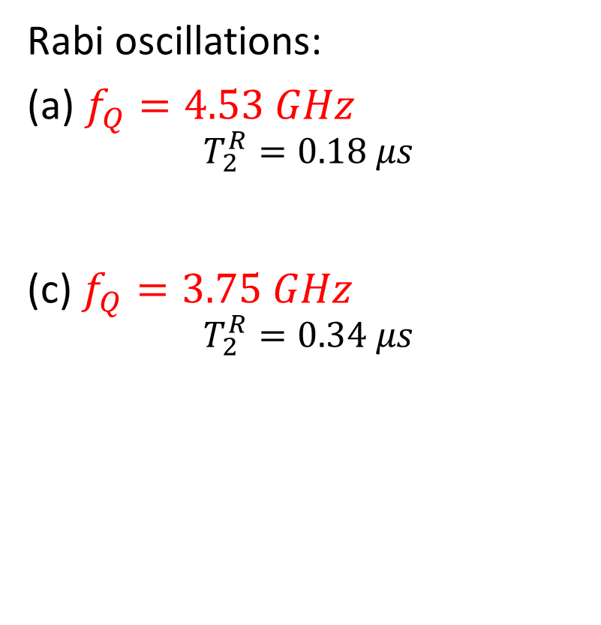
Time domain measurements:

Slide 10
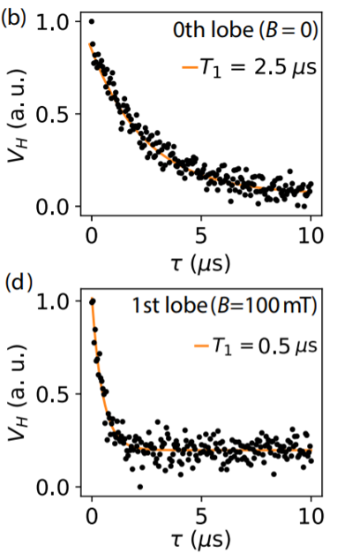
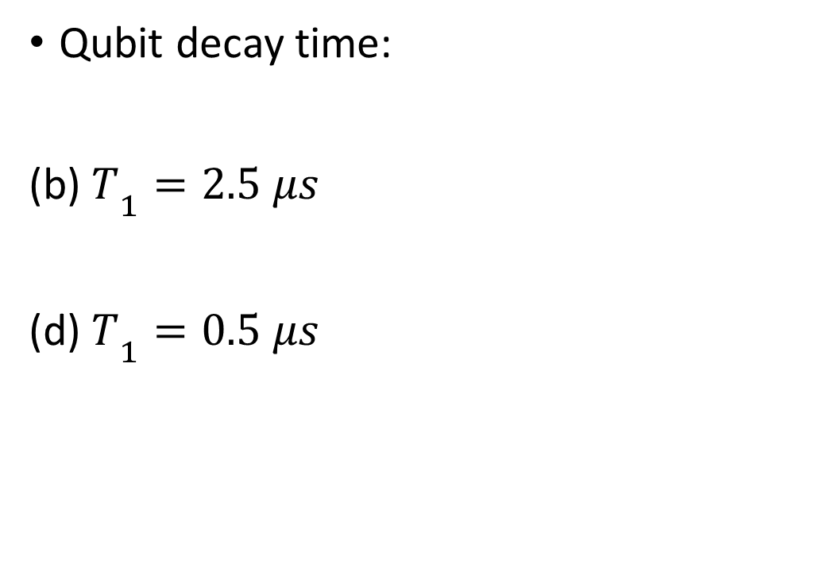

Slide 11
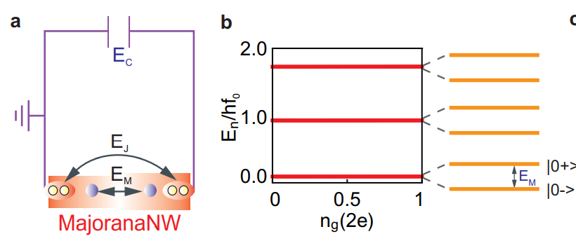
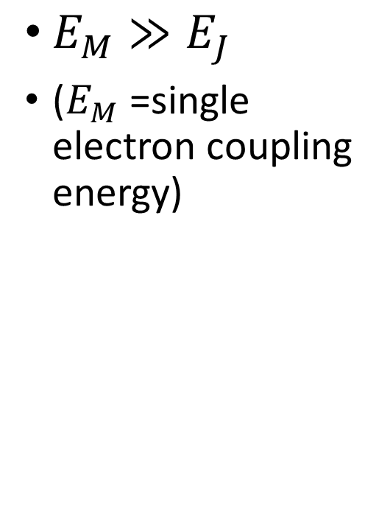
Ideal topological transmon-(fermion parity branches)

Slide 12
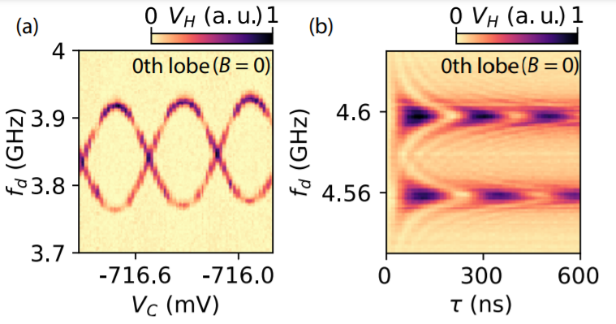
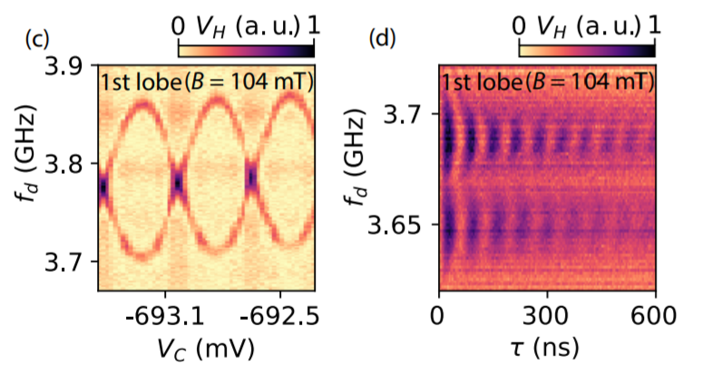
Qubit spectrum- Charge dispersion
Two charge parity branches:
Offset Charge Sensitive regime
Coherent oscillations of fermion parity branches

Slide 13
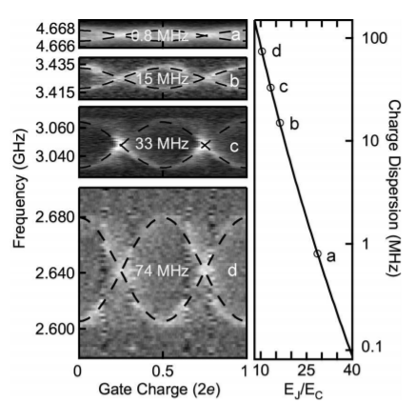

Slide 14
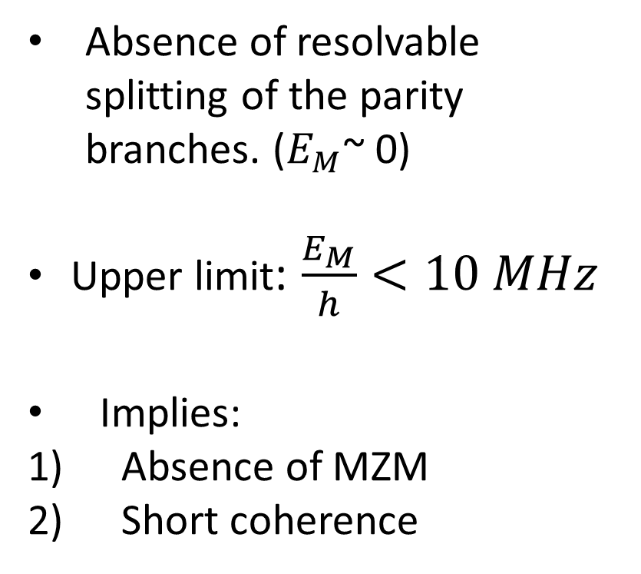

Slide 15
Reference:
arXiv:2010.13775v1 [cond-mat.supr-con] 26 Oct 2020
J. A. Schreier, A. A. Houck, Jens Koch, D. I. Schuster, B. R. Johnson, J. M. Chow, J. M. Gambetta, J. Majer, L. Frunzio, M. H. Devoret, S. M. Girvin, and R. J. Schoelkopf Departments of Physics and Applied Physics, Yale University, New Haven, Connecticut 06520, USA (Dated: December 20, 2007)
arXiv:2005.11848v2 [cond-mat.mes-hall] 30 May 2020
Pairing, pair-breaking, and their roles in setting the Tc of cuprate high temperature superconductors

Slide 16
THANK YOU

