Slide 1

Superconducting gatemon qubit based on a proximitized two-dimension electron gas(2DEG)
報告者：吳東欣
指導教授：邱奎霖 教授
Date:10/27/2020

Slide 2
Outline
Introduction of 2DEG
The way of experiment
Measurement of T1 T2echo
Conclusion
Reference

Slide 3
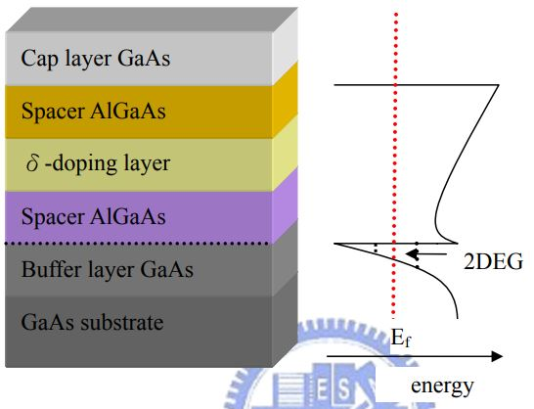
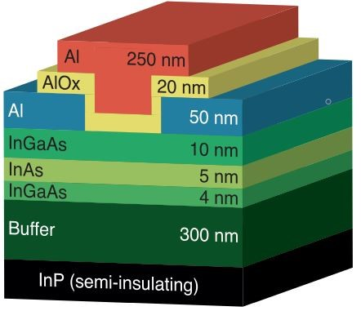
2DEG wafer
10meV
2DEG
↖
(Fe doped)
此為AlGaAs-GaAs 2DEG示意

Slide 4
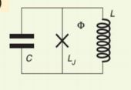
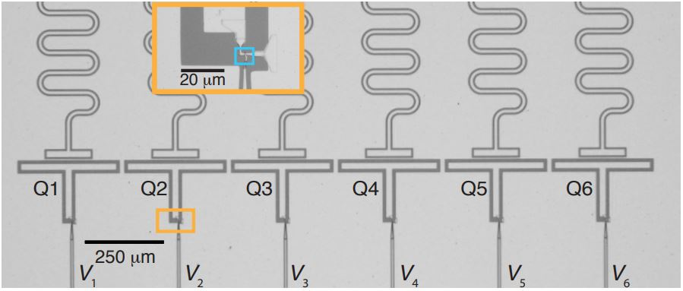
Gatemon
Capacitance(two plates)
LC circuit
Capacitance(between gatemon and ground)
From量子計算基礎導讀

Slide 5
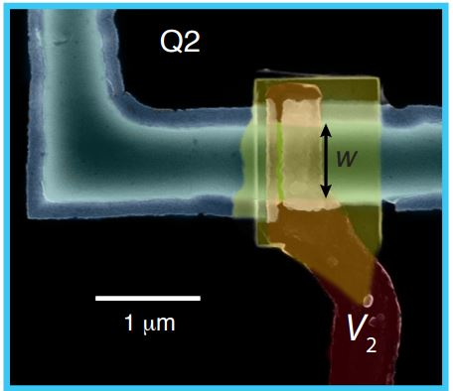
2DEG Gatemons

Slide 6
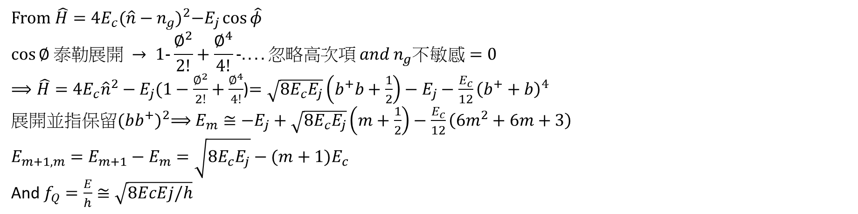
From $\hat{H}=4E_{c}{(\hat{n}−n_{g})}^{2}−E_{j}\cos{\hat{φ}}{ }$
$$\cos{∅ 泰勒展開 → 1-\frac{∅^{2}}{2!}+\frac{∅^{4}}{4!}-.... 忽略高次項 and n_{g}不敏感=0}$$
$⟹\hat{H}=4E_{c}{\hat{n}}^{2}−E_{j}(1−\frac{∅^{2}}{2!}+\frac{∅^{4}}{4!}$)$=\sqrt{8E_{c}E_{j}}\left(b^{+}b+\frac{1}{2}\right)−E_{j}−\frac{E_{c}}{12}{\left(b^{+}+b\right)}^{4}$
展開並指保留${(bb^{+})}^{2}⟹E_{m}≅−E_{j}+\sqrt{8E_{c}E_{j}}\left(m+\frac{1}{2}\right)−\frac{E_{c}}{12}{\left(6m^{2}+6m+3\right)}^{}$
$$E_{m+1,m}=E_{m+1}−E_{m}=\sqrt{8E_{c}E_{j}}−(m+1)E_{c}$$
And $f_{Q}=\frac{E}{h}≅\sqrt{8EcEj/h}$
From孔偉成PHD thesis

Slide 7
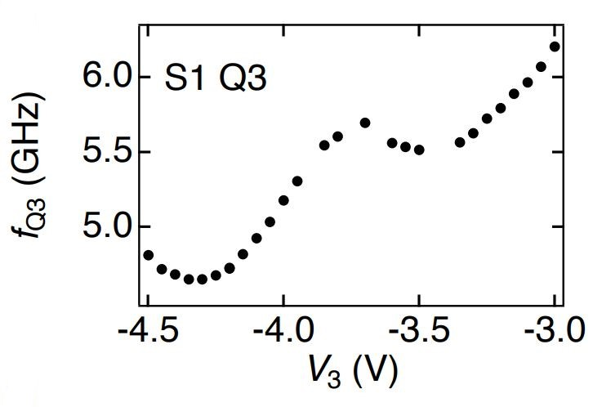
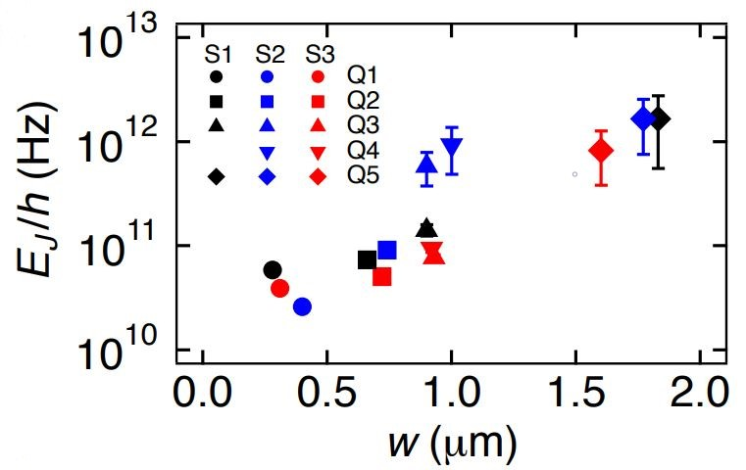

Result
$$fQ=\frac{E}{h} ≈ \sqrt{8EcEj/h}$$

Slide 8
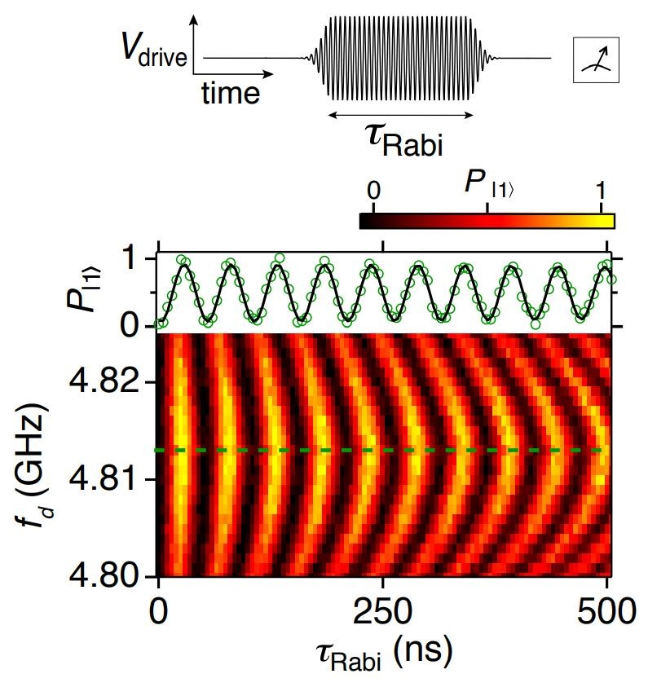
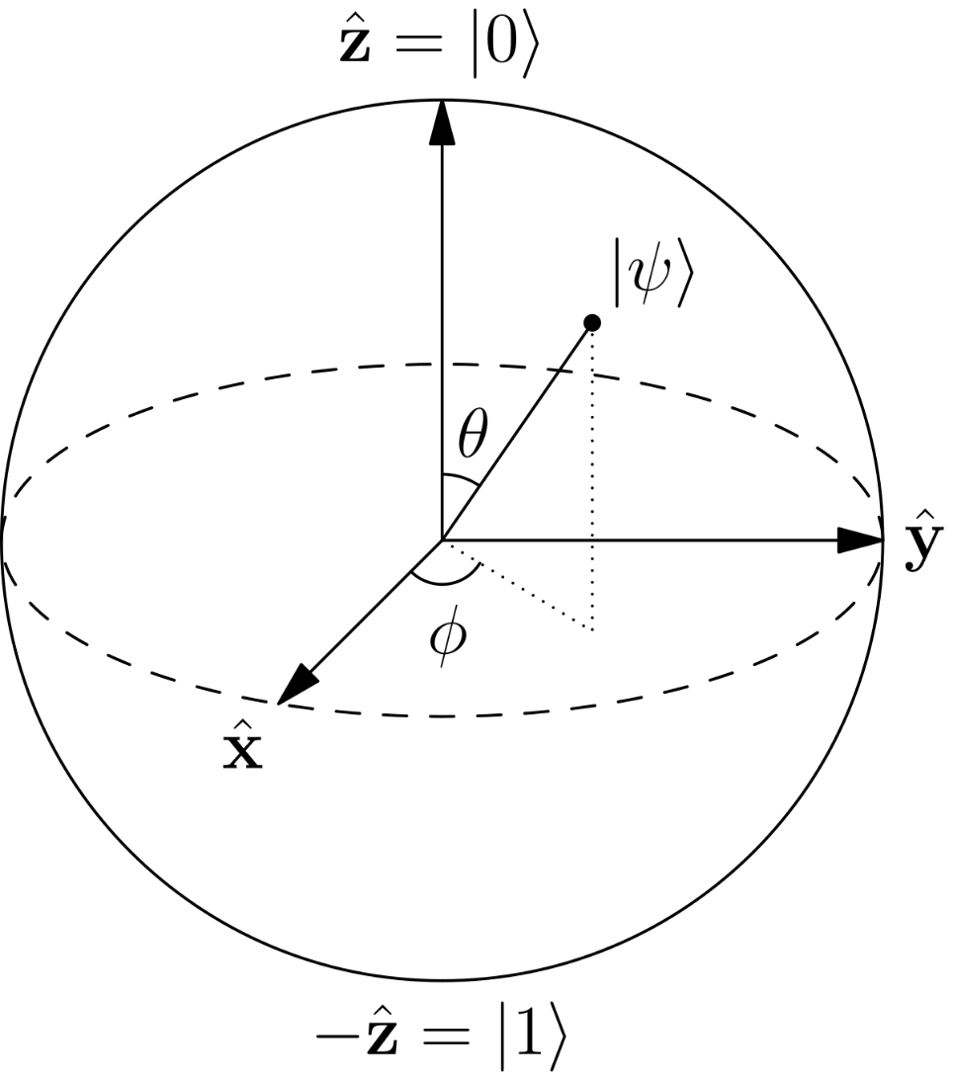
Rabi oscillation
V=-4.5V

Slide 9
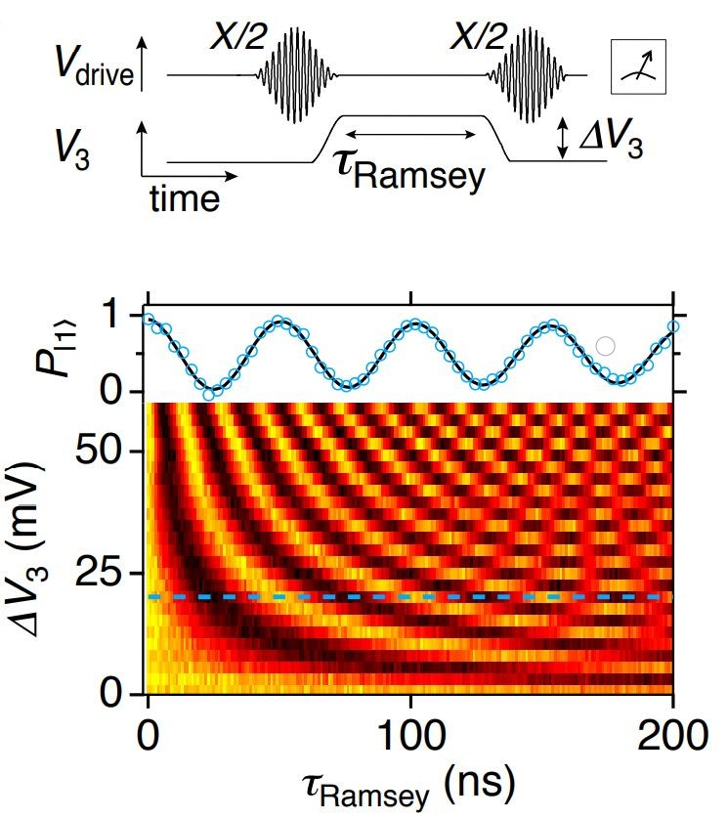
Ramsey oscillation

Slide 10
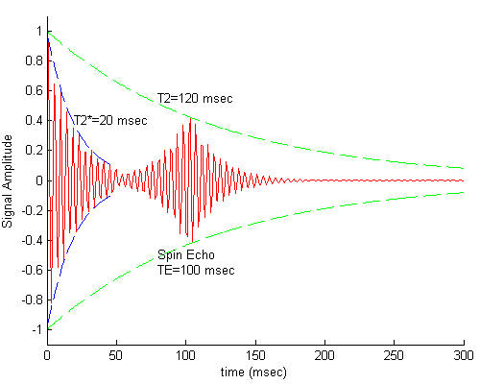
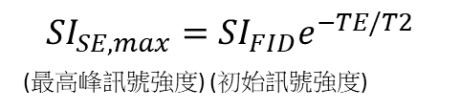
Hahn echo
$${SI}_{SE,max}={SI}_{FID}e^{−TE/T2}$$
(最高峰訊號強度) (初始訊號強度)

Slide 11
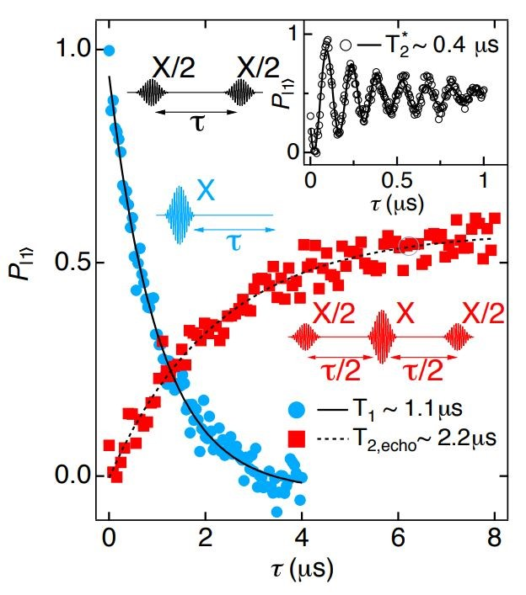
Measurement of T1 T2echo
T2,echo ～2T1
Indicates that 2DEG gatemon dephasing is dominated by low frequency noise

Slide 12
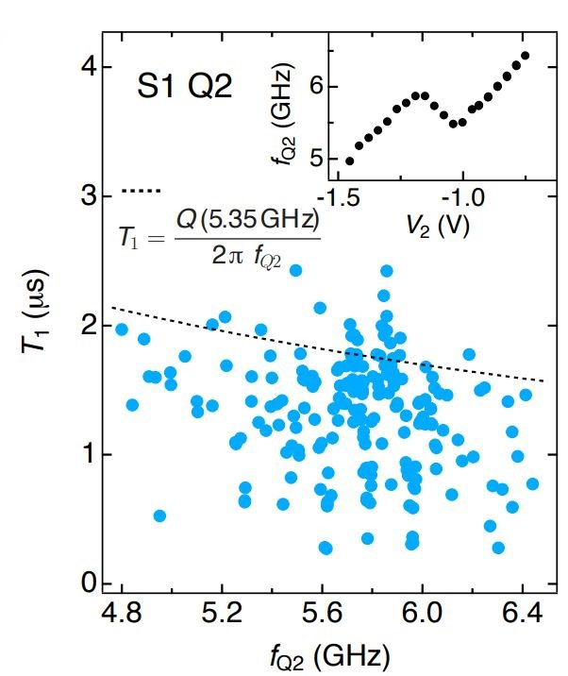
Result of T1

Slide 13
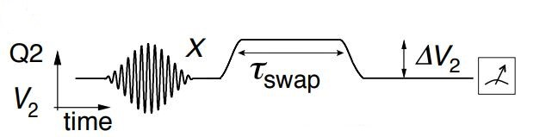
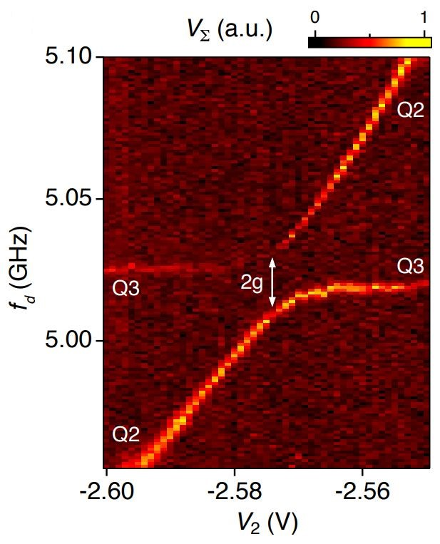
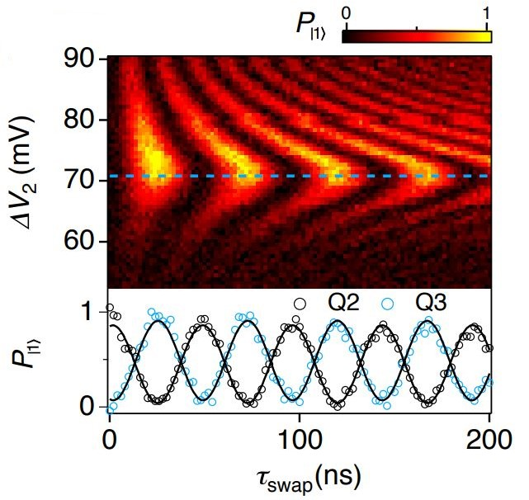
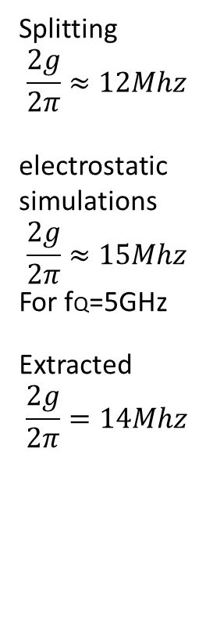
Coherent two qubits interaction
Splitting
$$\frac{2g}{2π}≈12Mhz$$
electrostatic simulations
$$\frac{2g}{2π}≈15Mhz$$
For fQ=5GHz
Extracted
$$\frac{2g}{2π}=14Mhz$$

Slide 14
Conclusion
Planar semiconductor materials and superconducting microwave circuits are compatible technologies that can be readily integrated while maintaining quantum coherence.
Since 2DEG gatemons represent a perfect quantum counterpart to semiconductor-based cryogenic classical control logic, they take the first step towards realizing a scalable all-electric hybrid superconductor-semiconductor quantum processor.

Slide 15
Reference
Casparis, Lucas, et al. “Superconducting Gatemon Qubit Based on a Proximitized Two-Dimensional Electron Gas.” Nature News, Nature Publishing Group, 23 July 2018, https://www.nature.com/articles/s41565-018-0207-y
圖源：1.https://en.wikipedia.org/wiki/Spin_echo
2.“Hahn Echo.” Questions and Answers ​in MRI, http://mriquestions.com/90deg-90deg-hahn-echo.html
https://www.researchgate.net/publication/283532114_Two-dimensional_epitaxial_superconductor-semiconductor_heterostructures_A_platform_for_topological_superconducting_networks
2DEG : https://ir.nctu.edu.tw/bitstream/11536/76146/6/155306.pdf
Thomas Kuo (2020/4/27) Topic: Superconducting Gatemon Qubit based on a Proximitized Two-Dimensional Electron Gas

Slide 16
Thank you for your attention

