Slide 1

Evolution of Nanowire Transmon Qubits and Their Coherence in a Megnetic Field
報告者: 羅程瀚
指導教授: 邱奎霖 教授

Slide 2
Outline
Introduction
Superconducting gap
Andreev reflection and Andreev bound state
Echo dephasing time
Nanowire Transmon Qubits
Experiments
Flux
Voltage gate
In-plane magnetic field Bll
Conclusion

Slide 3
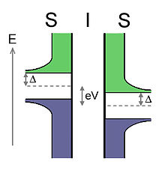
Superconducting Gap
energy gap :energy gain for two electrons upon formation of a Cooper pair.
Cooper pair is at Fermi energy.
density of states vanishes over an energy range
(hard gap)

Slide 4
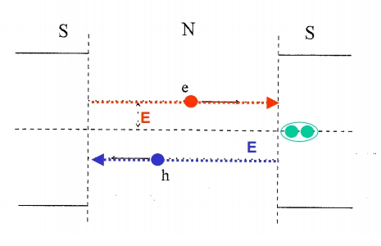
Andreev reflection
When an electron go through N/S,
Will reflect a electron hole and create a cooper pair in S

Slide 5
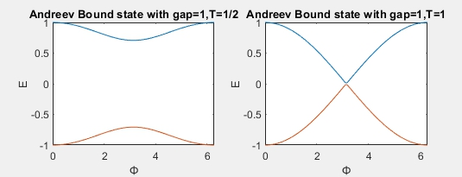

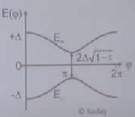
Andreev boundstate
Energy of e:
Ee=-Eh
Majorana fermion occur in E=0

Slide 6
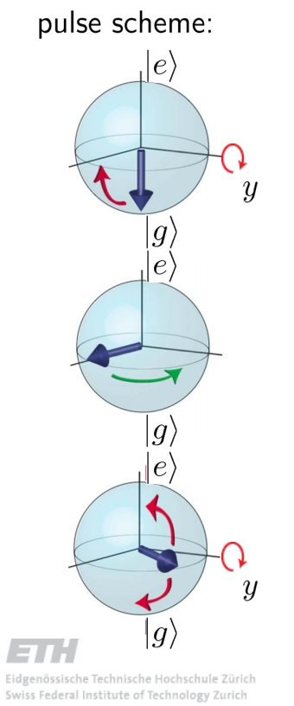
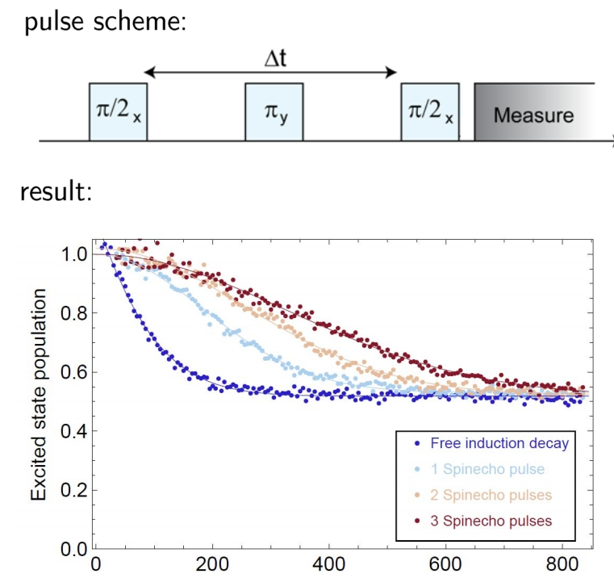
Echo dephasing time
Add a pulse to refocuse

Slide 7
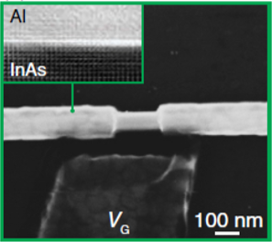
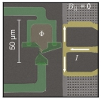
Nanowire transmon
SNS junction
InAs core:200nm
Al shell:30nm
SQUID:flux tunable
Vg
Bc=83.9mT (Gap=0)

Slide 8
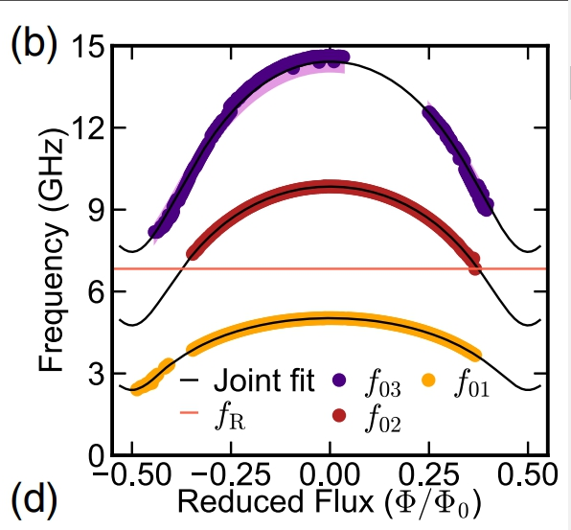



Qubit frequency-Flux
Andreev bound state:
Cooper pair box Hamiltonian:
fit value:

Slide 9
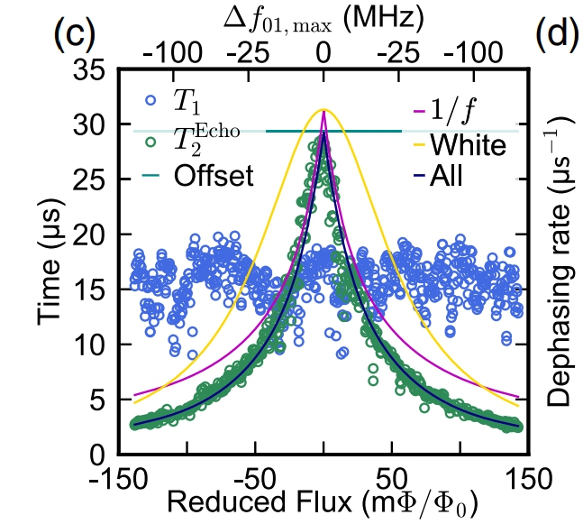
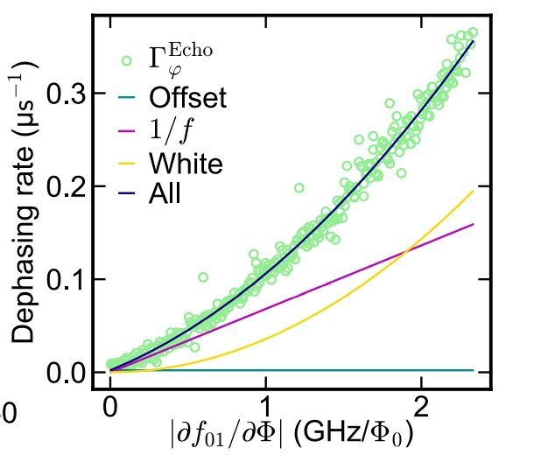

Decoherence time-Flux
$T_{2}^{echo}$ is T1 limited and contributed by:
1/f noise: power spectral density is inversely proportional to the frequency
White noise: power spectral density is constant

Slide 10
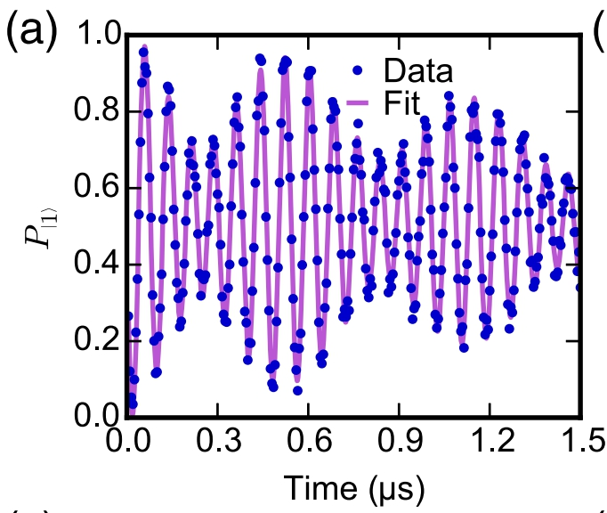
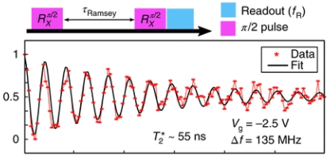
Frequency difference
Ramsey measurements:
Beating pattern:
Qubit frequency difference=1.6MHZ
Depend on Vg(Charge noise coupling)

Slide 11
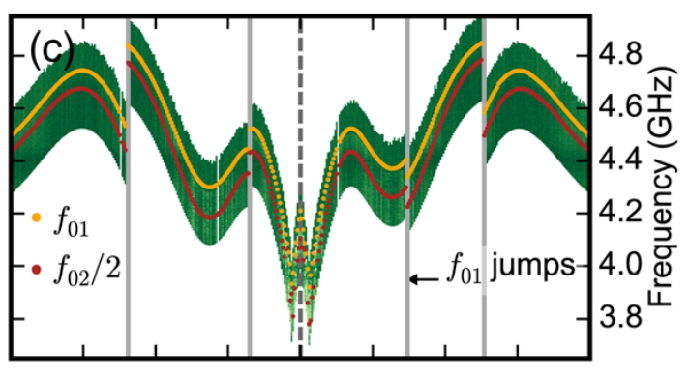
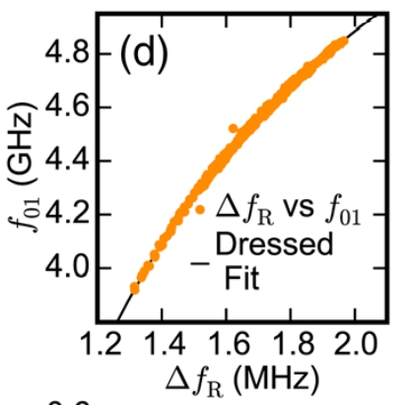
Frequency difference-Vg
Random but Reproducible jumps
Two channels dominated

Slide 12
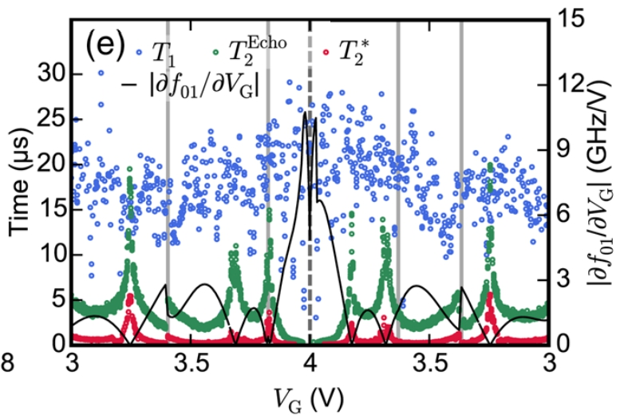
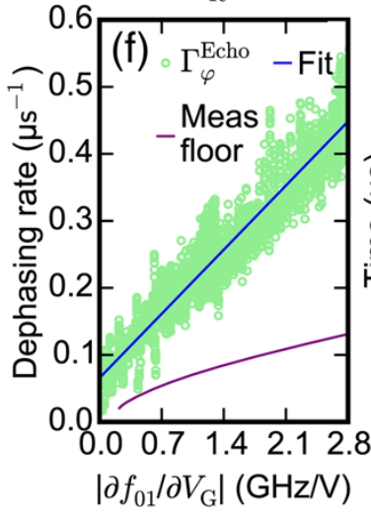
Decoherence time-Vg
T2 peak occur on the sweet spot

Slide 13
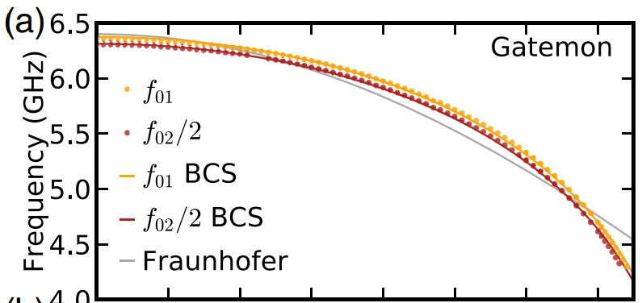


Qubit frequency-Bll
Monotonic decay:
Change of gap
Parameter(best-fit):
Ta,b=0.95,0.62
Bc=83.9

Slide 14
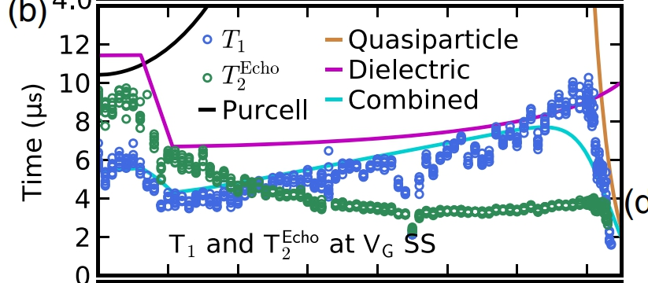
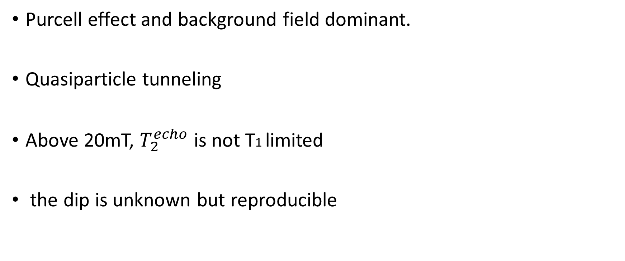
Decoherence time-Bll
Purcell effect and background field dominant.
Quasiparticle tunneling
Above 20mT, $T_{2}^{echo}$ is not T1 limited
the dip is unknown but reproducible

Slide 15
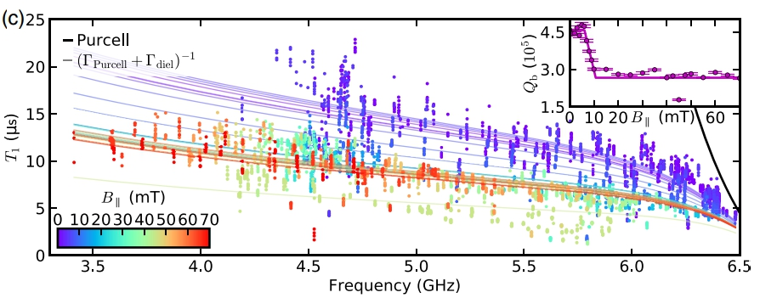
Quality factor (Qb)
By T1-f01 at different Bll can get Qb
Decrease at 6mT to 10mT
Due to Al wire bonds turning normal

Slide 16
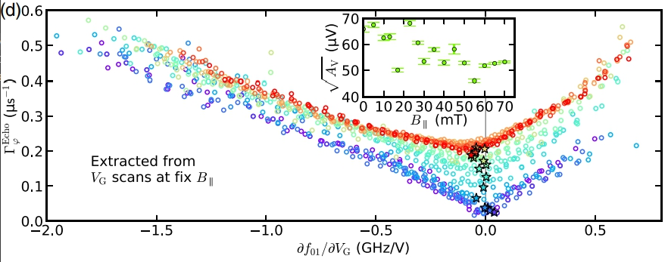

Dephasing rate-sensitivity
Not understood:
Difference at sweet spot
1/f noise amplitude drop
$T_{2}^{echo}$ is not T1 limited

Slide 17
Conclusion
Use Andreev bound state to get Hamiltonian
Using Flux,Vg and Bll as parameter to measure decoherence time and qubit frequency(by changing gap ,transimision,flux)
Under different Bll,some properties are not explained well yet

