Slide 1


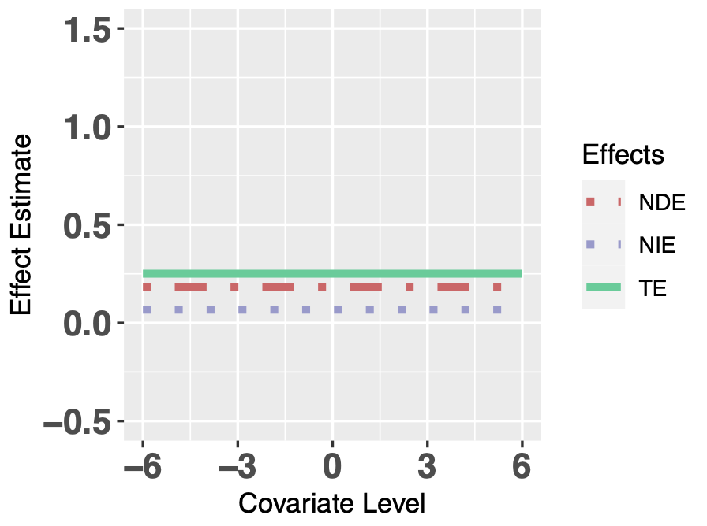
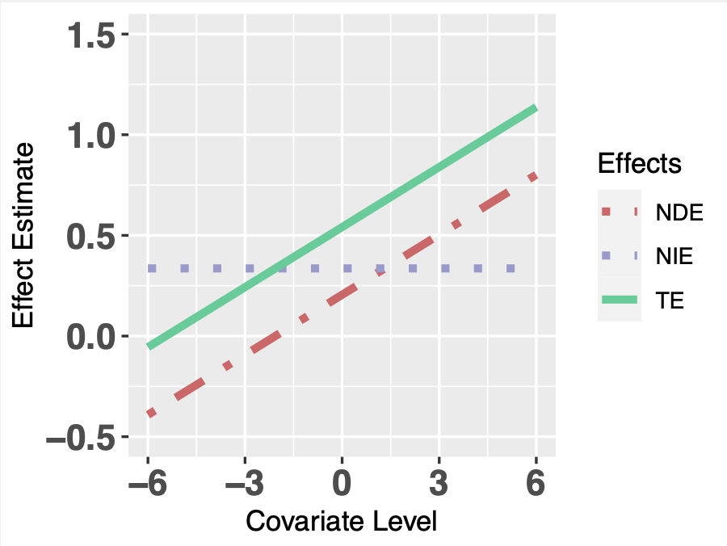
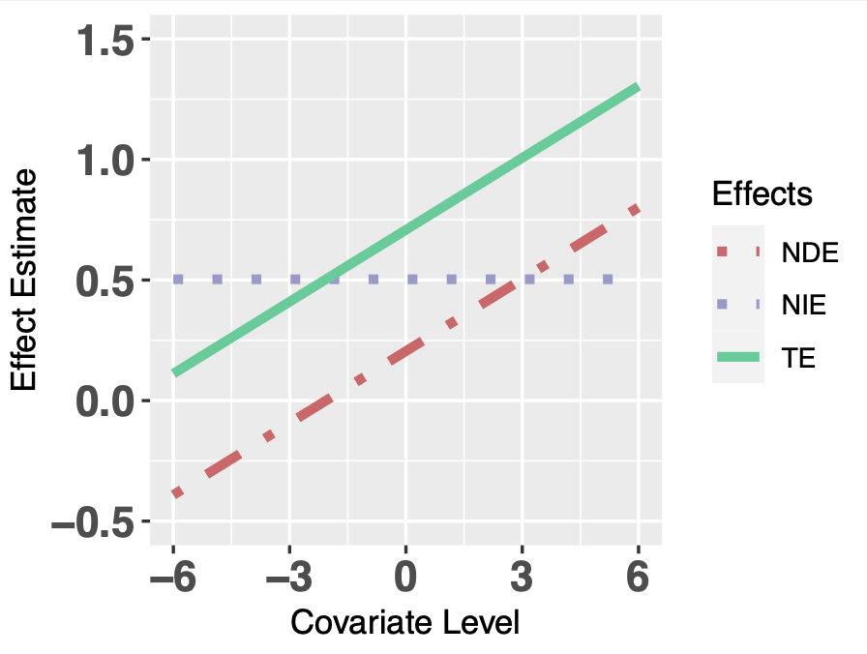
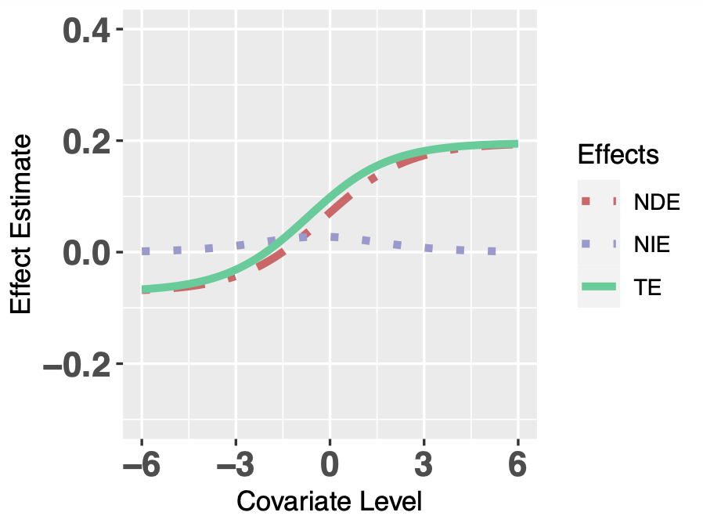
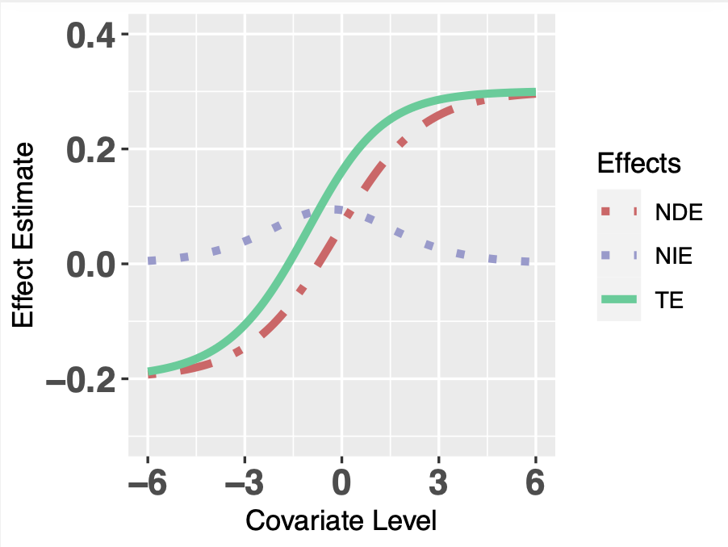
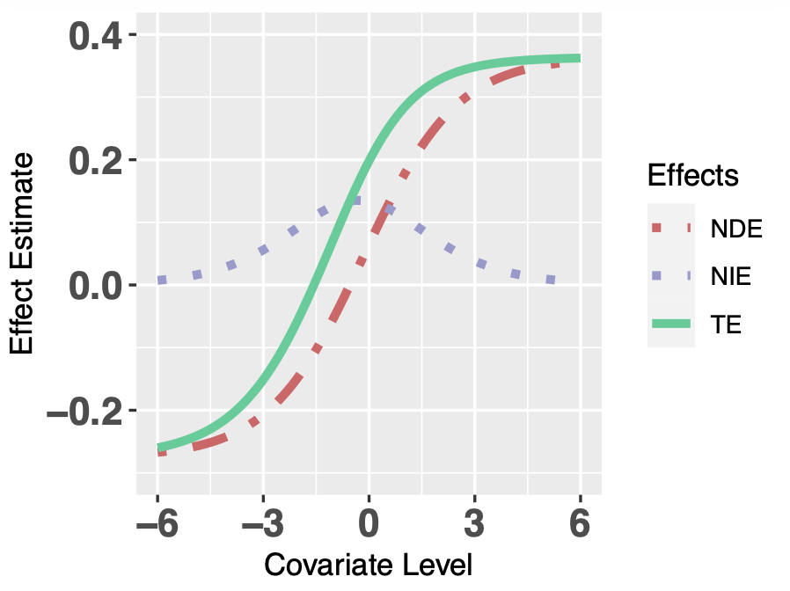
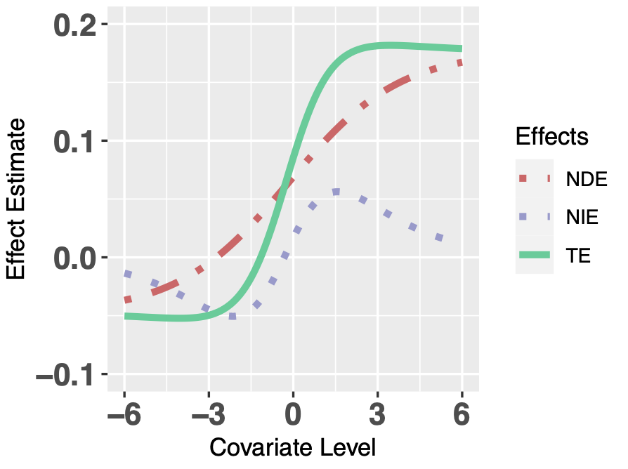
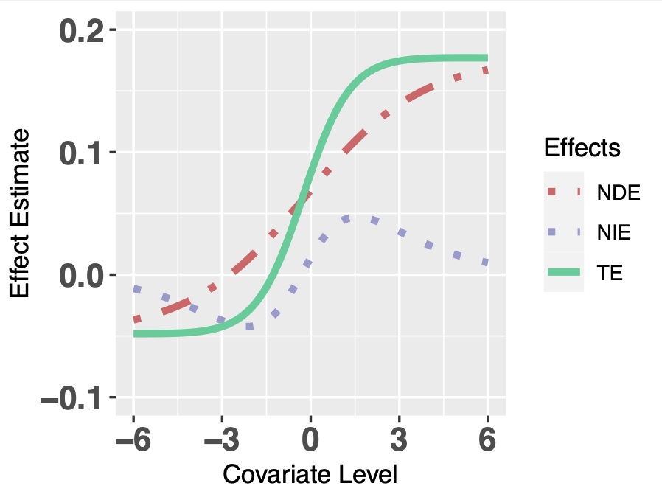
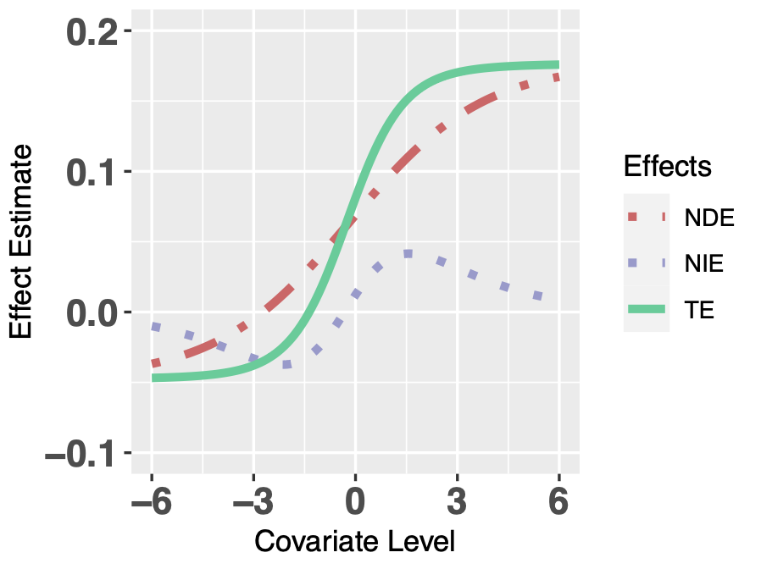
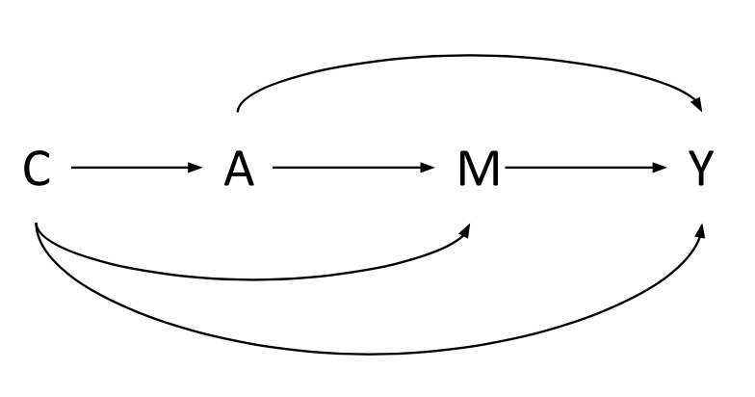
Effect Modification by Covariates: Extending the Current Causal Mediation Analysis
Yi Li^{1,2}, Robert J. Glynn^{1,2}, Daniel H. Solomon², Kazuki Yoshida²
¹Harvard T. H. Chan School of Public Health, Boston, MA, USA; ²Brigham and Women’s Hospital, Boston, MA, USA
Introduction
Results
Conclusions
The closed-form mediation mediation analysis approach by Valeri & VanderWeele (VV2013) estimates the natural direct effect (NDE) and natural indirect effect (NIE), conditional on covariates.
VV 2013 includes a treatment-mediator interaction term in outcome model.
But in some cases, there are effect modification by covariates in mediator and outcome models.
A-M interaction coefficient
Covariate levels can affect the direction and the magnitude of natural effects.
Whether and how natural effects depend on covariate dependence is affected by the magnitude of A-M interaction, effect modification by C and link functions.
θ₃ = 0.0
θ₃ = 0.5
θ₃ = 0.8
Continuous M and Y + A-M interaction
Aims
Extend the model by VV2013, including additional interaction terms.
Demonstrate covariate dependence under different scenarios.
Binary M, continuous Y + A-M interaction
Methods
Treatment A; Mediator M; Outcome Y; Covariates C.
Extended mediator model:
g_{a,c}[E(M|A, C)] = β₀ + β₁a + β₂c + β₃ac
Extended outcome model:
g_{a,m,c}[E(Y|A, M, C)] = θ₀ + θ₁a + θ₂m + θ₃am + θ₄c + θ₅ac + θ₆mc
- bold: additional
effect modification terms
References & Acknowledgements
Binary M, continuous Y + A-M interaction in outcome model + A-C interaction in mediator model
Valeri L & VanderWeele TJ. (2013). Mediation analysis allowing for exposure-mediator interactions and causal interpretation: theoretical assumptions and implementation with SAS and SPSS macros. Psychological Methods, 18(2), 137.
Acknowledgement: We would like to thank Dr. Maya Mathur (Stanford) for a helpful discussion.

