Slide 1
Differentiation of Renal Clear Cell Carcinoma and Oncocytoma Using Deep Learning Methods
COMPUTER SCIENCE 168 SPRING 2019
ERDI KIDANE
XUESEN CUI
KEANE GONZALEZ

Slide 2
Table of Contents
Introduction
Data Preparation
Model Setup
Results
Conclusions

Slide 3
Introduction
The goal of this project was to utilize deep learning methods to differentiate between two types of kidney tissues, renal cell carcinoma and a similar, but non-cancerous tumor tissue called oncocytoma.
Normally, this differentiation requires a radiologist to manually review images to determine if a cancer is likely present. This process is time consuming and subject to the skill level and biases of the reviewing radiologists. An automated method not only has the possibility of speeding up the process, but also may detect things that go unnoticed during manual screenings. The Inception deep learning model was identified as a possible candidate for exploration into this avenue of research.

Slide 4
Data Preparation
The raw data consisted of DICOM images for 118 patients with at least one renal clear cell carcinoma indication and 36 patients with at least one oncocytoma lesion.
Each patient had CT images taken during specific timed phases to capture contrast filtration effects. These phases were:
Pre-Contrast
Post-Contrast, during corticomedullary phase
Post-Contrast, during nephrographic phase
Post-Contrast, during excretory phase
Every phase had its own DICOM image set with an accompanying segmentation file detailing the volume margins of the lesion found

Slide 5
Data Preparation
Patient image sets (for all phases) were broken up into cases with RCC and those with oncocytoma
All of the phases were kept together for each patient
There were far more patients with labeled RCC than oncocytoma (almost 4:1)
DICOM images were read in and tags analyzed (specifically the slice location tag)
The slice location tag was used to re-order slices that were not in order via the saved filenames (several cases were like this)

Slide 6
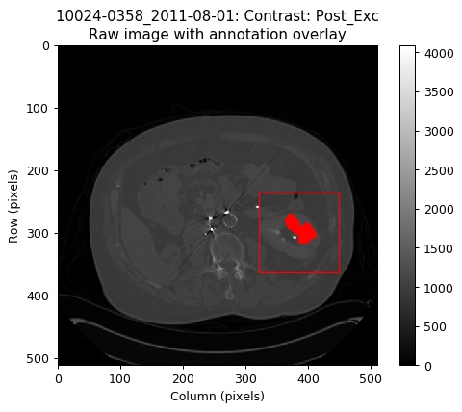
Data Preparation
Once the DICOM pixel array data was processed, the MHA file, containing all the radiologist defined margins, was processed.
The margins delineated where the volume of the lesion (RCC or oncocytoma) was within the CT image
To get a smaller sample for use in the model, we'd need to know where the center of the volume of lesion was. Using the annotation data, the center was taken and that slice taken as the center slice.
The center pixel here and half the box size (our wanted image size is 128 x 128, so 64 pixels) in each direction made our model image (see the red outlined box in image). The solid red indicates 2d area of lesion.

Slide 7
Data Preparation
The 128 x 128 image data (grayscale, default units) was then saved to a standard JPEG formatted file for use with the Inception model.
Only the slices that contained lesion were kept and saved as model inputs (if the lesion didn't exist in a slice, we did not need that tissue biasing our results).
This not only assured us of having input images with lesion data, but also reduced the amount of data being input into the model.

Slide 8
Model Setup
Training from scratch is computationally intensive and can take quite a long time.
Requires large amounts of data
Pre-trained model
500 training 250 validation
Change the number of labels in the final classification layer.
Restore weights from the pre-trained inception v3 except for the final classification layer this should be randomly initialized.

Slide 9
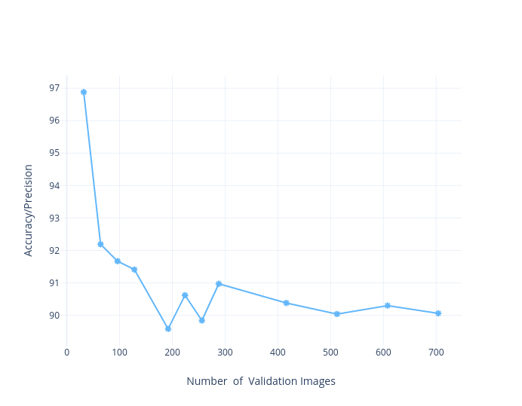
Results
500 training images
250 testing images
90% accuracy

Slide 10
Conclusions
Input data would have benefited from more stringent filtering processing.
For some patients, the lesions were close enough to the outer edge of the kidney that a the chosen 128 x 128 dimensions of the sub-image captured parts of other organs/tissue.
Further rules on choosing model input sizes could have been used (try 64 x 64 or another size)
Using smaller sub-patches of this input image (so maybe 28 x 28 patches within a 128 x 128 image) may have provided some benefit (assuming those patches with errrant tissue were not weighted heavily by the model)
A more robust auto-segmenting of the kidneys would have provided pure kidney data for the model
Limiting the image to only include the lesion volume with zero padding for the rest of the image was another alternative (the effects of a lot of zero padding in the image would need to be investigated)
More patient data, whether with or without all the renal contrast phases, would have provided more features/textures for the model to analyze.

