Slide 1
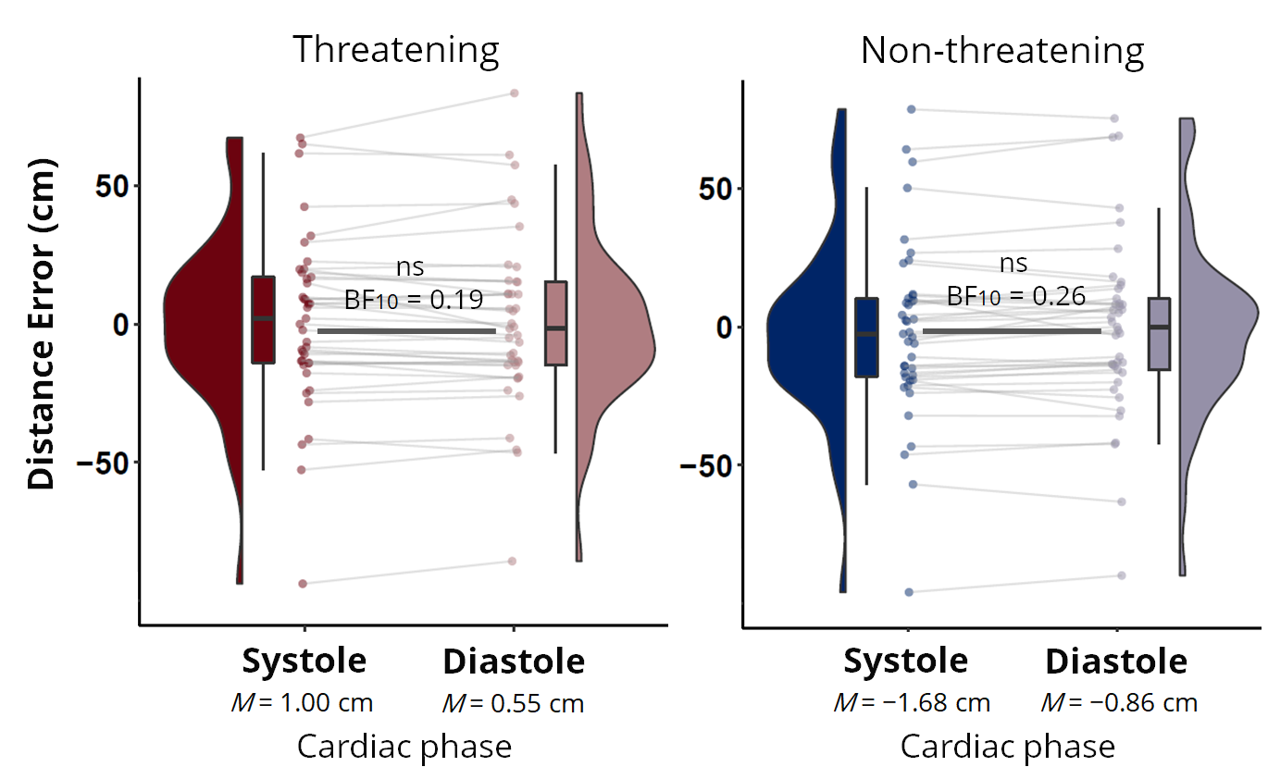
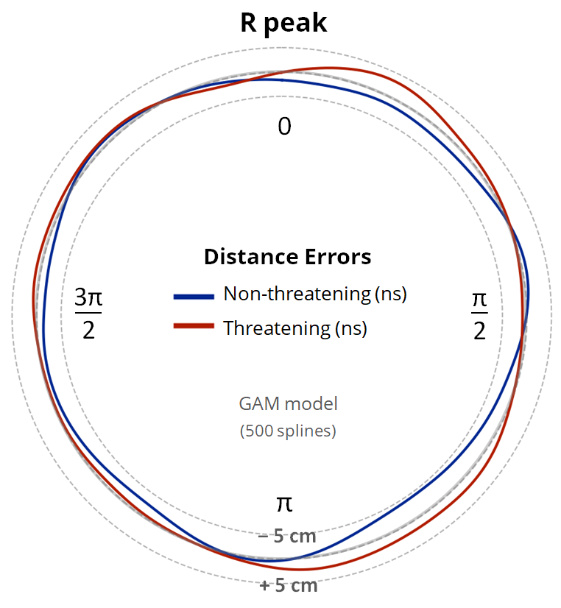

D
Threatening
Non-threatening
s BF10 = 0.19
ns BF10 = 0.26
Distance Error (cm)
Systole
Diastole
Systole
Diastole
M = 1.00 cm
M = 0.55 cm
M = −1.68 cm
M = −0.86 cm
Cardiac phase
Cardiac phase
a)
b)
Distance Errors:
Non-threatening (ns)
GAM model
(500 splines)

