Slide 1


Intelligent Inventory
A Time Series Analysis and LSTM Optimization
Edwin Quijano
University of West Florida
Capstone Project In Data Science IDC-6940 | Professor Dr. Shusen Pu

Slide 2
Project Background
Inventory storage during 2020 to 2022.
Normalization of inventories in 2023 and 2024.
U.S political policies affecting supply chain in 2025.
Shipments are re-routed to South America to reduce costs.
The challenge of limited warehouse space.

Slide 3
Why Forecasting Is Important
Helps Plan Warehouse Capacity
Improves Labor & Staffing Plans
Reduces Congestion and Cycle Time
Enables Better Inventory Strategy
Supports Financial and Operational Planning
Improves Vendor and Inbound Scheduling
Creates Early Warning Signals

Slide 4
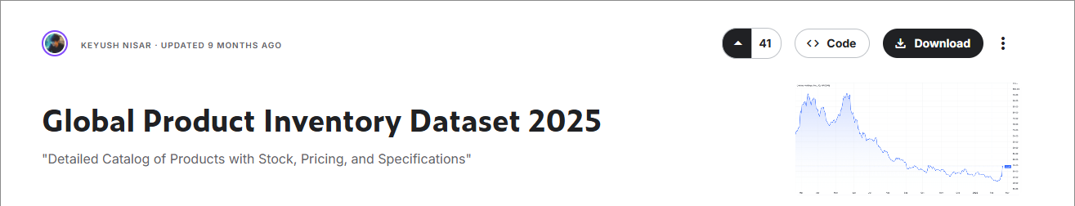

Data & Quality
10,000 rows
4 product categories
Product dimensions
Stock quantity

Slide 5
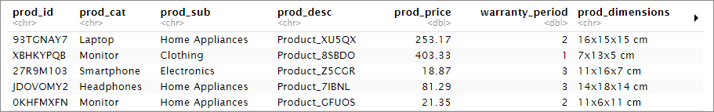
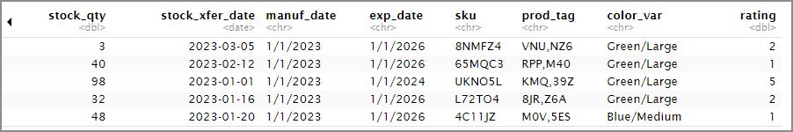
Key variables

Slide 6
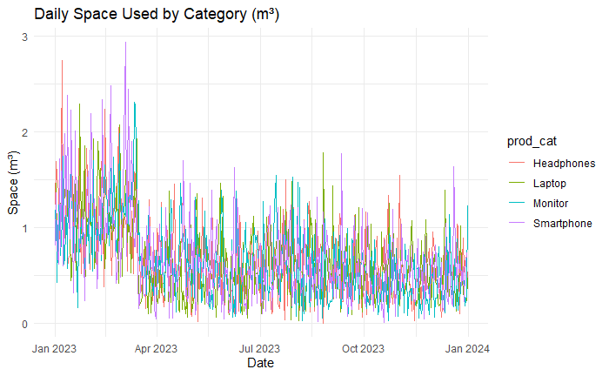
MODEL & METHODOLOGY
Data Preparation for Modeling
Stationarity Testing (ADF Test)
SARIMA Model Structure
SARIMA Residual Diagnostics
VAR Model

Slide 7
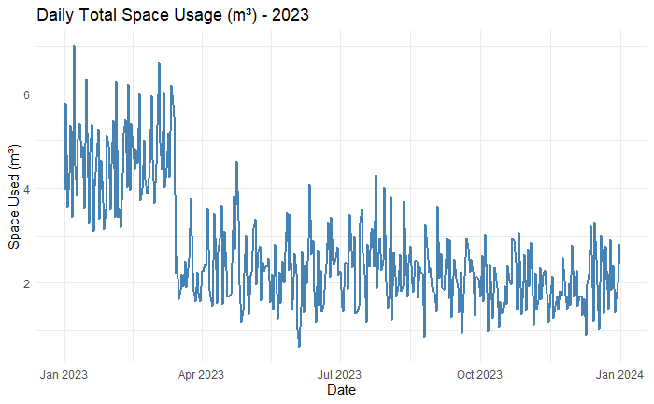
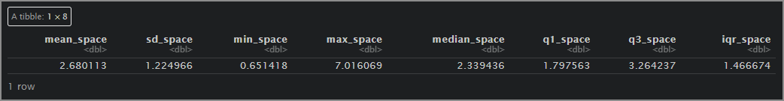
RESULTS & INTERPRETATION
Total space usage

Slide 8
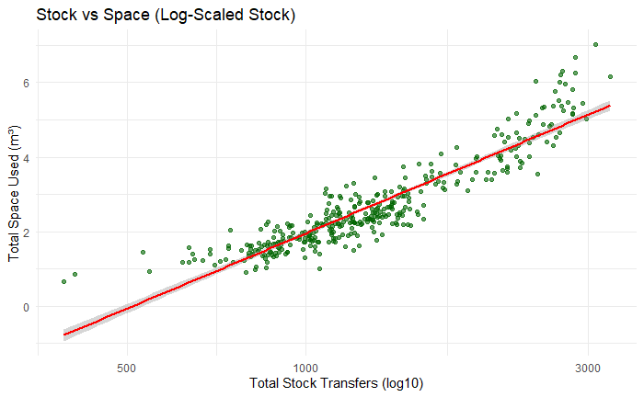
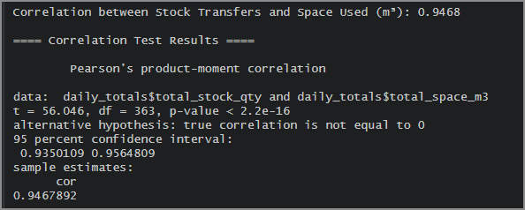
Stock vs. Space Correlation

Slide 9
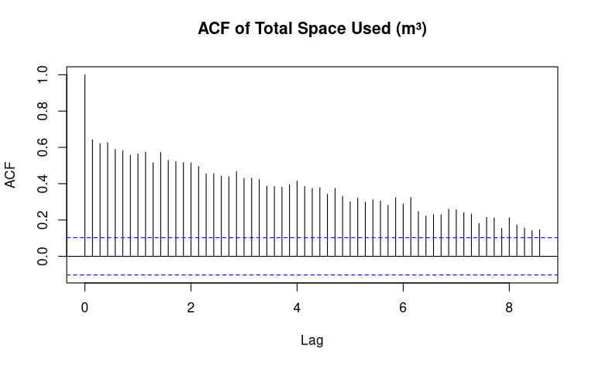
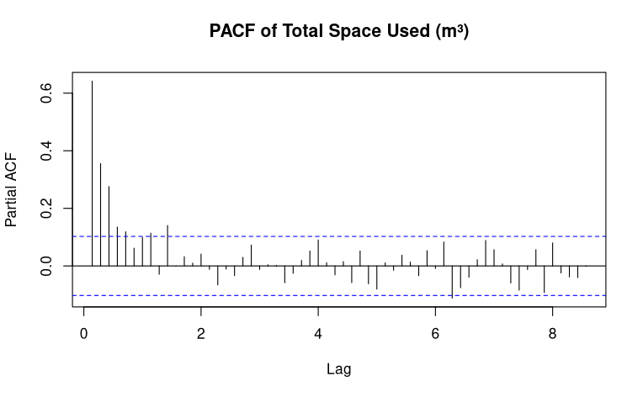
Total Space – Non-Stationarity

Slide 10
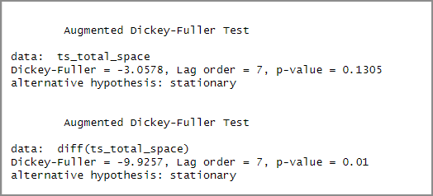
Augmented Dickey–Fuller (ADF) test

Slide 11
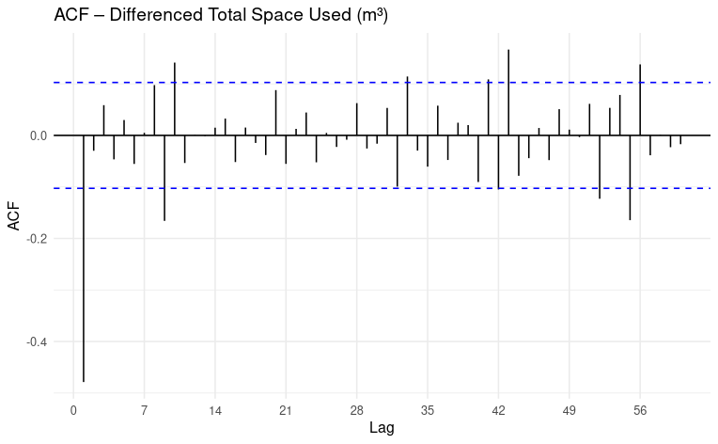
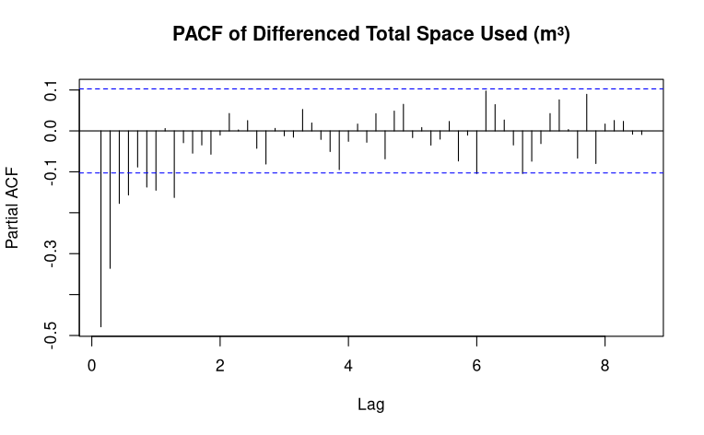
Total Space with difference

Slide 12

SARIMA Model
SARIMA (p,d,q) (P,D,Q)
$$Φ(B^{s})φ(B)(1−B)^{d}(1−B^{s})^{D}y_{t}=Θ(B^{s})θ(B)ε_{t}$$
Where:
$B$= backshift operator
$φ(B)$= non-seasonal AR
$θ(B)$= non-seasonal MA
$Φ(B^{s})$= seasonal AR
$Θ(B^{s})$= seasonal MA
$s=7$days (weekly seasonality)
p=0, d=1, q=2 P=2, D=0, Q=2 s=7

Slide 13
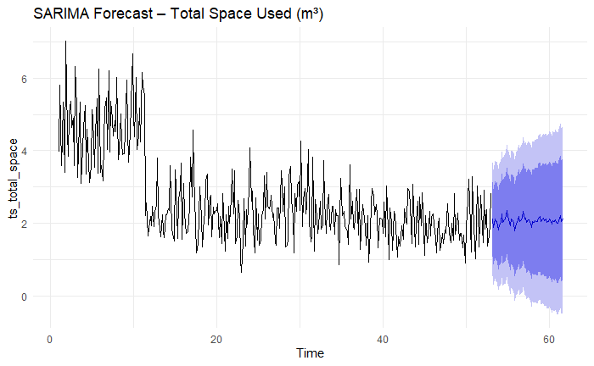
SARIMA Model

Slide 14

VAR Model
A VAR(2) means today's changes depend on the last two days.
The full model:
$$Δy_{t}=c+A_{1}Δy_{t−1}+A_{2}Δy_{t−2}+ε_{t}$$
Where:
$Δy_{t}$= vector of differenced category space at time t
$c$= vector of intercept constants
$A_{1}$= coefficient matrix for lag 1
$A_{2}$= coefficient matrix for lag 2
$ε_{t}$= vector of multivariate white-noise errors

Slide 15
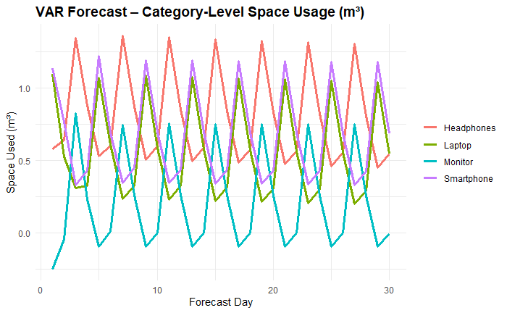
VAR Model

Slide 16
LSTM vs ARIMA
Model | Performance | Results
ARIMA (SARIMA) | Excellent at capturing weekly seasonality and short-term dynamics. RMSE ≈ 0.62 m³/day | Best-performing model
LSTM | Learns nonlinear patterns, robust to noise RMSE typically 0.75–0.95 m³/day | Underperforms compared to ARIMA

Slide 17
OPERATIONAL & BUSINESS
The warehouse should expect regular weekly fluctuations in space usage. Smartphones are the single most important category for peak capacity planning.
Forecasts help identify high-demand periods early, allowing better resource allocation.
Category-level forecasts allow teams to plan which zones will need the most space in upcoming weeks.

Slide 18
Future Improvements
Expand the Dataset (More Historical Data)
Add Key External Predictors (ARIMAX or ML Models)
Integrate Machine Learning Models

Slide 19

Thank You!

