Slide 1
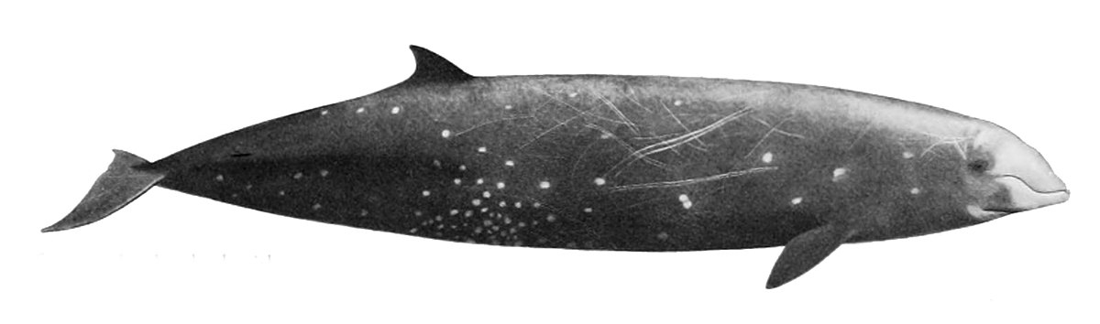
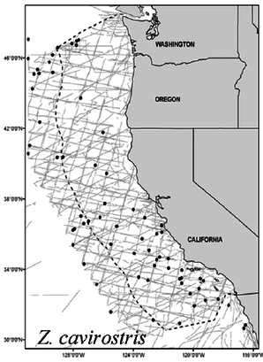
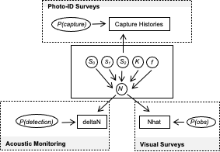
Technical progress: Task 3c
Goal is to investigate statistical power to detect trends in metapopulations of marine mammals where disturbance and sampling may not be uniformly distributed.
We have developed a simulation tool to evaluate statistical power under different scenarios
Population Simulation
Survey Simulation
Model Simulation

Slide 2
Technical Progress: Task 3c
Population Simulation
Two areas, one disturbed and one undisturbed
Matrix population model
Animals can move between areas
Disturbance affects carrying capacity, but animals do not perceive this change
Disturbed
Undisturbed
Notes:
Carrying capacity is lower in the red region due to disturbance, but the animals don’t know that. So, in this scenario, one animal moves from the undisturbed area to the disturbed area to “even out”

Slide 3
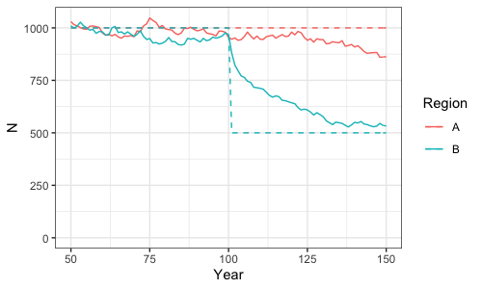
Technical Progress: Task 3c
Population Simulation
Notes:
Example scenario where carrying capacity decreases in the blue region but not in the red region. Red population decreases because animals are being lost to the blue region.

Slide 4


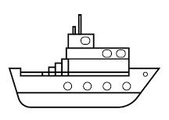
Technical Progress: Task 3c
Survey Simulation
Line-transect visual surveys
Photographic capture-recapture surveys
Passive acoustic monitoring of trends
Disturbed
Undisturbed
Notes:
We simulate different survey modalities at different intensities. In this scenario, the disturbed area is monitored using all three modalities, but the undisturbed area only has line-transect surveys.

Slide 5
Technical Progress: Task 3c
Model Simulation
State-space Bayesian integrated population model
Central population process model is linked to three observational submodels

Slide 6
Technical progress: Task 3c
Process will be repeated for different scenarios of carrying capacity, disturbance, survey types and survey intensities
Each scenario will be repeated many times to estimate expected power to detect trends
Process will be applicable to other species and scenarios
Population Simulation
Survey Simulation
Model Simulation

