Slide 1
SuRE WP6 — Sunlit Sea
First Review Meeting Eirik Larsen, Sunlit Sea

Slide 2
WP6 — what was committed (DoW)
Overall goal: Build an integrated model chain — aluminium pressing simulation, structural FEM, thermal CFD, and LCA — and use it to drive multi-dimensional optimisation of Sunlit’s floater design.
TRL commitment: TRL 2 → TRL 6
Key KPIs:
50% reduction in aluminium material consumption
~3% thermal loss reduction (~6°C lower operating temperature)
SSC5 structural validation

Slide 3
On track — milestone status
Milestone | Status
D6.1 — model chain architecture + pressing pipeline | Delivered
Pressing simulation pipeline | Complete — ~3,900 runs; 1,300 Pareto-filtered candidates
First full CAD → FEM → redesign loop | Complete (P3 → P4)
Gen2 prototype development | P3 built and under test; P4 design closed

Slide 4
WP6 is on track with all DoW commitments at first review.

Slide 5
D6.1 — what’s been delivered
D6.1 documents the model chain architecture and delivers first modelling results:
Interfaces defined — 19 physical component interfaces (I1–I19) and 6 model-to-model data interfaces (I-1 to I-6)
Pressing pipeline — ~3,900 forming simulations; 1,300 Pareto-filtered geometries ready for multi-domain screening in D6.2
Structural FEM — first SiSim analysis on P3 by IFE complete; load paths and failure modes identified
Thermal CFD — model built and run for Gen2 geometry; result already driving a production decision
Screening methodology — four-domain pass/fail framework defined; execution is the D6.2 headline deliverable

Slide 6
KPI progress
KPI | Target | Evidence at first review
Aluminium reduction | 50% | Pressing pipeline operational; 1,300 candidates span 0.8–1.5 mm range; quantified reduction delivered in D6.2
Thermal loss | ~3% / 6°C | CFD drives colour change: worst-case hinge temp drops 83.8°C → 48.3°C; implemented in Gen2
SSC5 structural | Validated | IFE FEM confirms infill critical; P4 redesign complete; validated FEM with infill in D6.2

Slide 7
The model chain in practice — first complete loop
The core WP6 claim is that modelling drives design decisions. This loop has been completed once:
P3 geometry built in parametric FreeCAD
STEP file exported to IFE (interface I-2)
IFE ran SiSim FEM — 10 mm imposed horizontal elongation
Findings: insufficient freeboard; aluminium and PU near/above yield; glass attachment sensitive to mounting method
Findings drove P4: hinge geometry revised, buoyant PU rods on all four sides, load paths rerouted away from PU–glass interfaces
This is the TRL advancement the DoW describes.

Slide 8
IFE findings → P4 design responses
IFE finding | Design response in P4
Al and PU near/above yield (simulated without infill — deliberate) | Infill confirmed structurally necessary; PU foam with adhesive bonding selected for next FEM run
Insufficient freeboard / deep submergence | Rod dimensions adjusted; angled bottom plate under evaluation to shift float toward water surface
Glass stresses sensitive to panel–frame attachment | Hinge redesigned to route loads away from PU–glass and PU–Al interfaces; attachment method treated as explicit variable in next simulation
Each IFE finding maps to a concrete P4 design change:

Slide 9
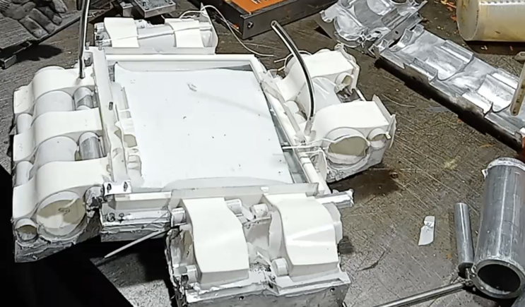
P3 — built, mold-to-cast workflow validated
Metal mold produced and cast — the FreeCAD → 3D-print → metal mold → PU cast workflow is proven end to end
Full P3 sample now in UV chamber at IFE; loose hinges in tensile and shear testing
PU tensile + UV degradation running at revised A1 protocol (~75°C max on samples) for clean 1000 h dataset
P3 after PU casting

Slide 10
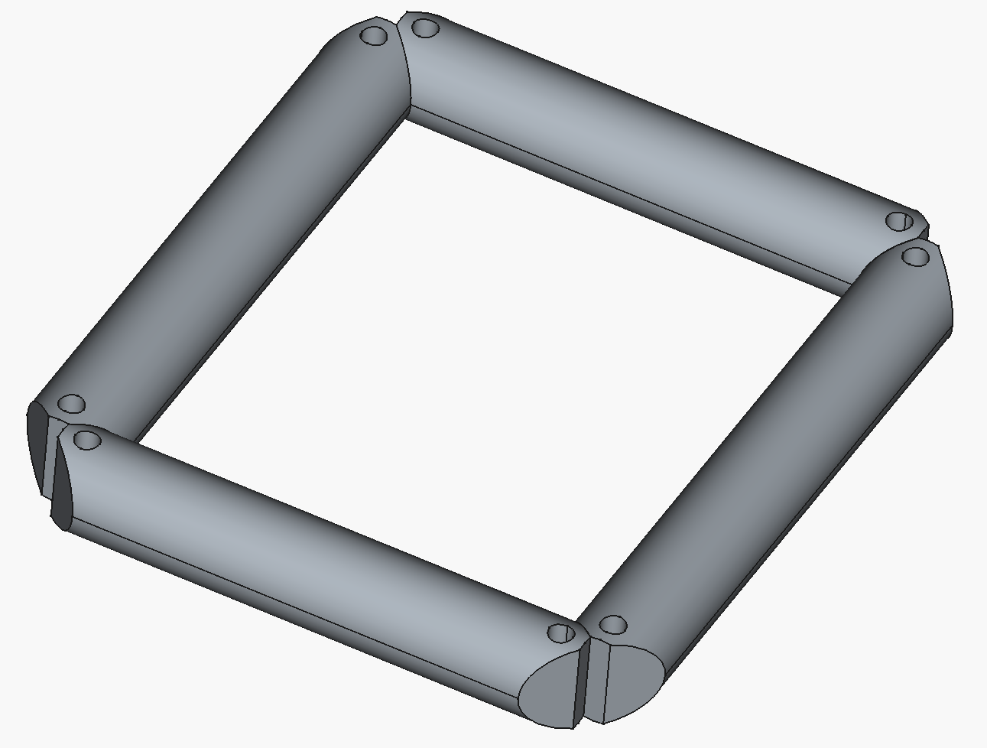
P4 — design closed, casting upcoming
Design changes from IFE findings now locked in:
Hinge geometry revised — load transfer shifted toward centre, away from PU–glass and PU–Al interfaces
Buoyant PU foam rods on all four sides — dual function: connector and added buoyancy
Infill redesigned — puzzle-fit multi-piece PU foam eliminates air cavities around junction boxes
Mold designed in FreeCAD; 3D-printed mold trial upcoming.
P4 buoyant 4-side connector concept

Slide 11
D6.2 — completing the chain
Interface | D6.1 status | D6.2 target
I-2: CAD → FEM (STEP) | Manual, demonstrated | Automated; STEP version and simplifications documented
I-3: Thickness field → FEM | Defined | Implemented: LS-DYNA → SiSim/PATRAN
I-4: Geometry → thermal CFD | Manual, demonstrated | Formalised; material property list agreed with IFE
I-5: Design data → LCA | Ad hoc | Versioned template; functional unit and system boundary confirmed
Each of the ~1,300 pressing candidates is evaluated across four domains in sequence. Pass/fail at each stage reduces the pool to a design short-list:
Manufacturing feasibility — already filtered in D6.1
Structural — peak stresses from SiSim (interfaces I-2 / I-3)
Thermal — peak PU temperature from CFD (interface I-4)
Life-cycle impact — material and process data to TNO LCA (interface I-5)
All four interfaces will be implemented by D6.2:

Slide 12
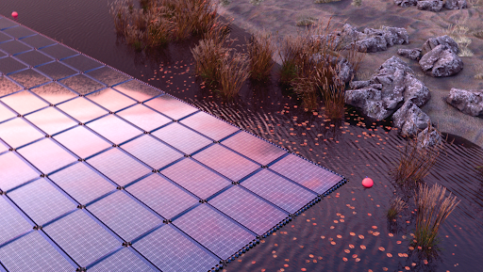
Summary
D6.1 delivered — model chain architecture, pressing pipeline, first FEM and CFD results
First model loop completed — CAD → FEM → findings → revised design working in practice
Thermal CFD drives a production decision — 83.8°C → 48.3°C; off-white PU implemented in Gen2
Prototype on schedule — P3 built and under test; P4 design closed
D6.2 roadmap clear — four interfaces to be implemented; 1,300 candidates screened; design recommendation produced

