Slide 1
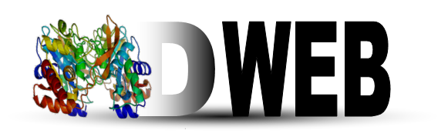
Molecular Dynamics On Web
Macromolecular Simulation Software Workshop CECAM – Jülich 2015 Hackathon

Slide 2
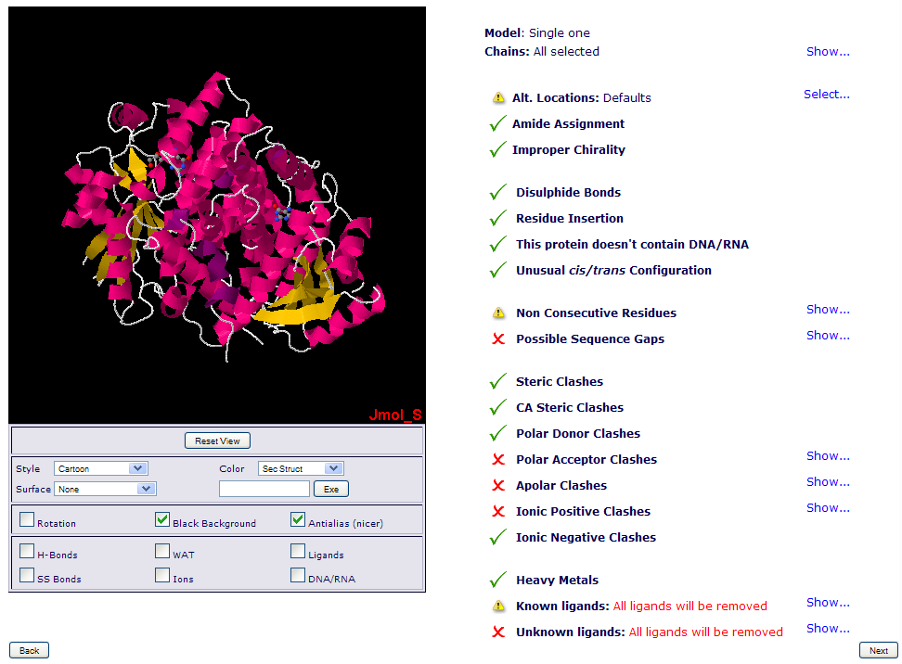
MDWeb: Structure Checking
Initial Structure Checking:
Models/Chains.
Atom Alt. Location.
Amide Assignments.
Missing atoms/residues.
Clashes.
Ligands (known/unknown).
Notes:
That’s an intermediate page specific to MDWeb, it’s not implemented as web services.
It’s a really important step, because in a molecular dynamics simulation, the correctness of input structures is crucial. Small errors in the input structure may cause MD simulations to became unstable or give unrealistic trajectories.
So in this checking page, users can select some parts of the structure to be simulated: the interesting chain/s or model, they can also fix some structure problems like incorrect amide assignments, and they will be informed about a set of possible problems within the structure, like missing parts or atom clashes.
The page also informs if the protein has known or unknown ligands (wether we have parameters in our MoDEL database or not).

Slide 3
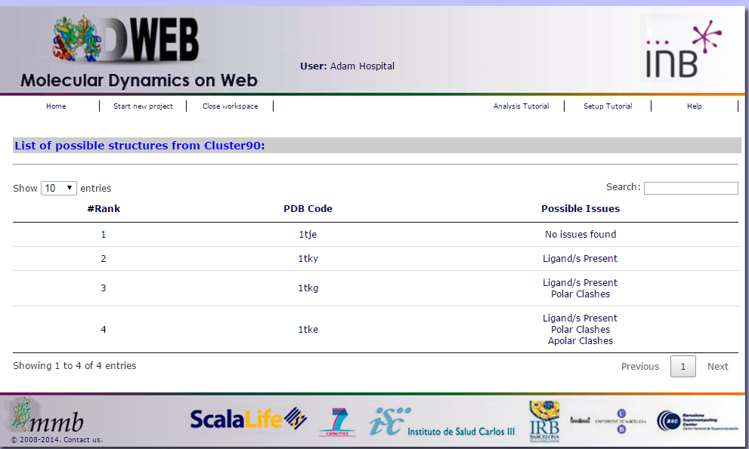

Slide 4
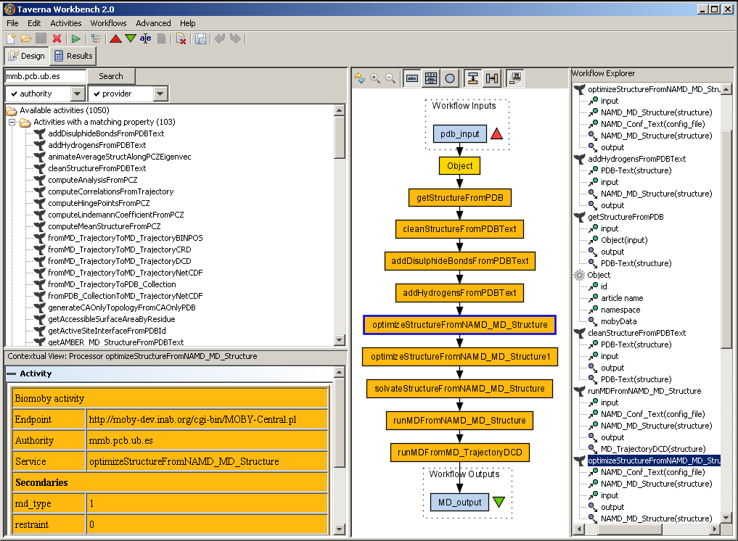

MobyLite Perl Workflow.
########## getStructurePDB Service ########## print "\n1.- Running getStructurePDB Service...\n"; my $object = Object->new($pdb,'PDB'); my $pdbStruct = getStructureFromPDB ( 'structure' => $object ) -> {'structure'}; if ($@) { print "Service execution failed:\n$@"; exit; }
my $checkList = PYTHON (pdb, model, chain/s)
if(CORRECT($checkList)) {
continue;
else {
list_possible_issues;
}
Web Services (Workflows)

