Slide 1
Monday
12:30
13.1 ºC
Week schedule
Notes:
Als pijl omhoog > display: 13,2 C, als pijl omlaag display: 13,0 C.

Slide 2
Week schedule
Monday
12:30
+
Low:
13.1 ºC
High:
21,3 ºC
Tuesday
+
Low:
13.1 ºC
High:
21,3 ºC
Wednesday
+
Low:
13.1 ºC
High:
21,3 ºC
Thursday
+
Low:
13.1 ºC
High:
21,3 ºC
Friday
+
Low:
13.1 ºC
High:
21,3 ºC
Saturday
+
Low:
13.1 ºC
High:
21,3 ºC
Sunday
+
Back
Low:
13.1 ºC
High:
21,3 ºC

Slide 3
Add Switch
Monday
Begintijd:
00:04
Eindtijd:
00:04
High:
21,3°C
Delete
Save

Slide 4
13.3 ºC
Uitknippen
13.0 ºC
13.4 ºC
13.2 ºC
12:31
13.1 ºC
12:29

Slide 5
Knippen
Monday
Tuesday
Wednesday
Thursday
Friday
Saturday
Sunday
Monday
Tuesday
Wednesday
Thursday
Friday
Saturday
Sunday

Slide 6
Settings
Time
Day
Date
Back

Slide 7
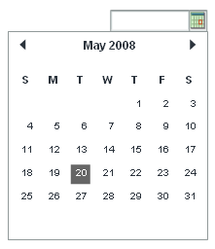
Knippen

Slide 8

Date settings
Select date and click save
Back
Save
Alternatief 1

Slide 9
Day settings
Select day and click save
Monday
Back
Save

Slide 10
Time settings
Enter time and
click save
00:04
Back
Save

Slide 11
Date settings
Select date and click save
29
February
2008
Back
Save
Alternatief 2

