Slide 1
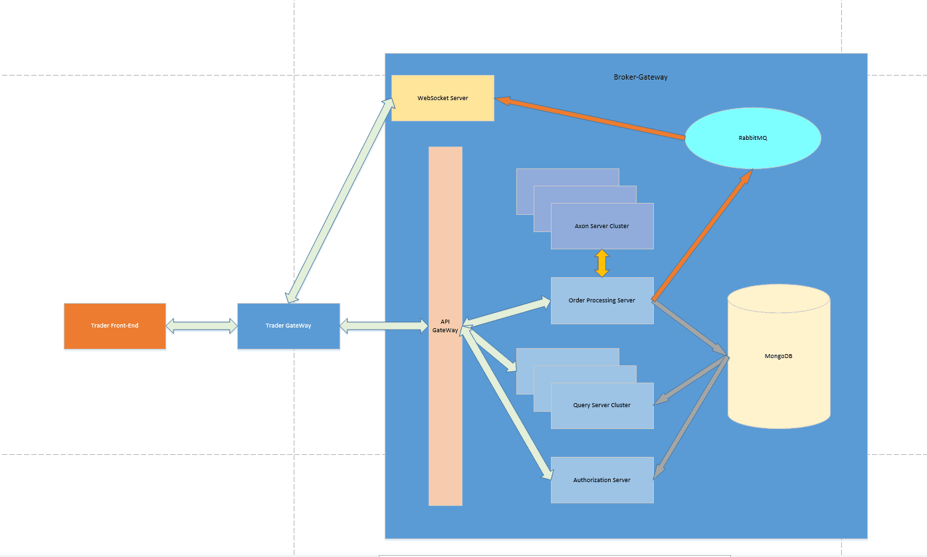
Broker Architecture

Slide 2
Broker Highlight One——Decoupled Component
Microservice Architecture
RabbitMQ Middleware
Event-driven Domain

Slide 3
Broker Highlight Two——Excellent Performance
In-memmory Order Processing
Asynchronous Function Call
Fine-grained Concurrency Without Lock
CQRS(Command Query Responsibility Seperate)
Algorithm && Data Structure

Slide 4
Broker Highlight Three——High Availability
Cluster Deployment Pattern
Event Sourcing && Snapshot
Docker-Compose && CICD

