Slide 1

Simulated
Exchange
小组成员：
宋逸凡 516030910411
王见思 516030910412
潘子奕
01

Slide 2
“
Project Structure
02

Slide 3
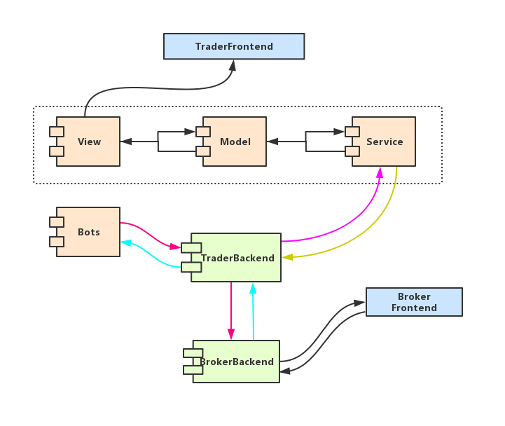
Structure
11

Slide 4
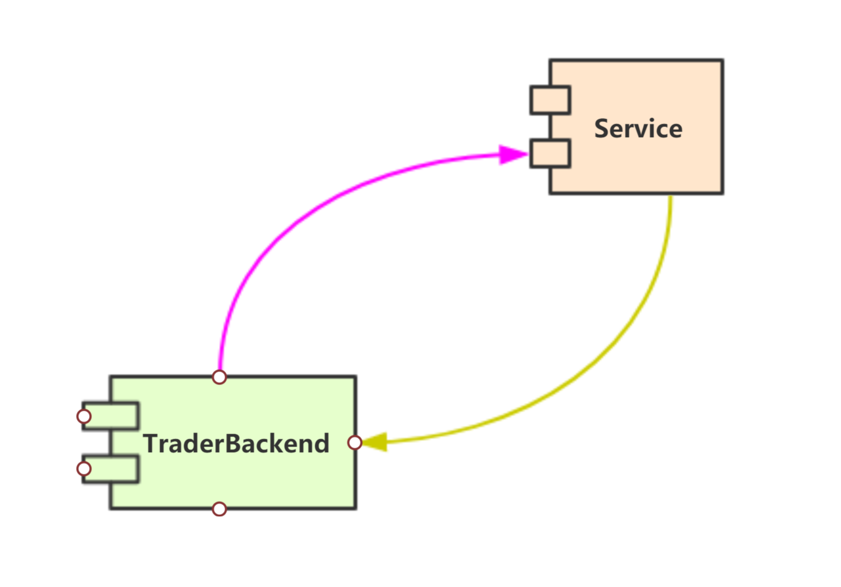
Message
WebSocket
FrontendService TraderBackend
=>(once)
Username;Token;BrokerId;FutureId
<=(once)
History;OrderBook;MarketQuotation
<=(cycle)
OrderBook;MarketQuotation
=>
Switch/Close
11

Slide 5
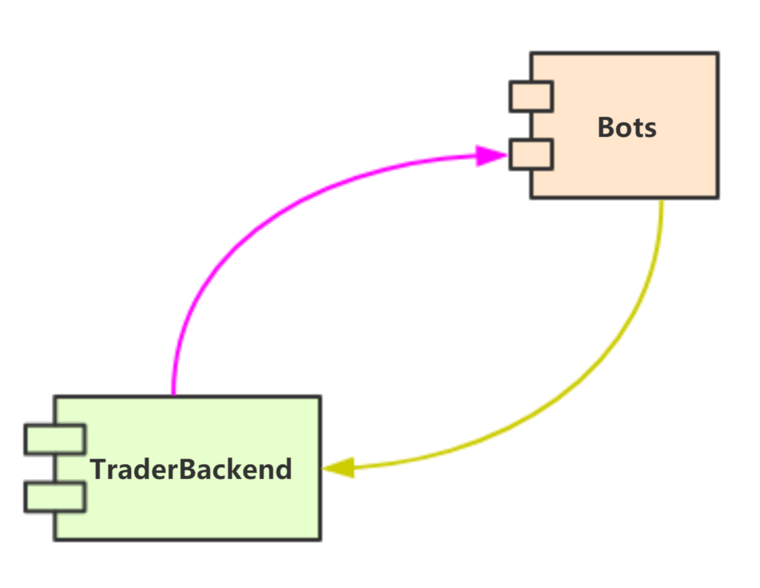
Message
Bots TraderBackend
=>(cycle)
BrokerId;FutureId
<=(cycle)
OrderBook;MarketQuotation
=>(cycle)
CreateOrder
11

Slide 6
Bots
Liquidity
Simulate Strategy1
……
1
2
3
4
5
Random
Bot
MainTrend
Bot
Follow Trend
Bot
AntiTrend
Bot
…
Volatility
Simulate Strategy 2
12

Slide 7
LOGO
Thanks
小组成员：
宋逸凡 516030910411
王见思 516030910412
潘子奕
13

