Slide 1


David Eisenbud
Project: find finite descriptions of infinite algebraic structures coming from geometry
Notes:
Making a dodecahedron at the National Book Festival to advertise MSRI’s National Math Festival in DC.
PhD University of Chicago 1970
Brandeis 1970-1997, Berkeley since 1997. Meanwhile:
Mathematical Sciences Research Institute: Director 1997--2007 and 2013--22
Simons Foundation: founding Director of Math/Physical Science 2010--12 , now Trustee

Slide 2
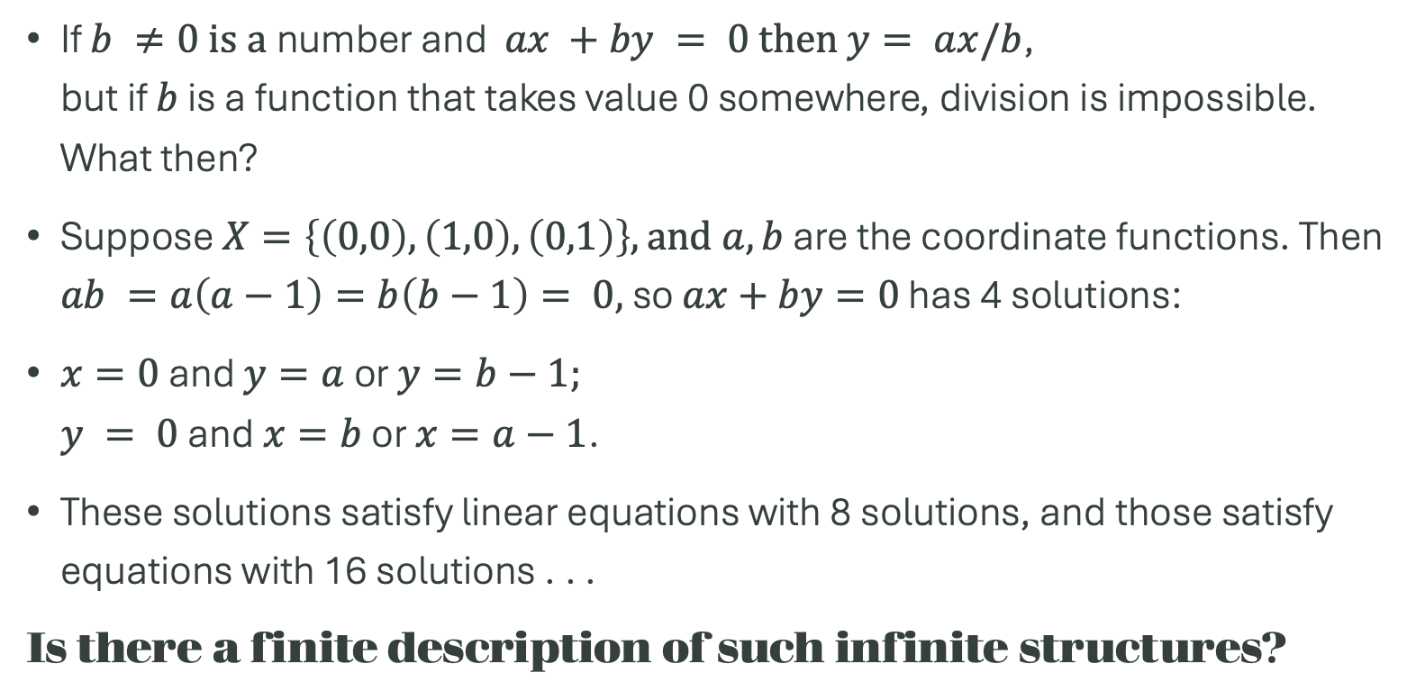
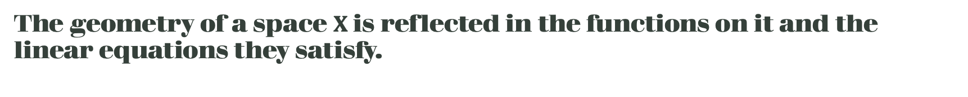
The geometry of a space $X$ is reflected in the functions on it and the linear equations they satisfy.
If $b ≠0 is a$number and $ax +by = 0 then$ $y= ax/b$, but if $b$ is a function that takes value 0 somewhere, division is impossible. What then?
Suppose $X=\left\{\left(0,0\right), \left(1,0\right), \left(0,1\right)\right\}, and a,b$ are the coordinate functions. Then $ab =a\left(a−1\right)=b\left(b−1\right)= 0,$ so $ax+by=0$ has 4 solutions:
$x=0$ and $y=a$or $y=b−1;$ $y = 0$and $x=b$ or $x=a−1$.
These solutions satisfy linear equations with 8 solutions, and those satisfy equations with 16 solutions . . .
Is there a finite description of such infinite structures?

